Slide 1
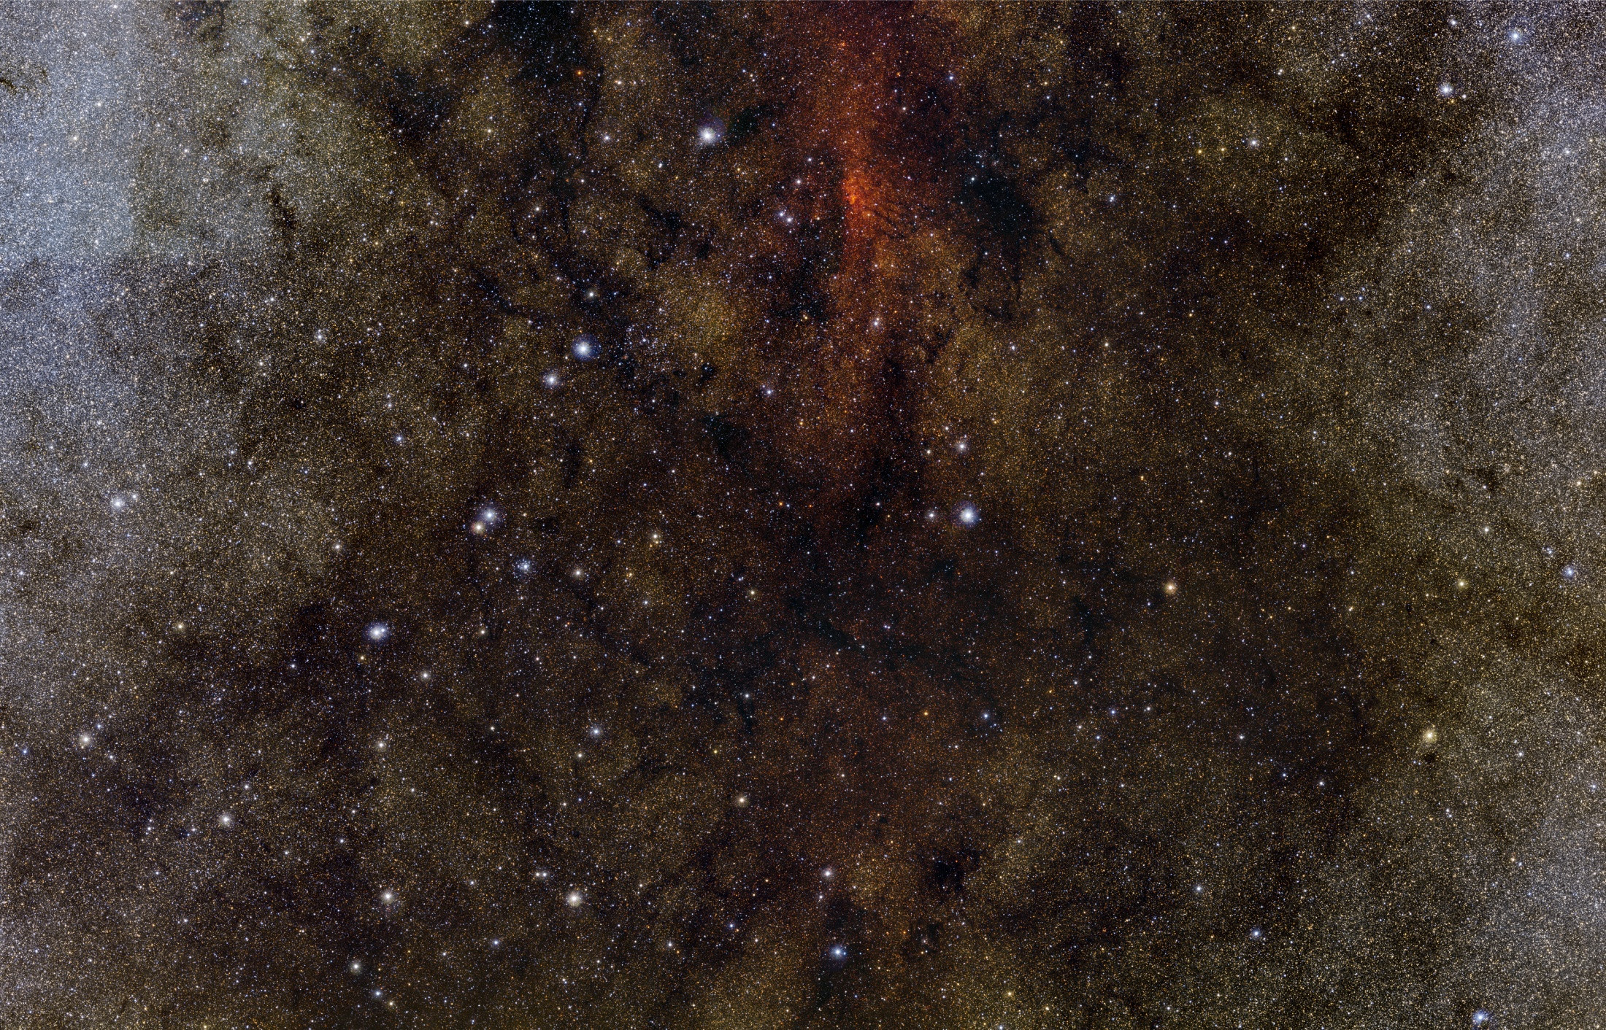



VDFS: The VISTA Science Archive
Nicholas Cross, Rob Blake, Ross Collins, Mark Holliman, Mike Read, Eckhard Sutorius, Nigel Hambly,
Andy Lawrence, Bob Mann, Keith Noddle
Wide Field Astronomy Unit, Institute for Astronomy, University of Edinburgh, UK

Slide 2
What is the VSA?
Relational Database Management System
  Linked tables containing different types of data
    Design emulates data structure.
    meta-data from images
    Catalogue data – detections, merged sources, variability statistics
    Self-describing: information about each programme and processing in curation tables
  Microsoft SQL Server: reliable product used by SDSS, WSA, 2 of the most successful astronomical archives.
Main DB and documented static releases
Multiple interfaces for different scientific usage

Slide 3
Purposes of Science Archive
Interface for survey teams and community to explore survey products to do science.
Interface for survey teams to check data for quality control.
Repository of VISTA data from reduced images to complex, catalogue products.
Requires both:
  a dynamic main-DB which is updated with new data, better calibration, reprocessing, quality control, higher order products.
  Static, well documented release-DBs that can be referred to in publications.

Slide 4
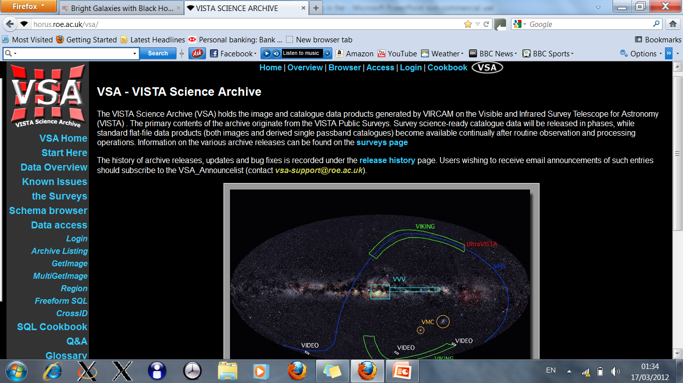
The VSA: http://surveys.roe.ac.uk/vsa

Slide 5
WFAU tasks
Ingest nightly processed image and catalogue data from CASU – See MJI talk
Provenance - link related images
Quality Control: Automated + input from teams.
Link tile and pawprint data
Process data for semester - done per programme :
  Produce and ingest deep stacks/tiles/mosaics + catalogues
  Merge pass-band catalogues to create source tables
  Create neighbour tables to link external catalogues
  Link multi-epoch data and calculate variability statistics
Release a documented, static data product to users
Create useful interface tools for users to query specific data, view and analyse it

Slide 6
Automated Pipeline
Post QC tasks run in automated pipeline
  Uses DB to determine what needs to be done
    How many pointings, how many filters, how many epochs?
    What has already been completed?
    Have processes been done in correct order?
    Consistency between expected products and actual
Reduces workload on operations (when it is working)
Essential for processing many PI programmes with same range of products as main surveys.

Slide 7
VISTA complications
Technical:
  Pawprints + Tiles: two layers of products, detections from both kept
  10x increase in catalogue data
  VVV so time consuming that a separate server is needed, but some tables and data common – synchronisation
Political:
  WFCAM: WFAU deal with UKIDSS, CASU, UKIRT (v. occasionally)
  VISTA: WFAU deal with separate survey teams, ESO, CASU

Slide 8
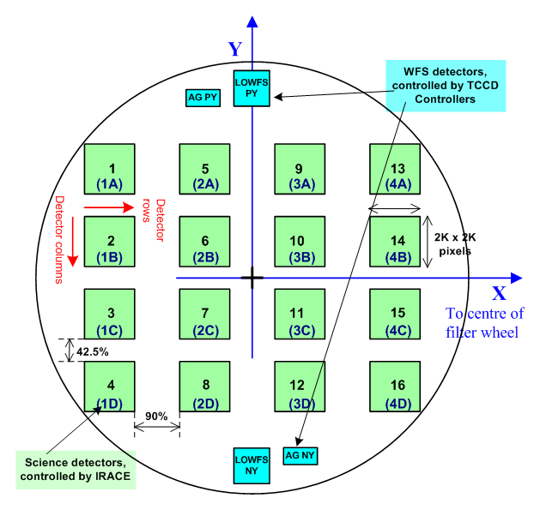
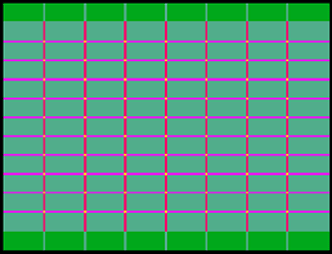
VISTA Tiles
Pawprint: 16 detectors spaced 90% apart in X direction and 42% in Y
6 pawprints can make a tile: 2x depth on average, but “ears” have single depth.

Slide 9
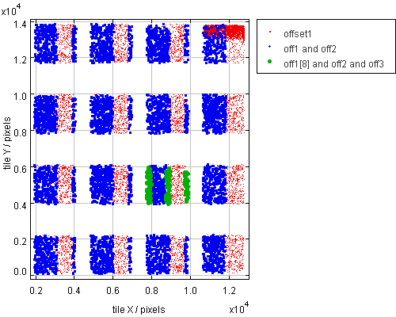
Tile-pawprint detections linked
Able to compare tile and pawprint photometry.
Select data from specific regions of the tile or specific pawprints.

Slide 10
Data Rates WFCAM → VISTA
Images:
  WFCAM 1720 raw image frames a day (4 2kx2k)
  VISTA 580 raw image frames a day (16 2kx2k)
  Only 30% increase in raw image volume.
Catalogues:
  More area (2.9x), increased sensitivity (~2x), tile + pawprints (~3x). Expect 15-20x as many detections.
  14x WSA: 3.2M detections per day, VSA: 44M
  Catalogues are important factor for relational DB
  VVV: VSA currently has >21billion rows, expect ~10¹¹

Slide 11
VVV takes archive to new level
Up to P87:
  VMC: 500 million detections, 18 million objects
  VHS: 1.9 billion detections, 270 million objects
  VVV: 21 billion detections, 500 million objects
Data rate of VVV is 10x other surveys. Combination of shallow and dense fields
~1 billion stars, 80 – 100 epochs.

Slide 12
Galactic Plane and Bulge from VISTA and WFCAM
VVV + GPS mosaic ~ 1 billion stars
http://djer.roe.ac.uk/vsa/vvv/iipmooviewer-2.0-beta/lb.html
March 29th 2012, #1 most read article on BBC

Slide 13
VVV processing
VVV takes months to process 1 year of data.
Variability statistics is slowest stage.
  Many speed ups already
    separate servers for main and release DBs
    Split detection tables into months
    Parallelisation of CPU intensive processes that do not call DB
  I/O is main bottleneck now. Solutions:
    Improved optimisation of curation queries
    Column orientated databases
    Solid state disks for DB.
  Reprocessing of data a major headache

Slide 14
Using the Archive
Support
Documentation / Publications
Quality Control
Different Interfaces

Slide 15
Expert support: vsa-support@roe.ac.uk
VSA: 10-20 helpdesk queries per month
  Similar in WSA, more mature archive.
Types of queries posed
  Detailed knowledge of data (and data quality)
  Detailed knowledge of SQL
WFAU have a mixture of technical and scientific knowledge.

Slide 16
Provenance tracking is crucial
Rare object search is major analysis mode
  Selecting on wide range of attributes
Reproducibility
Is this an unusual object or a junk data value?
  Quality control at image and detection level is vital.
Track back from each data value to parent data and processing chain
  Complex data structure – absent in flat-file catalogue
  At file level, e.g. tiles – pawprints, deeps – OBs, stack – raw.
  Detection level, multi-band – single band, tile detection matched to pawprint detections.
Notes:
Examples – Provenance, QB,

Slide 17
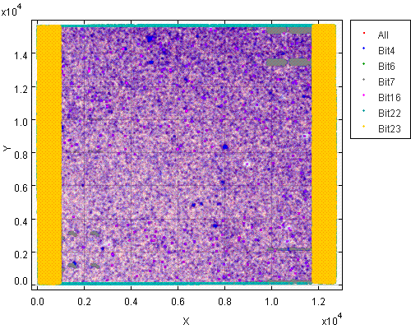
Bit-wise flagging of detection data
VMC deep tile.
Under-exposed strip
Edges
Low confidence
Deblends
Saturated
Bad pixels
Detector 16
Bright stars to come

Slide 18
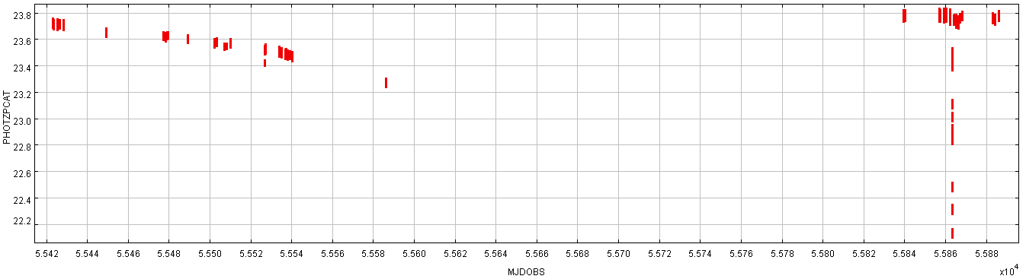
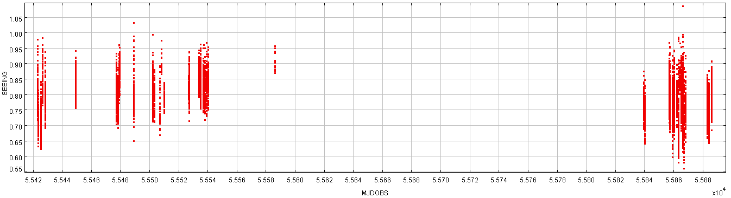
Provenance: ZP and seeing of input files to a VIDEO mosaic wrt time

Slide 19
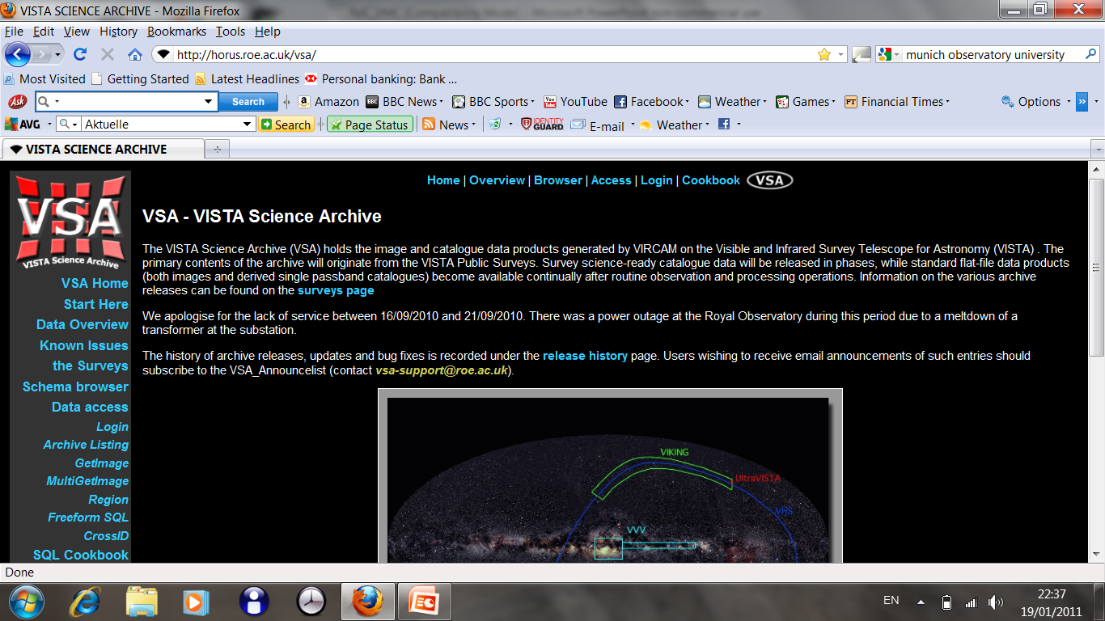
Using the VSA
Freeform SQL query (enhanced)
Cross ID (now includes Synoptic Source)
Archive Listing
GetImage / MultiGetImage

Slide 20
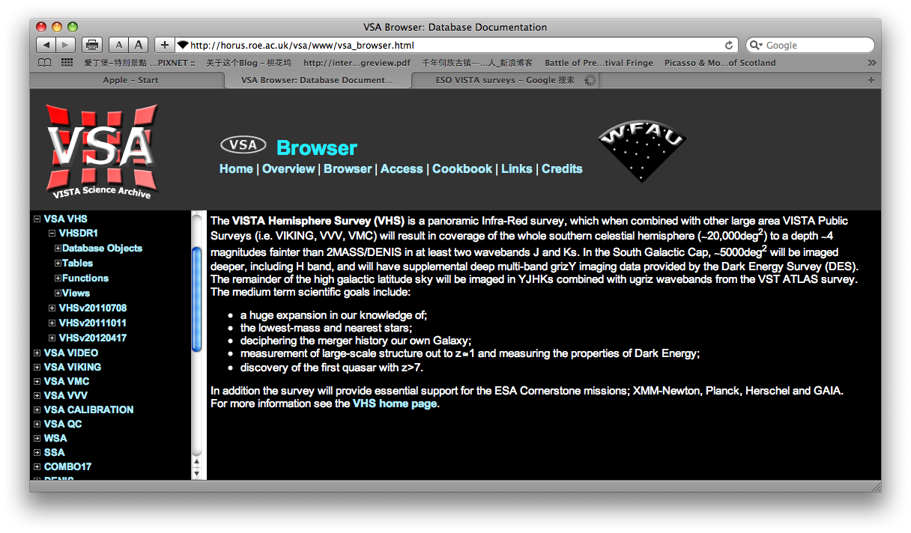
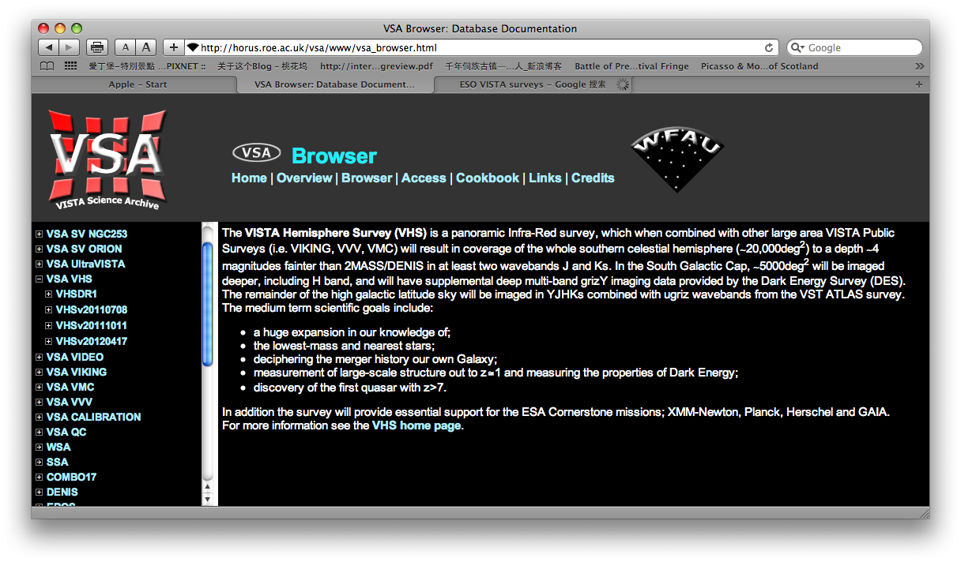
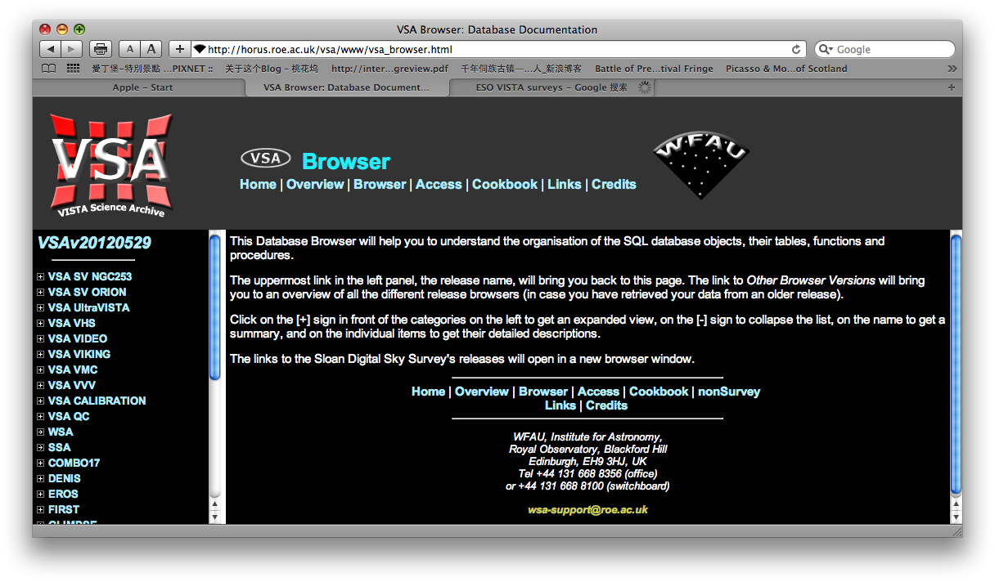
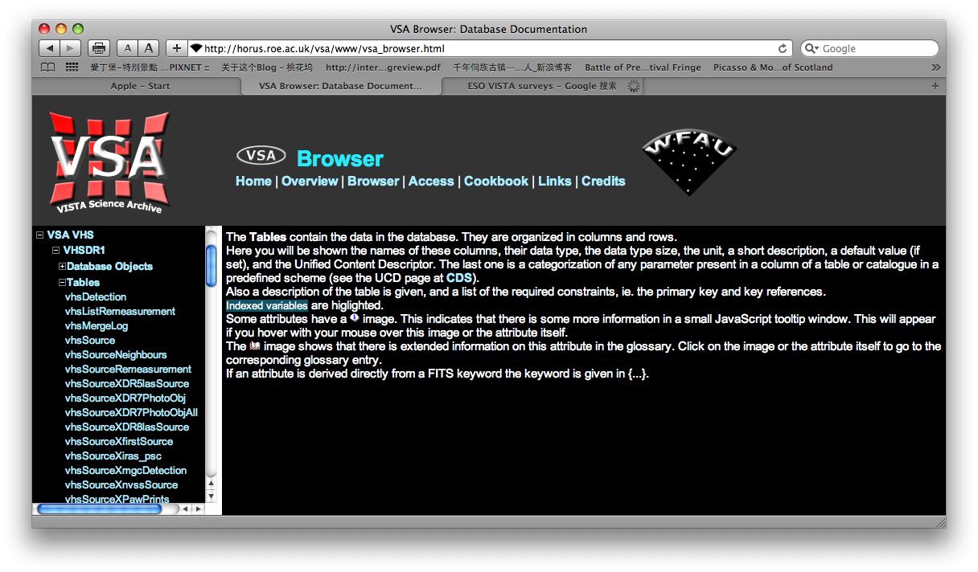
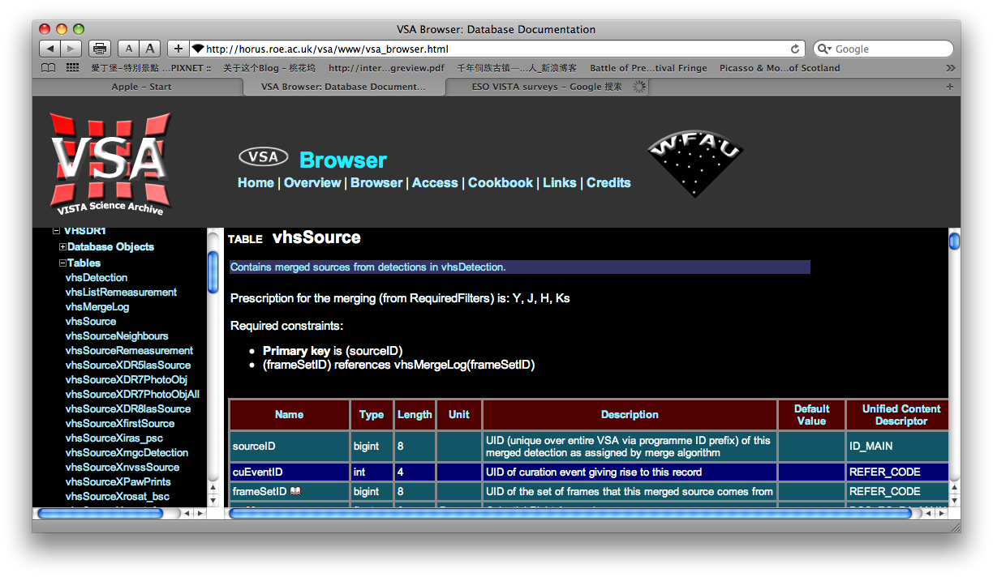
VSA – schema browser

Slide 21
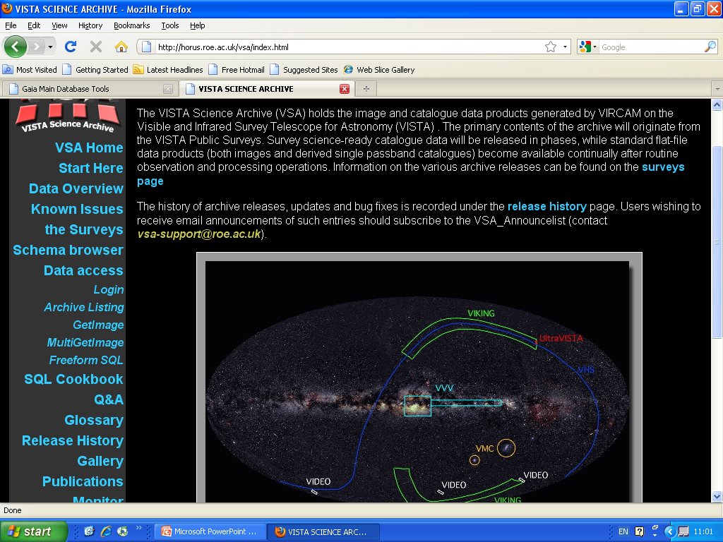
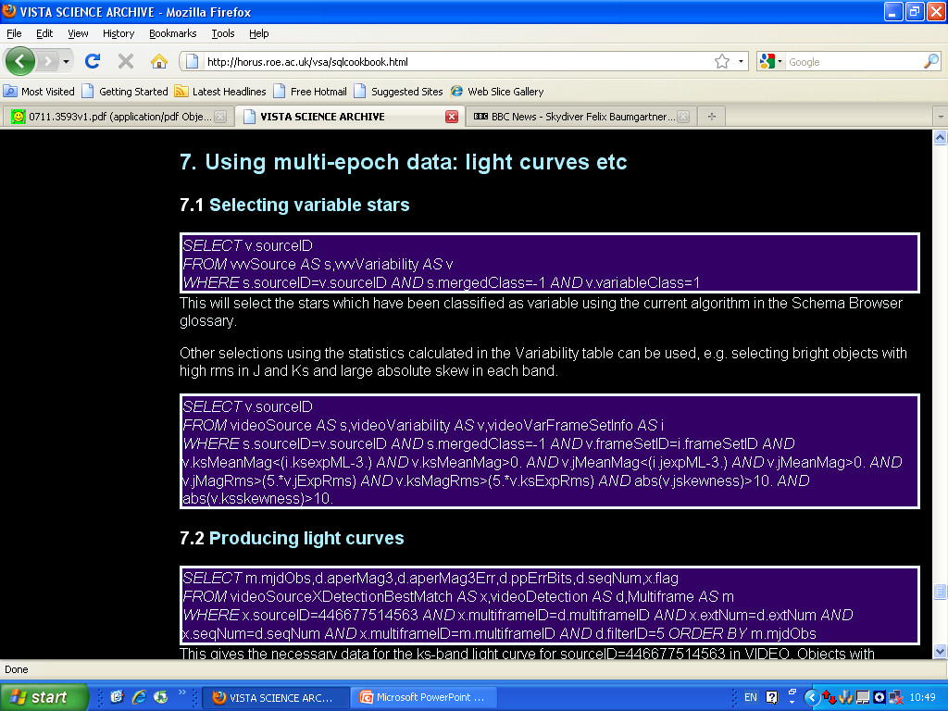

Slide 22
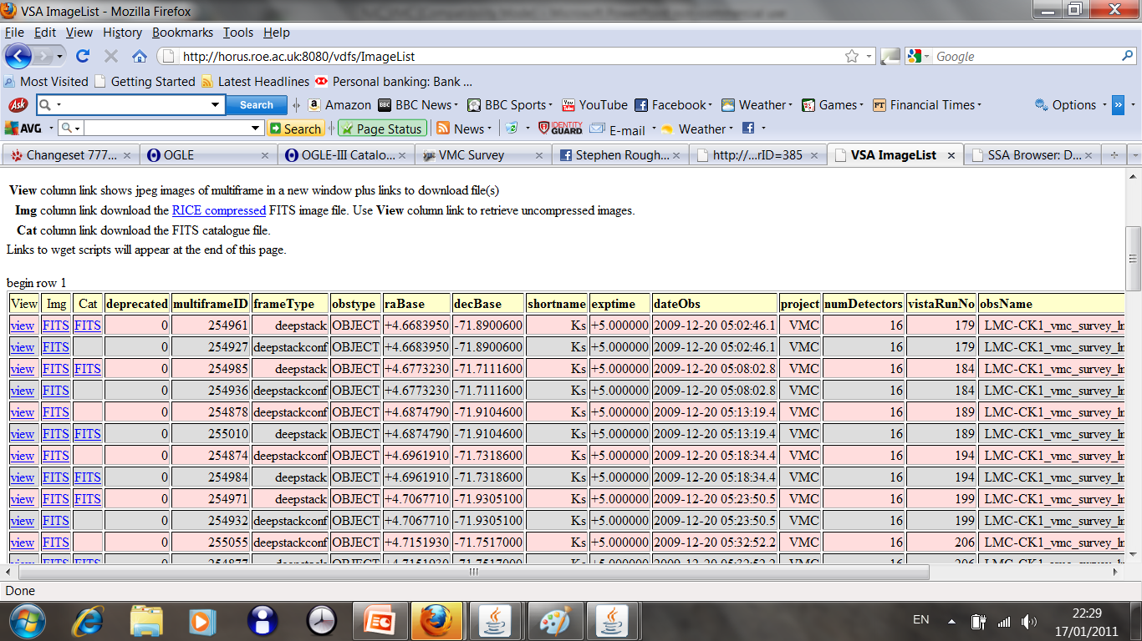
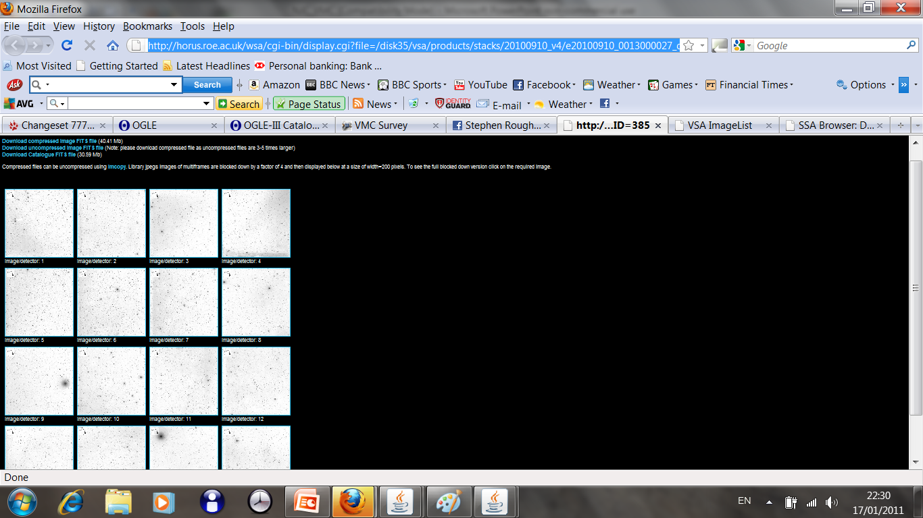
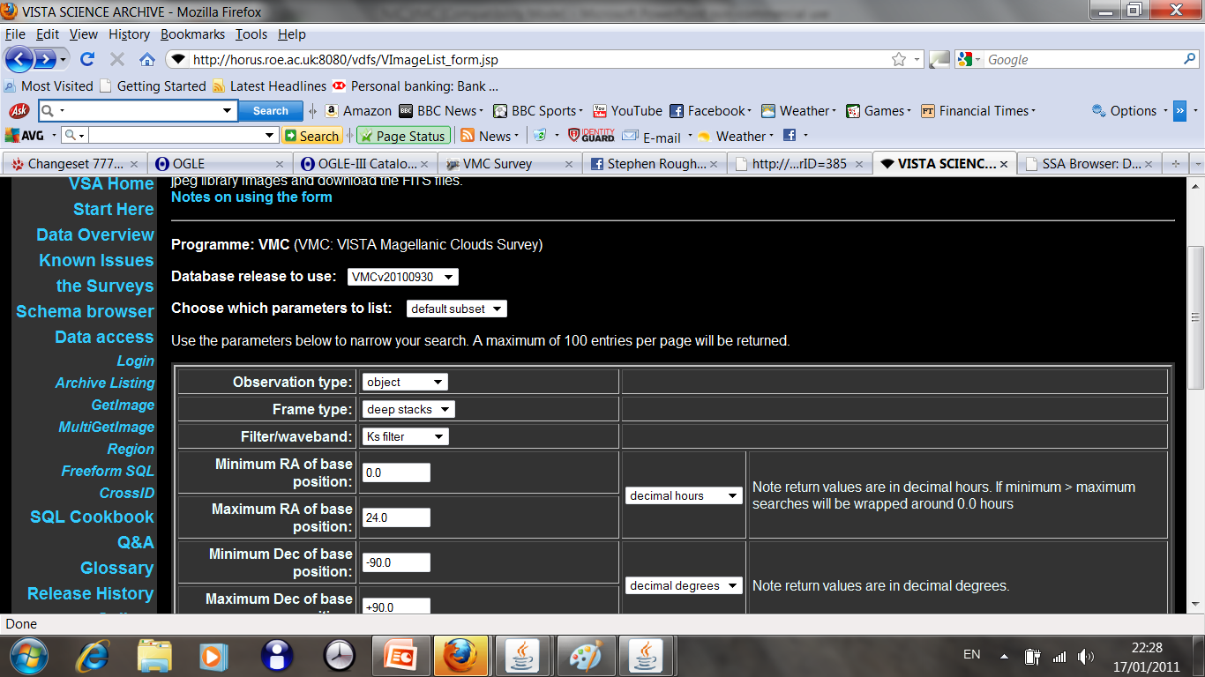
Archive Listing

Slide 23
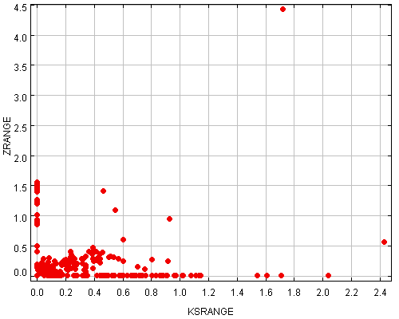
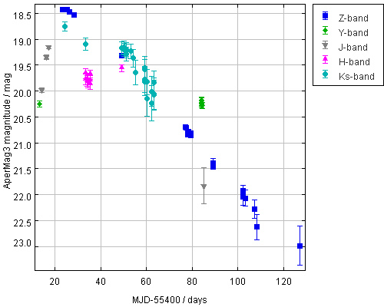
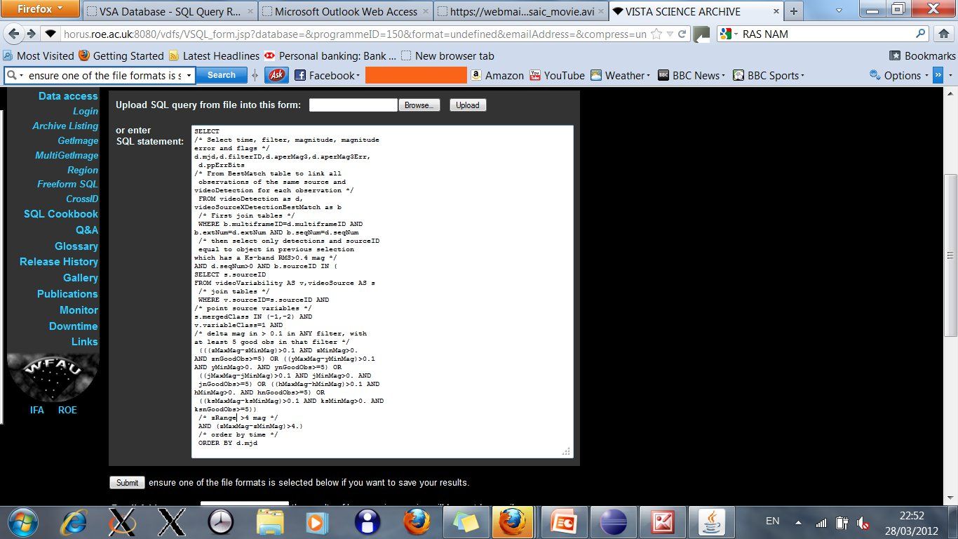
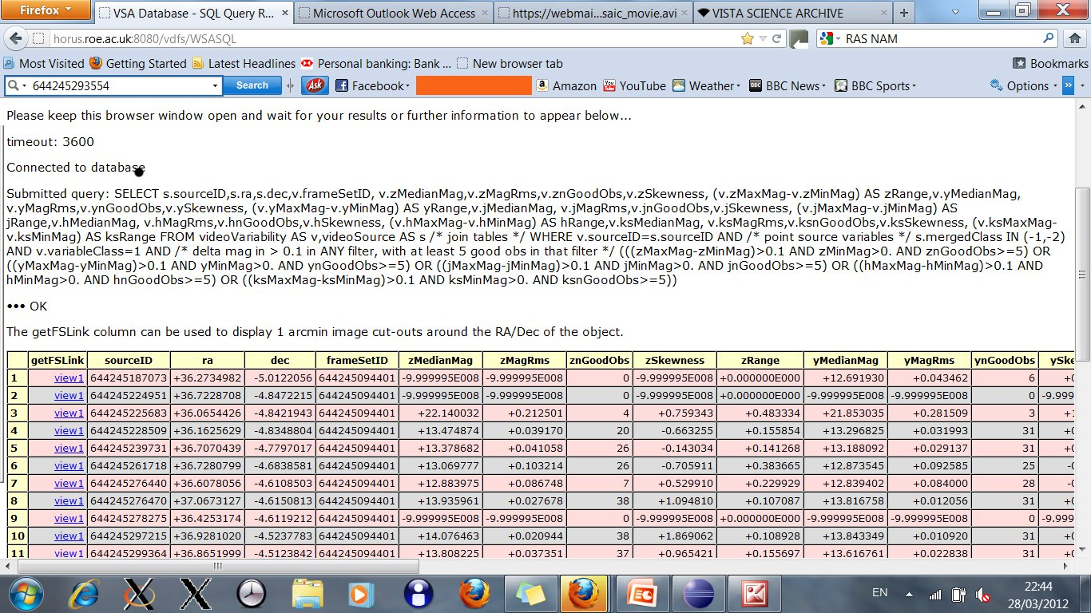
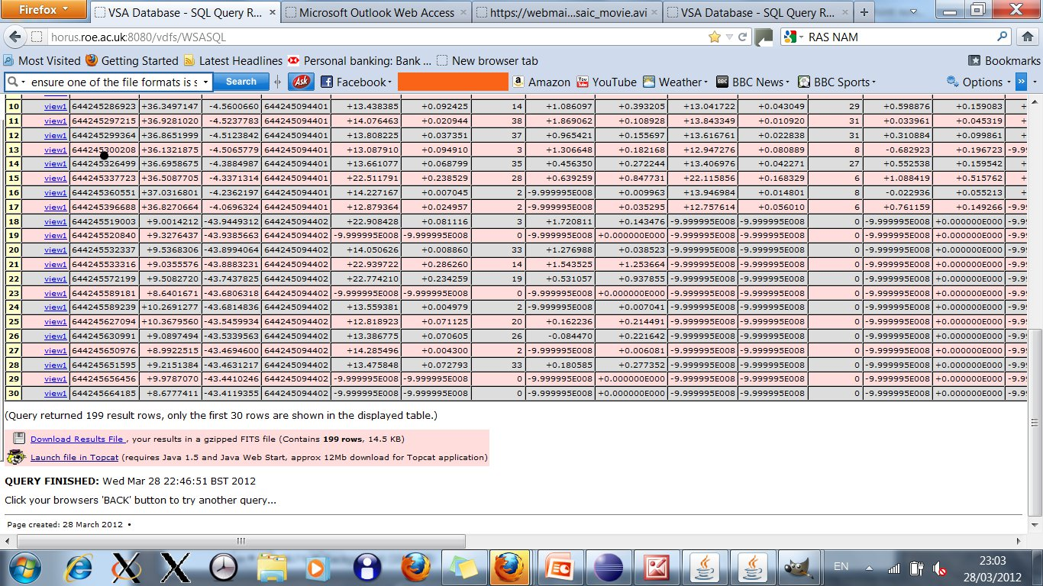
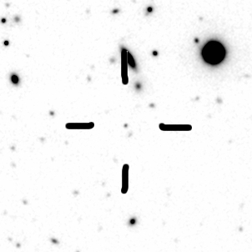
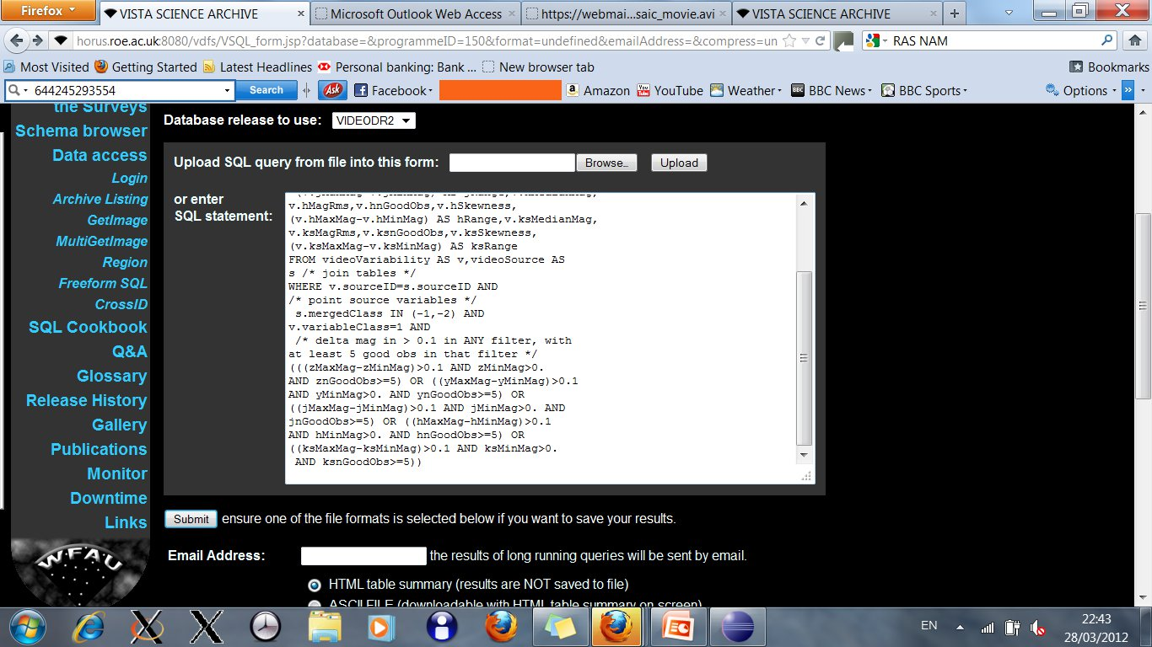
An Example: Selecting point source variables in VIDEO
Type 1a SN2010gy
Select light curve data
Select variable: old selection + zRange>4 mag
Notes:
Point source variables with Delta mag>0.1 in at least one band, z=0.06 PanSTARRS SN, no host galaxy

Slide 24
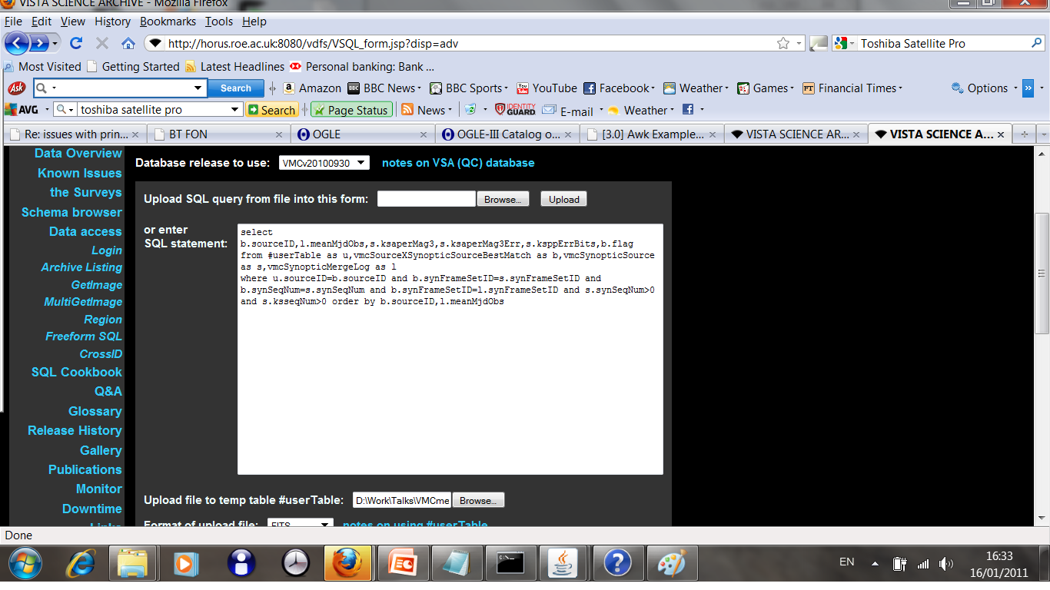
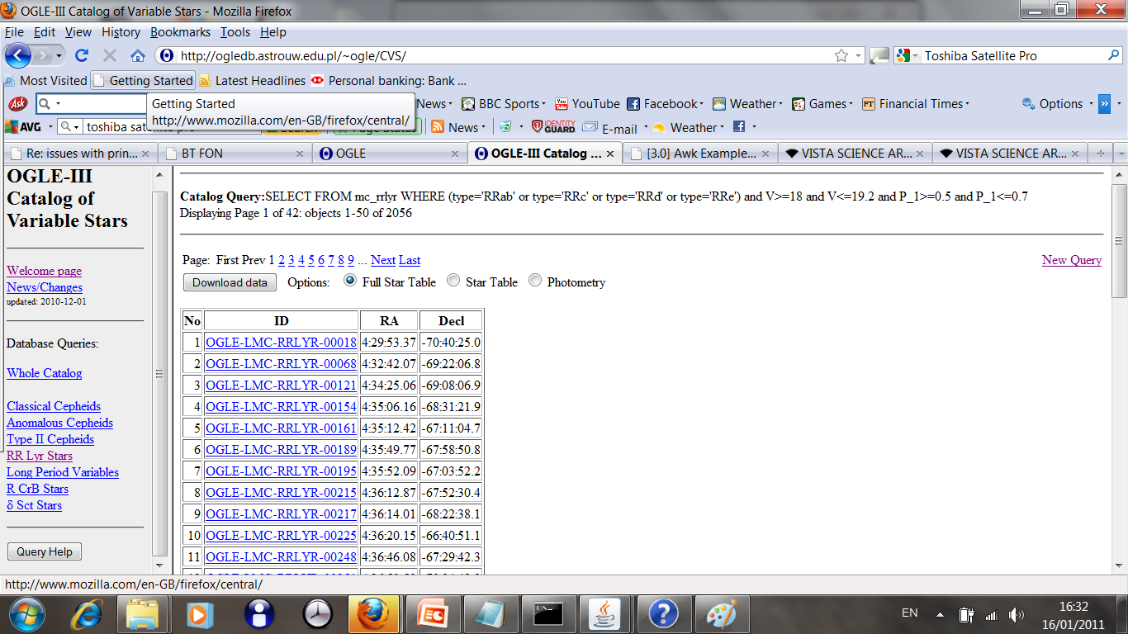
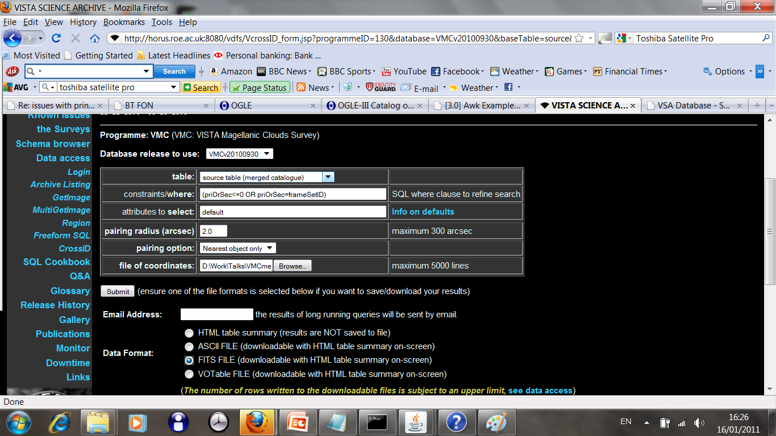
Enhanced Queries
Use crossID to match with main survey Source table.
Save matched table as FITS/VOTable
Take data from outside the VSA, e.g. own data, online catalogue.
Upload matched table as #userTable, use in standard queries

Slide 25
Surveys are not independent entities
Importance of multi-wavelength astronomy
  GAMA, COSMOS fields, deciphering galaxy evolution, with complex star formation histories with dust.
  Rare objects (e.g. high-z QSOs, BDs, odd transients)
Common survey fields
  VST-ATLAS and VHS
  KIDS and VIKING (GAMA extends this in some areas)
  VVV, GPS, IPHAS, VPHAS+
Need for data integration
  Cross-neighbours tables, publishing to VO
  Matched aperture photometry

Slide 26
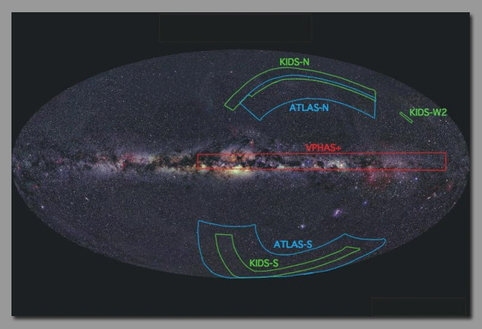
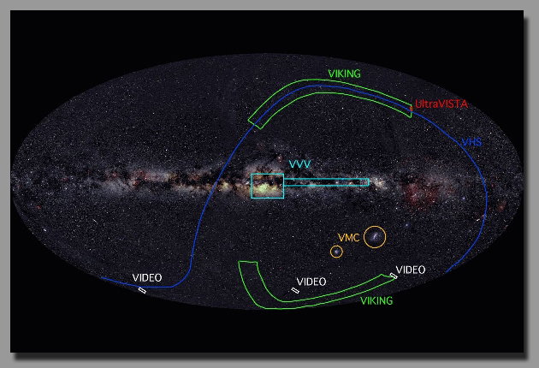
VHS -- ATLAS
VIKING -- KIDS
VVV -- VPHAS+

Slide 27

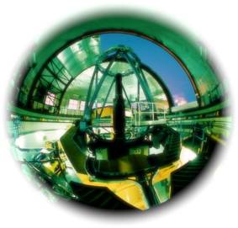
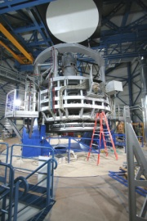
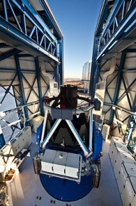
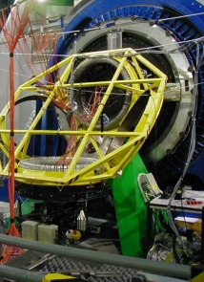



WFAU Science Archives
EARLIER PROCESSING AT CASU
WFAU

Slide 28
Combining Data from Surveys
Neighbour Tables (Main Existing method)
  Joins to main external surveys: 2MASS, SDSS, SSA, GALEX, FIRST, WISE, …..
Matched aperture photometry.
  Pipeline almost ready. First use on P90 data.
Using VO interfaces.
  Output in VOTables, launcher for TOPCAT
  SIAP services, footprints for Aladdin.
  New MyDB style applications on the way.

Slide 29
WFAU VDFS Publications
Hambly et al. 2008, MNRAS, 384, 637 (WSA)
Cross et al. 2009, MNRAS, 399, 1730 (Multi-Epoch processing)
Cross et al. 2012, A&A, 548A, 119 (VSA)

Slide 30
Summary
VISTA an order of magnitude increase in catalogue data volume of WFCAM
  VSA met the challenge and producing regular releases to the survey teams and wider community.
  VVV very difficult, but challenge helps to keep WFAU as one of the leading data centres in the world.
VSA is the most efficient way for many types of science:
  to find rare objects (transients in the VVV, very cool brown dwarfs, z>7 QSOs).
  Working with data across wide areas, multi-wavelengths
Edinburgh Data Centre with VSA at the centre, linking with WSA, OSA, SSA and external data.
VISTA will be very successful, many papers already published, many to come: see PI talks.
Notes:
Cut down slides, leave out some details. Add a few new examples (e.g. VVV transients). Emphasise that this cannot be done through ESO archive. Draw on experience from WSA, lead to new archives in future. Audience: engineers, scientists, bigwigs, from STFC etc.

