Slide 1
VISTA: The Telescope challenge
Systems Engineering the Solution?

Slide 2
Systems Engineering at the Core of VISTA Design
UK ATC Project Office Proposal
“The purpose of VISTA is to conduct large-scale semi-automated surveys of the sky at IR and visible wavelengths. Our concept of VISTA is not a conventional 4m telescope with instruments. We regard VISTA as a single integrated camera with an IR and a Visible channel, in which the "telescope" is really the fore-optics.”

Slide 3
Phase A and Phase B
Phase A proposal
  Can VISTA actually be achieved for the Money?
  Develop designs to level to demonstrate compliance with Science Requirements
  Determine the best strategy for maximising functionality within budget and timescales
  Agree Strategy and Deliverables before starting Phase B
Phase B
  Follows successful Phase A
  Same personnel
  Procurement
  Testing
  Integration
  Commissioning
Enhanced VISTA
  Additional funding for full functionality

Slide 4
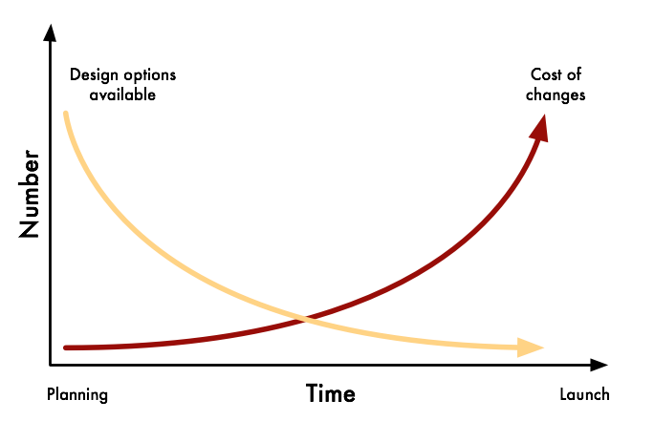
Cost v’s Change v’s Time

Slide 5
Cost v’s Change v’s Time
End Phase A

Slide 6
Cost v’s Change v’s Time
End Phase A
By the end of Phase A the design is essentially locked in

Slide 7
Design Development
JIF Design Baseline resulting in f/2.5 primary
Brainstorm of various layouts
f/1 identified as potential cost saver
f/1 and f/2.5 progressed to level demonstrating a clear advantage to the f/1 design
Need to concentrate on one design
MO recommended proceeding with f/1 design
  scheduled Design Validation Review
  VEB approved development of f/1 in interim as long lead procurement

Slide 8
VISTA Designs
f/2.5 “JIF design”
f/1 with both instruments mounted at cassegrain focus
f/1 was clearly more cost effective
  f/1 has tolerance issues on M2
Design still based on 3x3 array

Slide 9
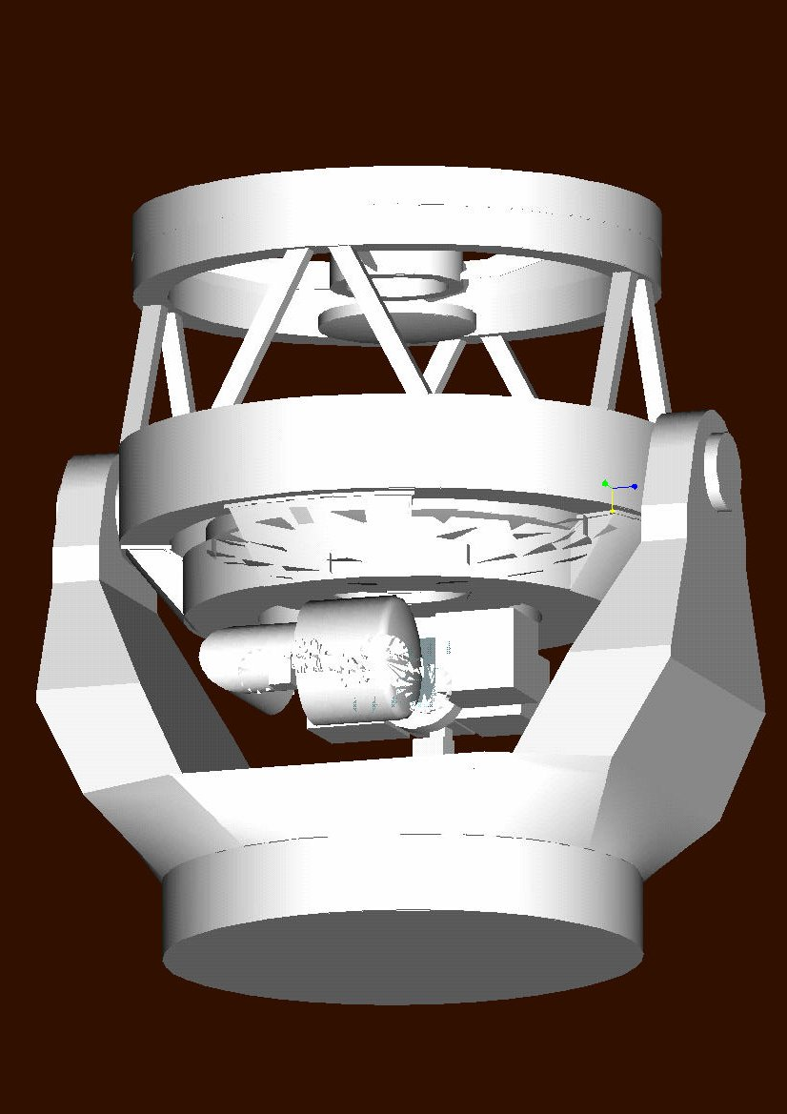
The Design Validation Review
Purpose
  Review choice of design
    MO has identified f/1 type design as most suitable for VISTA
    Close out all design other optical layouts
  Determine of choice is correct
  Identify any issues in adopting this approach

Slide 10
The ESO involvement
Who’s the Customer?
    Vista Consortium?
    ESO?
Pros and Cons
  Site
  Standards
    Requirements
    SOWs
    Software definition
    Hardware definition
  3x3 to 4x4 focal plane

Slide 11
The ESO involvement
Who’s the Customer?
    Vista Consortium?
    ESO?
Pros and Cons
  Site
  Standards
    Requirements
    SOWs
    Software definition
    Hardware definition
  3x3 to 4x4 focal plane
Consortium
ESO

Slide 12
The ESO involvement
Who’s the Customer?
    Vista Consortium?
    ESO?
Pros and Cons
  Site
  Standards
    Requirements
    SOWs
    Software definition
    Hardware definition
  3x3 to 4x4 focal plane
Consortium
ESO

Slide 13
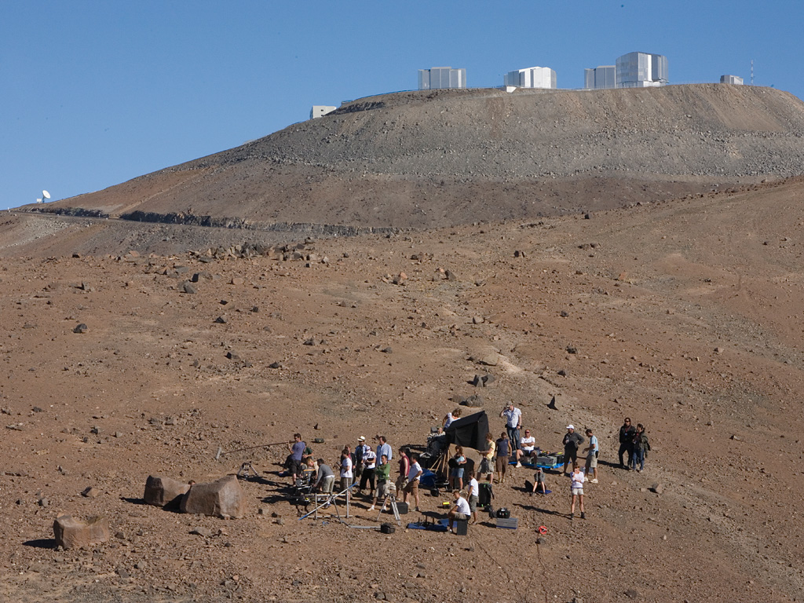

Filming “OO7: Quantum of Solace”

Slide 14
Paranal Geology
Where is the bedrock?
  Plateau 20m excavation
  NTT 5m leveling
What about construction?
  Plateau: Dust, noise pollution
What about Utilities?
  Plateau £0.3m
  NTT £0.5m

Slide 15
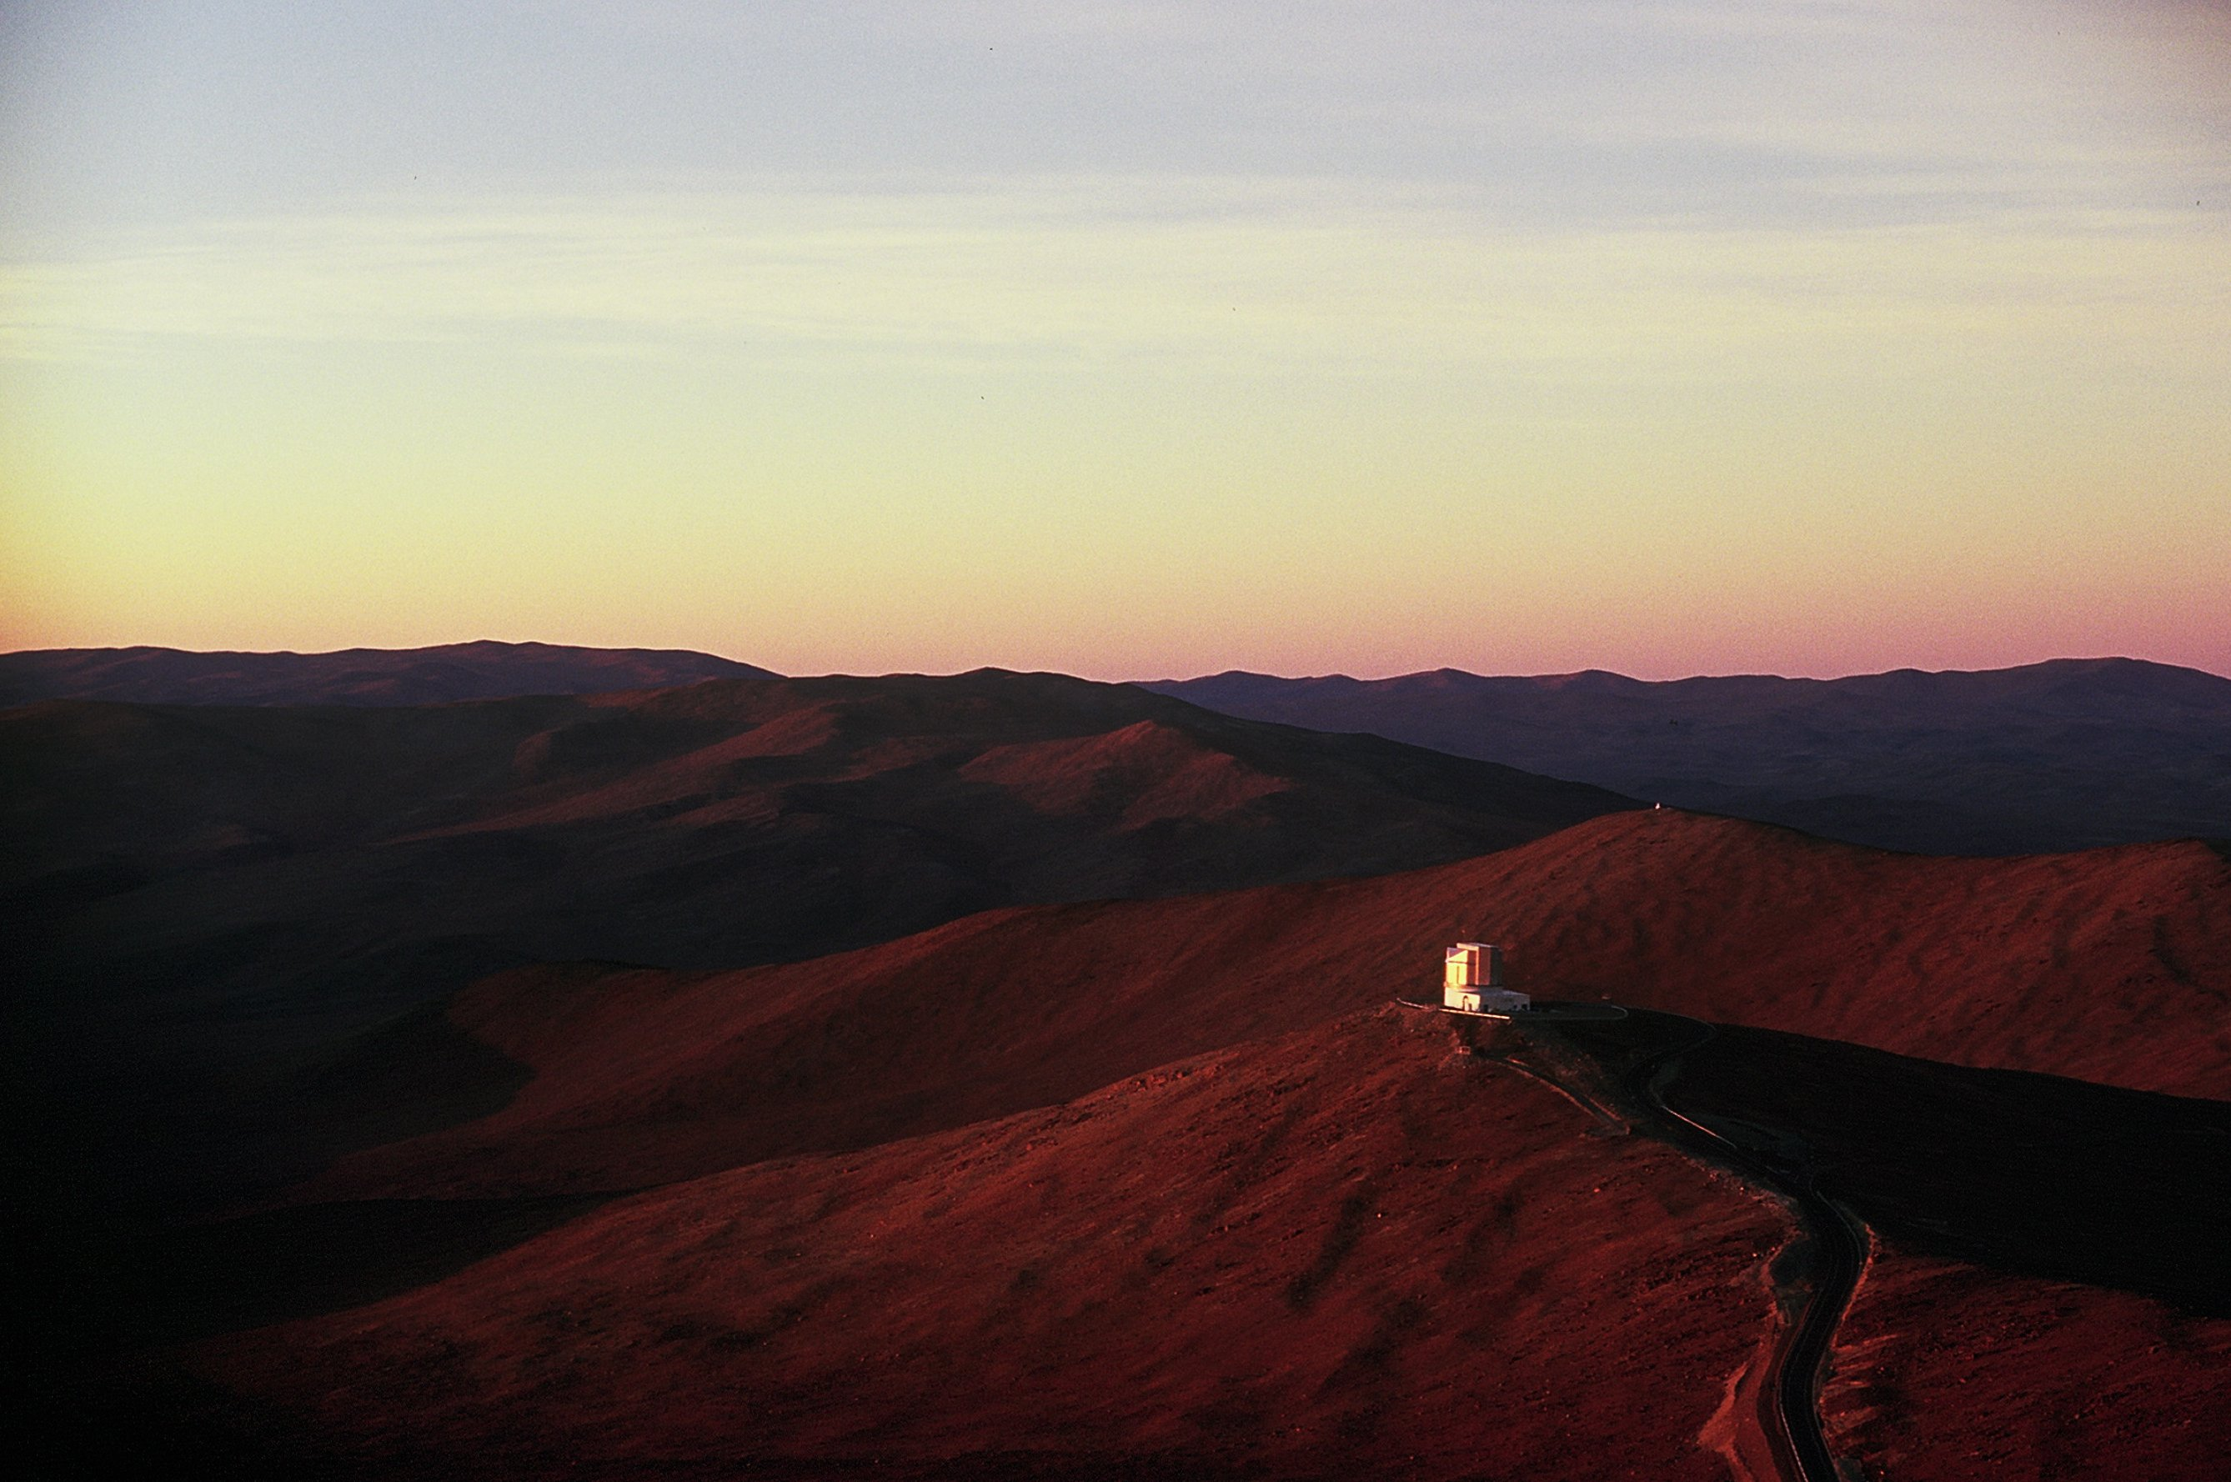

Slide 16
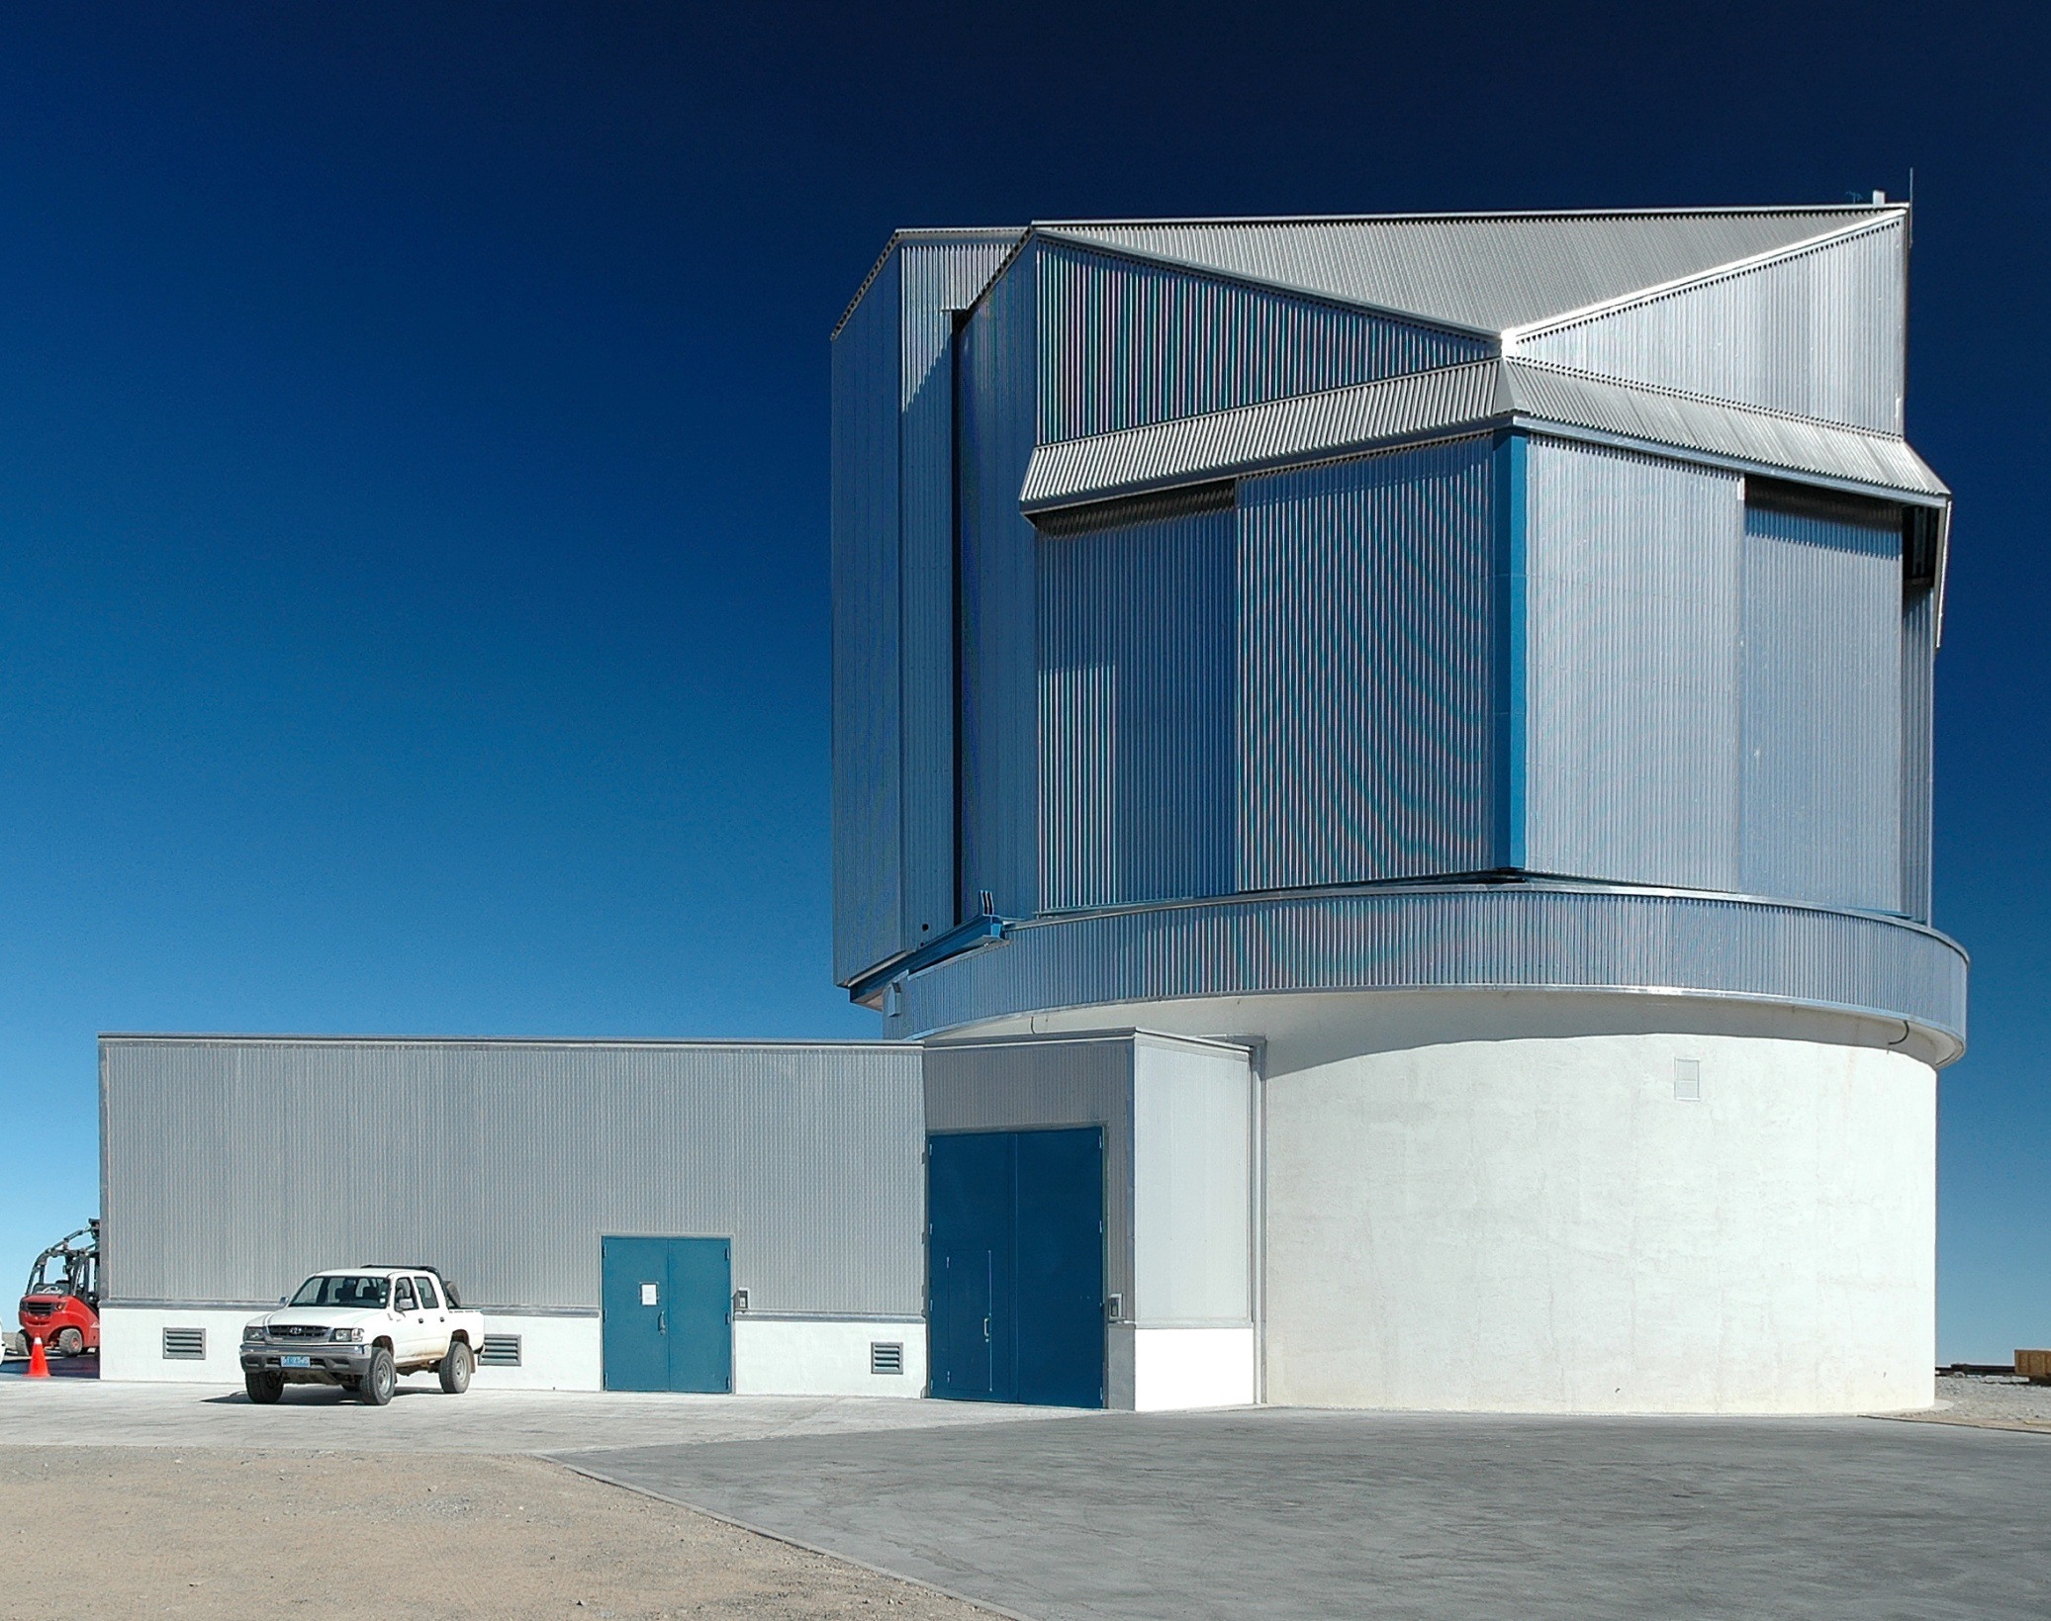

Slide 17
The ESO involvement
Who’s the Customer?
    Vista Consortium?
    ESO?
Pros and Cons
  Site
  Standards
    Requirements
    SOWs
    Software definition
    Hardware definition
  3x3 to 4x4 focal plane
Consortium
ESO

Slide 18
Requirements
All requirements:
  Shall be unambiguous and tied to performance metrics that are verifiable, achievable and realistic.
  Shall not be solution specific, vague or impossible to verify.

Slide 19
and Goals?
Goals are not requirements.
  Though they may become requirements
    Logical development (with additional resources, funding etc.)
    By osmosis – Spec creep
Goals:
  shall not be needed to achieve the science performance (that is a requirement).
  Each goal must have an underlying requirement.
  As soon as cost and/or schedule are compromised by a goal, the goal is either amended or dropped.
  The only benefit of including a goal is during in the early stages of development, steering choices between design options.

Slide 20
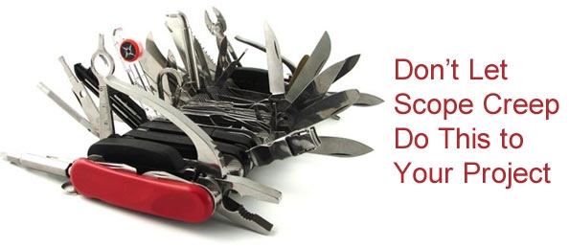

Slide 21
The ESO involvement
Who’s the Customer?
    Vista Consortium?
    ESO?
Pros and Cons
  Site
  Standards
    Requirements
    SOWs
    Software definition
    Hardware definition
  3x3 to 4x4 NIR focal plane
Consortium
ESO

Slide 22
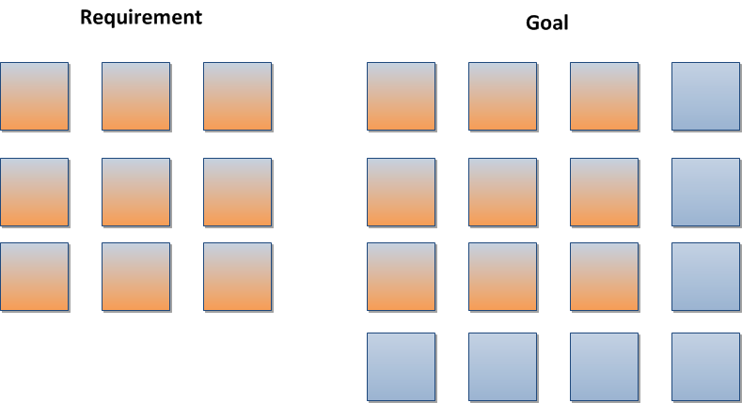
Spec creep?

Slide 23
Spec creep?
It was not the size of the focal plane but the cold stop re-imaging requirement that made this a technical issue.
( not to mention cost of detectors and controllers)

Slide 24
VISTA Designs
f/2.5 “JIF design”
f/1 with both instruments mounted at cassegrain focus
f/1 was clearly more cost effective
  f/1 has tolerance issues on M2
Design still based on 3x3 array

Slide 25
VISTA Designs
“The purpose of VISTA is to conduct large-scale semi-automated surveys of the sky at IR and visible wavelengths. Our concept of VISTA is not a conventional 4m telescope with instruments. We regard VISTA as a single integrated camera with an IR and a Visible channel, in which the "telescope" is really the fore-optics.”

Slide 26
VISTA Designs
“The purpose of VISTA is to conduct large-scale semi-automated surveys of the sky at IR and visible wavelengths. Our concept of VISTA is not a conventional 4m telescope with instruments. We regard VISTA as a single integrated camera with an IR and a Visible channel, in which the "telescope" is really the fore-optics.”
End Phase A

Slide 27
On Axis IR camera - cold baffles

Slide 29
Encircled Energy at Ks

Slide 30
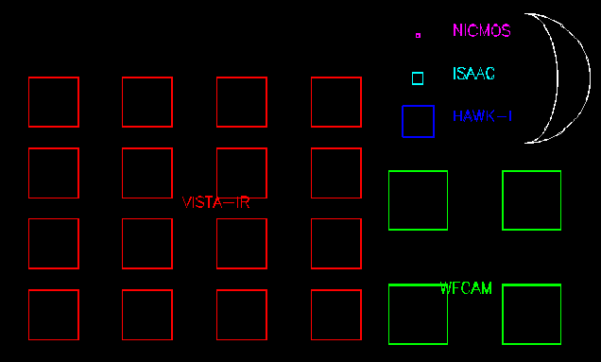
VISTA Field of View

Slide 31
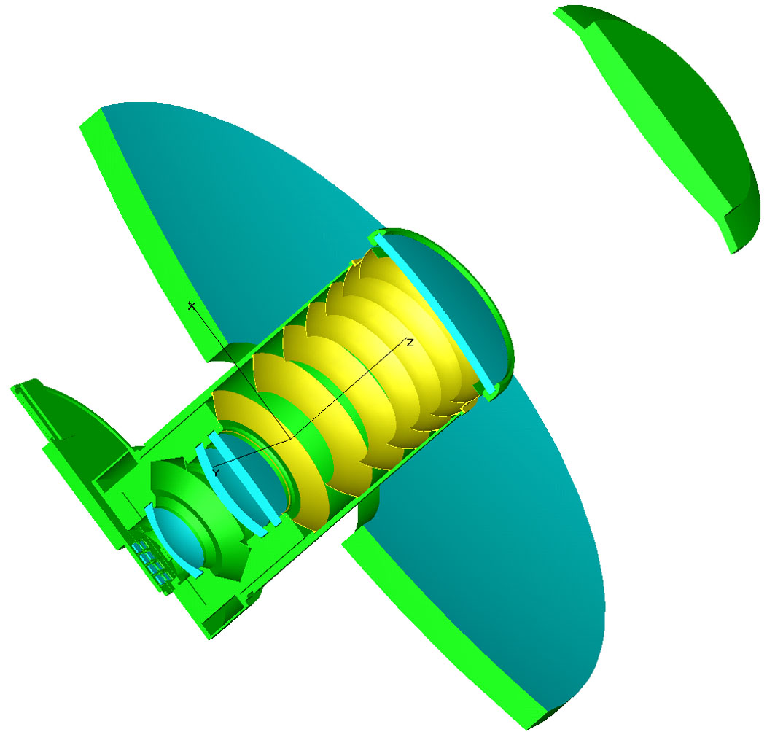

Slide 32
End Phase A
By the end of Phase A the design was essentially locked in

Slide 33
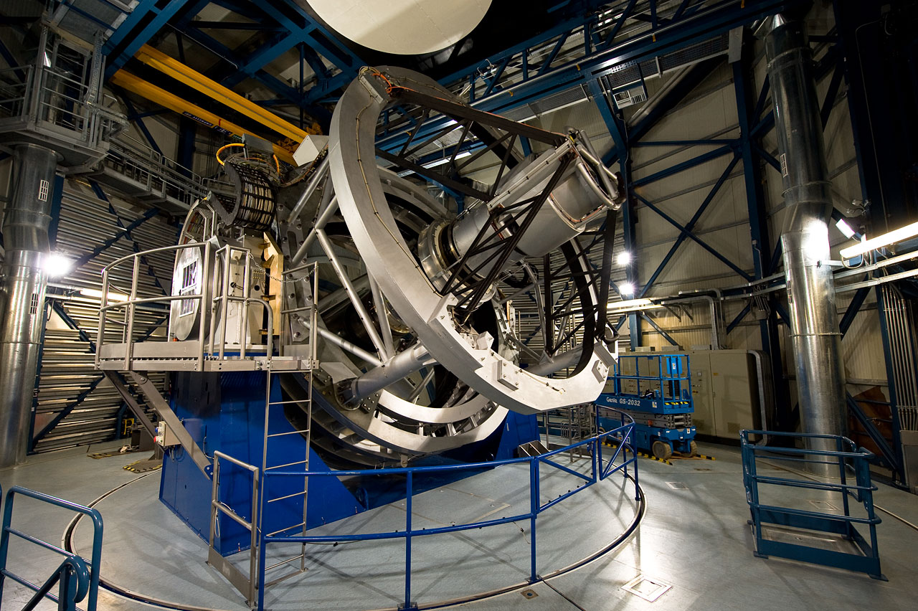

Slide 35
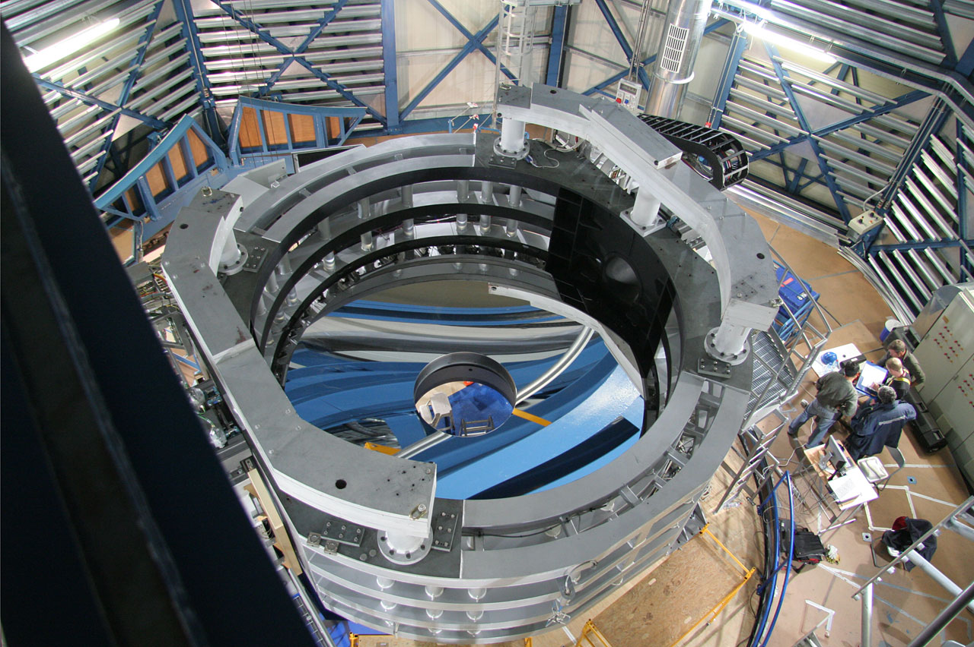

Slide 36
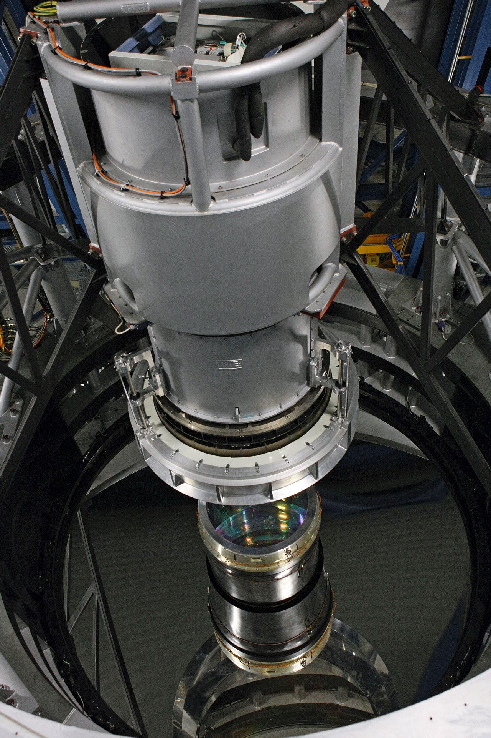

Slide 38
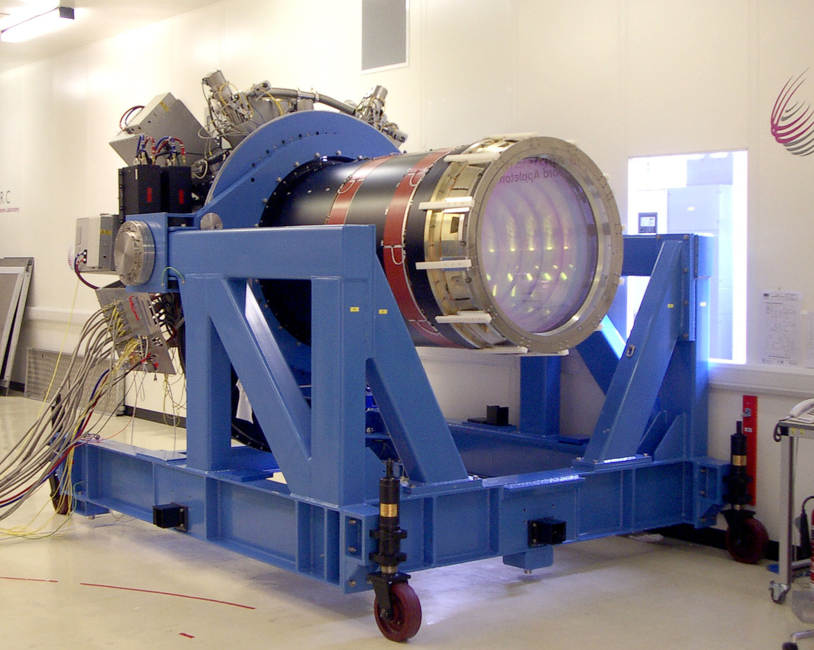

Slide 39
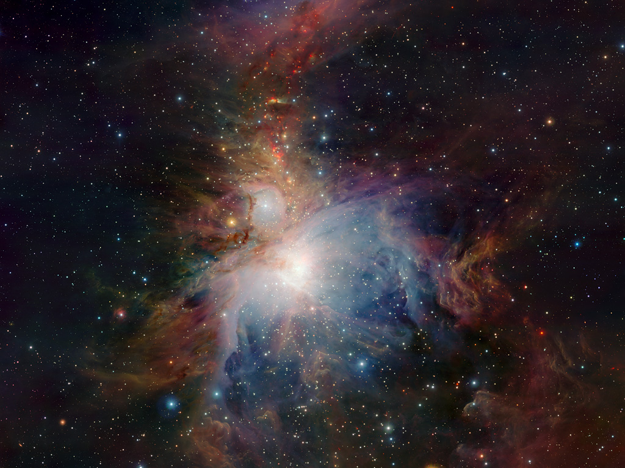

Slide 40
Acknowledgements
Key players
  Adrian Russell
  Jim Emerson
  Will Sutherland
VISTA f/1 guilty party
  Mark Casalli
  Eli Atad
  Martin Fisher
  Stefano Stangellini
Presentation
  Andy Born

