Slide 1
The Camera Challenge
Gavin Dalton
RALSpace

Slide 2
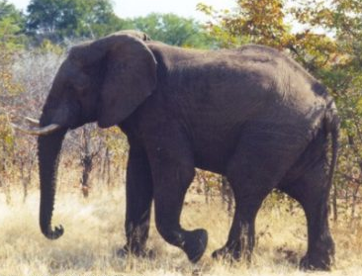
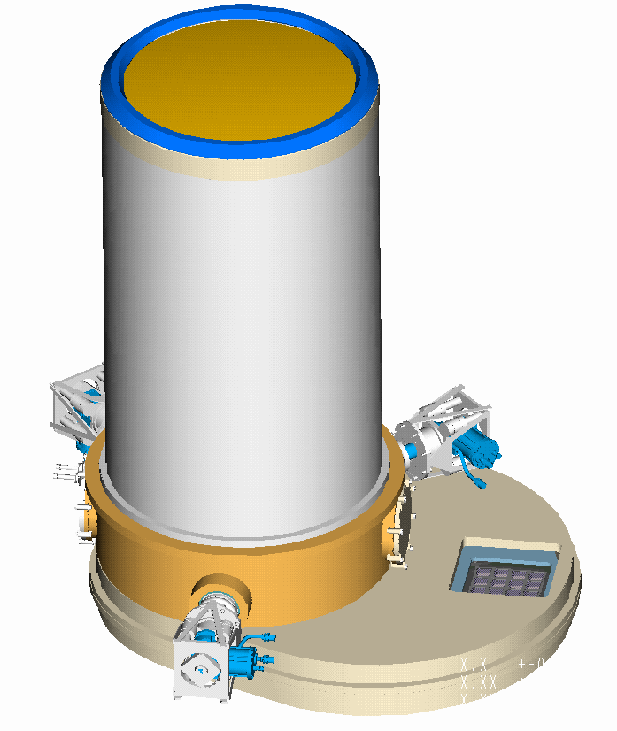
Big: 2.5m
Heavy: 2.5T
Requires lots of consumables
Long gestation: >2yrs
Long lifetime: >25years
Produces vast quantities of output
Difficult thermal control
Difficult to control
Difficult to handle
Difficult to transport
Precision optics
Coplanar detectors
Cryogenic temperatures

Slide 3
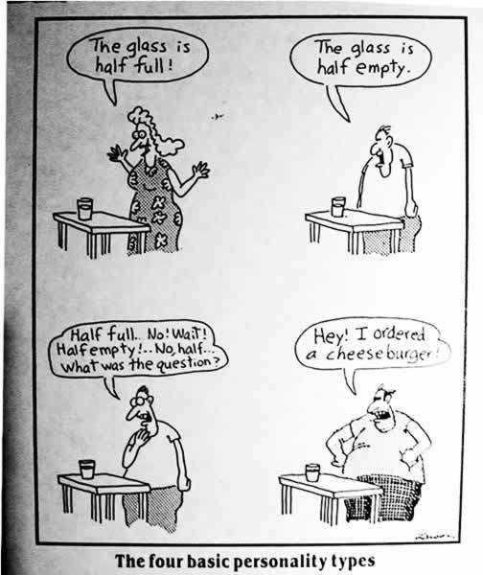

Slide 4
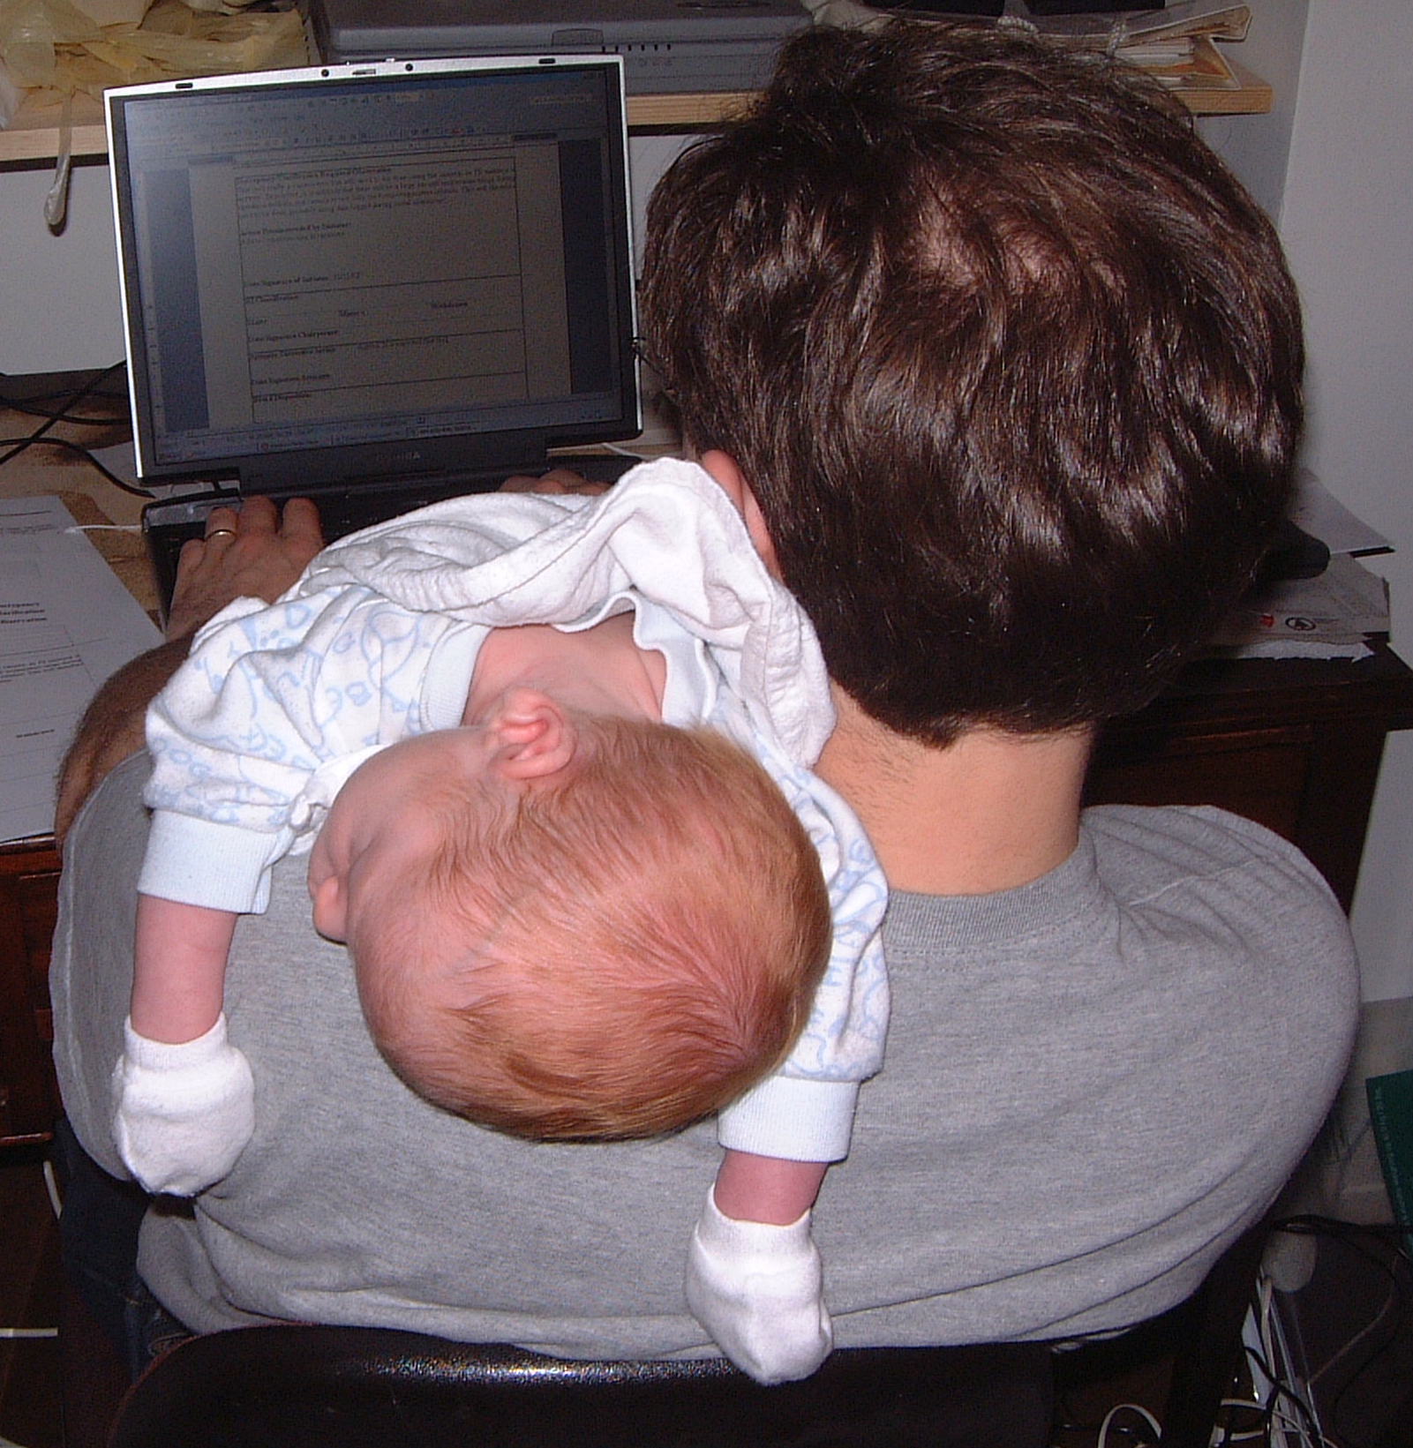
Timeline
System Design Phase (post CoDR): Apr 02
PDR held December 02
FDR held January 04
Camera fully built May 06
  Moved from assembly area
Delivery to Paranal Jan 07
On-sky mid-2008
  Commissioning of camera + telescope through mid-2009

Slide 5
Basic Parameters
Field of View 1.67 degrees @ f/3.3 (350mm focal plane)
16 2048x2048 Raytheon VIRGO HgCdTe Arrays
(840µm-2.5µm sensitive)
YJHKs baseline filter set (one filter per detector)
3 vacant slots in wheel (Z filter to take one)
4 2048x2048 E2V CCDs for wavefront sensing
2 2048x2048 E2V FT CCDs for autoguiding
7 nested ‘dichroic’ baffles for stray light control

Slide 6
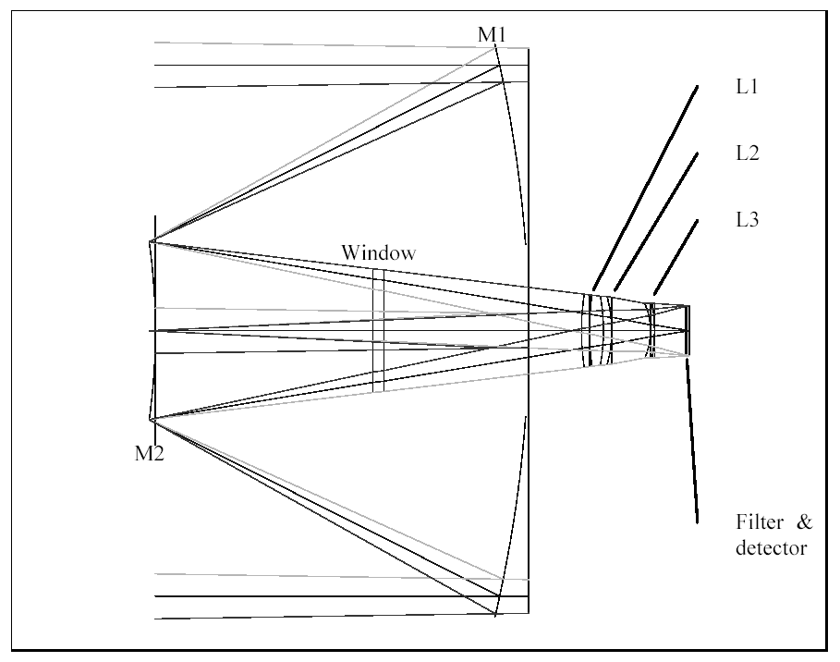
Optical System
Telescope and camera design optimised as a single system
Full system delivers 0.5” images (50% EED). Image distortion < 2% at extreme edge of field
1m diameter

Slide 7
Challenges
Cryostat
~1m vacuum window
Focal plane co-planarity (±25μm)
Detector procurement (ITAR)
Wavefront sensing (totally new)
Stray light baffles
Testing (optical system – 7000nm astigmatism)
Handling (in the lab and to/at the telescope)

Slide 8
Cryostat
5 sections, 15m of o-rings
Limited possibilities for suppliers
Substantial CAD assistance needed from RAL
Supplier staffing issues (non-work related injuries)
Heat shields (use of MLI rejected)
The ‘shrinkage’ problem

Slide 9
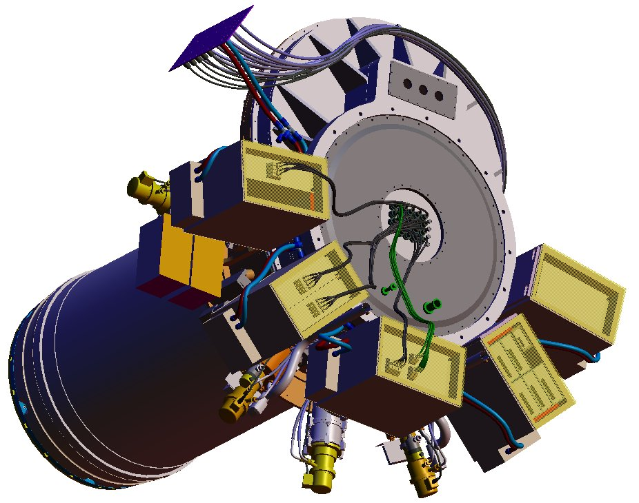
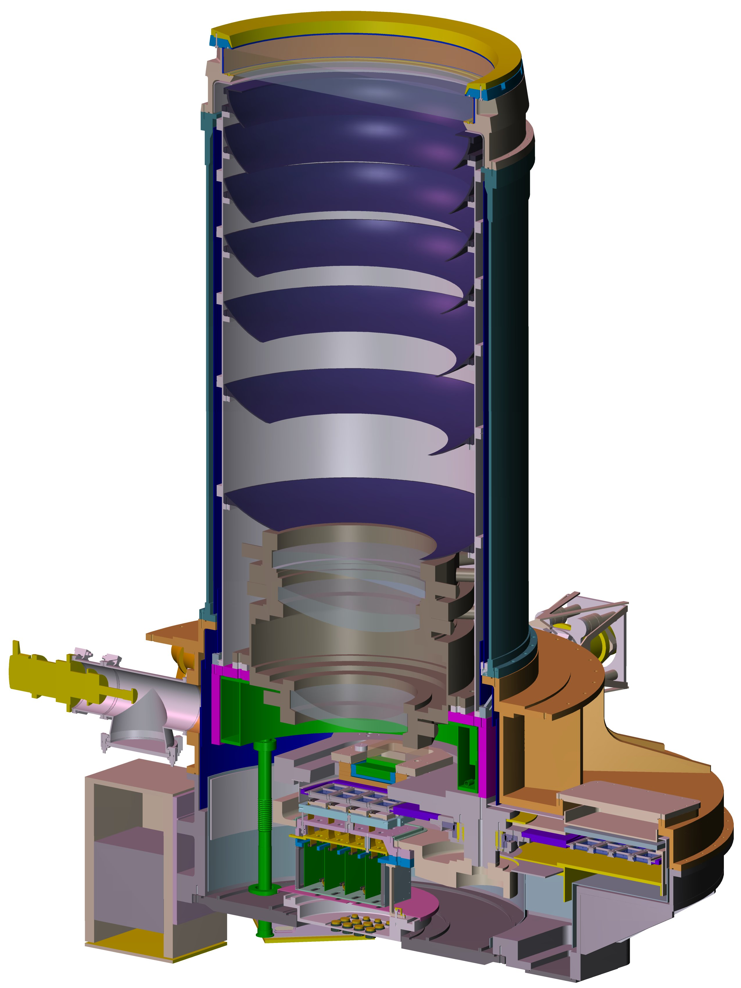

Slide 10
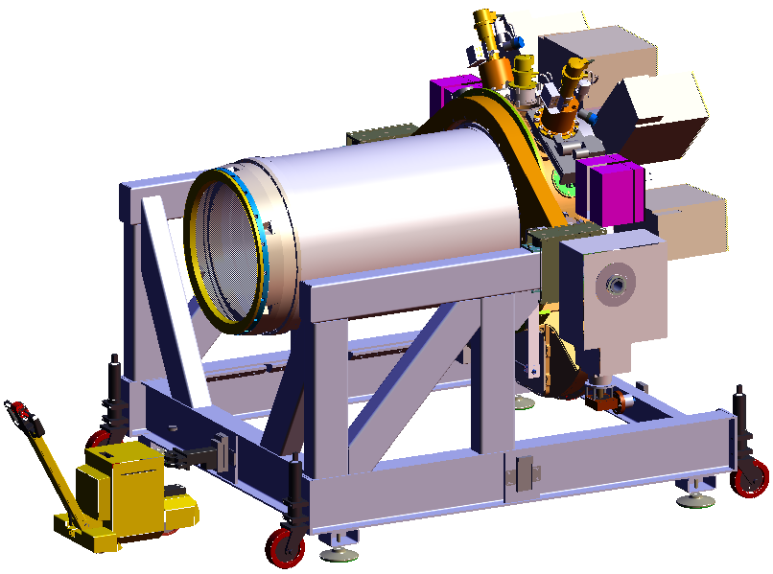
Handling Issues

Slide 11
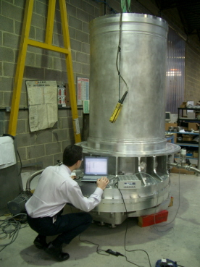

Slide 12
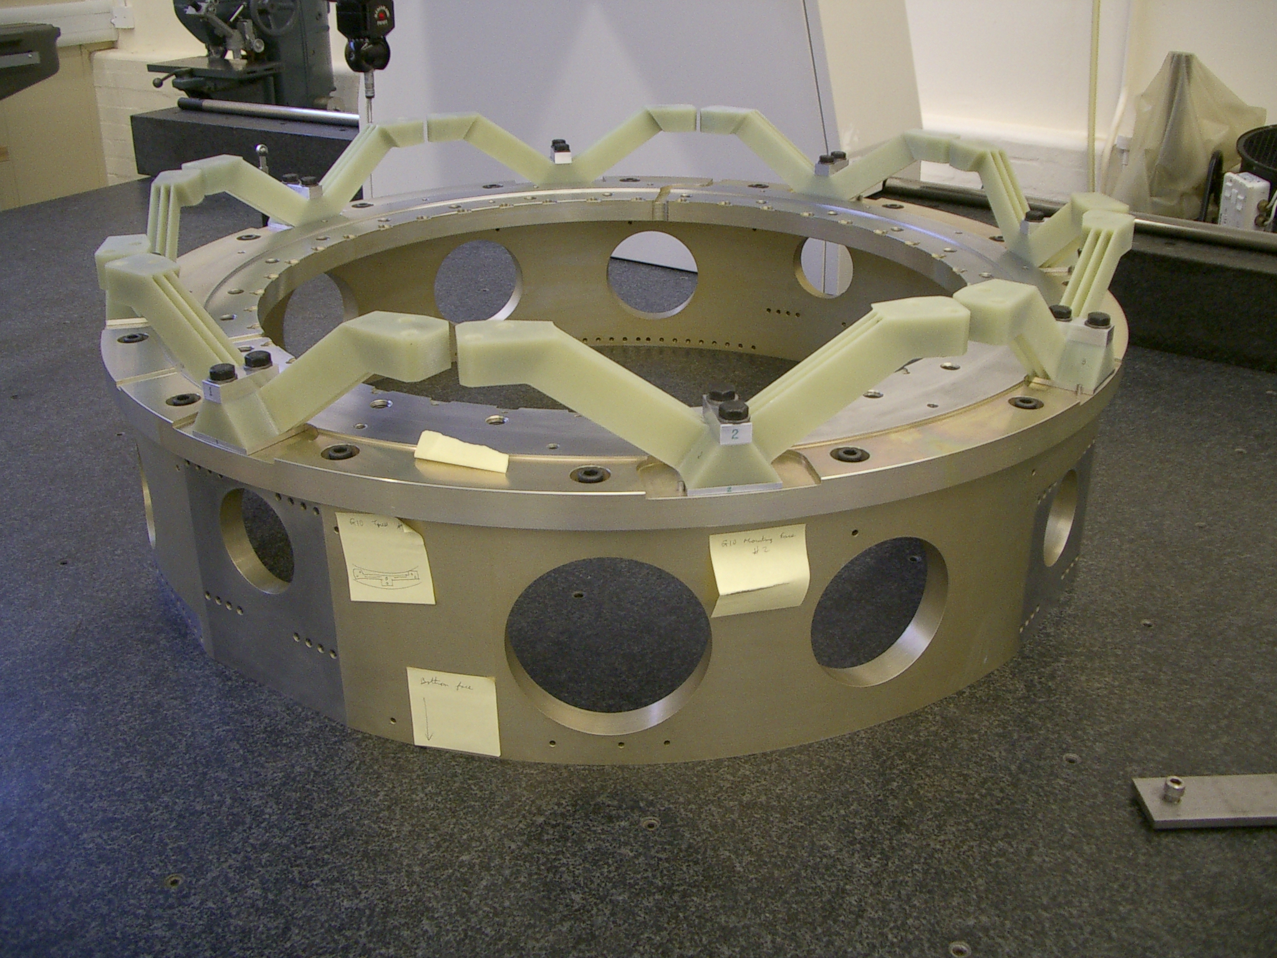

Slide 13
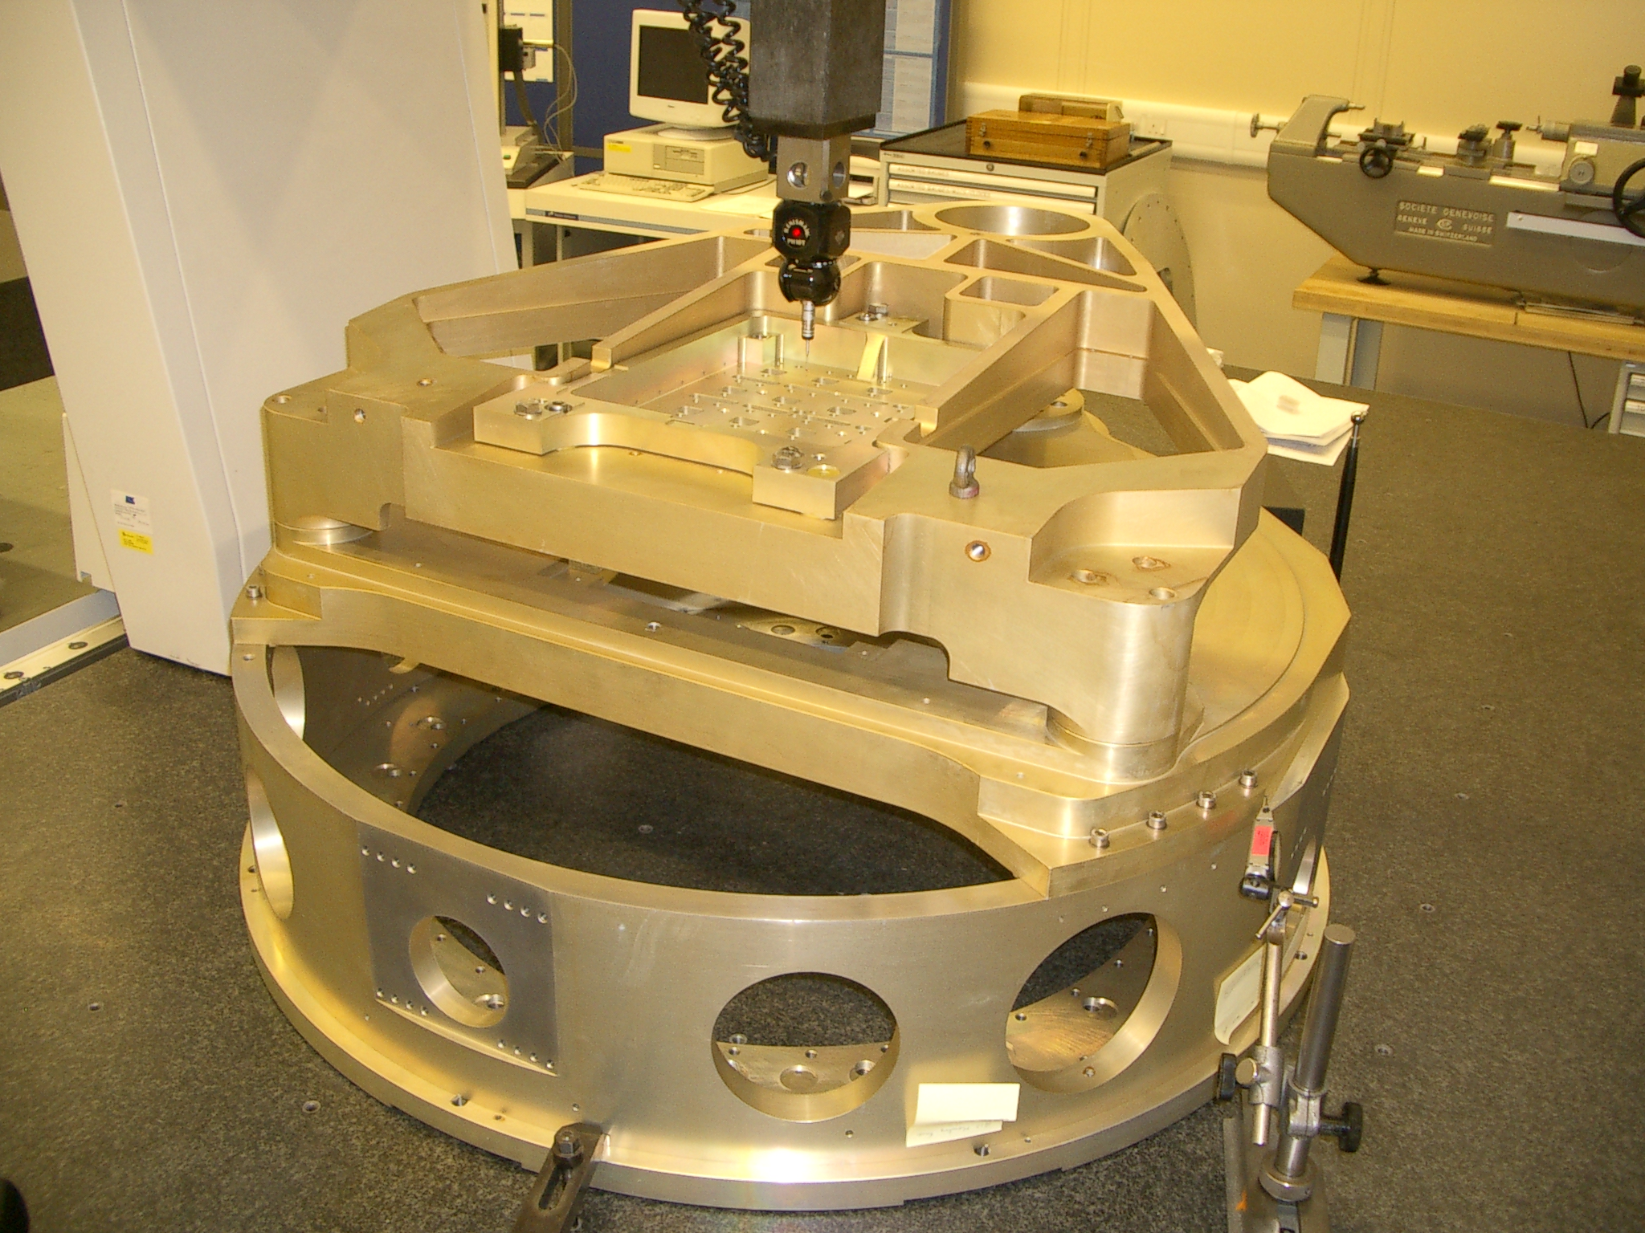

Slide 14
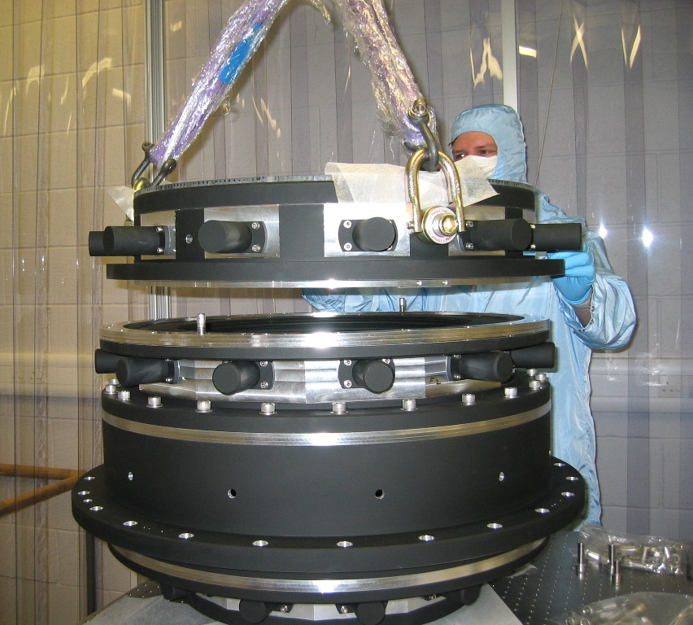
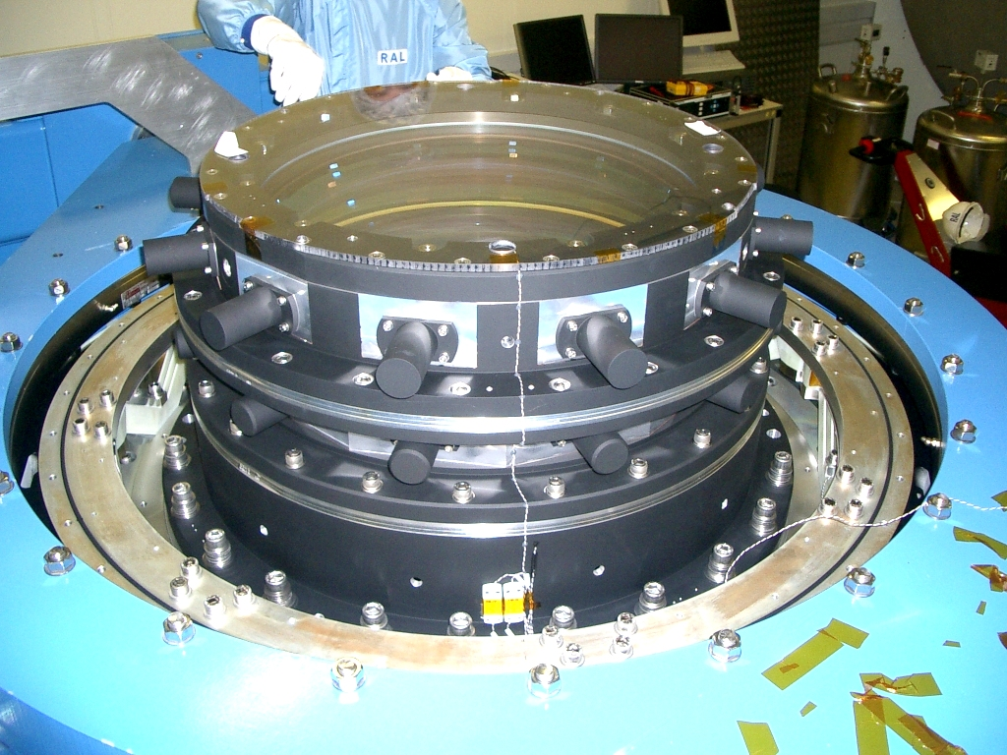
Field Corrector

Slide 15
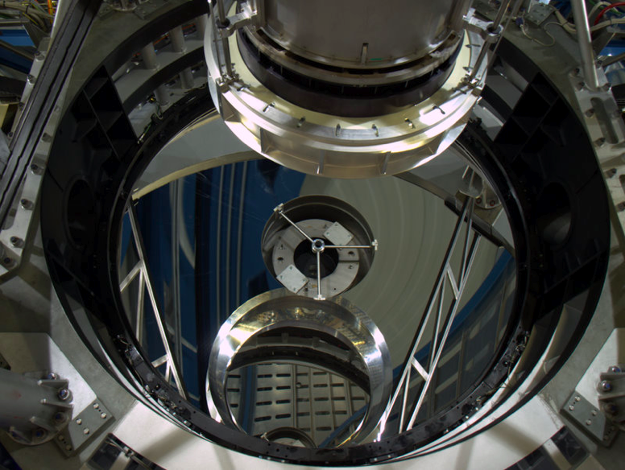
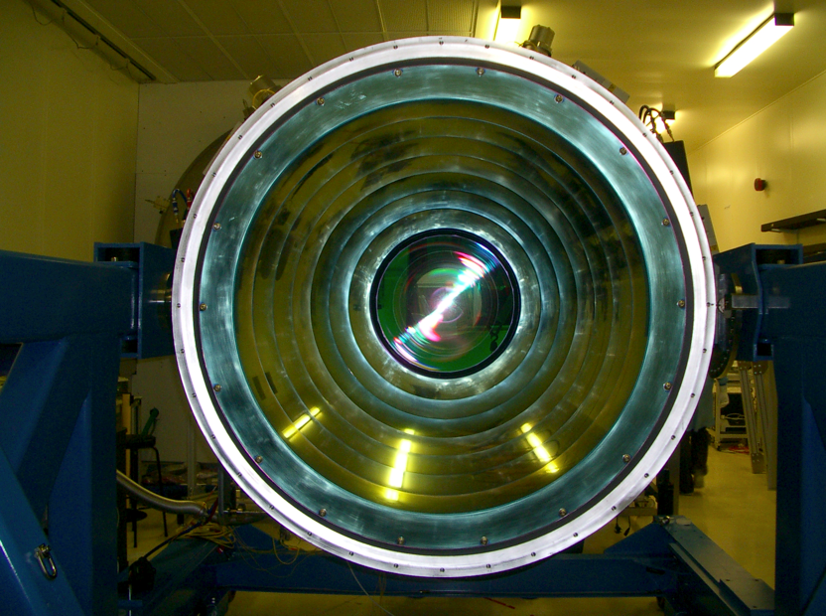
Baffle system
On-telescope: double reflective baffle around M2 restricts camera view past secondary, obstruction 1.4m.
In Camera: 1 flat, 7 nested elliptical dichroic baffles, reject out-of-band thermal through dewar window.

Slide 16
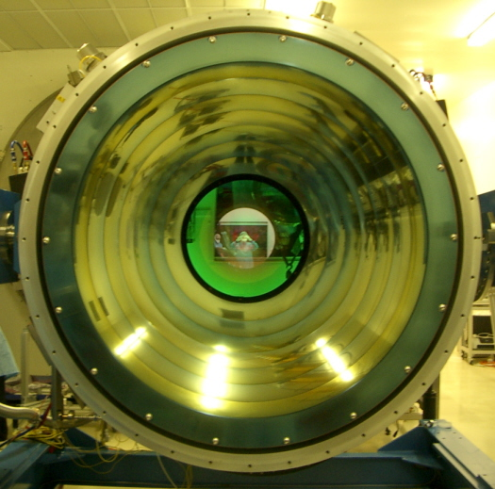
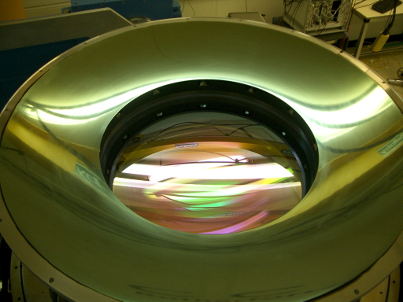
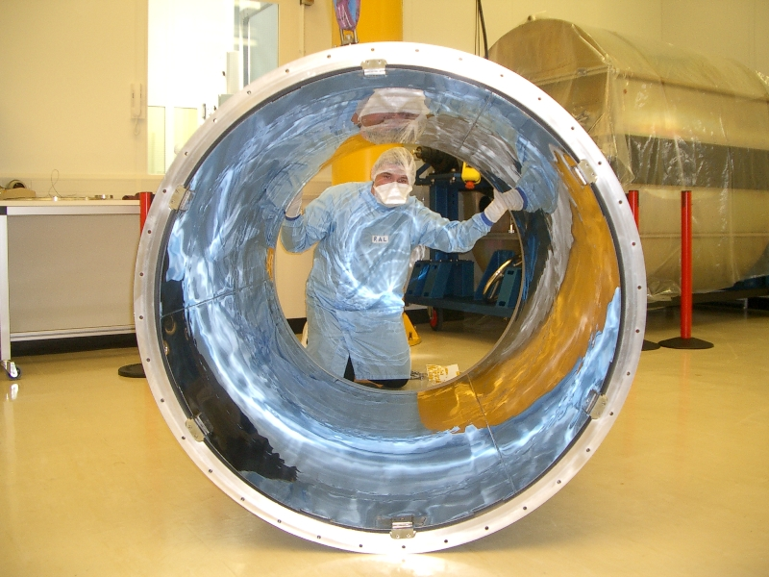
Baffle Assembly

Slide 17
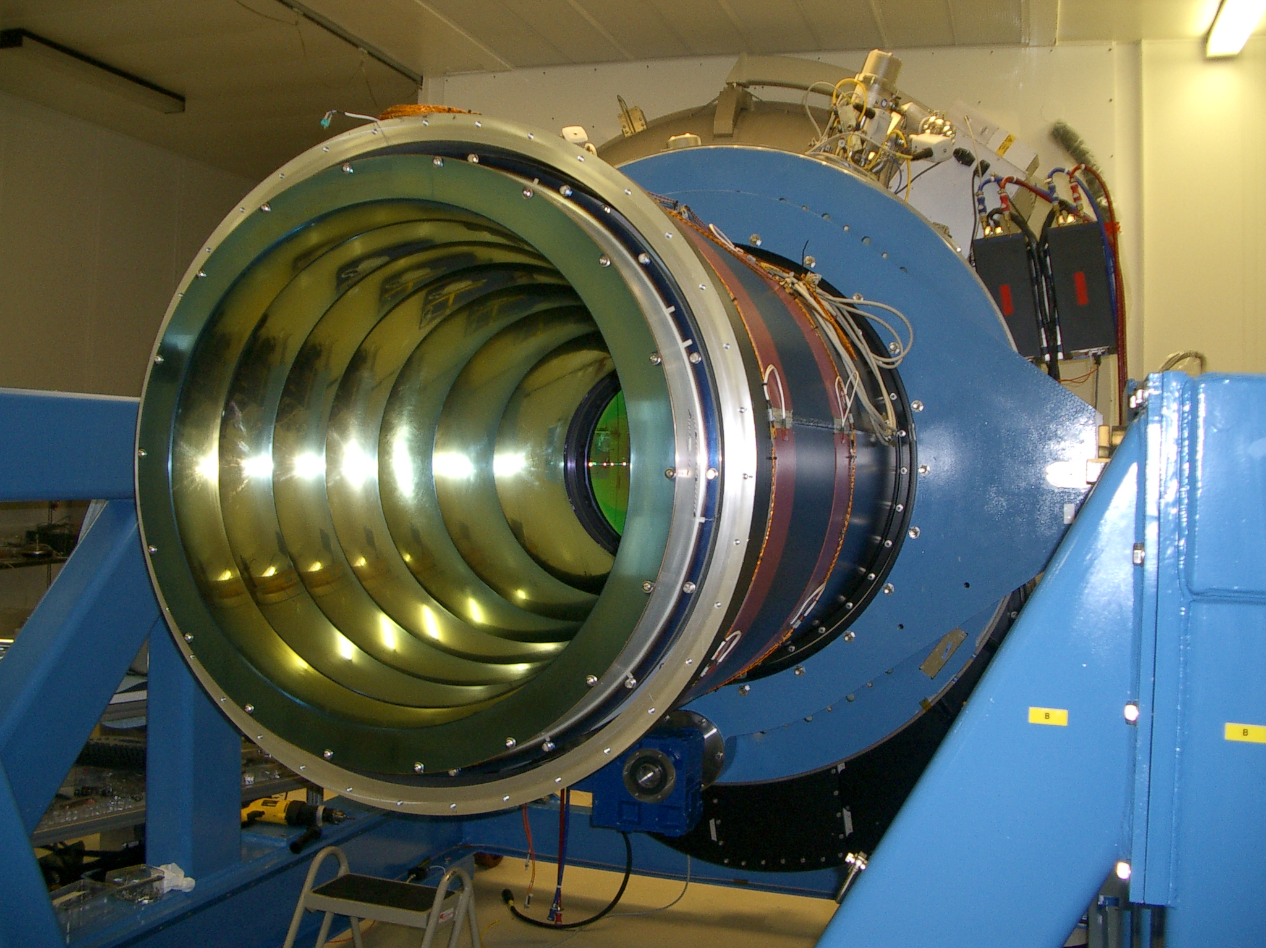

Slide 18
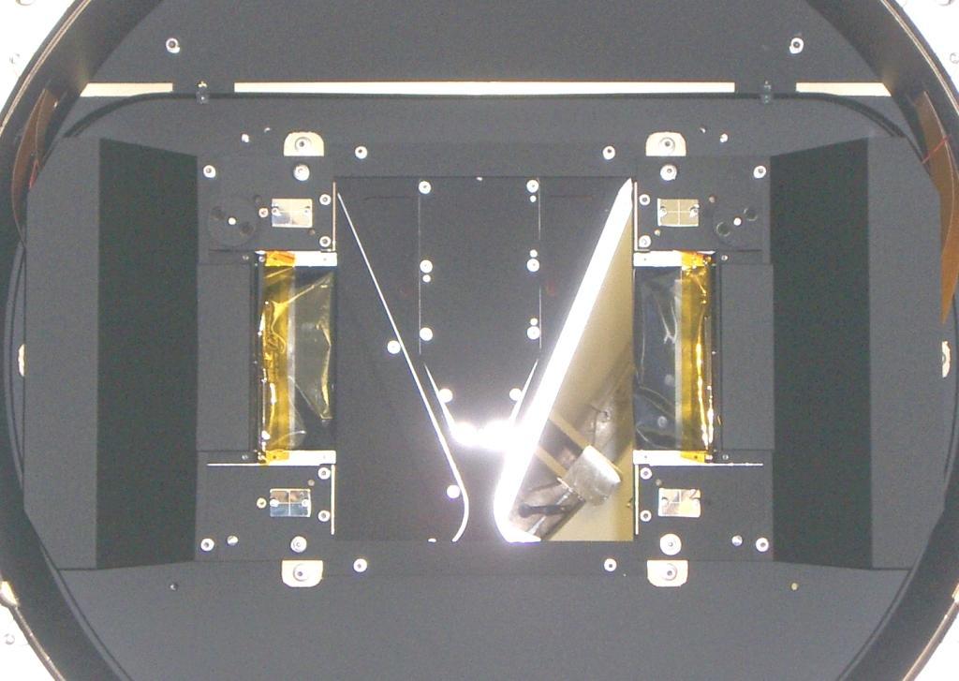
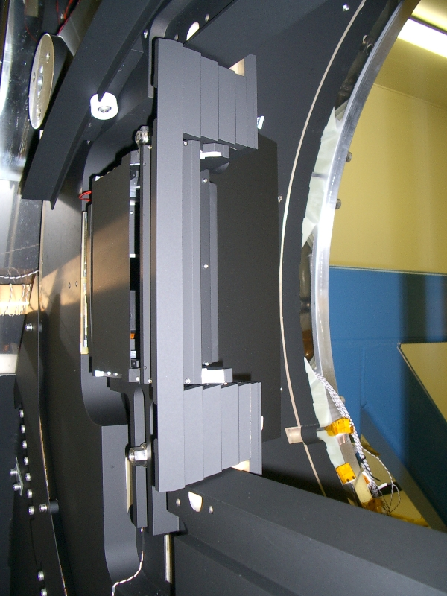
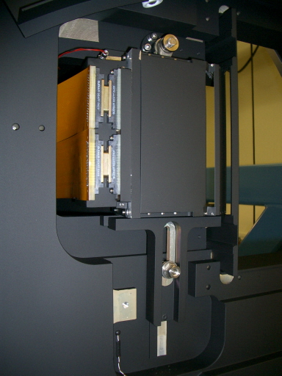
Wavefront Sensors/Autoguiders

Slide 19
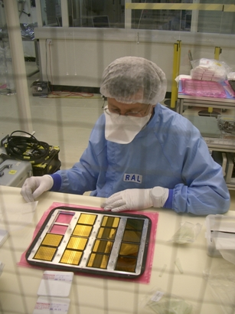
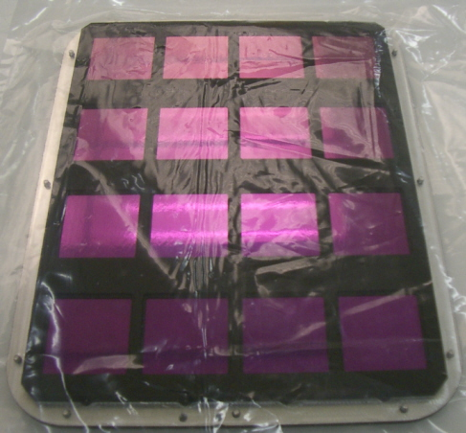
Filter Wheel
Each tray has 160 separate components…

Slide 20
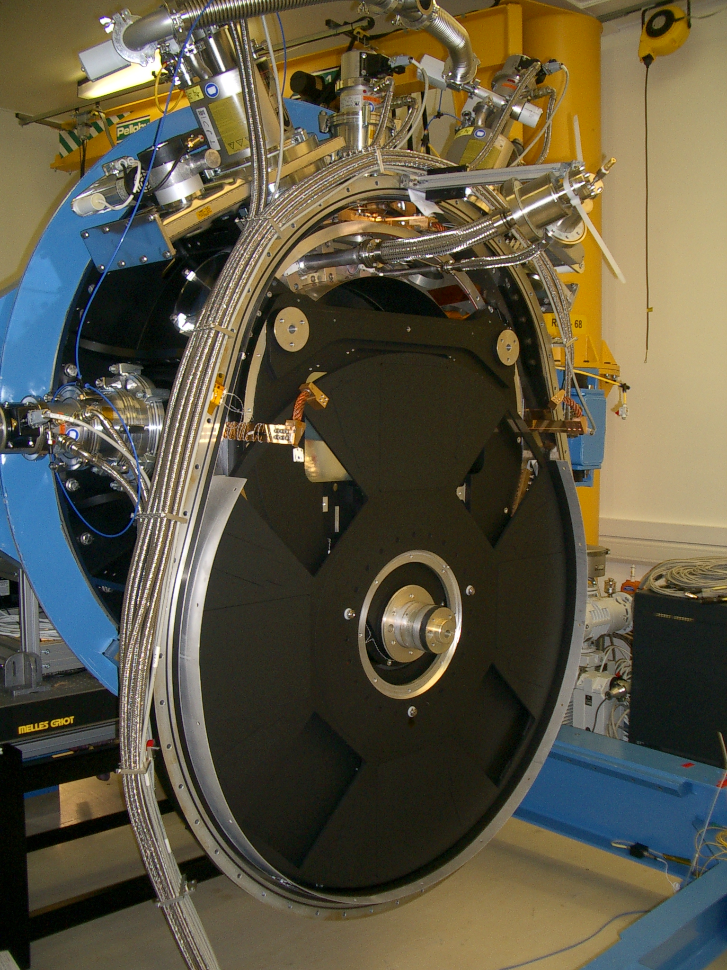
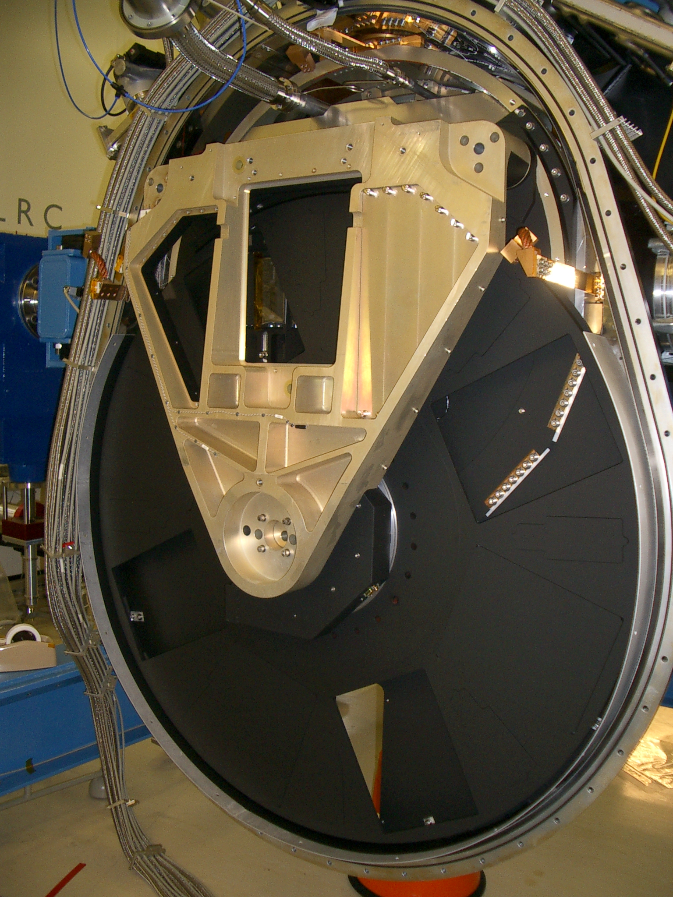
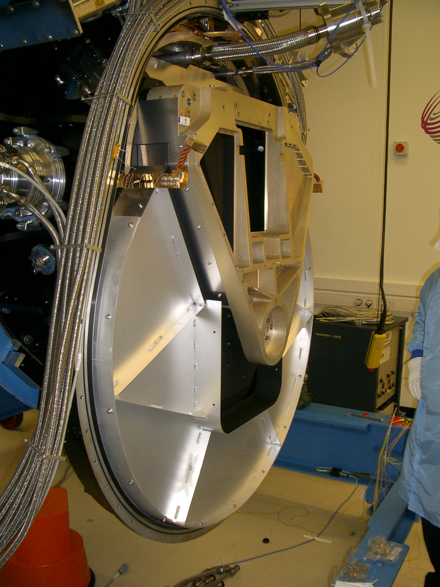

Slide 21
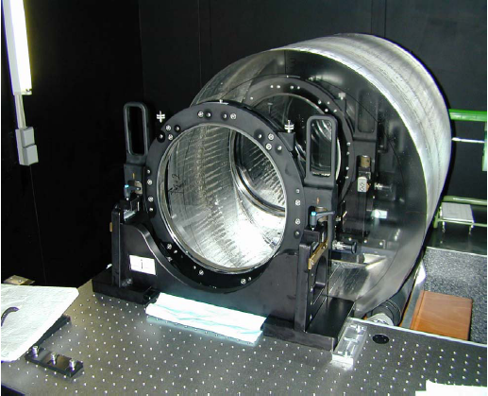
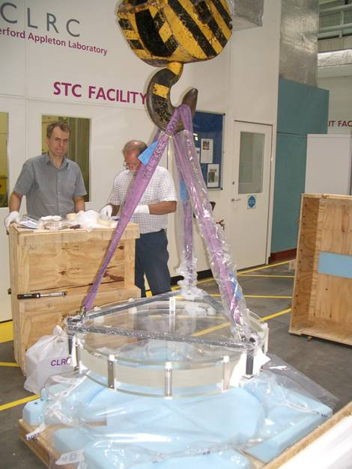
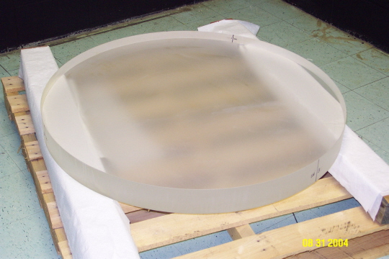
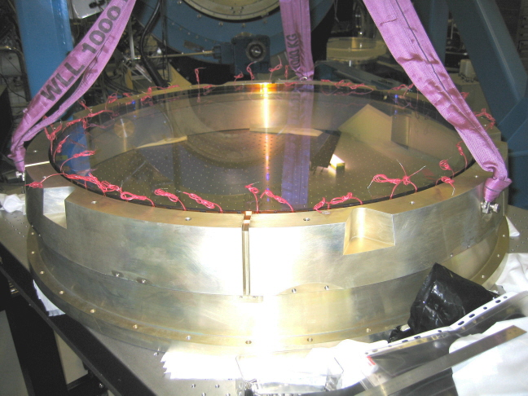
Cryostat Window
0.8MJ of stored potential energy due to pressure on the window!

Slide 22
Focal Plane Layout -> Images

Slide 23
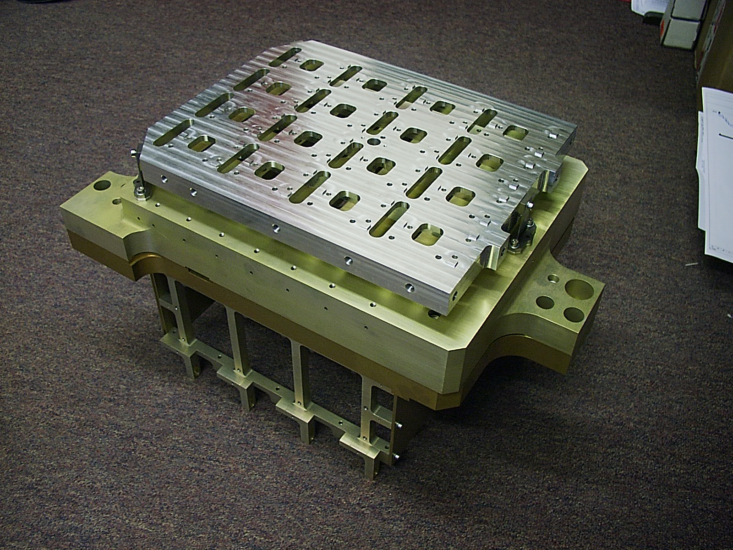

Slide 24
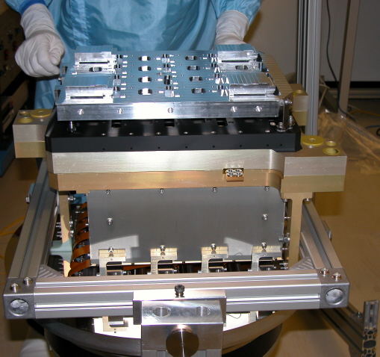
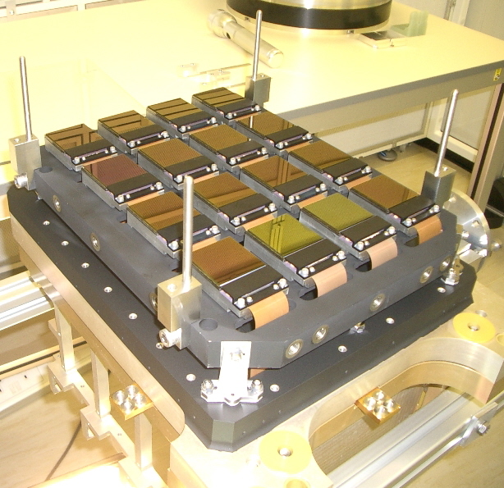
Focal Plane Assembly Details
Detector co-planarity: all pixels within ±25µm (Thanks Raytheon!)
ATC testing: Detector output not quite as expected… 1024 new Op Amps…

Slide 25
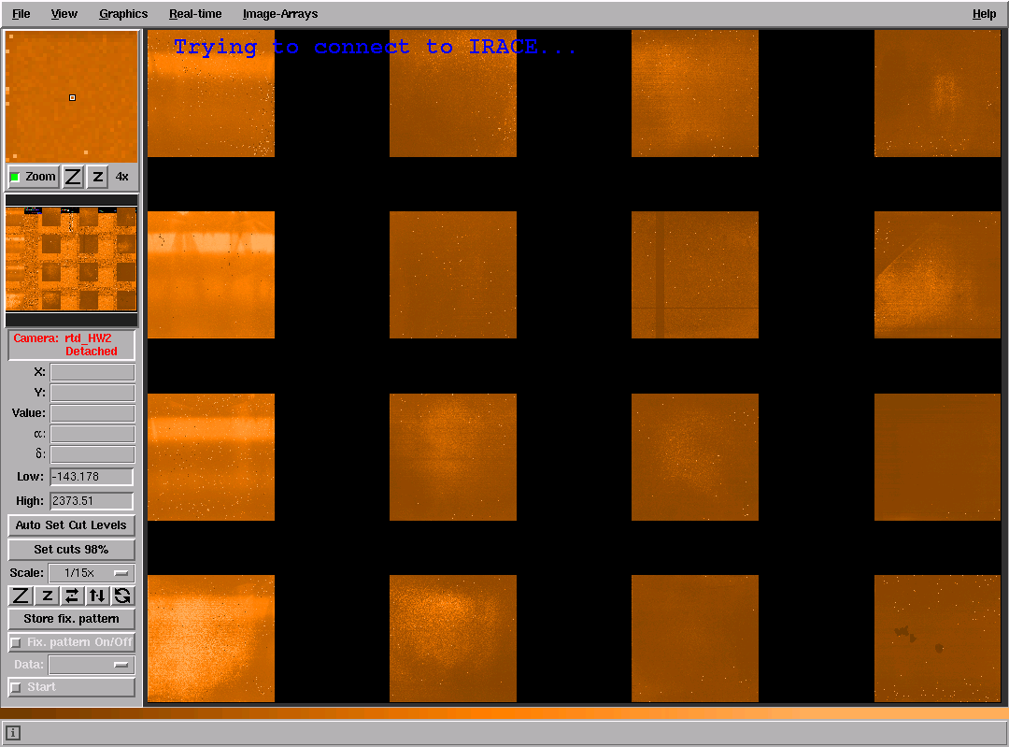
The scattered light puzzle…
Dark image

Slide 26
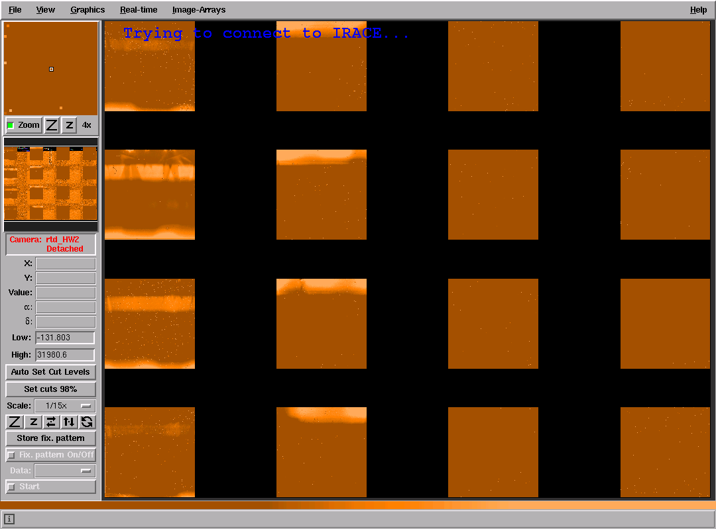
The scattered light puzzle…
Dark image

Slide 27
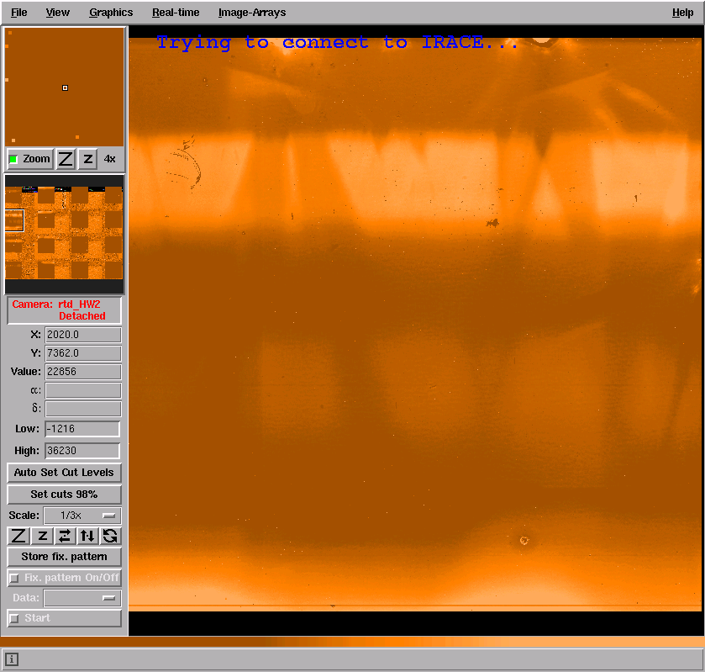
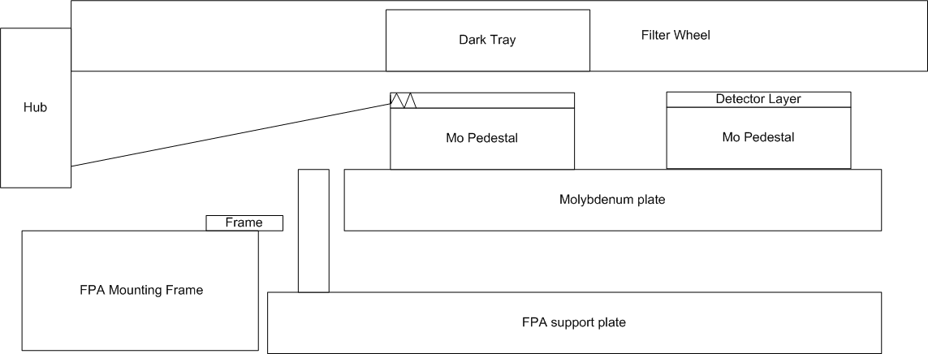
The scattered light puzzle…
Key to explanation came from chips on the edge of one detector…
-a side effect of 800μm thick substrates… (should have been 20μm)

Slide 28
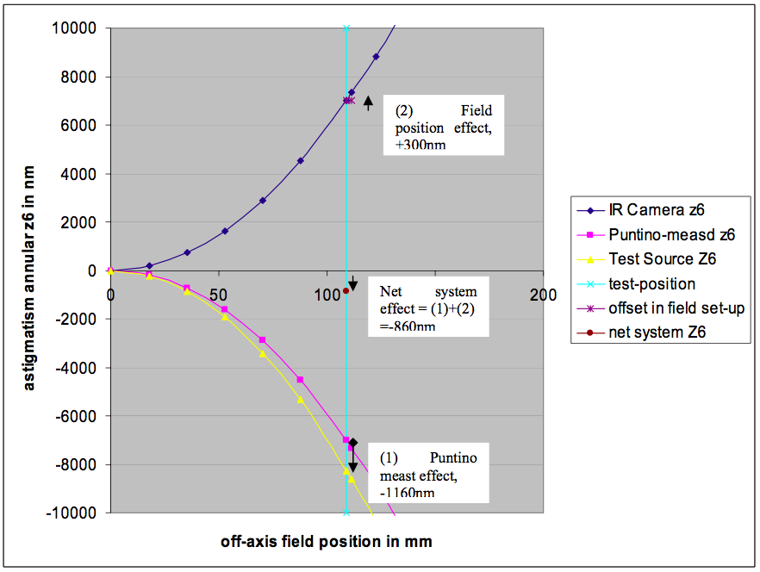
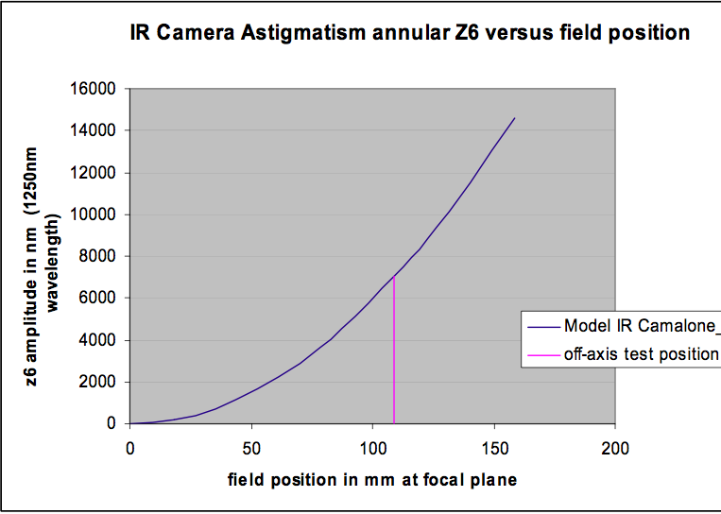
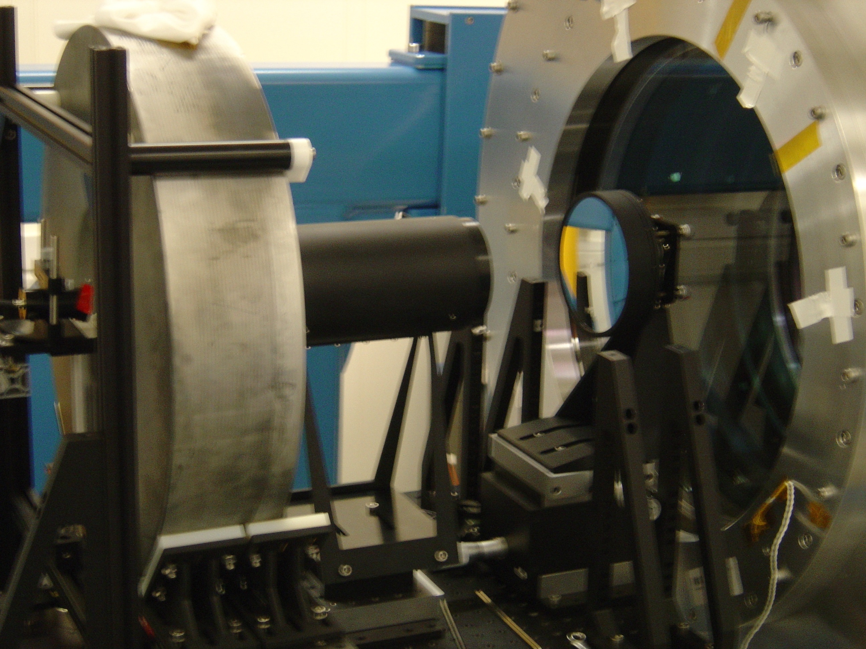
Laboratory image tests
Two-mirror + corrector injection source to simulate telescope aberrations. Align to generate a spot in the focal plane, then measure the source configuration with Shack-Hartmann test camera.
Predicted:measured Z6,Z7, Z11=(7025,-954, 729):(-6957,944,-742nm
Cross-check Z6 measurements against through-focus (±2mm ) spot images:
Error in camera optics < 130nm (111.5mm field) or < 240nm (113.5mm field)
Notes:
+300nm arises because the actual field positions used are 2.5mm or 4.5mm further off-axis than modelled.
-1160nm effect comes from an independent measurement of a systematic underestimate of the results returned by the SH system.

Slide 29
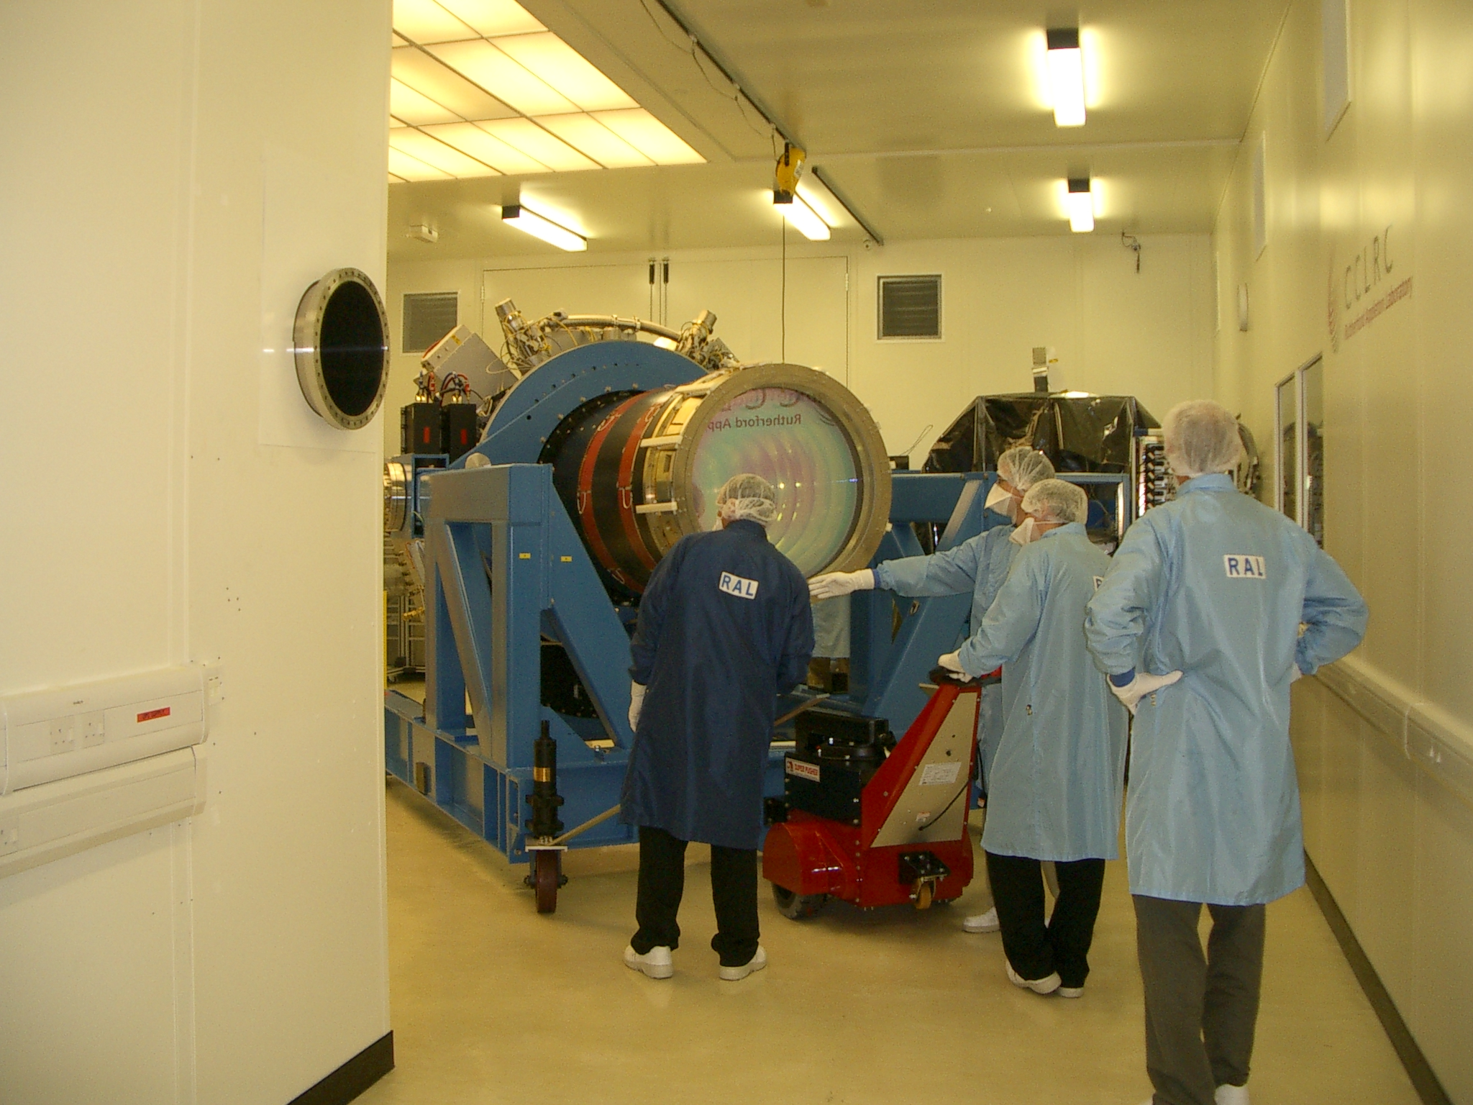
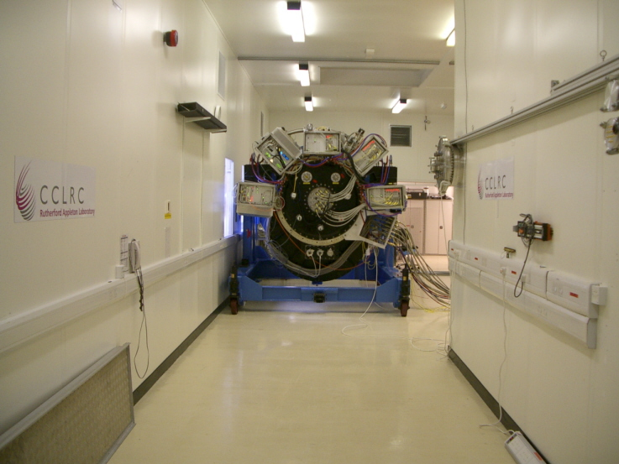
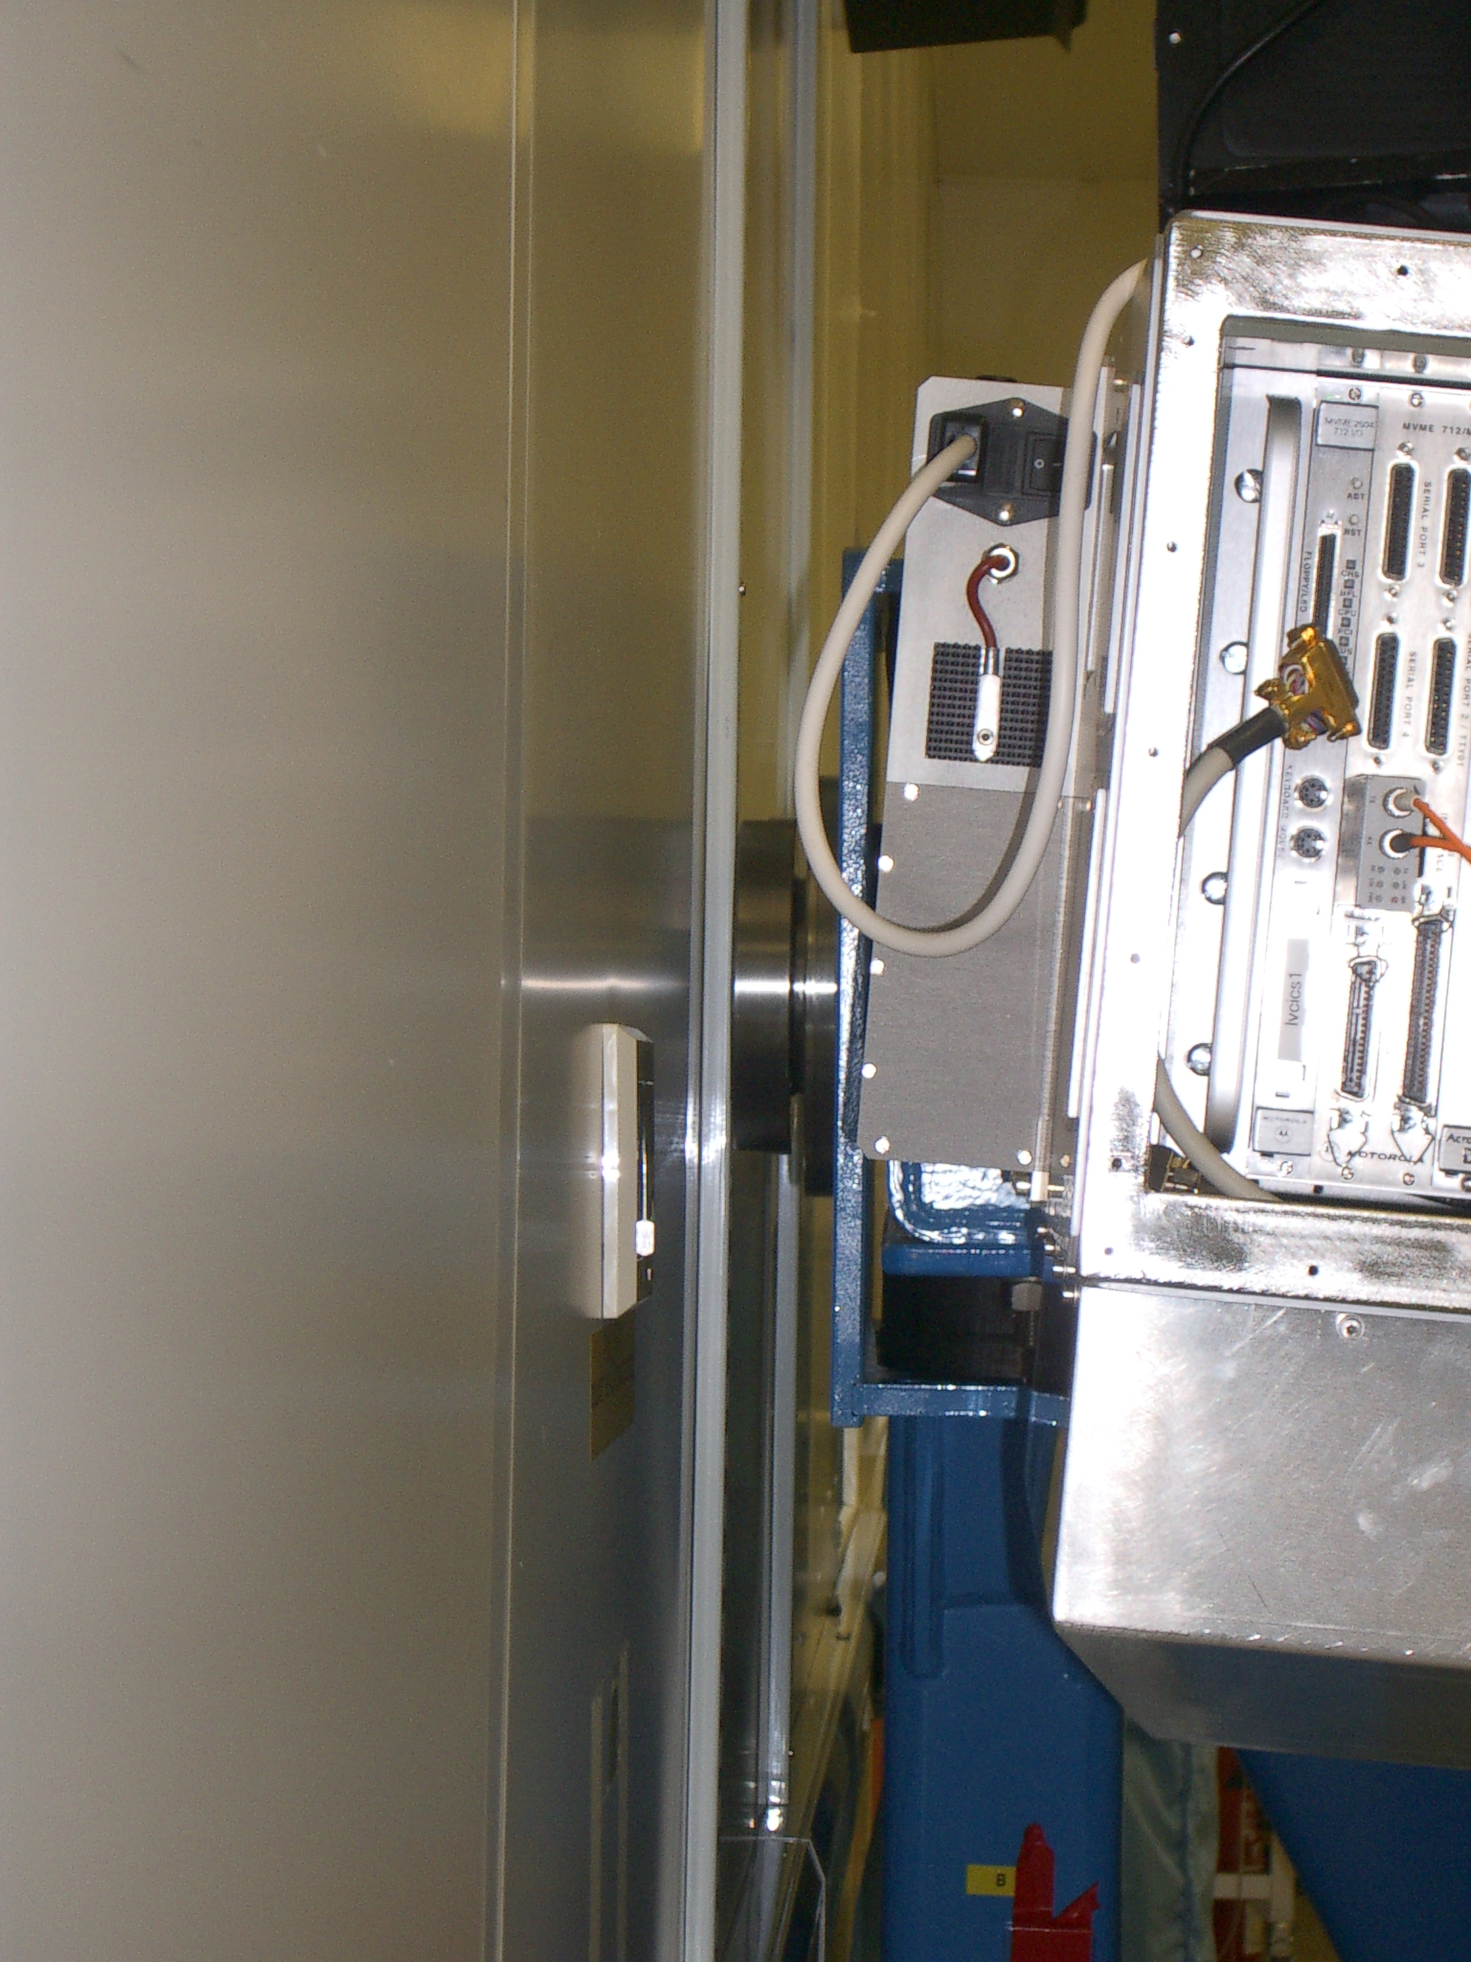
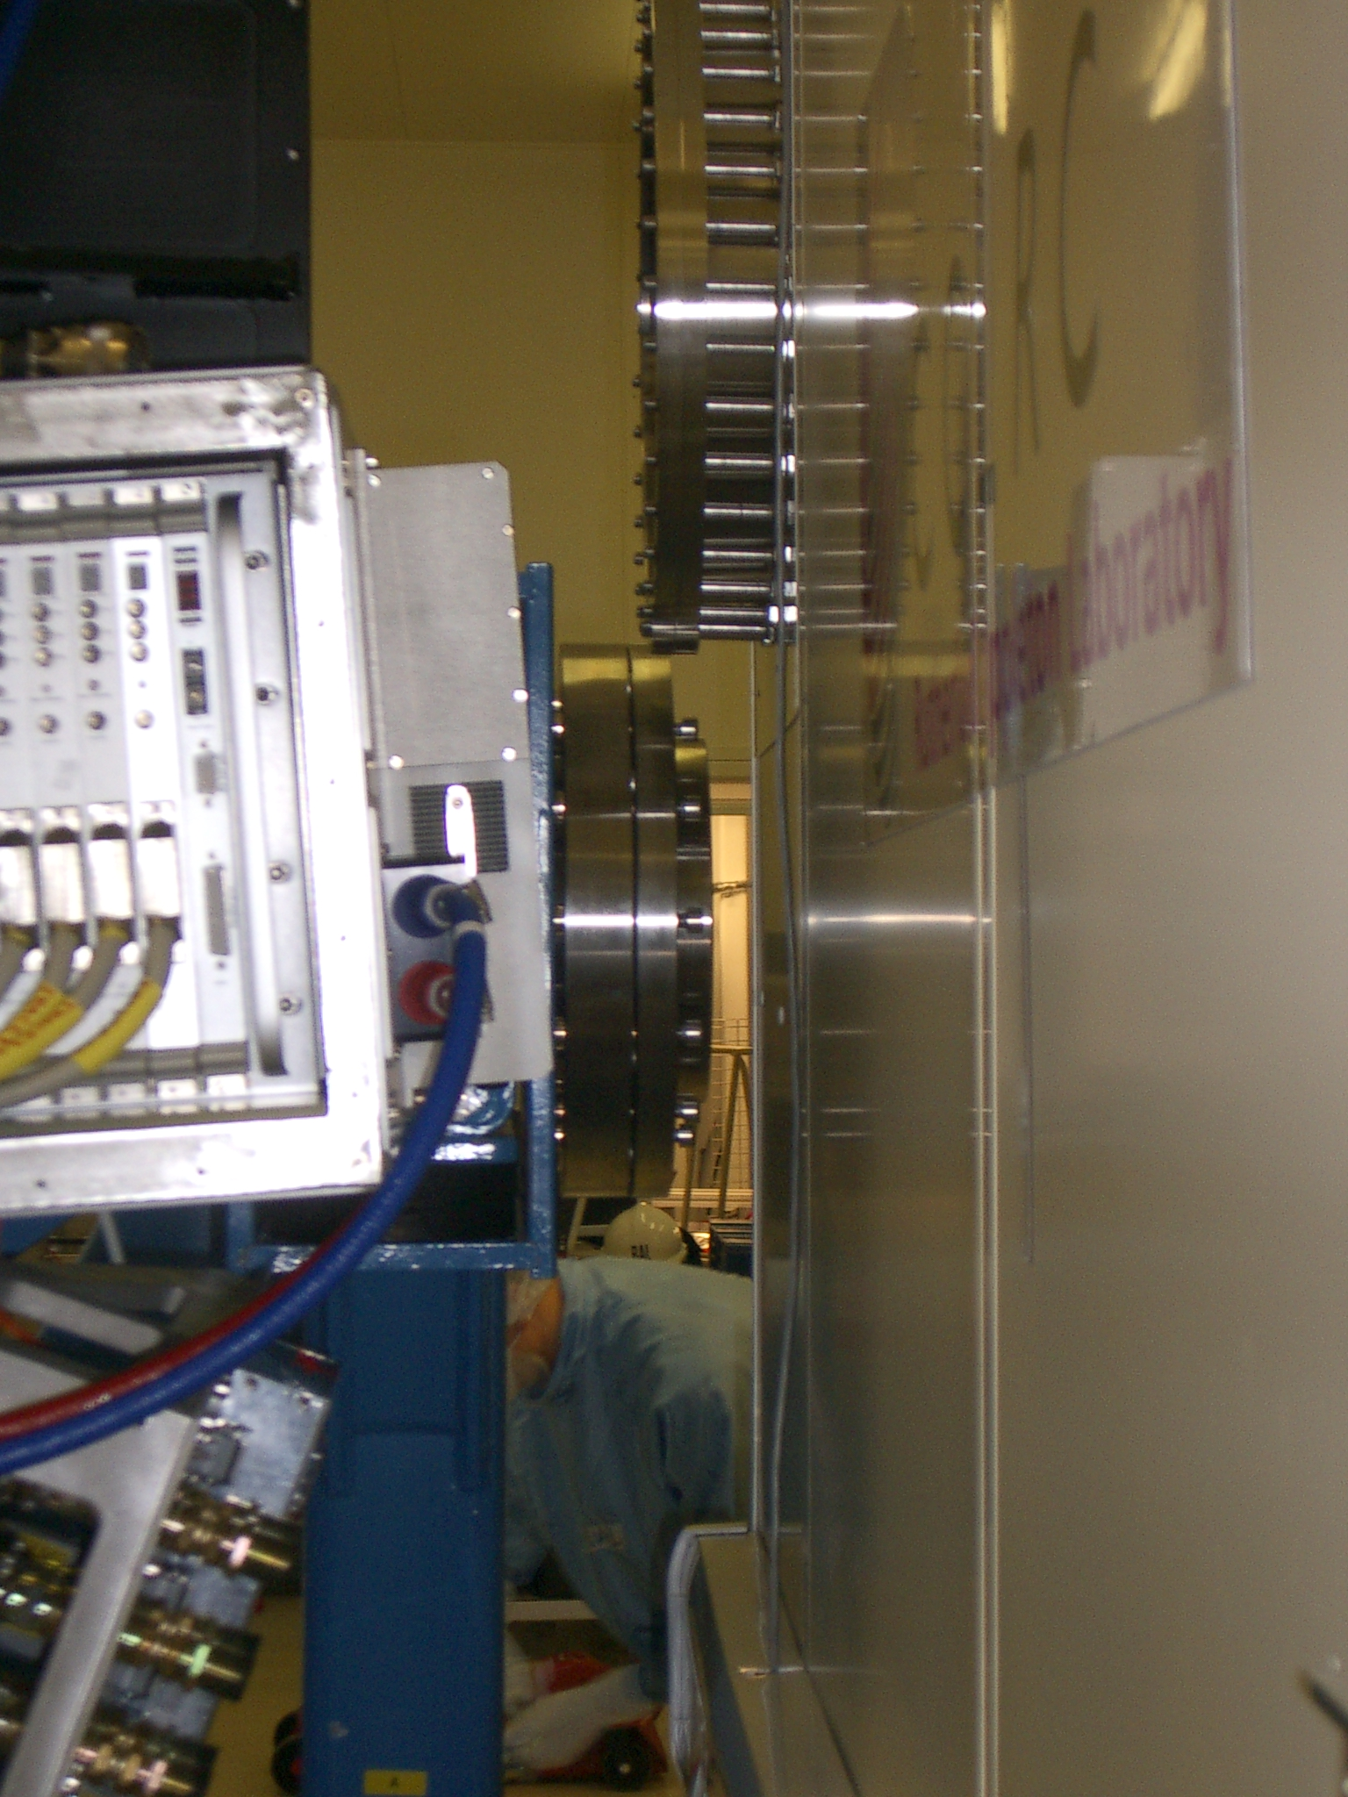
Getting it there

Slide 30
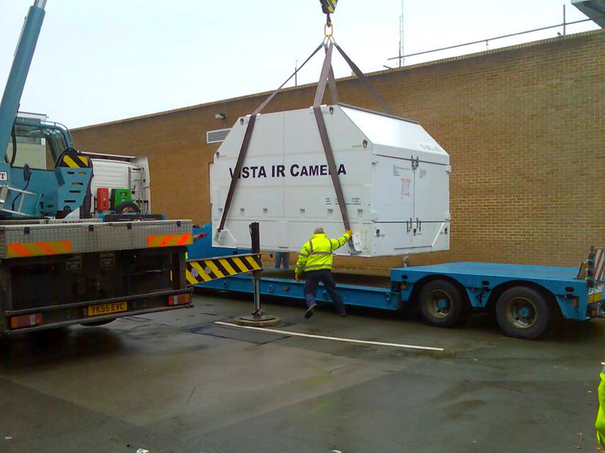
Shipped intact and at vacuum…
Cross-channel ferry (roughest night of the year) then 3 days by 747 (just fits). Finally by road from Santiago
Arrived at Paranal and unpacked (still at vacuum).
…not everything arrived in such good shape (3/5 He compressors damaged in transit)

Slide 31
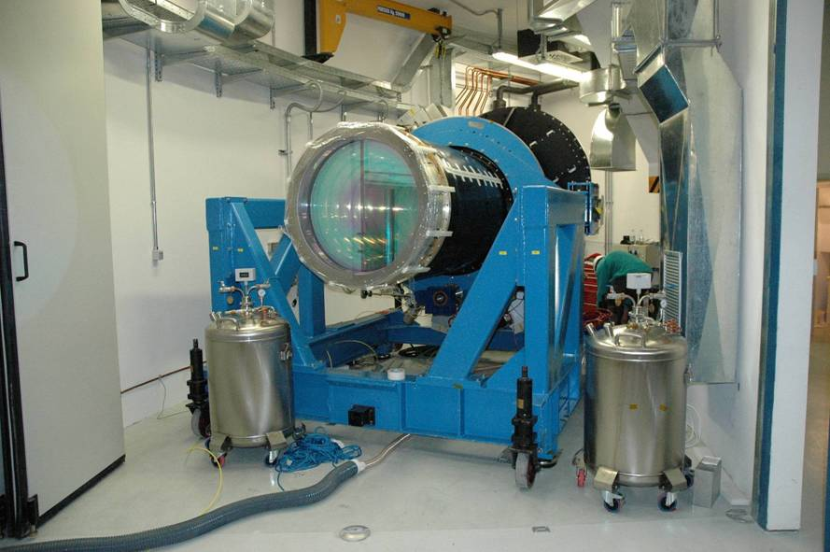
IR Camera in ground floor of VISTA Enclosure

Slide 32
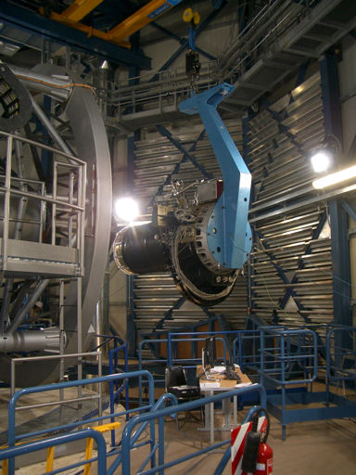
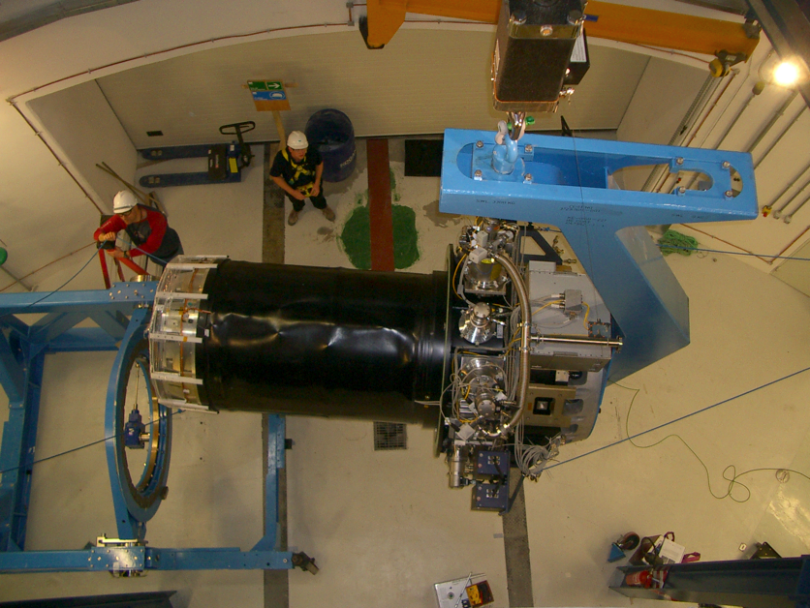

Slide 33
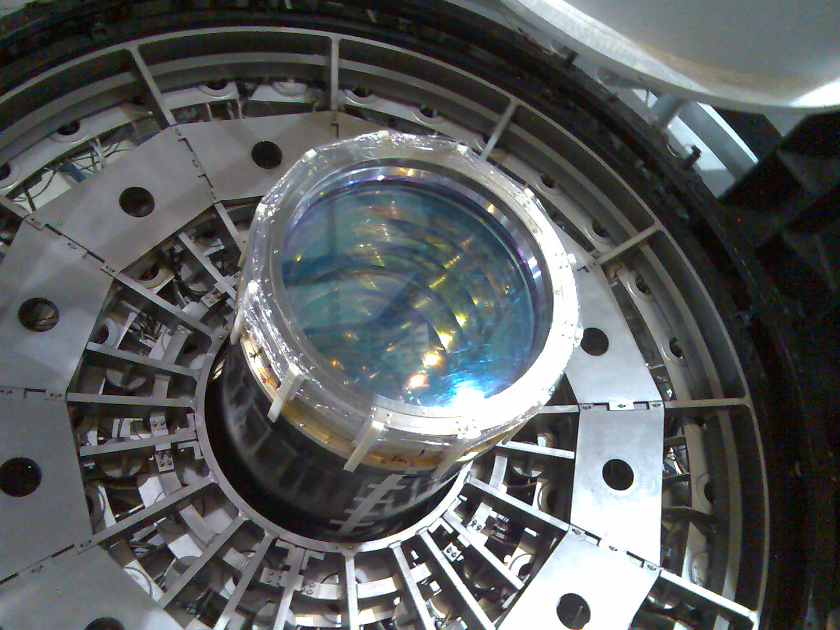



Slide 34
First Light
Early July 2008
M1/M2 setup taken from nominal test-camera data
AGs not set up
WFS -> M2 not set up
WFS-> M1not set up
WFS returning plausible Zernike values
  Apply corrections by hand, can estimate correct focus to ~200nm in Z4 by eye (WFS does a lot better).
After about 5 hours of this we stopped to take a picture…
(6x30s pawprints in J, dithered ‘by hand’)

Slide 35

Some Images
35° elevation, 0.85” images over most of the field

Slide 36

Wavefront Sensors
Pair of pre/post-focal images
(LOW order)
Analysis fit to the image-pair
Residuals

Slide 37


Wavefront Sensors
High Order
25 Zernike terms fitted
(Spherical terms not applied, but no significant level detected)
M2 trefoil (~800nm) seen with test S-H camera recovered well
Can sometimes fail to converge…

Slide 38

Beam-splitter cubes in-between filter positions can be deployed to 8 pre-determined locations for high-order curvature sensing measurements.

Slide 39




Calibrating M1/M2
VLT DIMM
recording 0.8”-1.0”
30/8/08
0.80”
0.82”
0.76”
0.79”

Slide 40

Residual Camera Astigmatism
Rotational variation of M1 astig corrections suggest a small camera term, consistent with the laboratory measurements.
-Add a term to the active optics controls to apply this as f(rotator) in open loop.

Slide 41


M2 tilt (field dep. astig)
Always appeared to see worse images in one, but not always the same, corner… Z5 and Z6 measurements initially confusing.
Model as two-component rotating term, and get better data…

Slide 42

M2 tilt (field dep. astig)
2 component model with a true field corrector mis-alignment term and a ‘phantom’ 2θ term from the gradient of the M1 trefoil correction. –Apply one term open-loop and ignore the other.

Slide 43

Focus Gradient (HOWFS)
October 2008
Difference between focus measured at corner- and near-axis-HOWFS locations (nm of Z₄

Slide 44

Difference between extreme and near-axis positions for each rotator setting

Slide 45

Focus Gradient (HOWFS)
March 2009
Same plot after lateral M1 position adjustment and recalibration of M2 positioning
Further repositioning of M1 in May 2009 corrected this residual

Slide 46

Final image quality from SV data
Formal image quality 0.45” (50%EED)

Slide 47
VISTA Performance
Throughput:
Z 51%
Y 45% (Filter)
J 53%
H 66%
Ks 63%
Total system…
telescope+camera+detectors
Array striping: controller effect, removed as identical in four arrays/IRACE sub unit
Channel cross-talk: none
Persistence: 1st Mag star residual disapppears completely in < 1min

Slide 48




Detector FlatFields
Lower left corner

Slide 49




Detector FlatFields
Lower right corner

Slide 50




Detector FlatFields
Upper left corner

Slide 51




Detector FlatFields
Upper Right corner

Slide 52


Slide 53



