Slide 1
Chris Willott, René Doyon, and the FGS/NIRISS Team
Niriss overvieW
JWST @ ROE
4 July 2016

Slide 2
Outline
Instrument overview
Observing modes
NIRISS GTO program overview

Slide 3
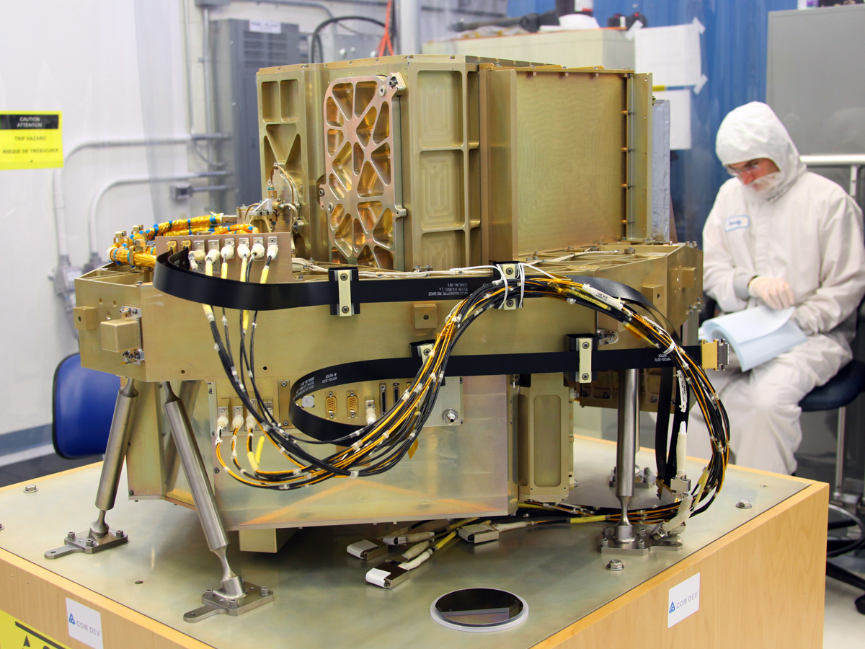
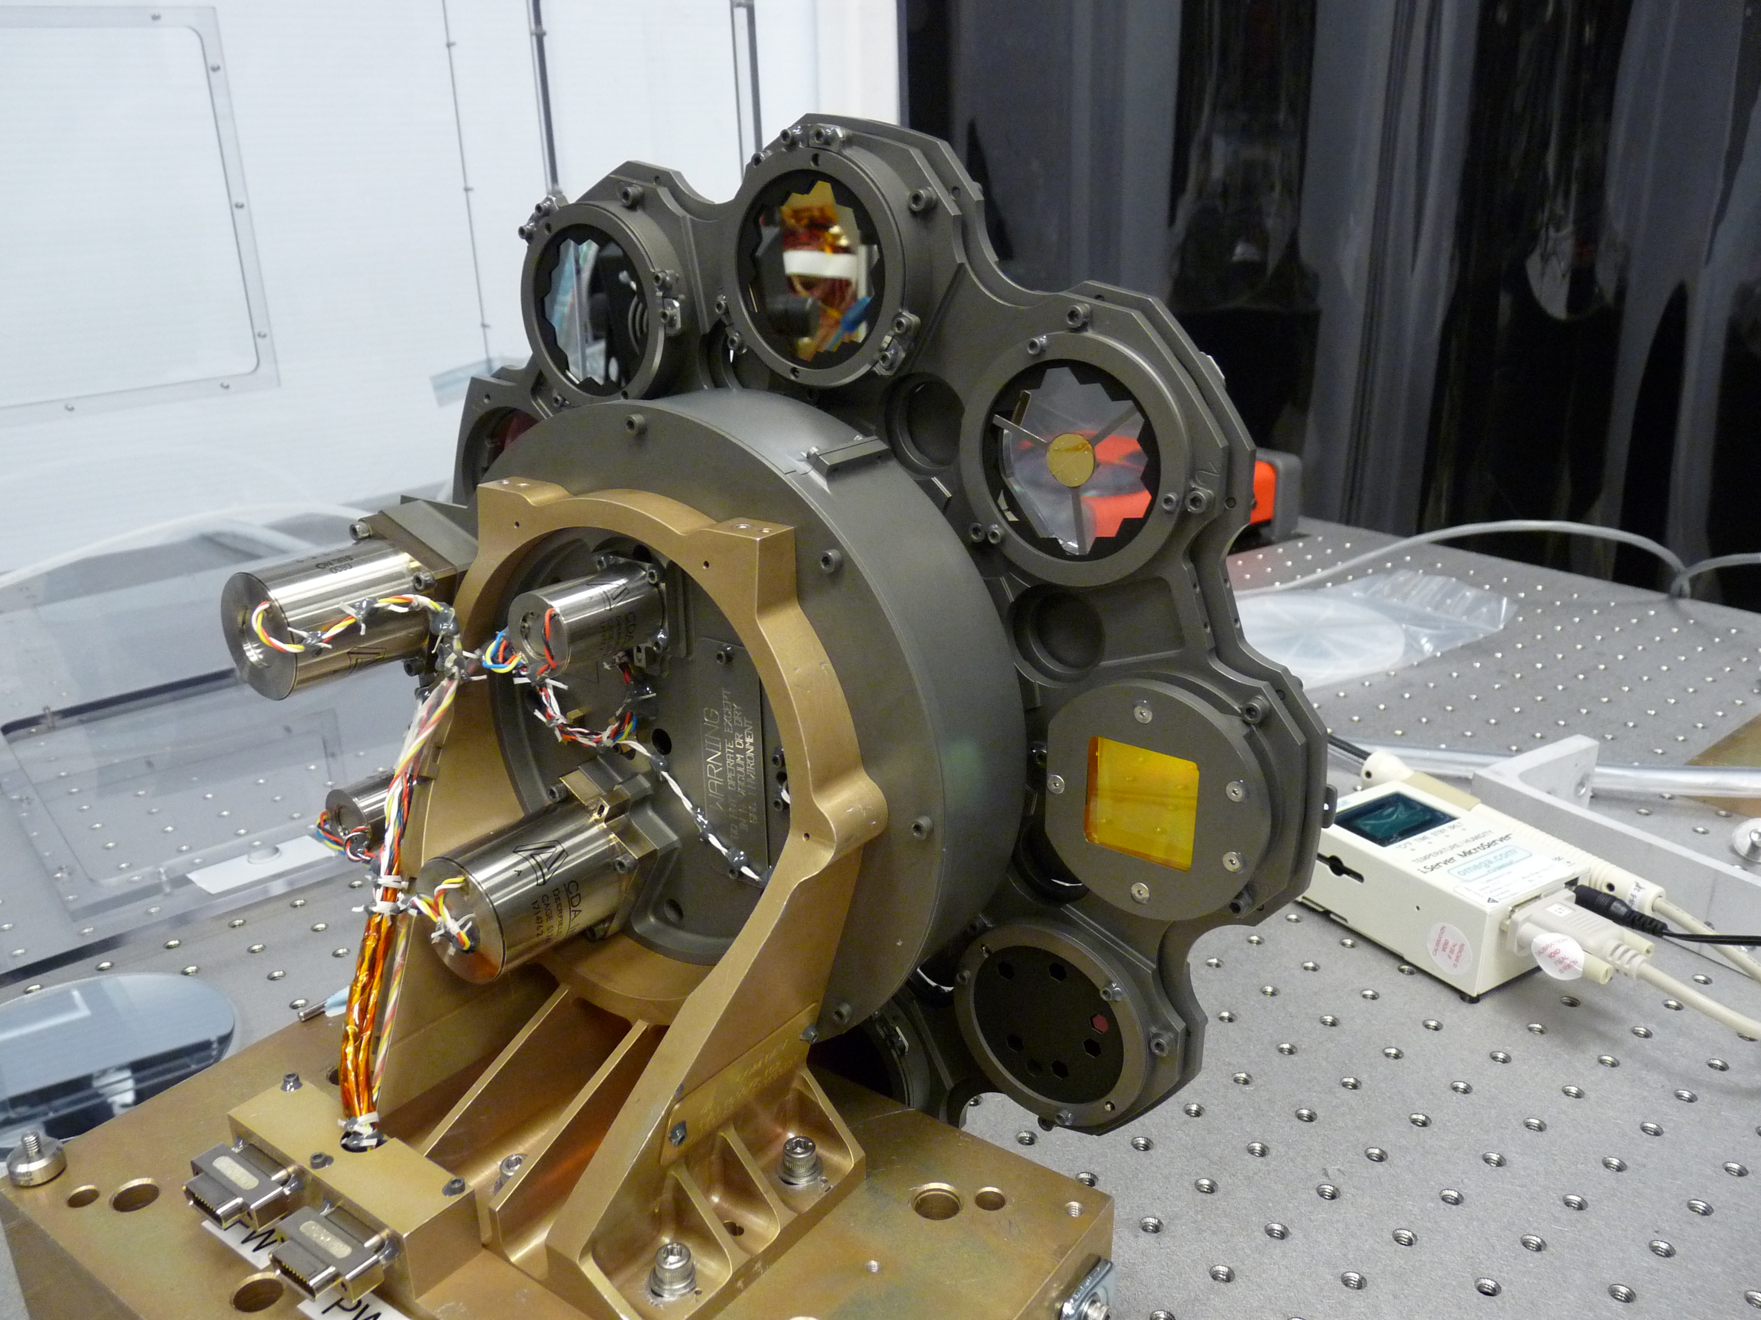
FGS/NIRISS overview
Two instruments in one box
FGS (Fine Guidance Sensor)
  Provides fine guiding to the observatory
  0.6-5 μm IR camera.
  No filters, single optical train with two redundant detectors each with a FOV of 2.3’x2.3’
    Noise equivalent angle (one axis): 4 milliarcsec
    95% sky coverage down to J_{AB}=18.9
NIRISS (Near-Infrared Imager and Slitless Spectrograph)
  0.6-5 μm IR camera similar to NIRCam LW
  Four observing modes
  Main science drivers
    Galaxy evolution
    Exoplanet spectroscopy
    High-contrast imaging

Slide 4
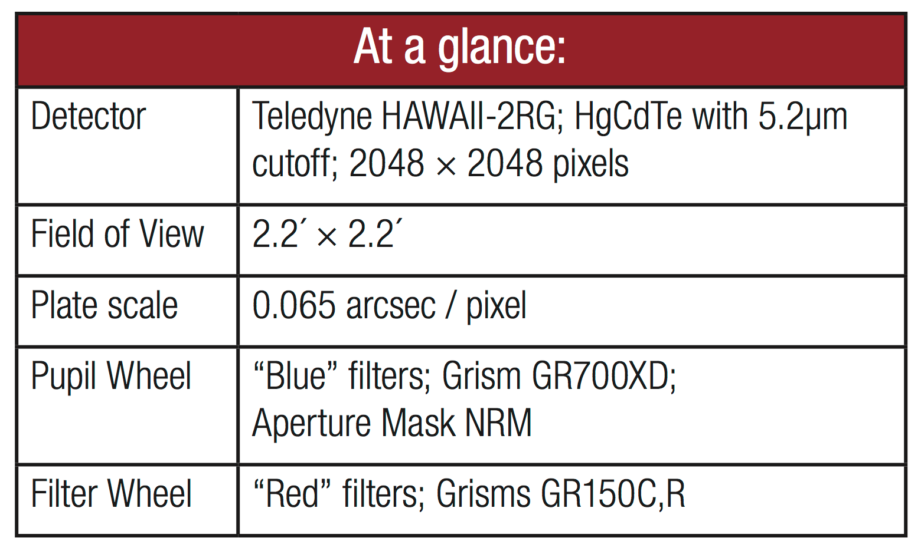
NIRISS overview ¹
¹ http://www.stsci.edu/jwst/instruments/niriss/docarchive/NIRISS-pocket-guide.pdf

Slide 5
Dual wheel optical elements

Slide 6
Outline
Instrument overview
Observing modes
NIRISS GTO program overview

Slide 7
Observing modes summary
Single-Object Slitless Spectroscopy (SOSS)
  Optimized for relatively bright stars (e.g. exoplanet transiting systems).
  Wavelength range: 0.6 – 2.8 μm
  Spectral resolution: 500-1500
  Brightness limit: J~7
Aperture Masking Interferometry (AMI, high-contrast imaging)
  Wavelength range: 3.8 – 4.8 μm.
  Three medium-band (5-8%) filters.
  Contrast: 10⁻⁴ between 70 and 500 mas on 5th magnitude star at 4.8 μm.
Wide-Field Slitless Spectroscopy (WFSS)
  Main application for high-z galaxies
  Wavelength range: 0.8 – 2.2 μm
  Spectral resolution: 150
  Line flux sensitivity requirement (10σ 10⁴s): 5.4 x10⁻¹⁸ ergs/cm² at 1.4 μm with F140M filter.
Broad-band imaging (BBI)
  7 NIRCam filters: F090W, F115W, F150W, F200W, F277W, F356W, F444W
  Mode used in support of WFSS observations.
  Can be used as extra field in parallel with NIRCam imaging.
  Instrument could be used without filters to be operated as a guider.
Provide unique science modes plus backup of NIRCam and NIRSpec modes

Slide 8
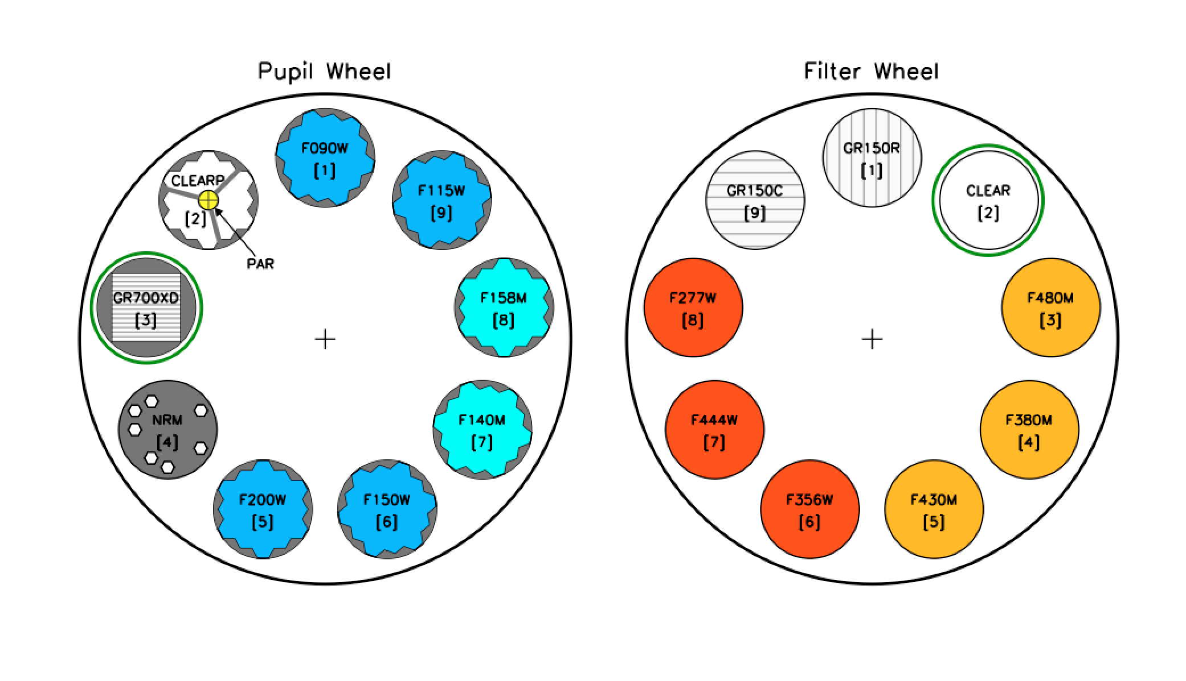
Single Object Slitless Spectroscopy

Slide 9
Single Object Slitless Spectroscopy
Specifically optimized for transit spectroscopy
  Grism with built-in defocussing weak lens to increase dynamic range and minimize systematic ‘’red noise’’ due to undersampling and flatfield errors
  Optical implementation to the successful « scanning mode » used on HST
Broad simultaneous wavelength range: 0.6-2.8 um
  Cross-dispersed (orders 1 and 2), no blocking filter.
Spectral resolution: ~1000 (700 @ 1.2) um in first order
  500-1600 across wavelength range

Slide 10
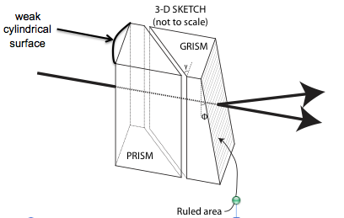
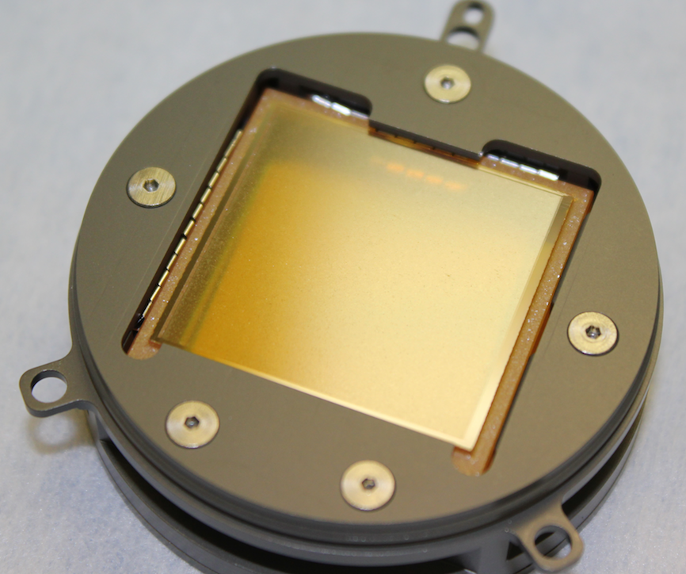
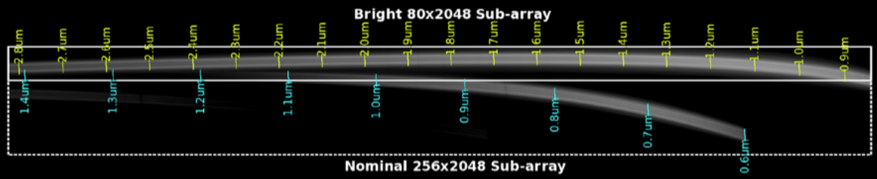
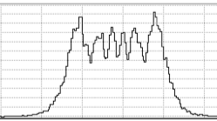
SOSS Hardware implementation
CV3 monochromatic PSF
Monochromatic PSF measured in the lab
λ
FWHM
Trace Width (defocus)

Slide 11
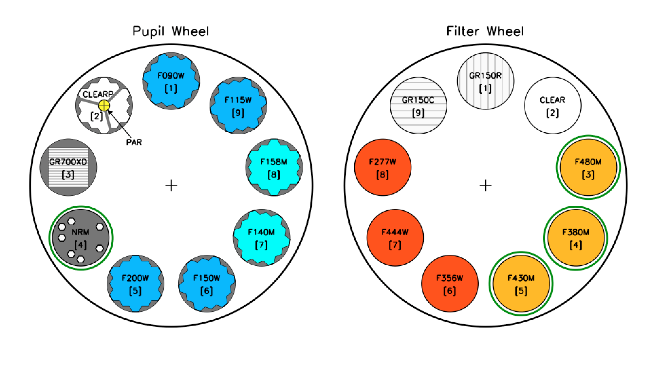
Aperture Masking Interferomery (AMI)

Slide 12
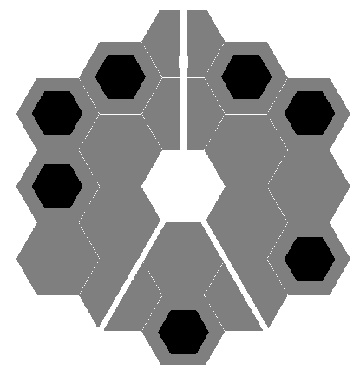
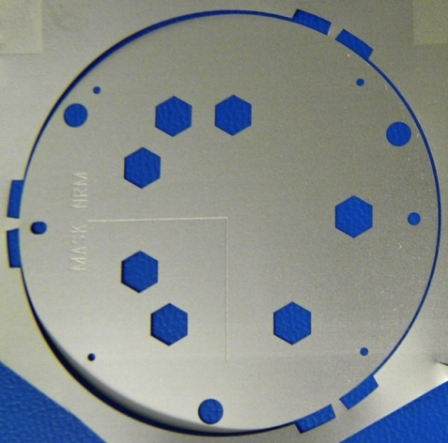
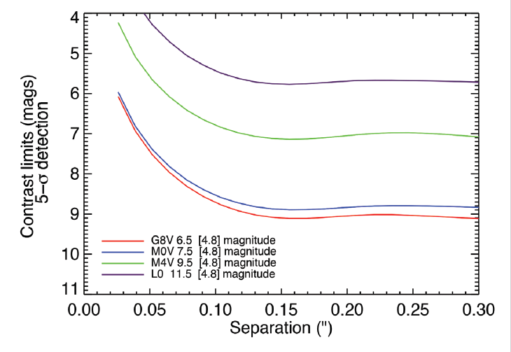
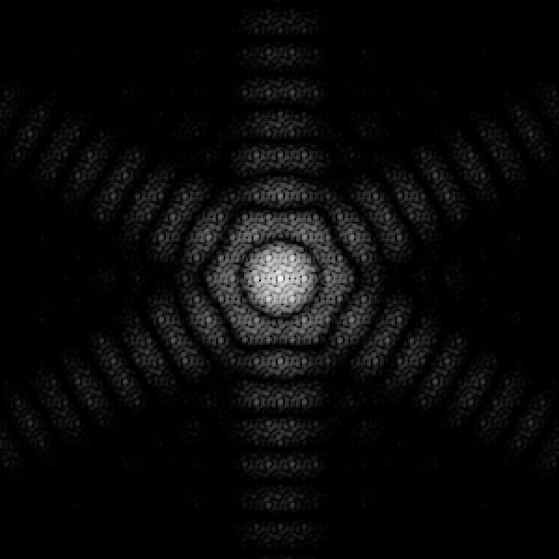

Aperture Masking Interferomery (AMI)
Probe separations of ~40 to 400 mas
At contrast of up to 9 mag
Filters: F380M, F430M, F480M, (and F277W)
7-aperture mask, in pupil wheel
Ground-based L’ & M’ limits
Image recorded at detector: interferogram
Its Fourier transform amplitude (and phase)
→reveals presence of companion

Slide 13
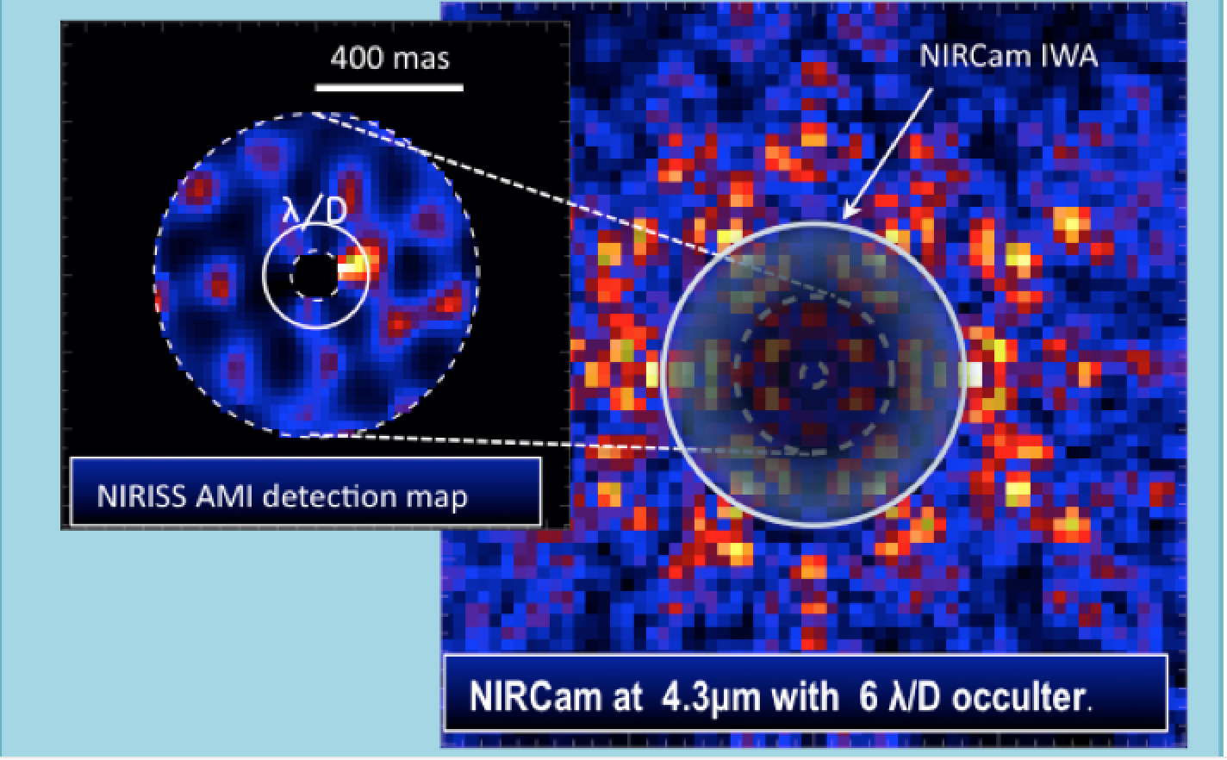
Probing JWST’s highest angular resolution
Simulation of 1-2 Mjup planet at 1 AU of an M0V located at 10 pc. Observing time: 3 hrs

Slide 14
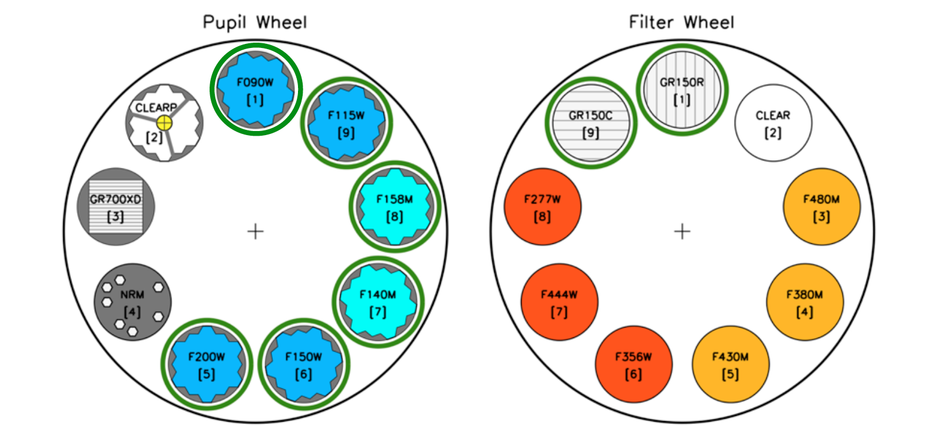
Wide field slitless spectroscopy (WFSS)
NIRISS can do wide-field slitless spectroscopy in FOV 2.2’ x 2.2’
Two orthogonal R=150 grisms and six blocking filters from 0.9 to 2.2 microns

Slide 15
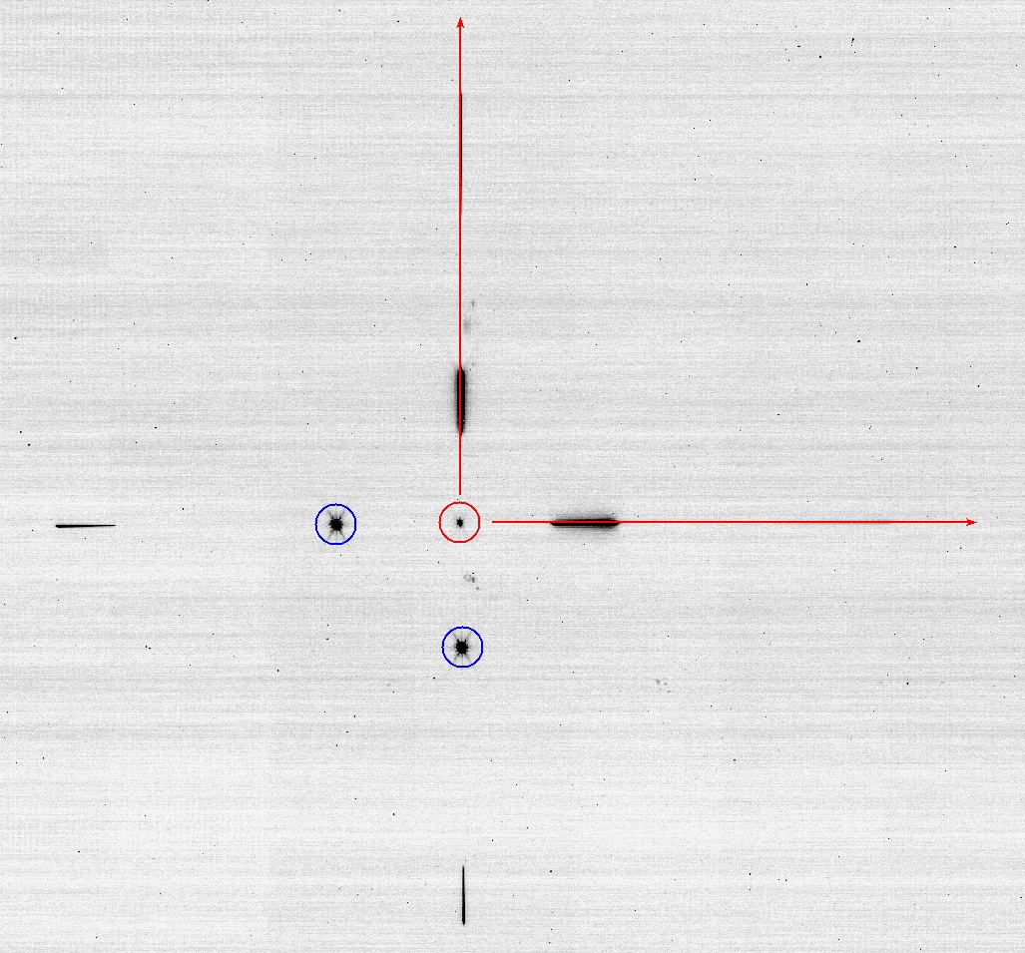
Wide field slitless spectroscopy (WFSS)
What is NIRISS Wide-Field Slitless Spectroscopy capable of?
Spectra of all objects in the field
In a ‘’blank’’ field there are ~3000 galaxies at mag < 28 ➔ high multiplex factor
Almost complete spectral coverage from 0.9 to 2.2 microns
At least one strong emission line from z=0.5 to z=4.9. Ly alpha if present at 6<z<17
Resolving power 100 to 200. Most spectral lines are unresolved, so a map of emission line is possible with WFSS.
Spatial resolution: 0.06’’ ~0.5 kpc
Cross-dispersed grisms to mitigate contamination
Point-and-shoot observing – no target acquisition
Ideal for pure parallels due to simple operation
CV3 data

Slide 16
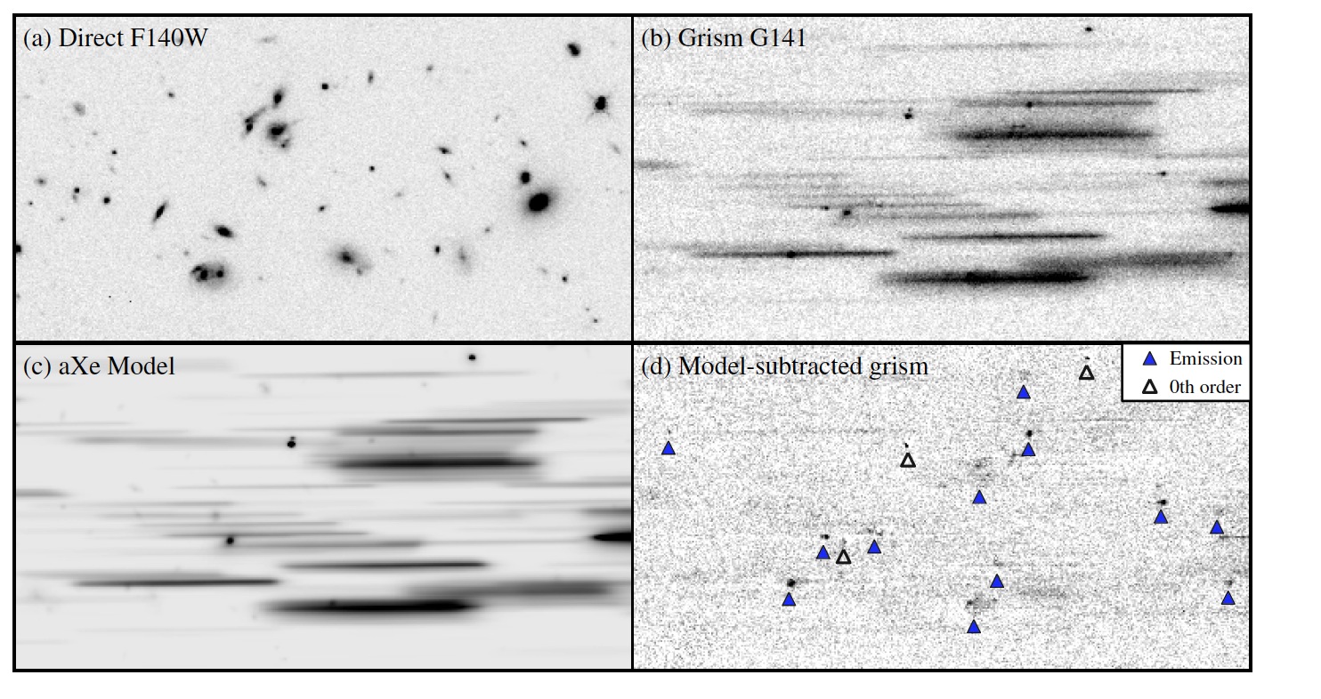
Surveys with WFC3-IR on HST have highlighted
capabilities of space-based near-IR grisms
Brammer et al. 2012.

Slide 17
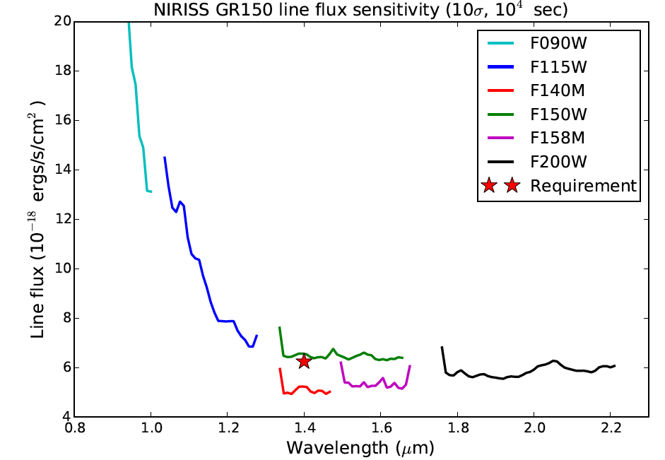
Wide field slitless spectroscopy
Model emission line sensitivity with various band-limiting filters

Slide 18
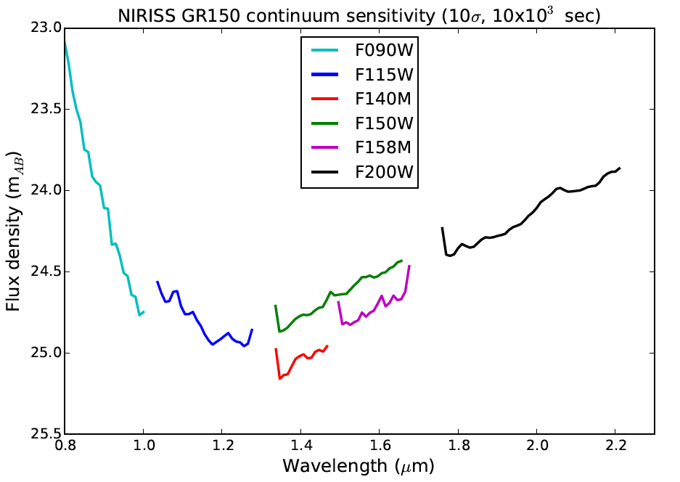
WFSS continuum sensitivity

Slide 19
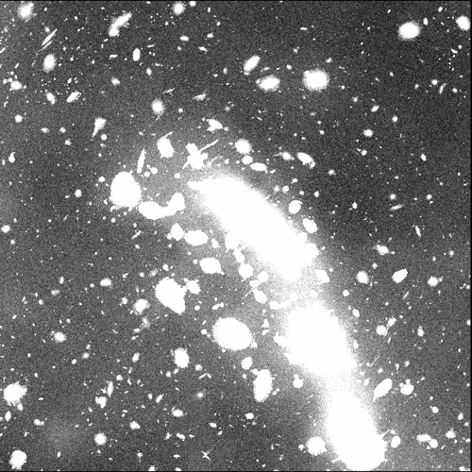
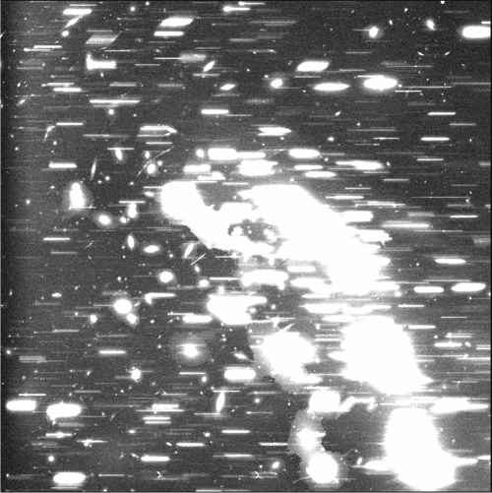
WFSS simulations of Frontier Field MACS0416
F200W + clear
F200W + GR150R

Slide 20
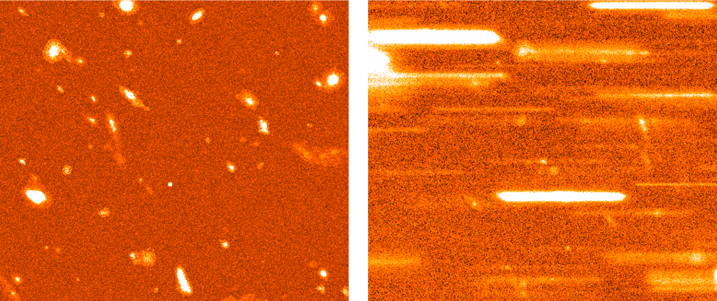
WFSS simulations of Frontier Field MACS0416
Zoom-in to 1% of the field shows many faint galaxies with emission lines
F200W + clear
F200W + GR150R

Slide 21
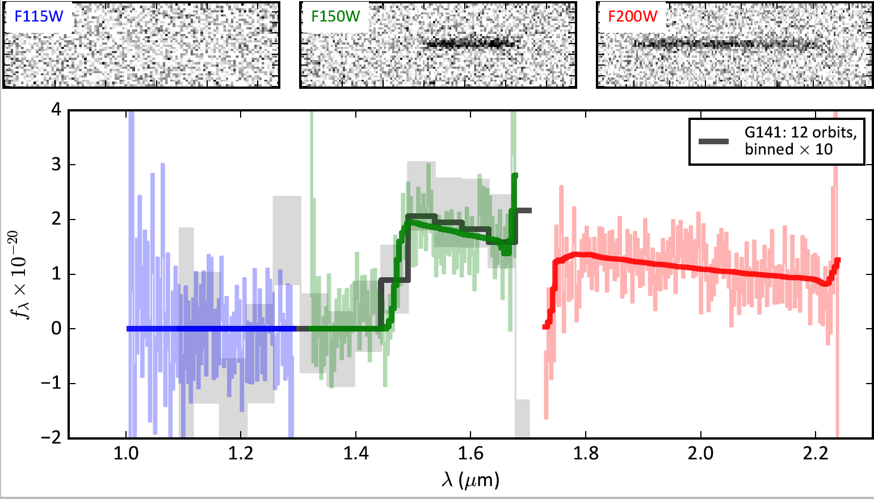
WFSS simulations of GN-z11
Below is a NIRISS simulation of Oesch et al. (2016) z=11 galaxy
Exposure time: ~3 hours per filter
NIRISS WFSS will get continuum break redshifts even if no Lyman-α
Oesch et al. 2016

Slide 22
Outline
Introduction – historical background
Instrument overview
Observing modes
NIRISS GTO program overview

Slide 23
NIRISS GTO in brief
NIRISS team has 450 hrs (wall clock time)
Two core programs
  High-z galaxies with WFSS (~200 hrs)
  Exoplanet characterization (~200hrs)
    Transit, eclipse and phase curve spectroscopy with SOSS
    High-contrast imaging with AMI
Miscellaneous programs (~50 hours)
  AGN imaging with AMI
  Sub-stellar IMF in young clusters with WFSS
  …

Slide 24
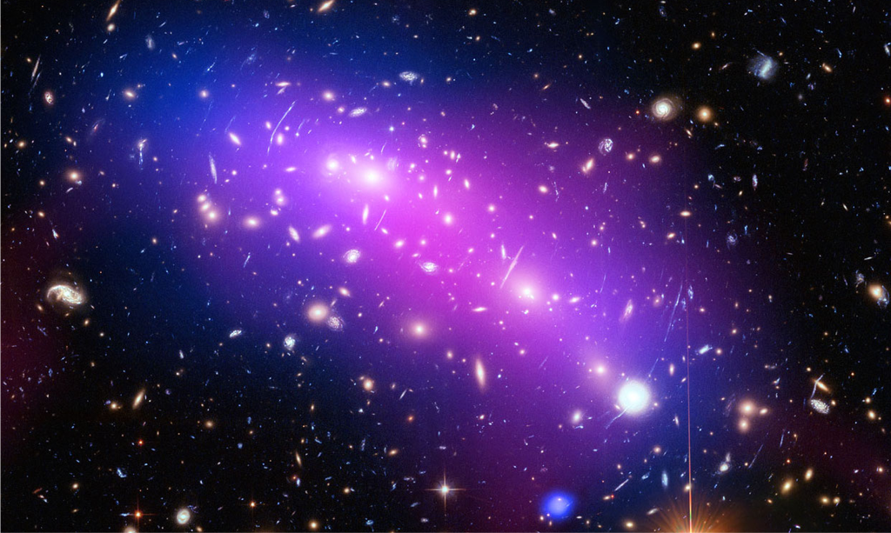
The Canadian NIRISS Unbiased Cluster Survey
NIRISS High-z Working Group
Bob Abraham
Loic Albert
Gabe Brammer
Pierre Chayer
Van Dixon
Rene Doyon
Jean Dupuis
Laura Ferrarese
Paul Goodfrooij
John Hutchings
Andre Martel
Swara Ravindranath
Marcin Sawicki
Chris Willott
Studying the Universe in and behind massive lensing clusters

Slide 25
Science Goals
Primary
The Evolution of Dwarf Galaxies
Galaxies in the Reionization Epoch
Massive Clusters and Cosmography
Secondary
Quenching
Merger Rate
Environments
Transients
The proposed survey emphasizes two unique features of Wide Field Slitless Spectroscopy with NIRISS:
Very high multiplex factor
Spatially-resolved emission lines

Slide 26
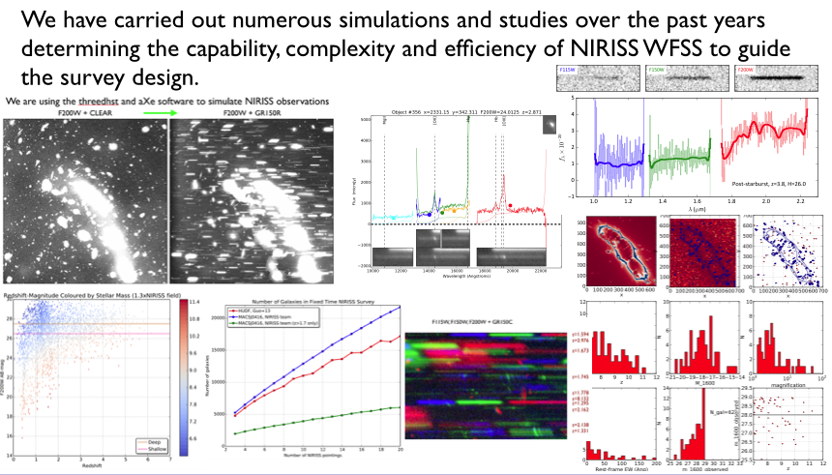
Survey Design

Slide 27
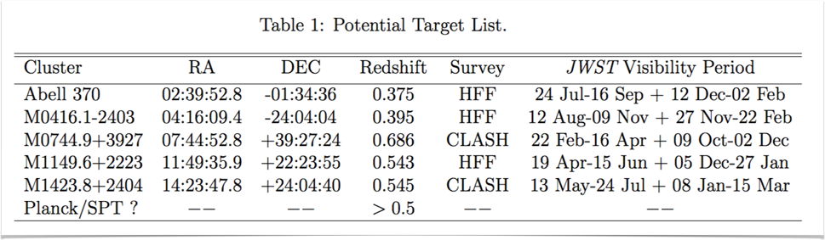
Survey Design
We will observe six strong-lensing galaxy cluster fields at 0.35<z<0.7. Large sample of distant galaxies (~3000 at z>1.7).
The NIRISS integration time of 6.3 hours per filter will produce unrivalled deep slitless spectroscopy more than an order of magnitude deeper than previous studies with Hubble at much higher spatial resolution and wider wavelength range.
Target list to be finalized April 2017.

Slide 28
Summary
NIRISS has unique and complementary/redundant capabilties with NIRCam (imaging) and NIRSpec (MOS).
NIRISS Wide-Field Slitless Spectroscopy provides a powerful alternative/complement to NIRSpec MOS when high redshift completeness required.
Low resolution grism spectroscopy particularly important for emission line maps of low-luminosity galaxies

