Slide 1
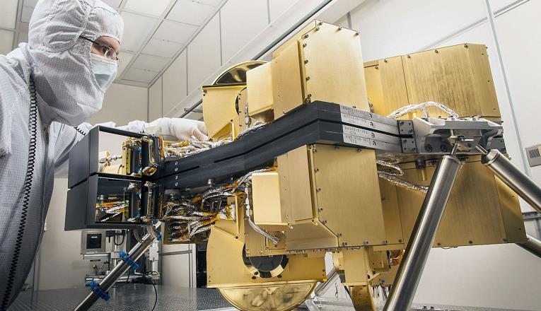
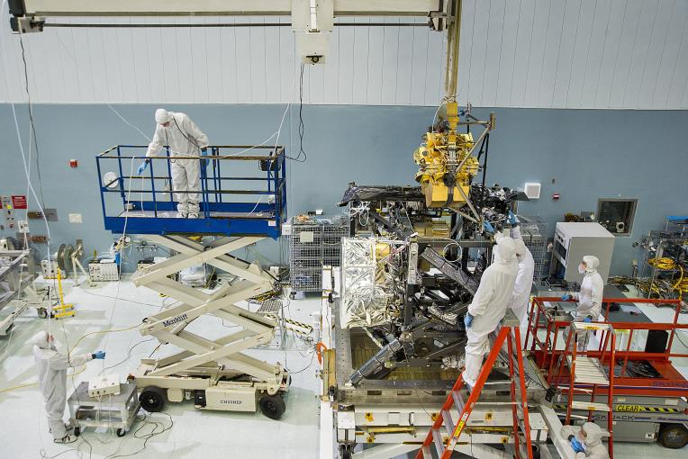
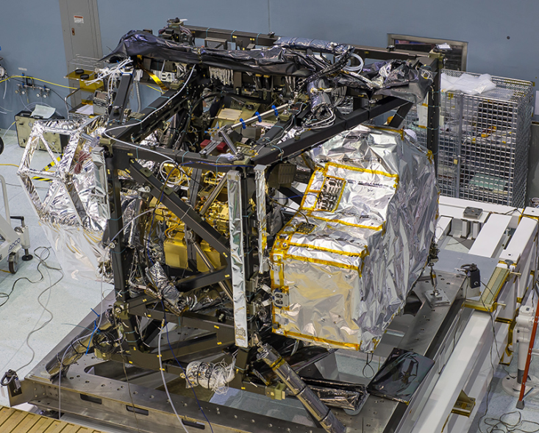
NIRCam: 0.6 to 5 Micron Imager

Slide 2
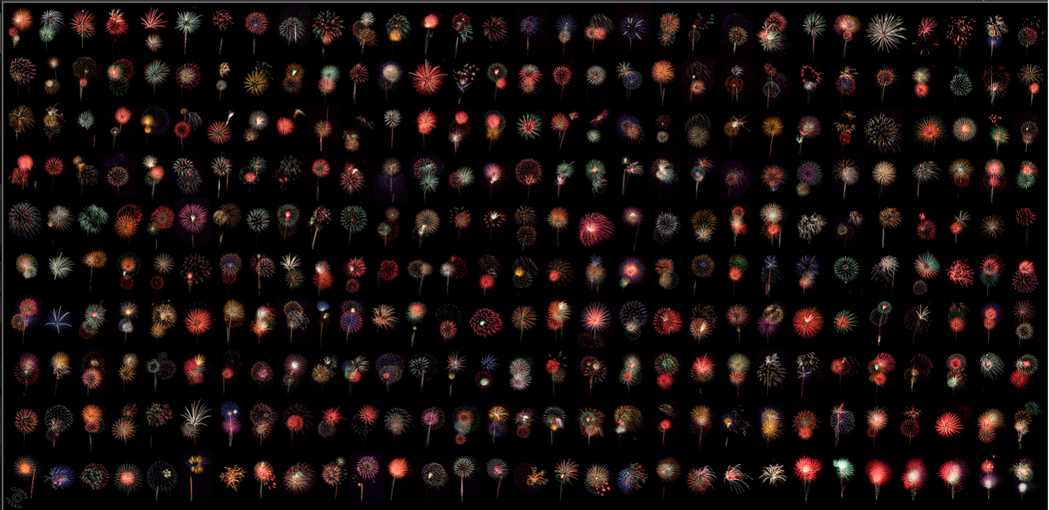
NIRCam : Your Next Near-Infrared Camera in Space
Marcia Rieke for the NIRCam Exgal Team
Stefi Baum, Alan Dressler, Eiichi Egami, Daniel Eisenstein, Laura Ferrarese, Brenda Frye, Kevin Hainline, Don Hall, Gerald Kriss, Simon Lilly, George Rieke, Brant Robertson, Dan Stark, Christina Williams, and Christopher Willmer
4th of July in Tucson

Slide 3
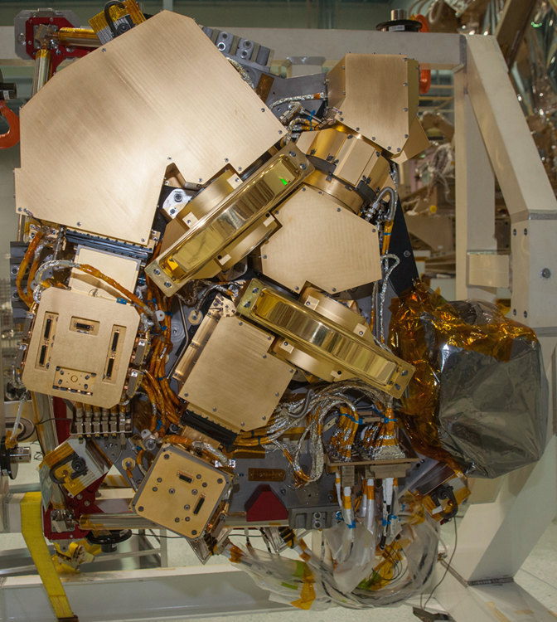
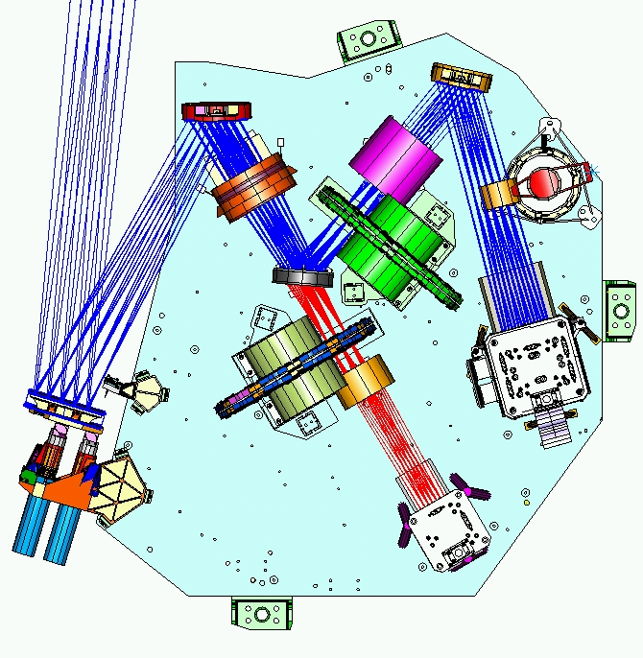
Design Overview
  Fully redundant with mirror image A and B modules
  Refractive optical design
  Thermal design uses entire instrument as thermal ballast ; cooling straps attached to the benches
  SIDECAR ASICs digitize detector signals in cold region
  Uses two detector types – 2.5 μm cut-off HgCdTe and 5 μm cut-off HgCdTe (this one is same as used on NIRSpec & NIRISS)
Light from Telescope
Short wave camera lens group
First fold mirror
Short wave fold mirror
Collimator lens group
Dichroic beamsplitter
Pupil imaging lens assembly
Coronagraph
occulting masks
Short wave filter wheel assembly
Focus and alignment mechanism
Short wave focal plane housing
Long wave filter wheel assembly
Long wave focal plane housing
Long wave camera lens group

Slide 4
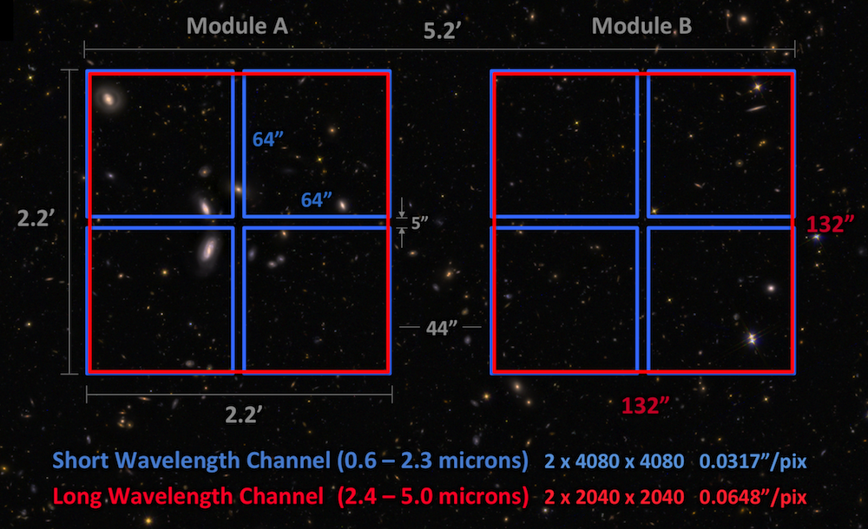
Deep Surveys: Design Driver for NIRCam
Figure courtesy of Dan Coe.

Slide 5
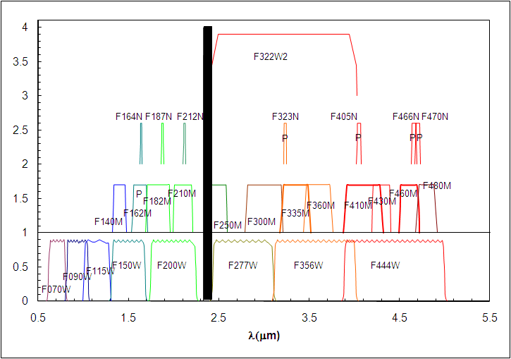
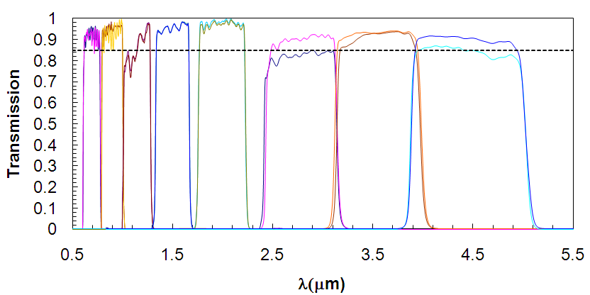
Pick Two Filters at a Time
Filters have names indicating wavelength (100x microns) and width (Wide, Medium, or Narrow)
Transmission of flight W filters.

Slide 6
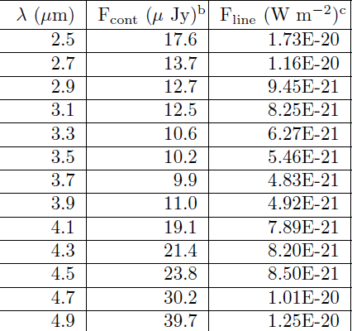
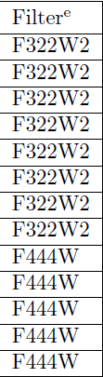
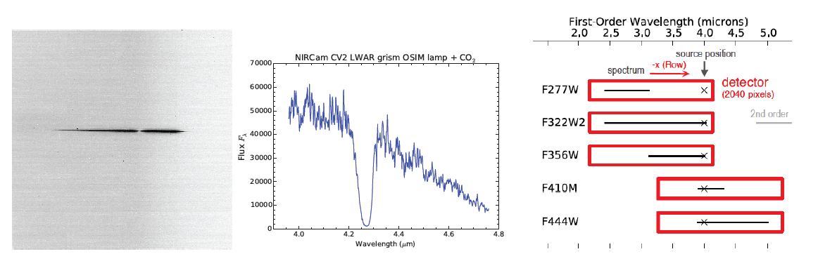
Slitless Grisms
Row and column-oriented grisms available in the long wavelength arms of NIRCam
Must be used in series with a bandpass filter
R ~ 1200 at 2.5 microns, 1550 at 5 microns
Both modules have grisms but Mod B will be ~16% less sensitive as the groove side of the grisms was not AR-coated
5-sigma in 1000 sec
CV2 Test Sample
See Greene et al. 2016 SPIE for more details.

Slide 7
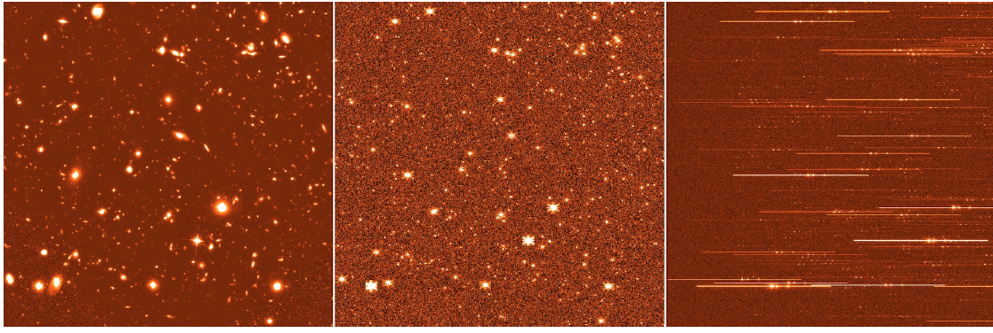
Grism Imagery
HST/WFC3-IR F160W
HUDF (65-hrs)
Simulated NIRCam F356W
(2-hrs)
Simulated NIRCam F356W + Row Grism (2-hrs)
The simulated grism exposure used z = 6 for all sources with a flat f_{ν} spectrum with emission lines from Hβ and [OIII] 4959/5007 with rest frame equivalent widths of 180, 200, and 600 Å respectively.
Simulations by E. Egami.

Slide 8
Redshifts & Wavelengths
From Massimo Robberto

Slide 9
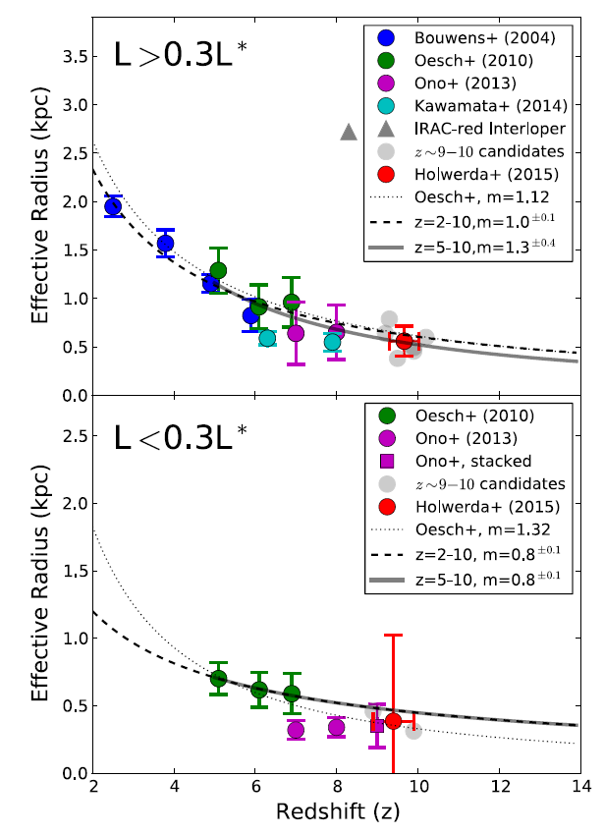
Angular Resolution
2 μm
3.6 μm
NIRCam resolution
JWST + NIRCam have enough resolution to study the structure of distant galaxies. The plots at right show the two-pixel resolution at 2 microns.
NIRCam resolution
Holwerda et al. 2015 ApJ, 808,6

Slide 10
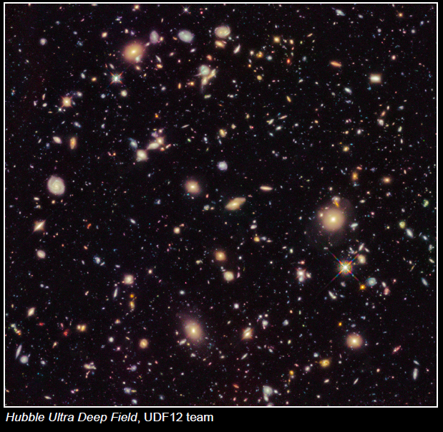
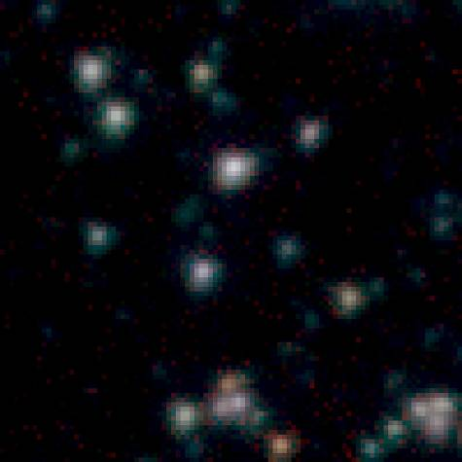
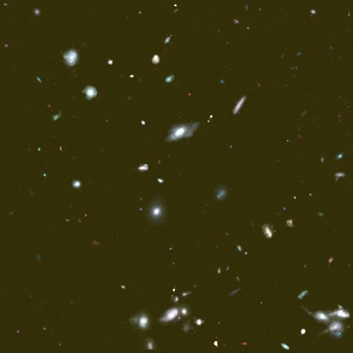
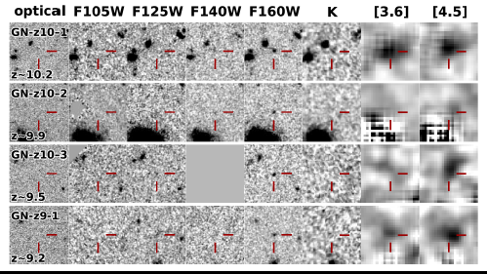
Full Near-IR Coverage is a Game Changer
1’x1’ region in the UDF – 3.5 to 5.8 μm
Spitzer, 25 hr/ band (GOODS)
JWST 1000s / band (sim)
Addition of high sensitivity images with good angular resolution at wavelengths longer than 1.6 microns is key!

Slide 11
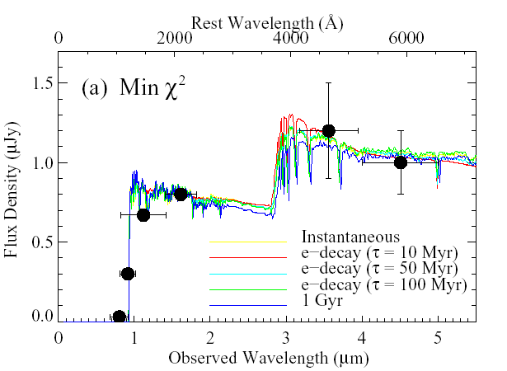
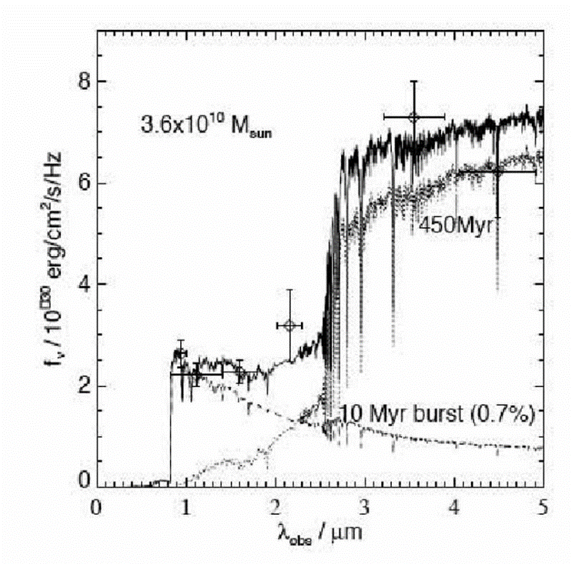
Period of Galaxy Assembly (2 < z< 7)
JWST brings the rest-optical diagnostics into play. Can do detailed studies of stellar mass, star formation, metallicity, size, morphology.
When/where do old stellar populations appear?
    constrain “old” stars in high-z galaxies by looking for the Balmer jump around 3800Å rest
What is the role of AGN?
How much variation is there in the specific star formation rates? In the morphology of star forming regions?
Environmental impacts, satellite galaxies, clustering.
Egami et al. 2005
Examples of the utility of the Balmer break.
Eyles et al. 2005

Slide 12
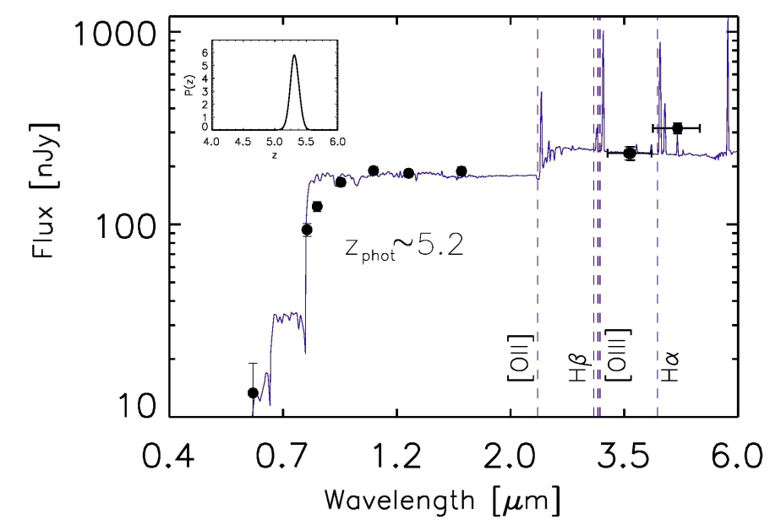
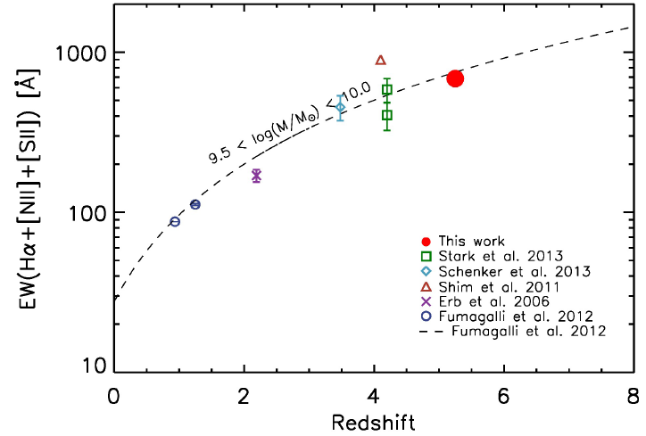
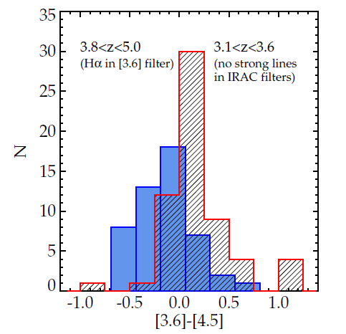
Interesting Complications
Some high redshift galaxies have very large emission-line equivalent widths. Deriving photo-zs from NIRCam data may be tricky because of this effect.
Rasappu et al. MNRAS submitted
Stark et al. 2013

Slide 13
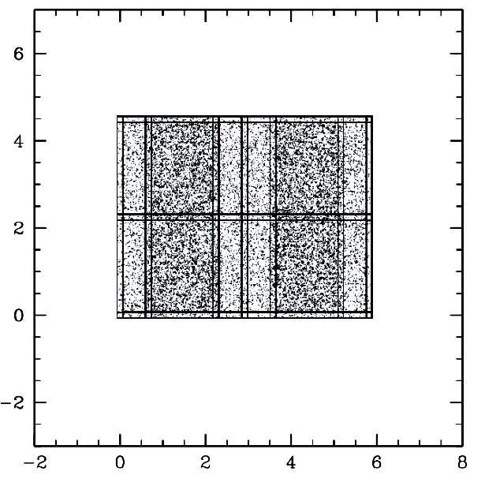
Sample Program
Use two base positions + dithers to cover an area that can then be efficiently studied with the 4 NIRSpec MSA quadrants
Use 4 filter setting pairs to cover 0.9 to 5 microns
F410M has essentially the same sensitivity as F444W but adds some z discrimination
UDF and HDF-N are likely spots
75 ksec / filter
Arc Min
37.5 ksec / filter
Arc Min
Sensitivities(10-σ) for the Deepest Survey
SW | F090W 5.5 nJy | F115W 4.7nJy | F150W 3.8 nJy | F200W 3.2 nJy
LW | F277W 4.9 nJy | F356W 4.1 nJy | F444W 7.9 nJy | F410M 8.1 nJy
z = 5

Slide 14
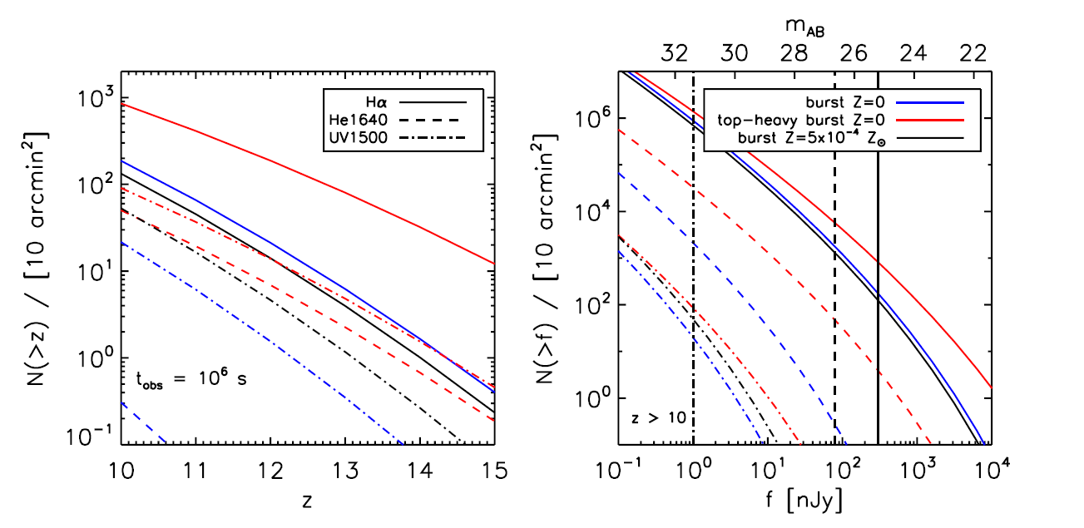
But Large Numbers at z>10 Not Expected
GTO Survey Limit
Pawlik wt al. 2011, ApJ, 731, 17

Slide 15
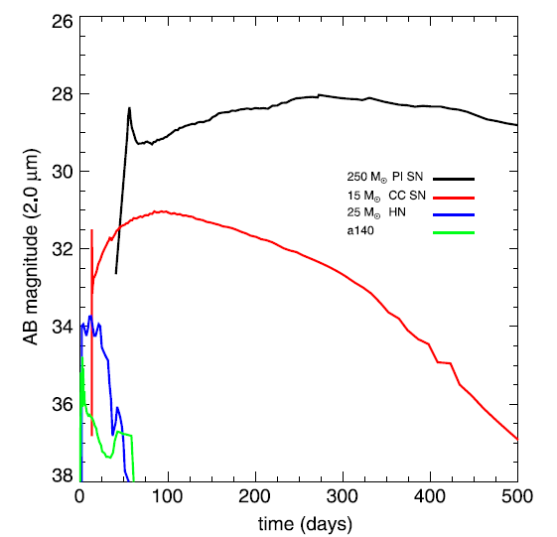

Supernovae
As shown at left, JWST will be able to detect Pop III SN from very massive stars.
However, very long times between exposures will be needed.
How many such SN per unit area on the sky?
Supernovae at z=15
NIRCam 5-σ 75ksecs
Smidt et al. 2015

Slide 16
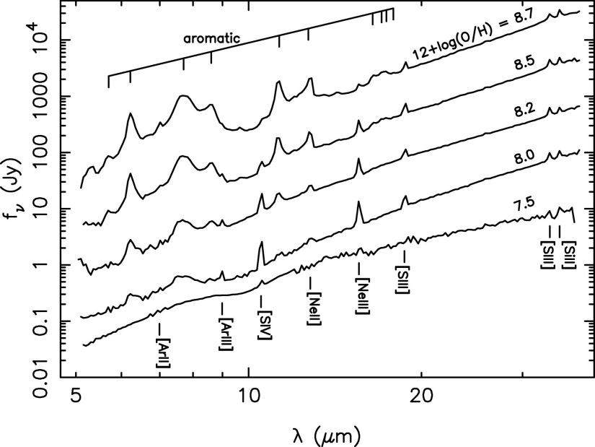
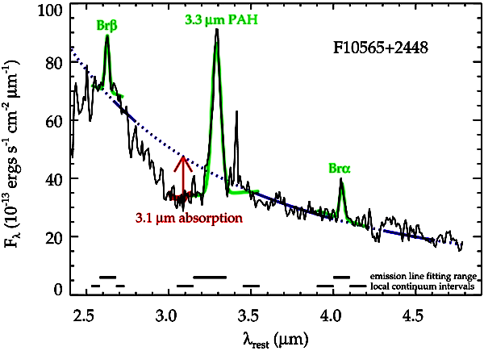
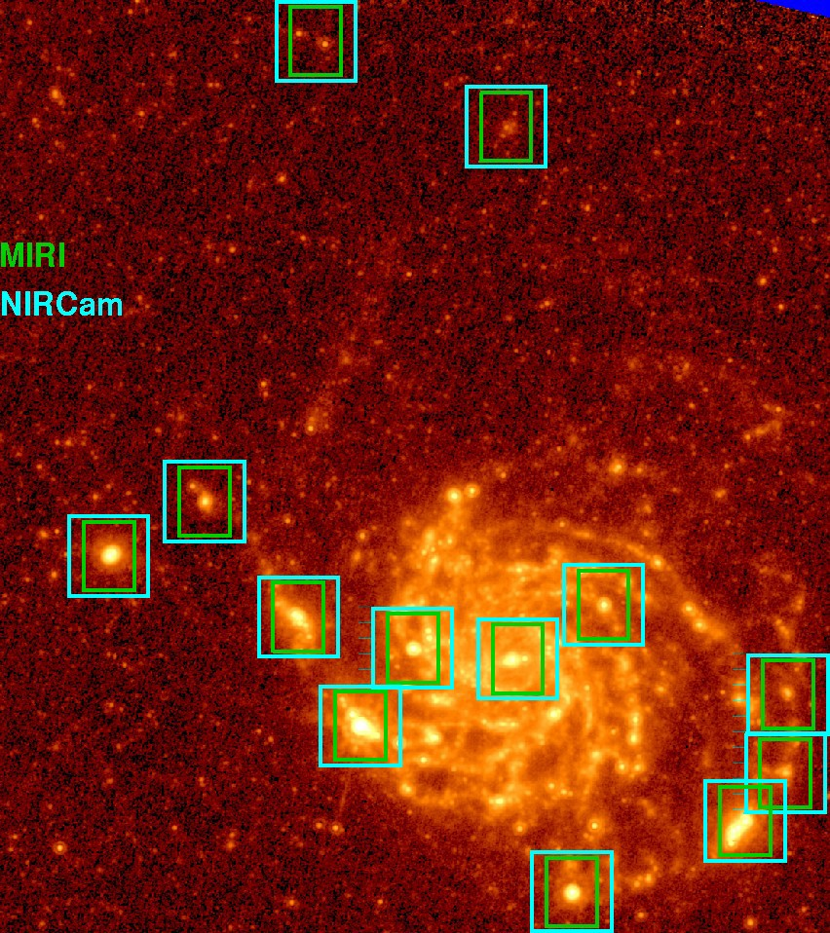
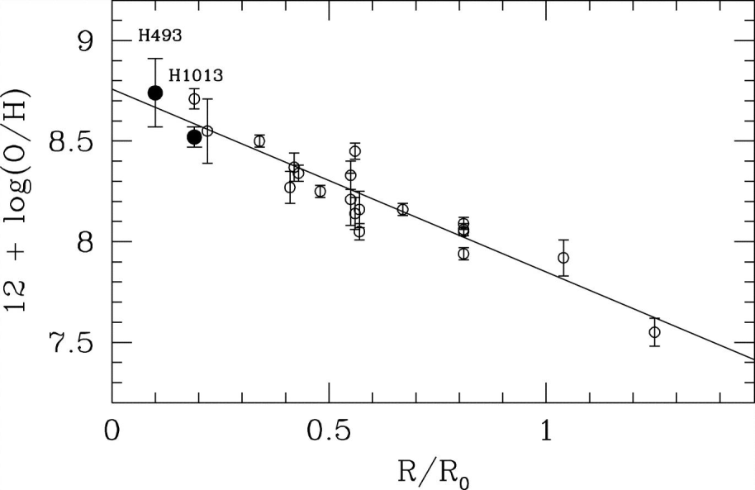
Nearby Galaxies
F335M
F405N
NIRCam could be used to study stellar populations and issues such as the excitation of PAHs and the relationship to metallicity.
Engelbracht et al. 2008 ApJ, 678, 804
Lee et al. 2012, ApJ.,756,95
M101 NIRCam resolution = 4pc
Kennicutt et al. 2003, ApJ, 591, 801; Bresolin 2007, ApJ, 656, 186

Slide 17
Summary
NIRCam has been designed to be efficient for surveying through the use of dichroics
The requirement for NIRCam to be fully redundant for its wavefront sensing role means that twice the area can be observed at once
NIRCam’s expanded wavelength range as compared to HST’s combined with HST-like angular resolution opens new avenues for studying galaxy assembly
Combining NIRCam imagery with MIRI, NIRSpec, and NIRISS data will let us address questions that have been completely out of reach until JWST

