Slide 1
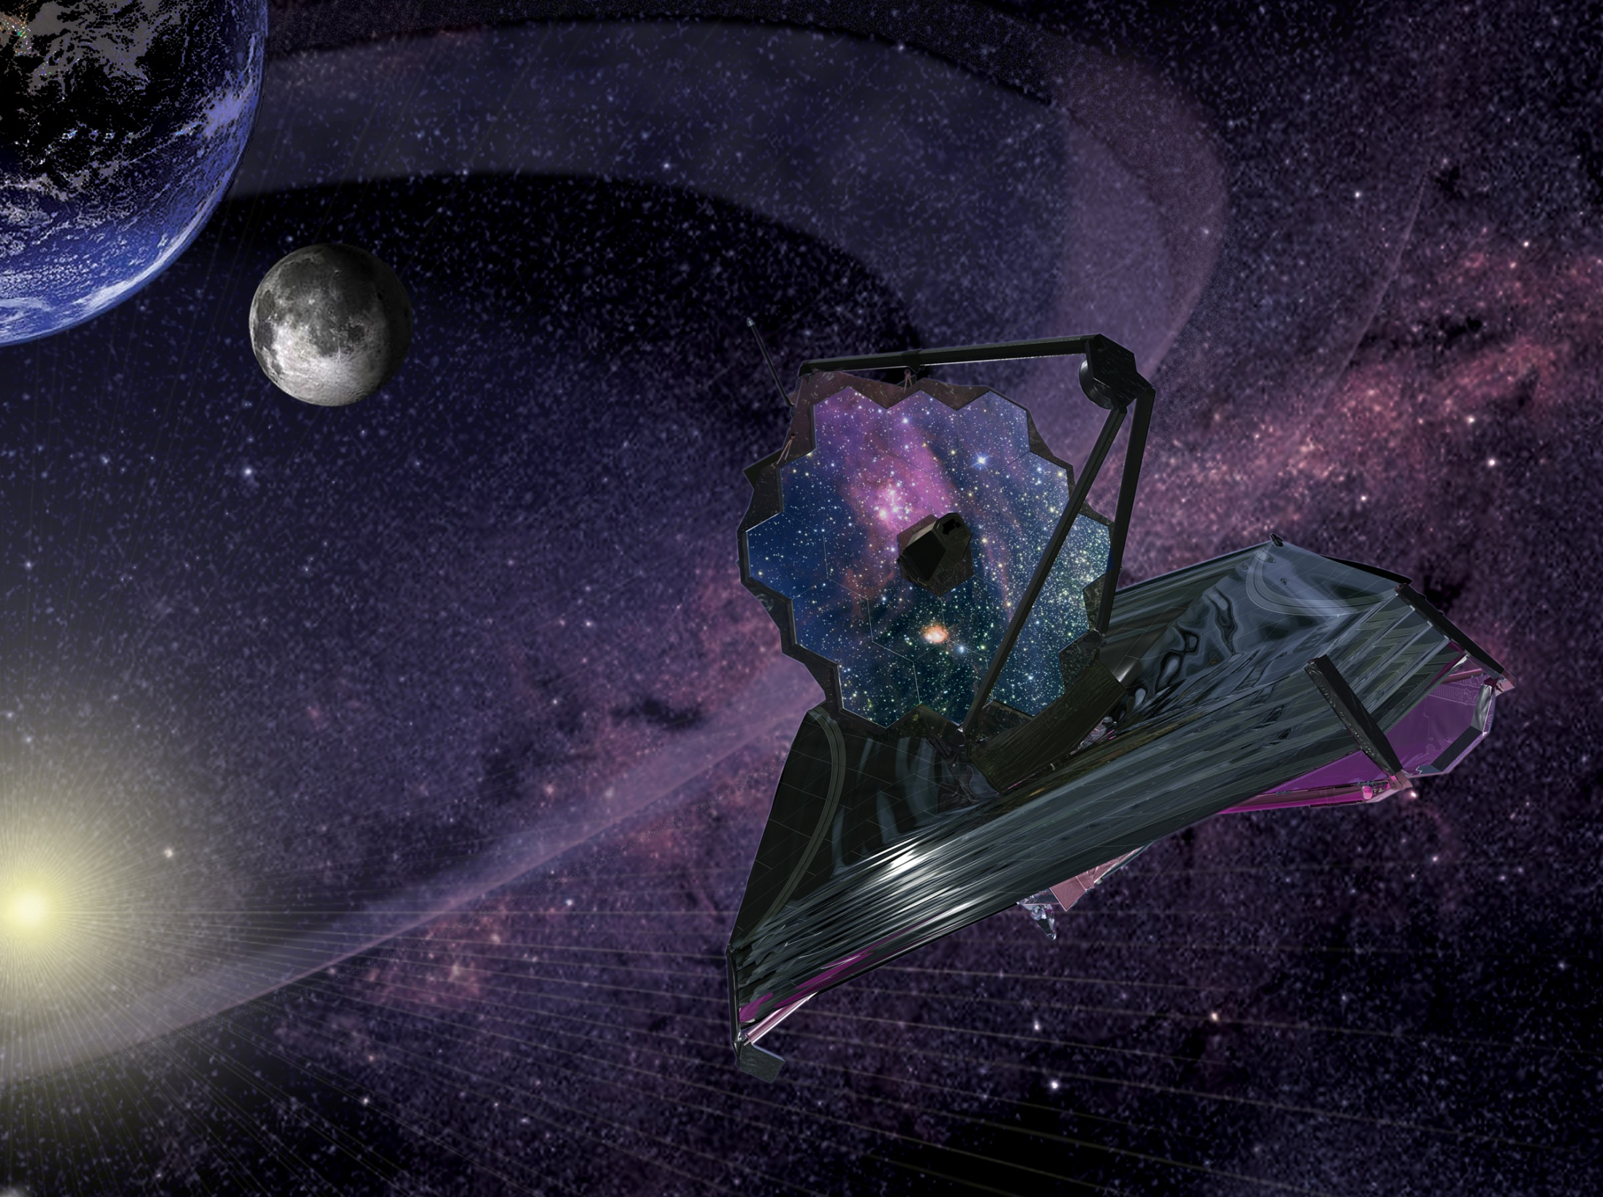
Status of the JWST Science Instrument Payload
Matt Greenhouse
JWST Project Office
NASA Goddard Space Flight Center
4 July 2016
@NASAWebbTelescp
#JWST

Slide 2
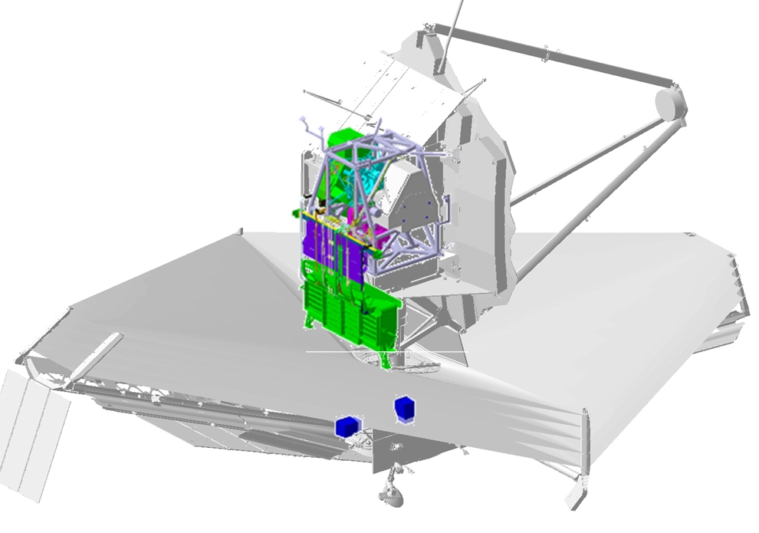
The Integrated Science Instrument Module (ISIM) is the science instrument payload of the JWST
ISIM is one of three elements that together make up the JWST space vehicle
Approximately 1.4 metric tons, ~20% of JWST by mass
Element-level I&T completed, ISIM was delivered to OTIS integration during March
The ISIM system consists of:
Five sensors (4 science)
MIRI, NIRISS, FGS, NIRCam, NIRSpec
Nine instrument support systems:
Optical metering structure system
Electrical Harness System
Harness Radiator System
ISIM electronics compartment
ISIM Remote Services Unit
Cryogenic Thermal Control System
Command and Data Handling System
Flight Software System
Operations Scripts System

Slide 3
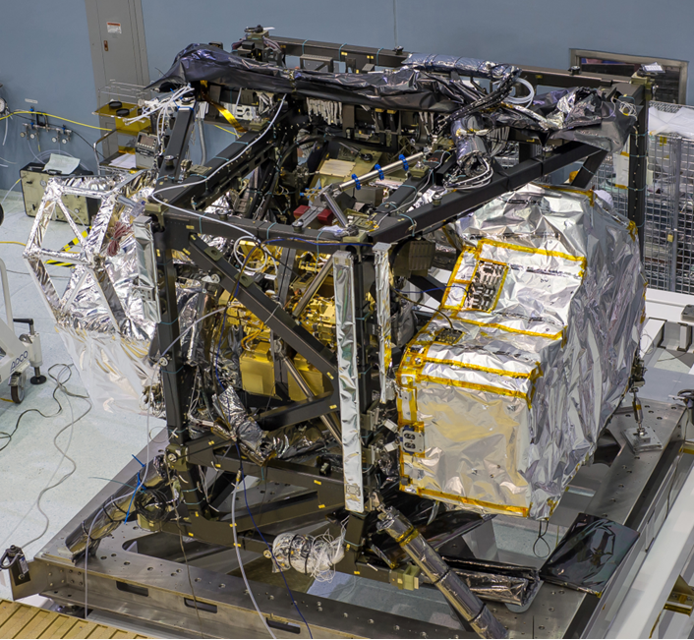
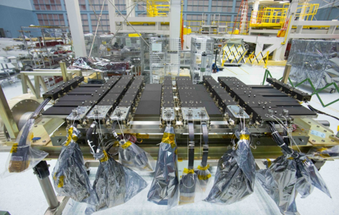
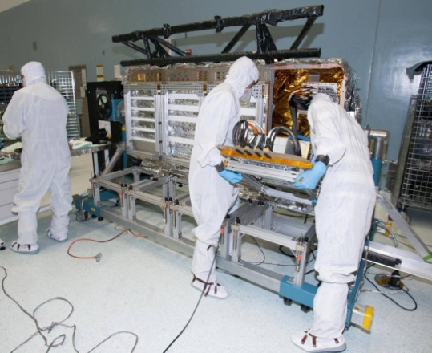
Three ISIM assemblies reside on the cryogenic side of the space vehicle
Four science sensors:
NIRCam, NIRSpec, NIRISS, MIRI
Fine guidance sensor (FGS)
Supports telescope pointing to ~ 10⁻⁶ deg
Optical metering structure
Sensor launch loads
Sensor optical alignment over ~250 deg ΔT
Harness Radiator (HR)
Passive cooling for ~2,700 electrical wires
Electronics Compartment (IEC)
Houses 11 electronics boxes
Manages 220 W power on cryo side of space vehicle
3

Slide 4
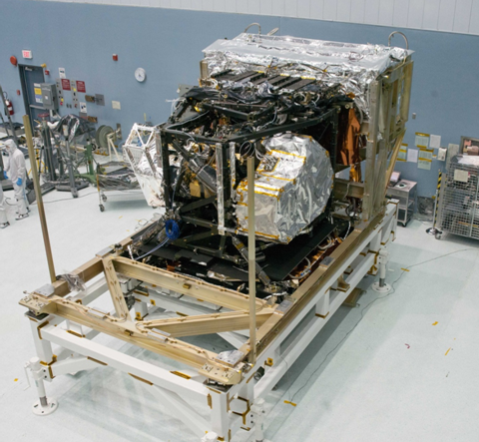
Flight ISIM test configuration
ISIM Electronics Compartment (IEC)
FGS/NIRISS
Harness Radiator (HR)
MIRI
NIRCam
NIRSpec
4

Slide 5
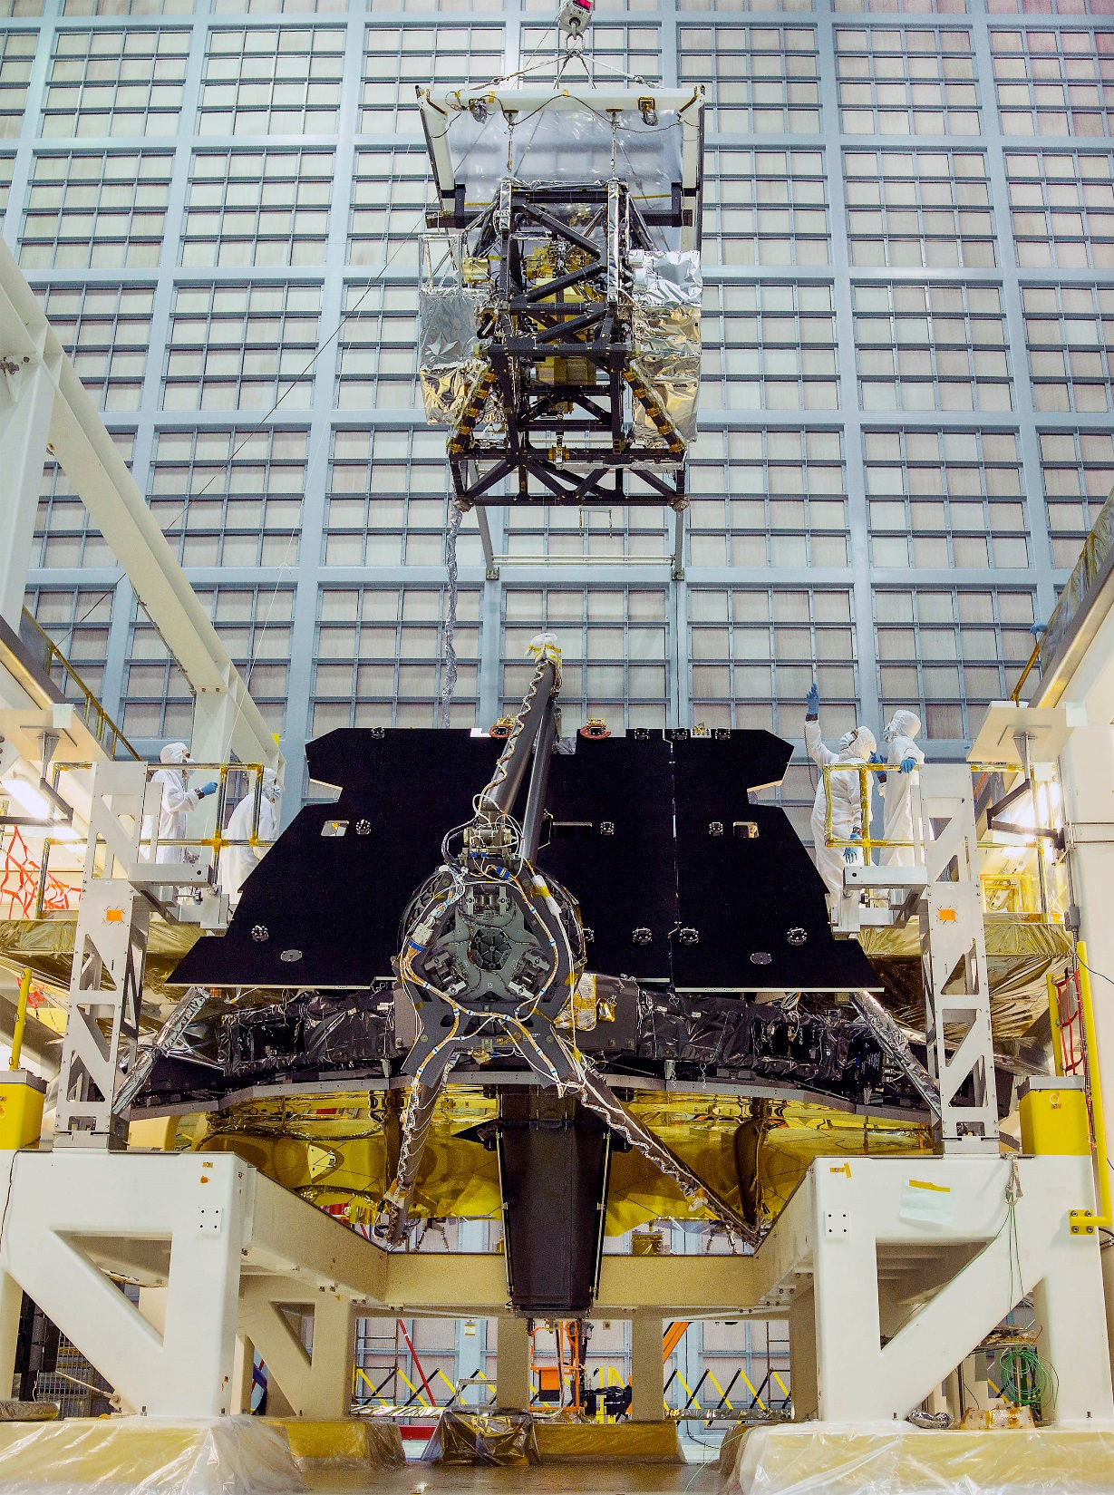
ISIM integration with OTE is on schedule for OTIS testing
Key 2016 integration milestones:
ISIM Prime module integration w/ OTE: May
MIRI FPE integration with IEC: Jun
FPE reworked after CV-3
IEC integration w/ OTE: Aug
Harness Radiator integration w/ OTE: Sep

Slide 6
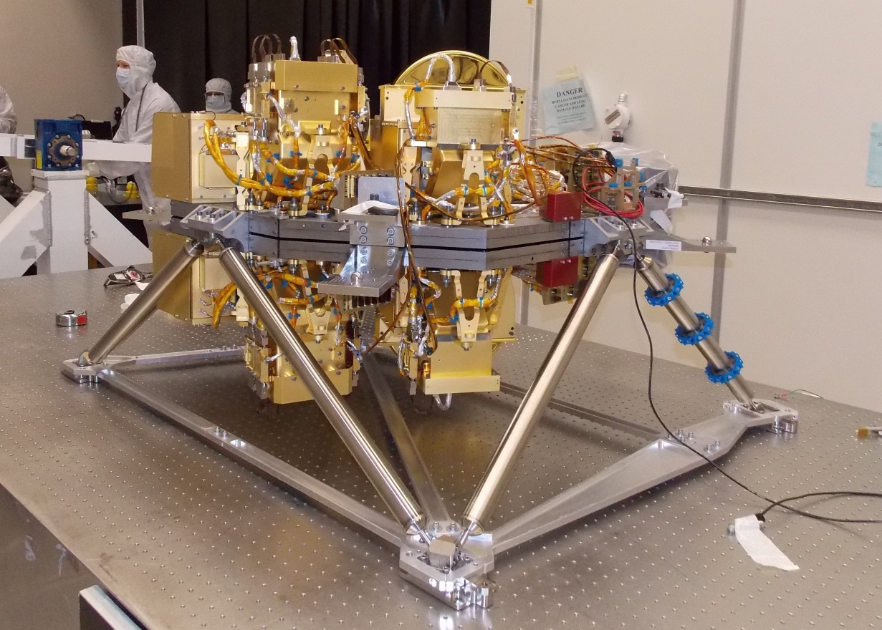
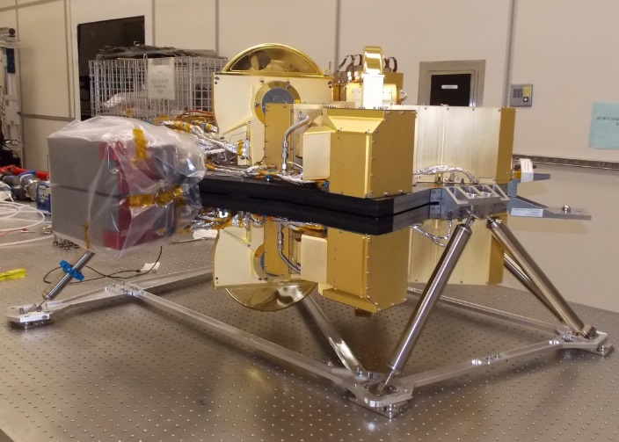
The NIRCam will image the earliest epoch of galaxy formation
NIRCam Flight Model

Slide 7
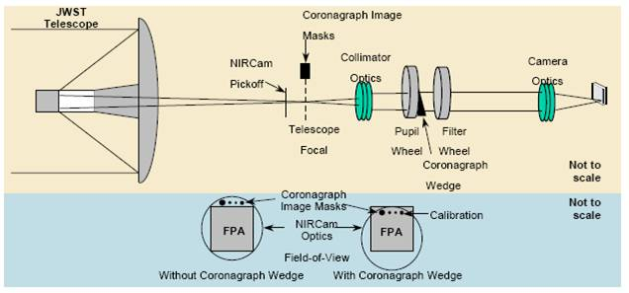
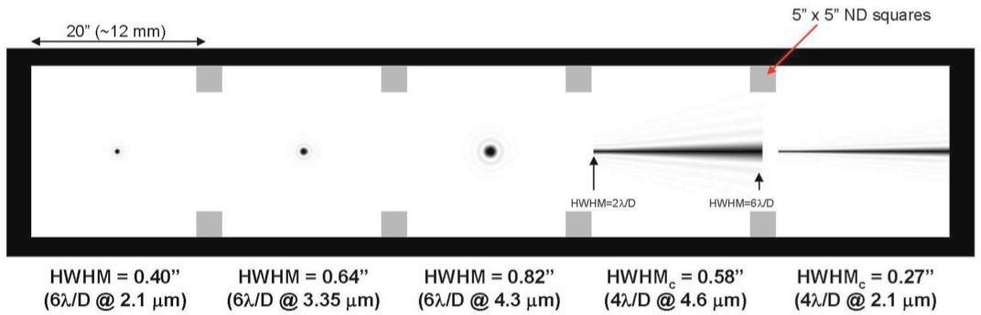
NIRCam will provide the deepest near-infrared images ever and will identify primeval galaxy targets for the NIRSpec
Developed by the University of Arizona with Lockheed Martin
Operating wavelength: 0.6 – 5.0 microns
Field of view: 2.2 x 4.4 arc minutes
Angular resolution (1 pixel): 32 mas < 2.3 microns, 65 mas > 2.4 microns
Imagery: R= 4, 10, 100 filters
Spectroscopy: grisim (slit-less) R~2000 2.4 – 5 microns
Coronagraph

Slide 8
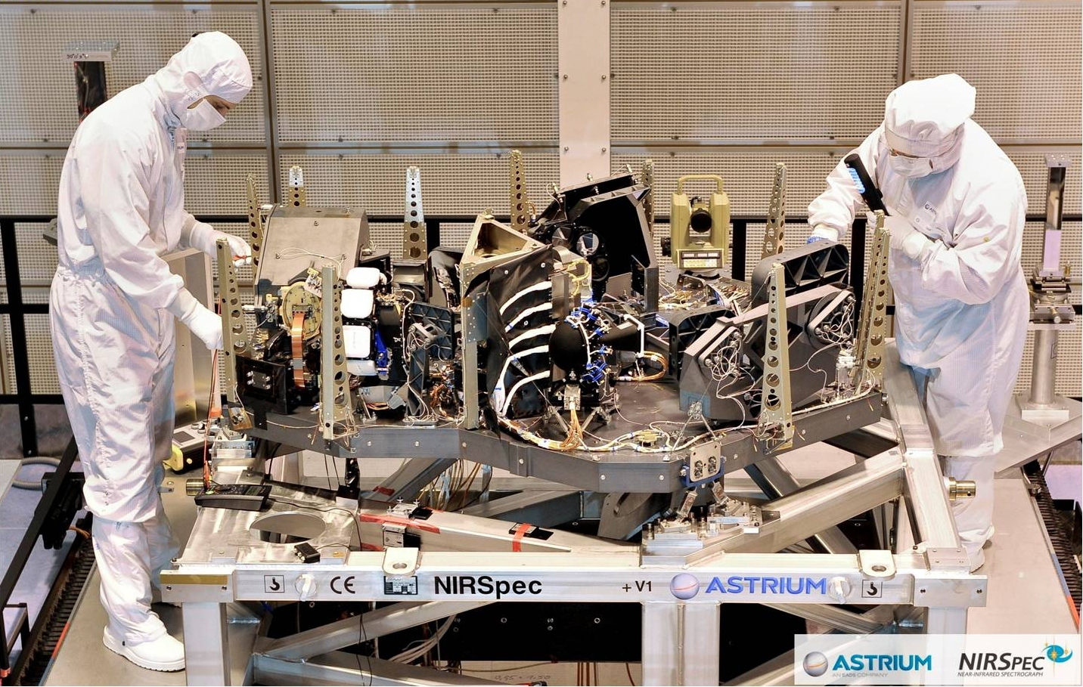
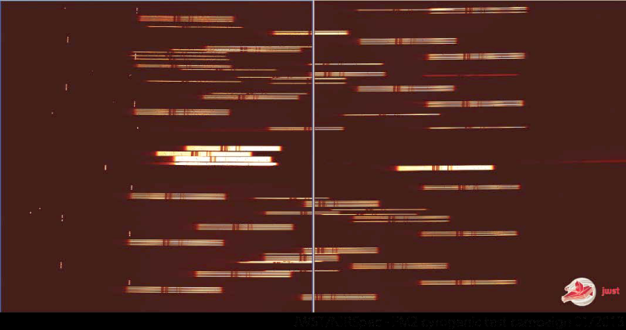
NIRSpec can obtain spectra of 100 compact galaxies simultaneously
FM2 test Jan 2013

Slide 9
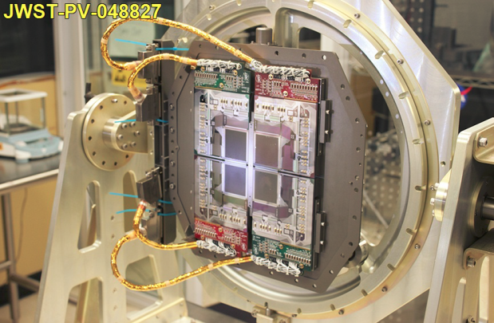
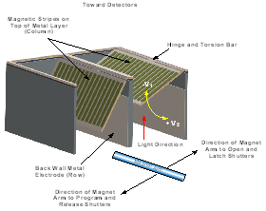
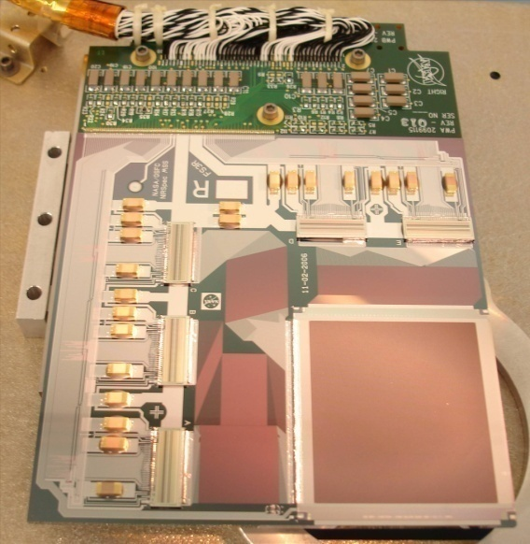
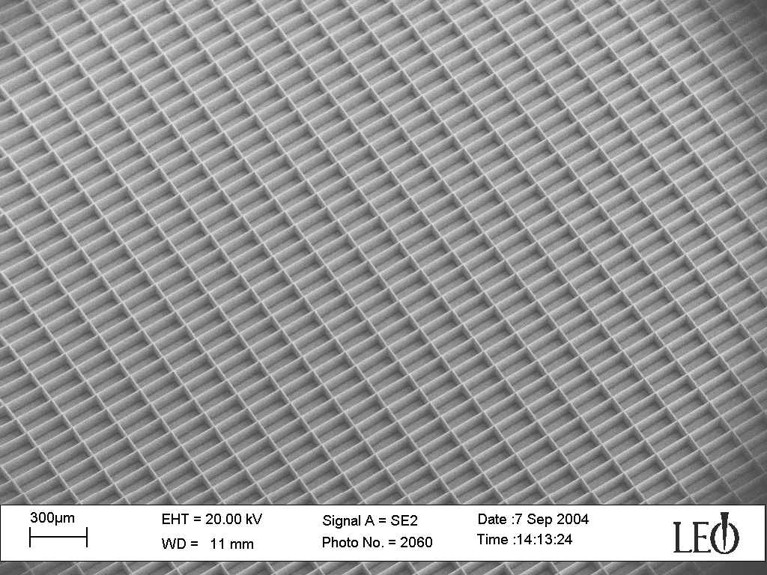
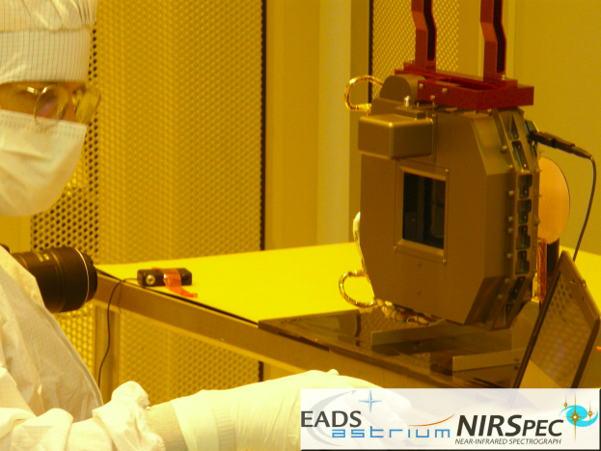
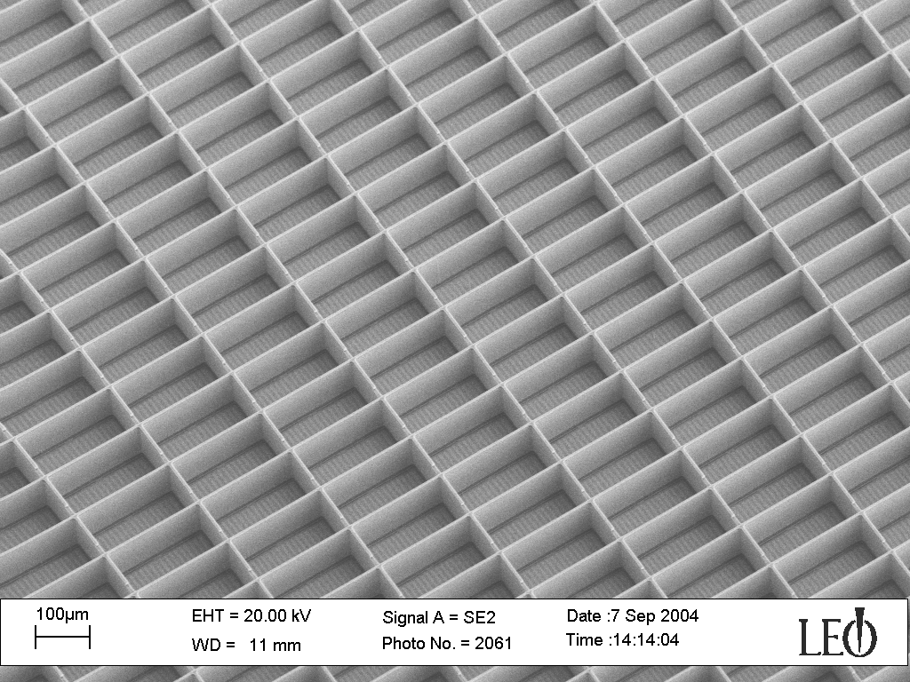
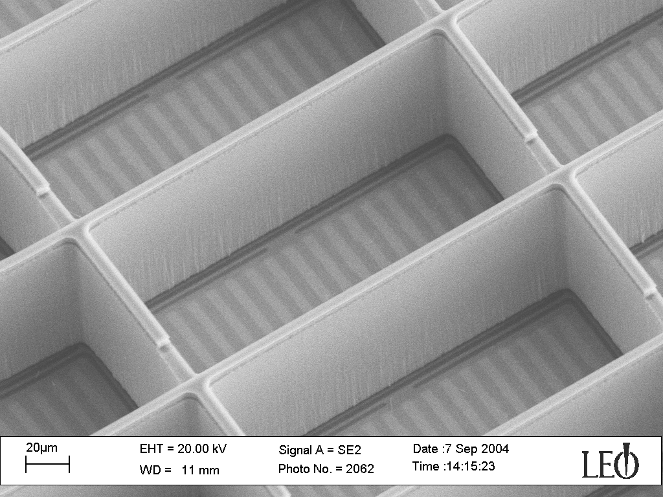
Aperture control: 250,000 programmable micro-shutters
203 x 463 mas shutter pixel clear aperture, 267 x 528 mas pitch, 4 x 171 x 365 array
Human Hair 90 um Dia.
Flight MSA

Slide 10
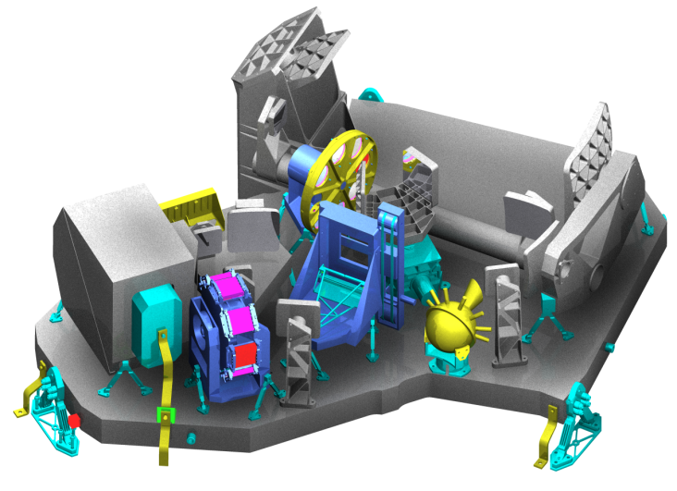
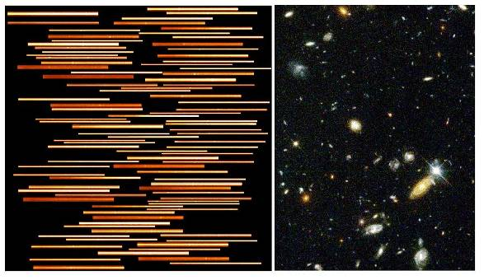
The NIRSpec will acquire near-infrared spectra of up to 100 objects in a single exposure
Developed by the European Space Technology Center (ESTEC) with Astrium and Goddard Space Flight Center
Operating wavelength: 0.6 – 5.0 microns
Spectral resolution: 100, 1000, 3000
Field of view: 3.4 x 3.4 arc minutes
Aperture control:
Programmable micro-shutters, 250,000 pixels
203 x 463 mas clear aperture (267 x 528 mas pitch)
Fixed long slits & transit spectroscopy aperture
200, 400, 1600 mas slit width
Image slicer (IFU) 3x3 arc sec FOV (100 mas slice width)
All aperture control modes available with any spectral resolution mode

Slide 11
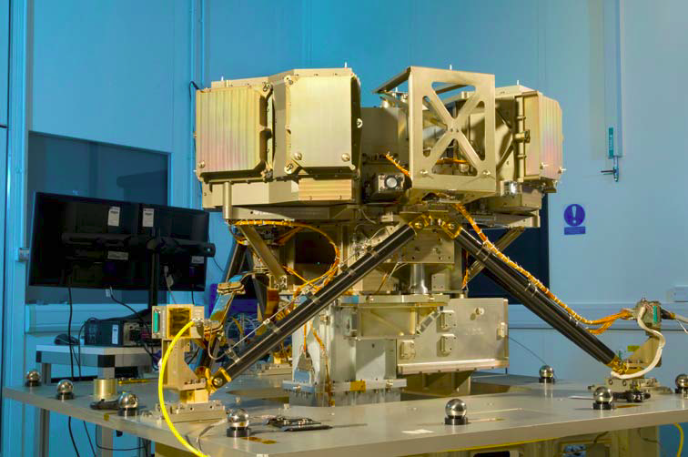
MIRI will provide the first high resolution imagery of the mid-infrared universe
x
MIRI flight model

Slide 12
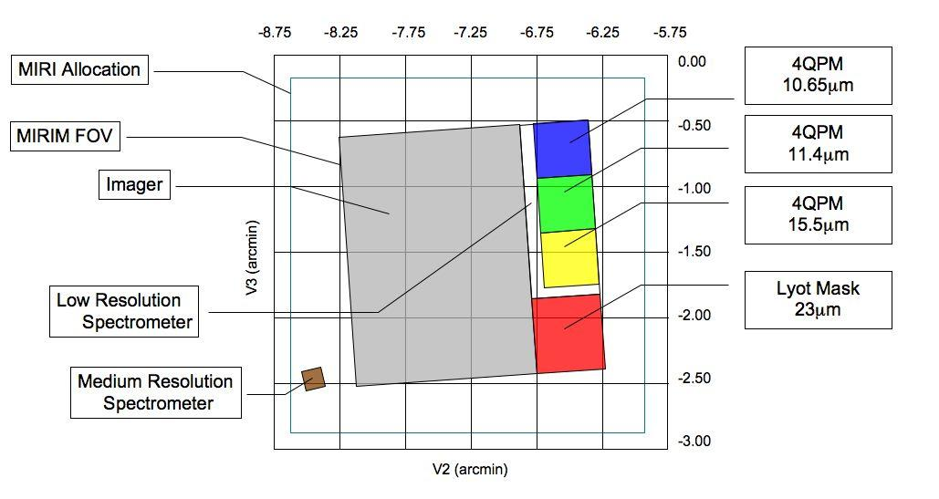
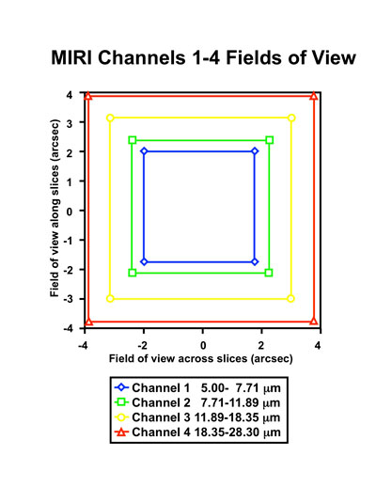
The MIRI will characterize circumstellar debris disks, extra-solar planets, and the evolutionary state of high redshift galaxies
IFU Fields of View
Developed by a consortium of 10 European countries and NASA/JPL
Operating wavelength: 5 – 28.5 microns
Broad-band imagery: 1.9 x 1.4 arc minutes FOV, 110 mas/pixel, 9 filters (R~5)
Spectroscopy:
R~100 long slit spectroscopy 5 x 0.2 arc sec
R~3000 IFU spectroscopy (4 image slicers fed by dichroic beam splitters)
Slice width: 19, 19, 24, and 27 mas
Coronagraphic imagery: Three 4QPMs and 1 Lyot occulting mask, 110 mas/pixel

Slide 13
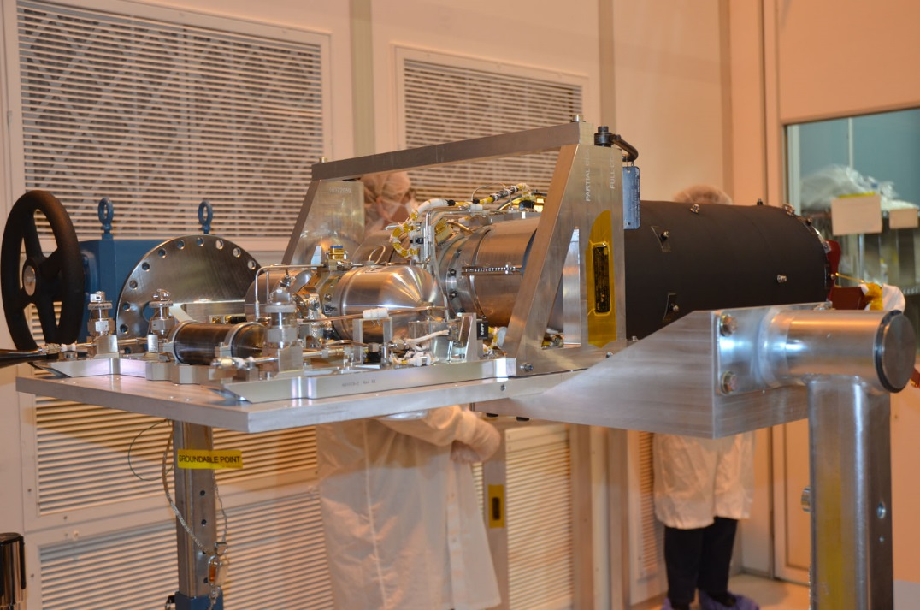
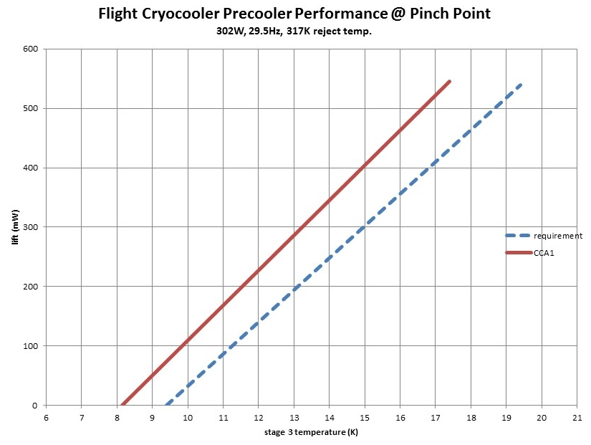
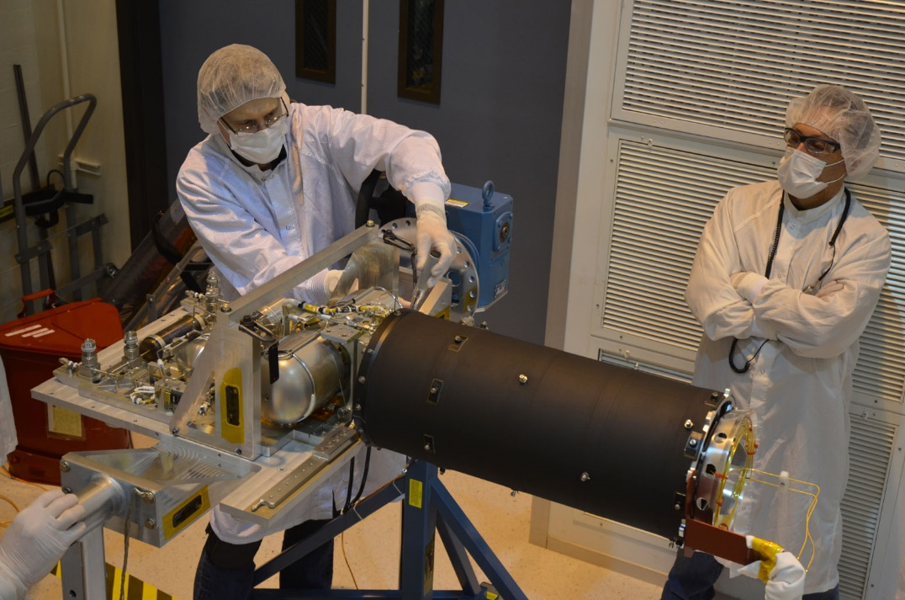
The MIRI cryo-cooler is complete and delivered to spacecraft I&T
Pre-Ship review completed during May
Flight spare cooler in final verification testing at JPL

Slide 14
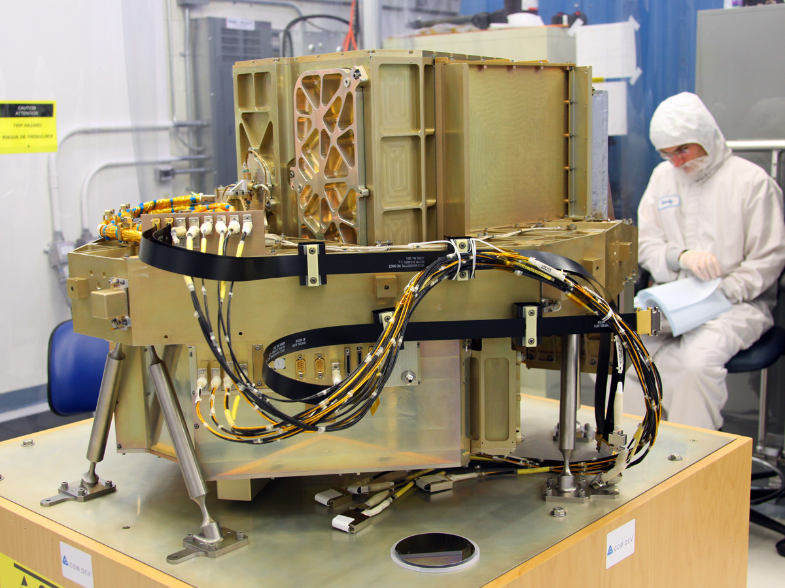
FGS can sense pointing to 1 millionth degree precision NIRISS enables moderate contrast imagery at an inner working angle of 0.5λ/D
Flight FGS

Slide 15
The FGS-Guider and NIRISS provide telescope pointing control imagery & slitless spectroscopy for Ly-a galaxy surveys and extra-solar planet transits
Developed by the Canadian Space Agency with ComDev
FGS: 4 mas noise equivalent angle (0.6 – 5 microns)
~95% probability of guide star acquisition over whole sky
7 mas LOS pointing stability
NIRISS:
Wide-field slit-less spectroscopic imagery (grism)
R ~ 150, 0.8 – 2.25 microns optimized for Ly alpha galaxy surveys
Single object spectroscopic imagery (grism): 3 orders cross-dispersed
R ~ 700, 0.7 – 2.5 microns optimized for exoplanet transit spectroscopy
Aperture mask interferometric imaging (7 aperture NRM, 21 unique baselines) 3.8, 4.3, and 4.8 microns (IWA ~ 0.5λ/D)
68 mas/pixel all modes
Simulated NIRISS aperture mask near-infrared image of a 1-2 M_{Jup} planet at ~1 AU of a M0V star 10 pc from the Sun.

Slide 16
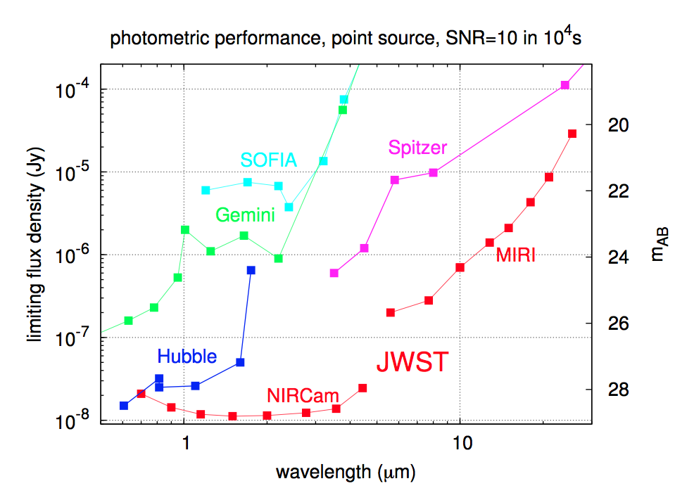
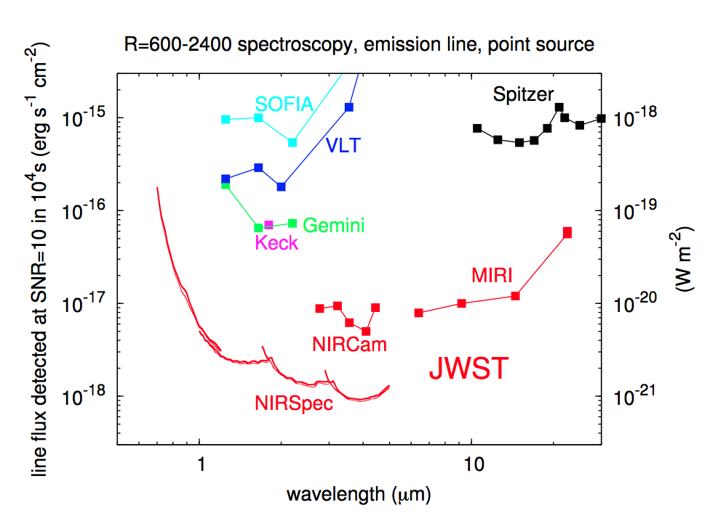
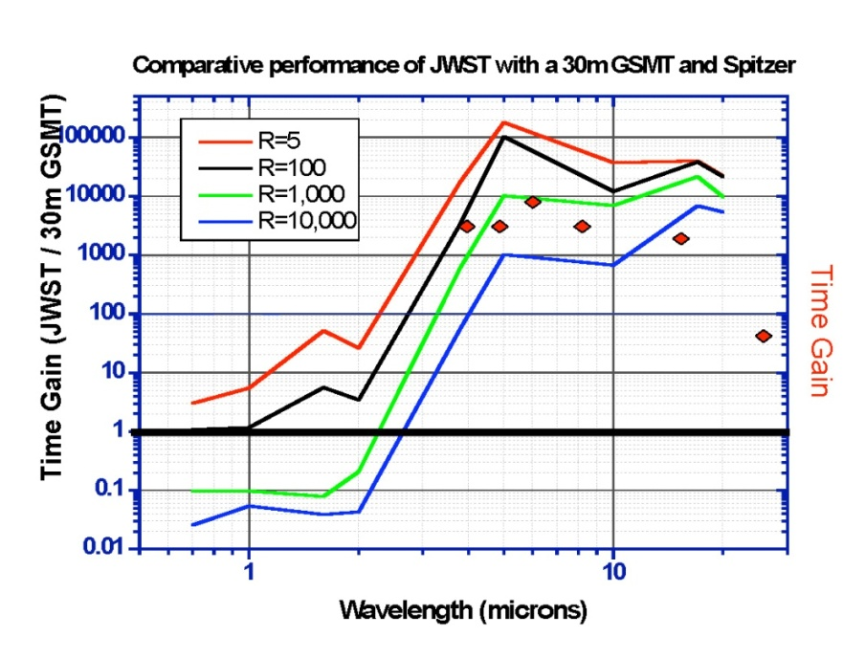
JWST will achieve unprecedented infrared sensitivity
However, 30 m ground-based facilities can challenge JWST performance for R > 1000 spectroscopy at wavelengths < 1.7 microns
Mauna Kea
JWST

Slide 17
Observer take-aways
The ISIM contains a Fine Guidance Sensor that enables the observatory to achieve 7 mas pointing stability
The ISIM includes 4 science sensors that enable:
Nyquist sampled imagery in broad-band filters
Coronagraphic imagery with contrast ~10⁴ - 10⁵ over the whole JWST wavelength range
Slit-less, long slit, and multi-object spectroscopy with R ~ 10² - 10³
IFU spectroscopy over the whole JWST wavelength range
Interferometric imagery over 4-5 microns with resolution 0.5λ/D
All ISIM sensors have sub-array detector readout capability to enable observation of bright targets
All ISIM sensors are designed for simultaneous and continuous operation

Slide 18
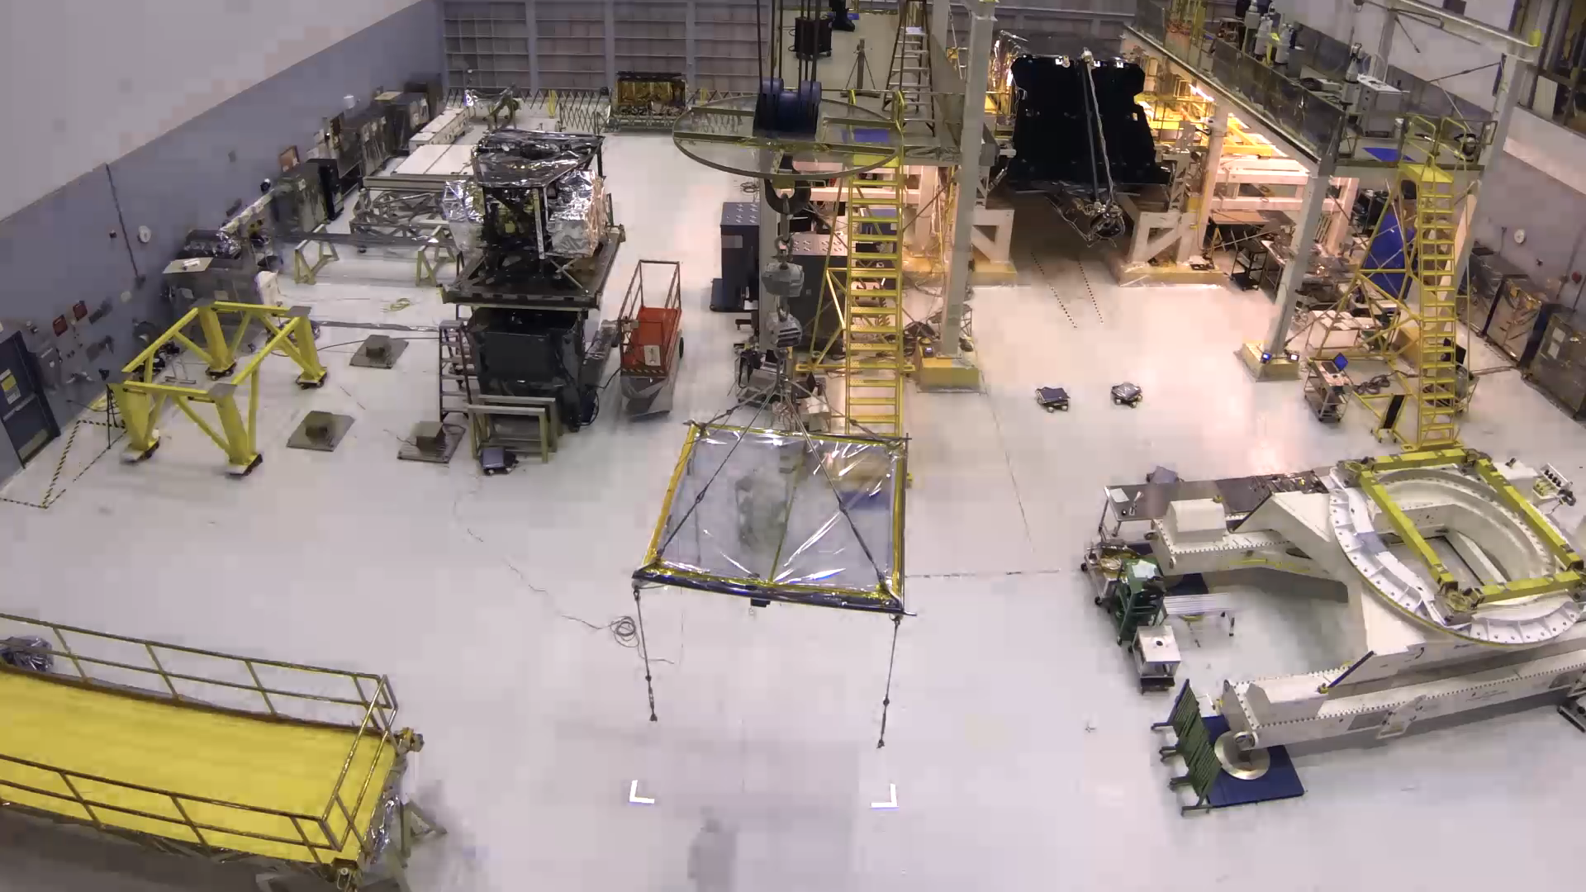
Instrument module integration with OTE
Click Video

Slide 19

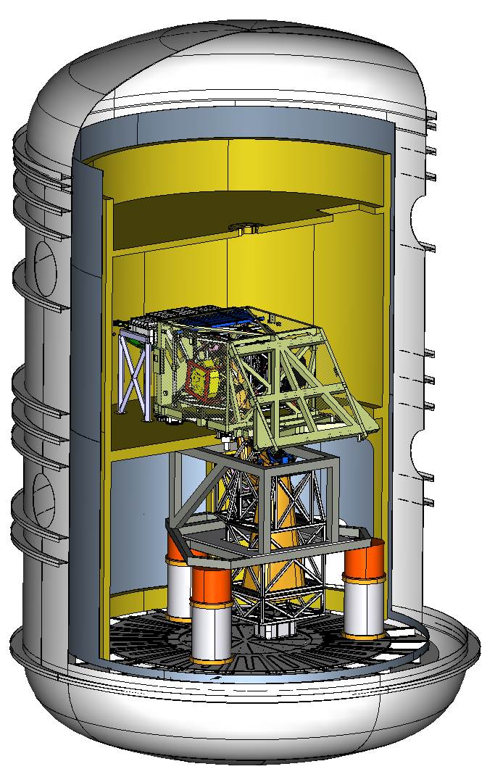
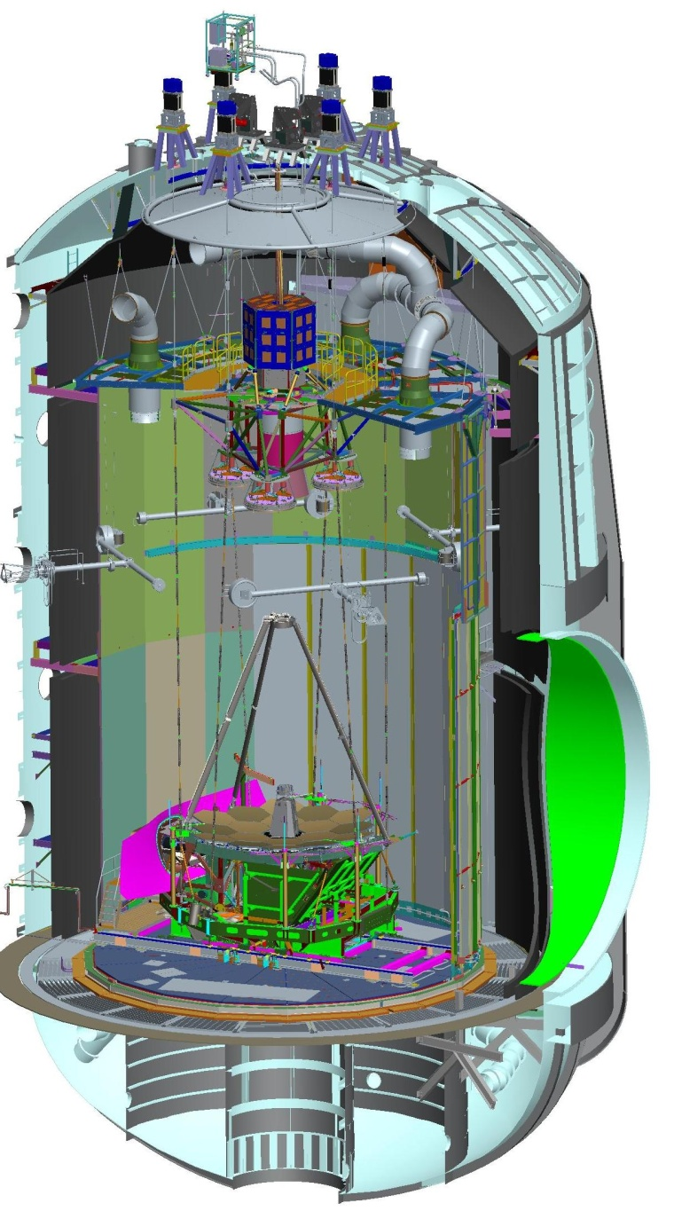
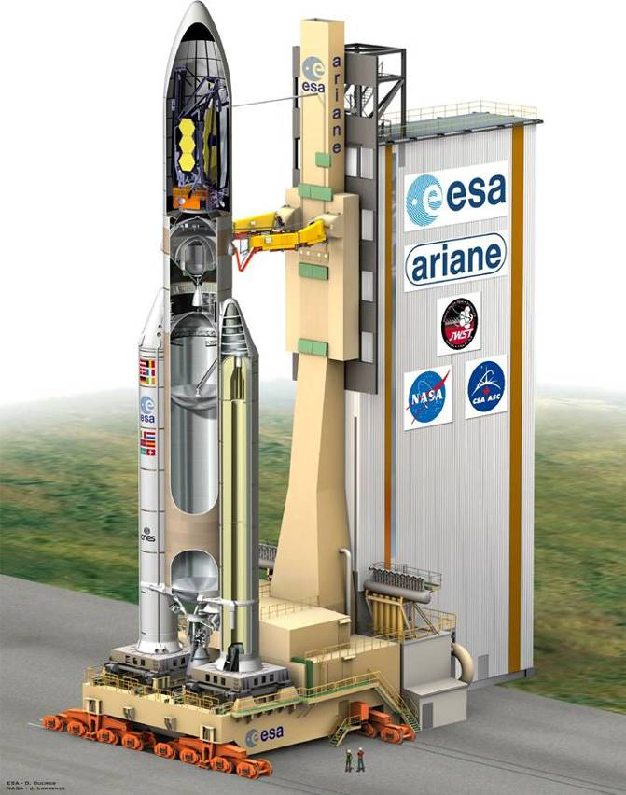
In Sum …
ISIM is on track to support the OTIS end-to-end optical test at JSC during April 2017
Integration of the ISIM system to the OTE is proceeding without issue
Last element-level ISIM test was completed during February 2016 in the GSFC SES chamber
Observatory end-to-end optical test
begins during April 2017 in JSC Chamber-A
Launch 2018 from Kourou Launch Center (French Guiana)

