Slide 1
What do we know about the evolution with redshift of dust attenuation in galaxies?
Véronique Buat
With the contribution of Barbara Lo Faro
LAM, Marseille, France
Madau & Dickinson, 2014

Slide 2
To define the framework
F(λ)
Selective attenuation A(λ) measured with an attenuation curve A(λ)/A_{V} or k(λ)/E_{B-V}
emitted
Amount of attenuation
In the UV (A_{UV}) well constrained by dust (IR) emission IRX:L_{IR}/L_{UV}
observed
λ₁ λ₂
Wavelength

Slide 3
Outline
The attenuation law from the local to the distant universe:
Formalisms and shapes of the laws
Attenuation laws for UV/optically selected galaxies
Attenuation laws for Dusty IR selected galaxies
The measure of the amount of dust attenuation
Using the UV slope ß
Using optical/NIR colors
Using stellar masses

Slide 4
Outline
The attenuation law from the local to the distant universe:
Formalisms and shapes of the laws
Attenuation laws for UV/optically selected galaxies
Attenuation laws for Dusty IR selected galaxies
The measure of the amount of dust attenuation
Using ß, colors
Using stellar masses

Slide 5
The shapes of some popular attenuation/extinction curves
Extinction curves

Slide 6
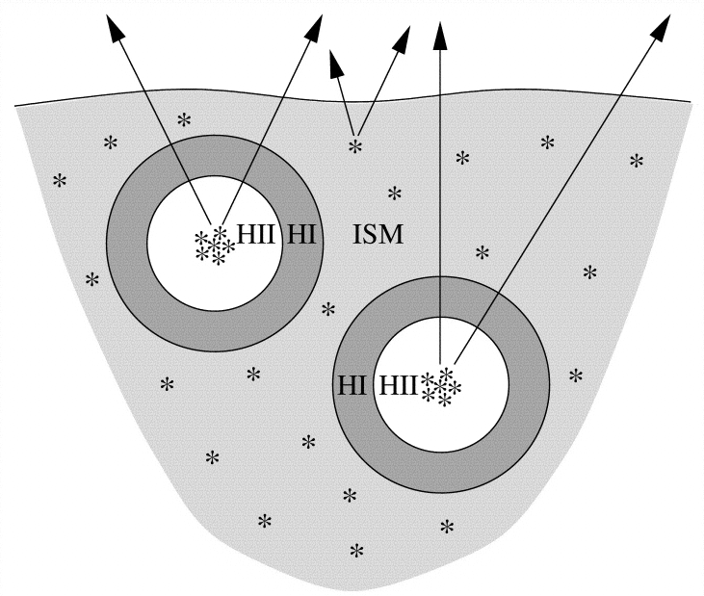
The formalisms of the attenuation laws currently used
Charlot & Fall 2000: power laws
Calzetti and Calzetti modified laws
(Calzetti+00 + UV bump) X power law
δ=-0.13
CIGALE code’s recipe (Noll+09)
E(B-V)_{young} for young stars
E(B-V)_{old} = f_{att} E(B-V)_{young} old stars
0<f_{att}<1
Calzetti+00, Cigale code (Noll+09), Buat+11,12 Kriek&Conroy13, Zeimann+15, Salmon+15…
with or without f_{att}
n^{BC} & n^{ISM} may be different and/or not fixed (Magphys code (da Cunha+08), , Wild+11 Chevallard+13…)

Slide 7
The formalisms of the attenuation laws currently used induce different shapes in the optical-NIR
Calzetti+00 & modified
Dashed lines
δ=-0.13
n^{ISM}=n^{BC}= n
Charlot & Fall 2000
Double power law
Solid lines
n=
Courtesy of Barbara Lo Faro

Slide 8
Outline
The attenuation law from the local to the distant universe:
Formalisms and shapes of the laws
Attenuation laws for UV/optically selected galaxies
Attenuation laws for Dusty IR selected galaxies
The measure of the amount of dust attenuation
Using ß, colors
Using stellar masses

Slide 9
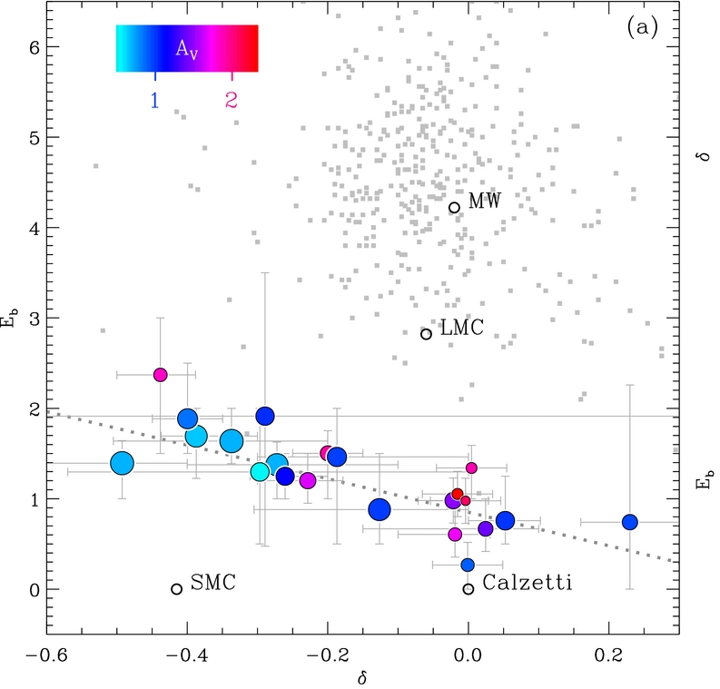
The variation of the attenuation curve in UV/optically (emission lines) selected star-forming galaxies
Kriek & Conroy 13
Newfirm composite SEDs
A_{V}
0.5<z<2
E_{b}
‘Calzetti modified’ formalism or method
δ
UV selected galaxies with IR detections
Buat+11,12,
Bump~LMC2, slightly steeper than C00
SMC
LMC
C00
1<Z<2
C00:
Starburst law, Calzetti.00
Calzetti+94 method
Notes:
Newfirm median band survey, composite SEDs

Slide 10
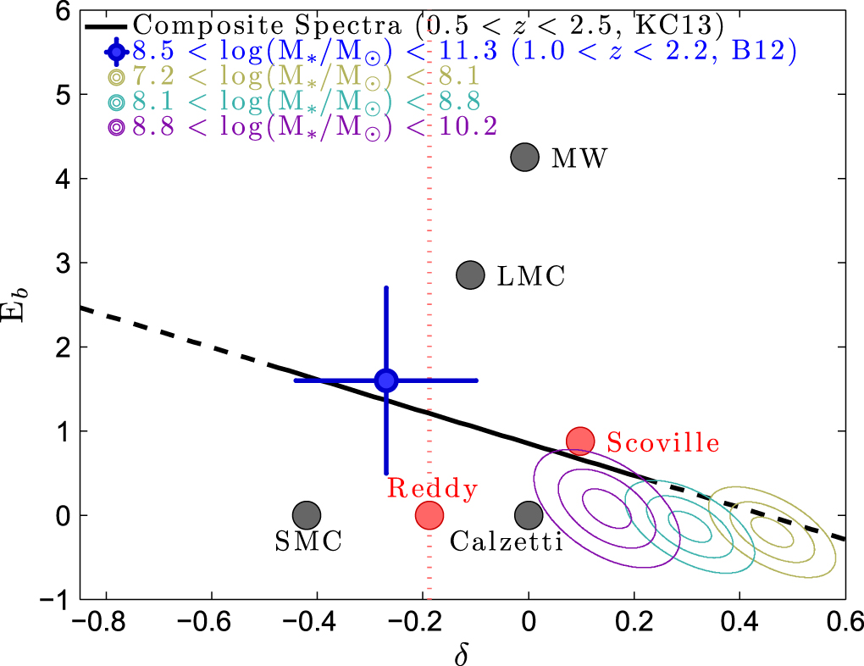
Zeimann+15, emission line galaxies

Slide 11
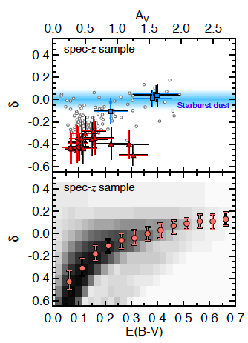
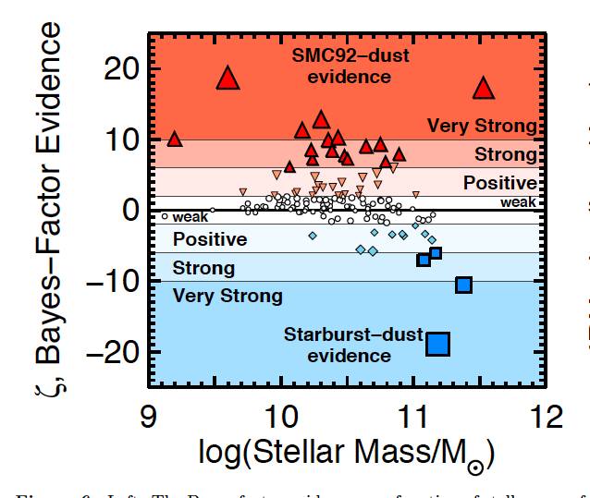
Salmon+15, arXiv , CANDELS data, 1.5<z<3 galaxies detected in the UV rest-frame and with SPITZER
Tentative conclusion?:
A shallower attenuation law for increasing attenuation and mass(?)
Attenuation laws which can be steeper than the Calzetti one with a moderate bump
Notes:
Delta at median likelihood per bin of EBV

Slide 12
Outline
The attenuation law from the local to the distant universe:
Formalisms and shapes of the laws
Attenuation laws for UV/optically selected galaxies
Attenuation laws for Dusty IR selected galaxies
The measure of the amount of dust attenuation
Using ß, colors
Using stellar masses

Slide 13
Herschel Extragalactic Legacy Project FP7/SPaCE
P.I. Seb Oliver
A census of galaxy populations and their star formation history from the local to the distant universe
« Ultimate « source extraction in all the cosmological Herschel fields (including HerMES and H-ATLAS surveys), UV to radio complementary data
→ photo-z, SFR, M* for all the sources

Slide 14
UV-to-FIR SED fitting
comparison with radiative transfer modelling
Lo Faro et al. to be submitted
Physically-motivated SED modelling
Radiation transfer SED modelling
Calzetti& modified, Double Power law GRASIL
cigale.lam.fr adlibitum.oats.inaf.it/silva/grasil/grasil.html
Z~1 LIRGs and Z~2 ULIRGs) (from Lo Faro+13,15)
Nearby (U)LIRGs from the GOALS sample (Armus+09)

Slide 15
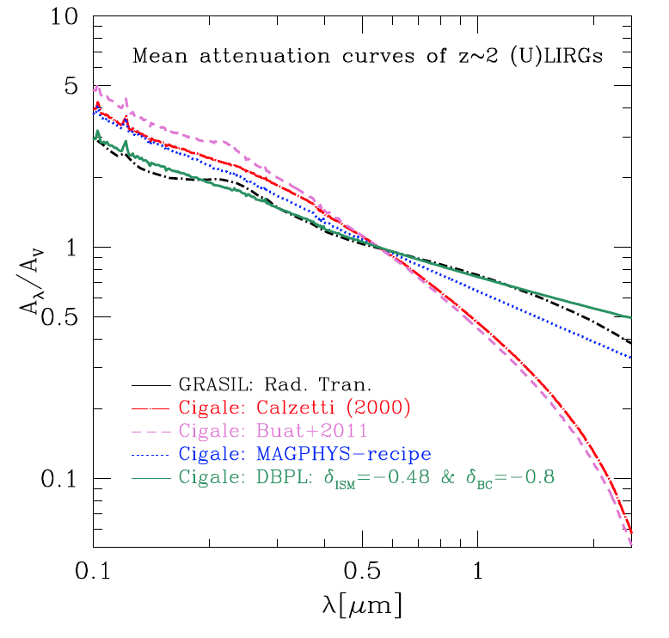
Grasil power law fixed power law free Calzetti+00 Buat+11
n^{ISM}= -0.48 & n^{BC} =-0.8

Slide 16
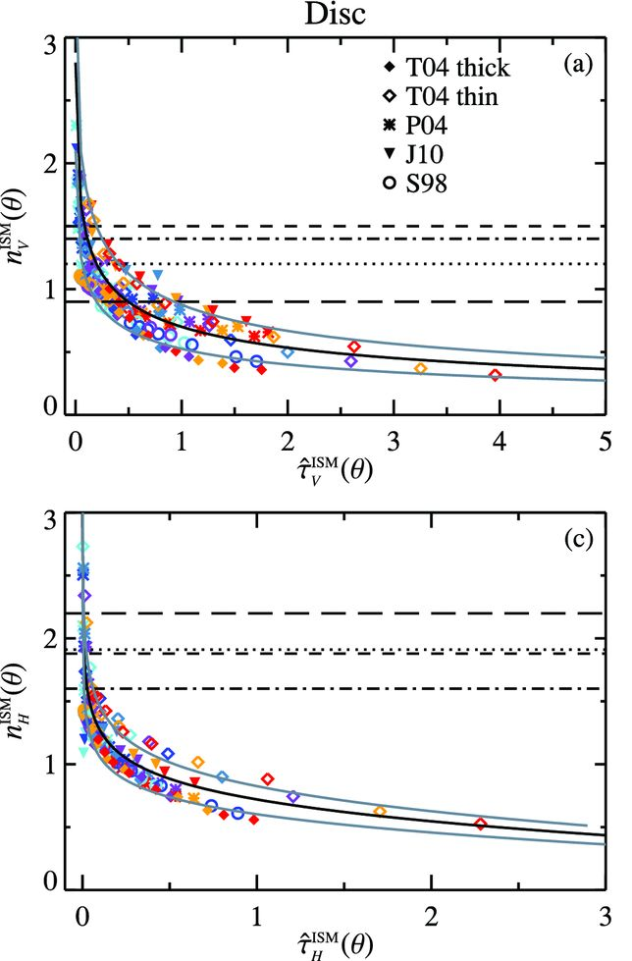
Flattening of the attenuation curve in high attenuated objects
In agreement with Chevallard et al. 2013:
Compilation of Radiative Transfer modeling results, confirming GRASIL calculations
→ All predict a grayer attenuation for an increasing attenuation

Slide 17
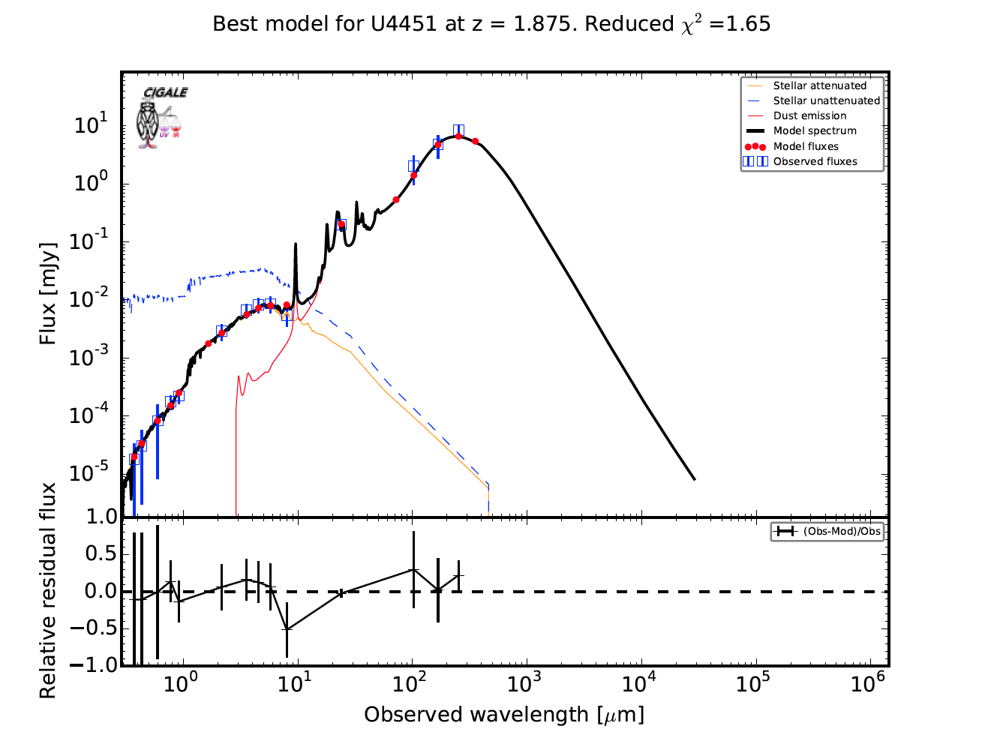
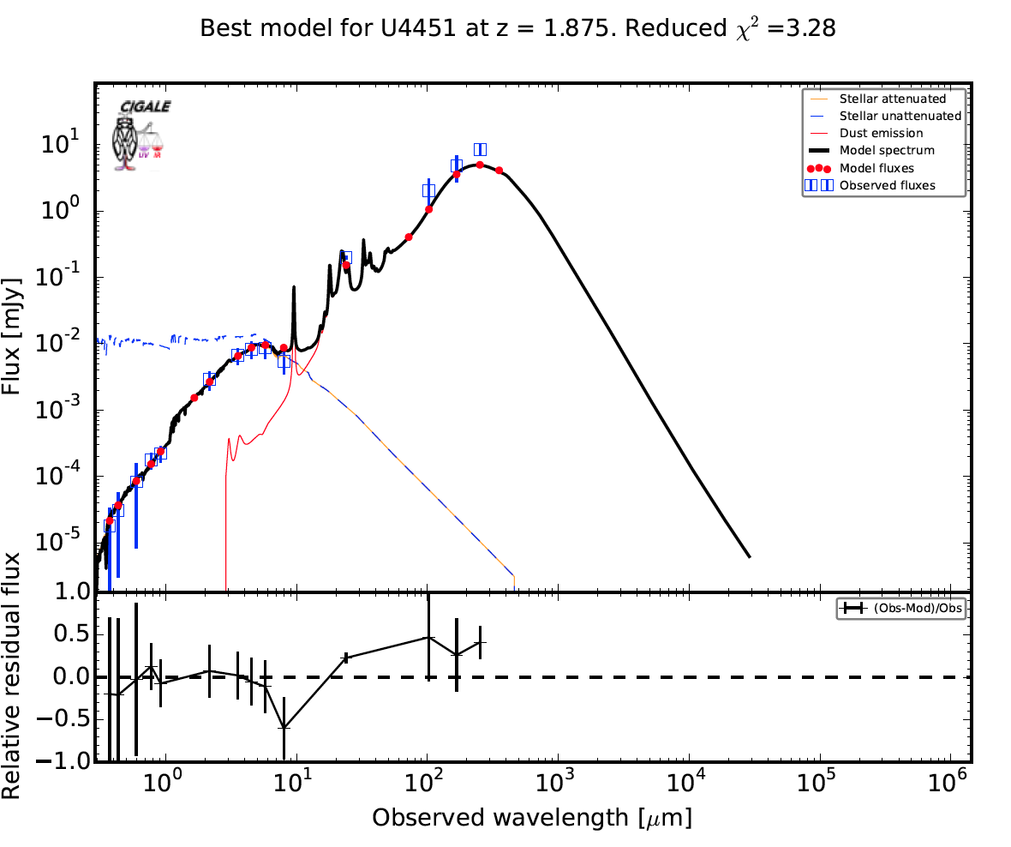
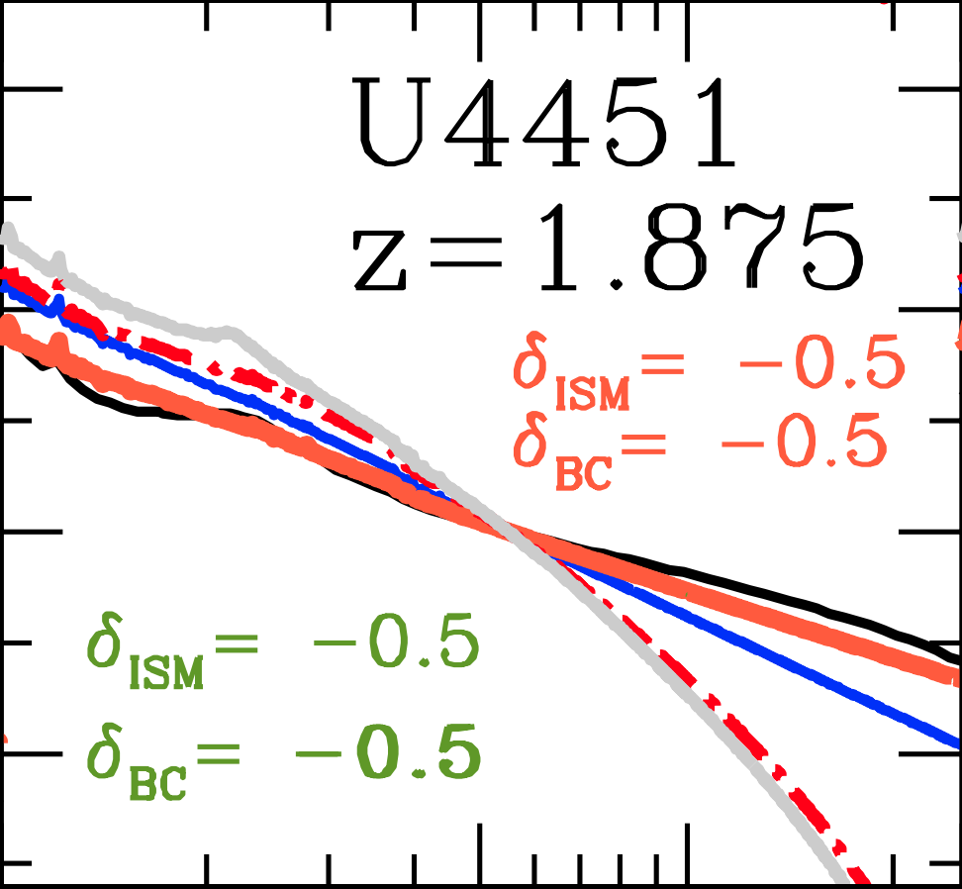
How do these ``flatter’’ attenuation curves affect the SED ?
n^{ISM}=n^{BC}=-0.5
Calzetti+00
attenuation in NIR
A larger amount of attenuation at longer wavelengths (NIR) than allowed by Calzetti+00 att. law.
(Mitchell+13, Da Cunha+10)
Affects the determination of the stellar mass
(Mitchell+13, Lo faro+13)
Notes:
#DBPL-free
U4451 SFH: tau_main=3086.18 +\- 2225 Myrs age=1747.44 +\- 690 Myrs SFR10=144 +\- 20 Msun/yr
M* = 1.34548319895E11 +\- 5.94E10 → LogM* = 11.13
#Calzetti2000
U4451 SFH: tau_main=3740.22 +\- 2240 Myrs age= 500 +\- 25 Myrs SFR10=128 +\- 6.42 Msun/yr
M* = 2.87E10 +\- 1.44E9 → LogM* = 10.46

Slide 18
Outline
The attenuation law from the local to the distant universe:
Formalisms and shapes of the laws
Attenuation laws for UV/optically selected galaxies
Attenuation laws for Dusty IR selected galaxies
The measure of the amount of dust attenuation
Using the UV slope ß
Using colors
Using stellar masses

Slide 19
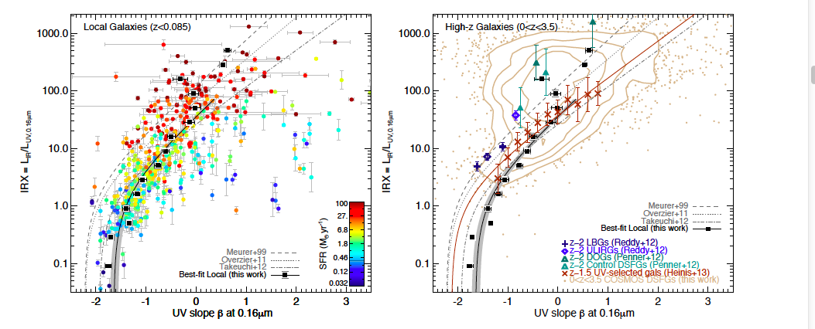
Measuring dust attenuation without IR data :
the slope of the UV continuum: β
GALEX+IRAS
Cosmos field
0<Z<3.5
Z=0
Casey+14

Slide 20
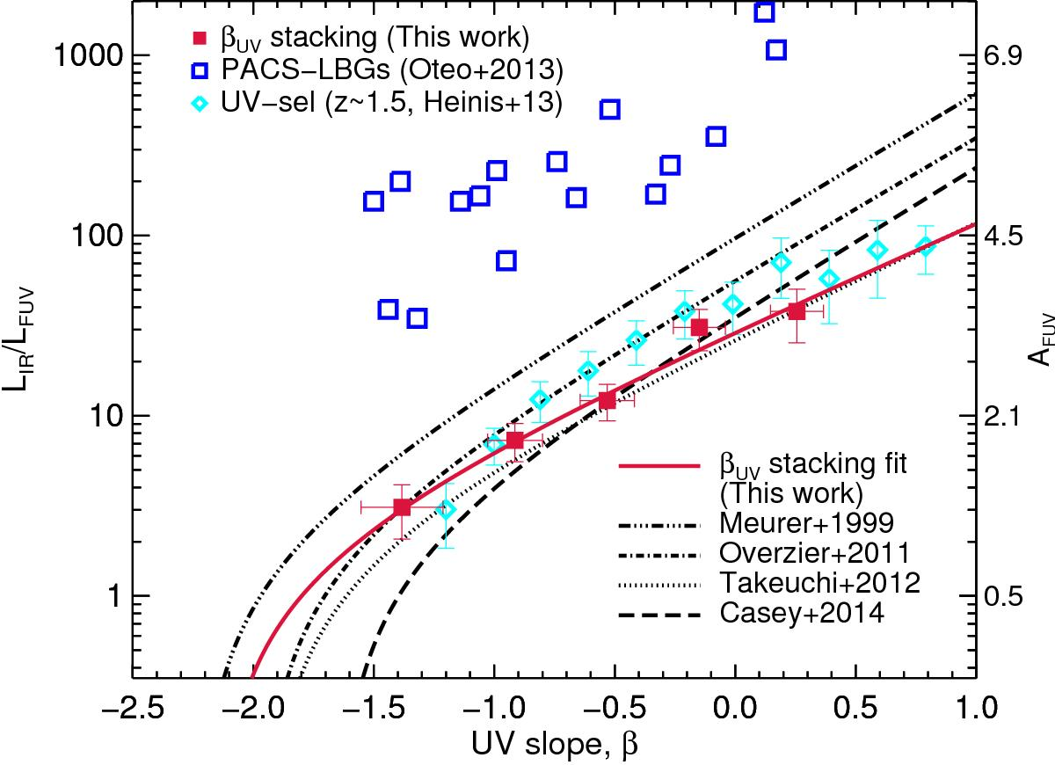
IRX-β : LBG selection at z~3
& stacking of Herschel data
Alvarez-Marquez et al. 2016
Z=3

Slide 21
The IRX-β plot is very sensitive to the shape of the attenuation curve in the UV
ULIRGs at z~2 detected by Herschel: a flatter curve in the UV
n^{ISM}
Lo Faro et al. To be submitted,
see also Salmon+15, Safarzadeh+16

Slide 22
Outline
The attenuation law from the local to the distant universe:
Formalisms and shapes of the laws
Attenuation laws for UV/optically selected galaxies
Attenuation laws for Dusty IR selected galaxies
The measure of the amount of dust attenuation
Using the UV slope ß
Using rest-frame NIR optical colors
Using stellar masses

Slide 23
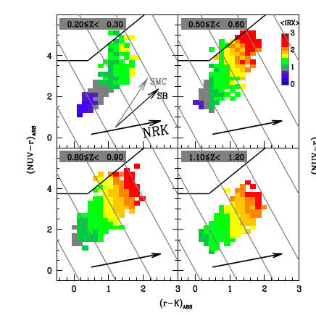
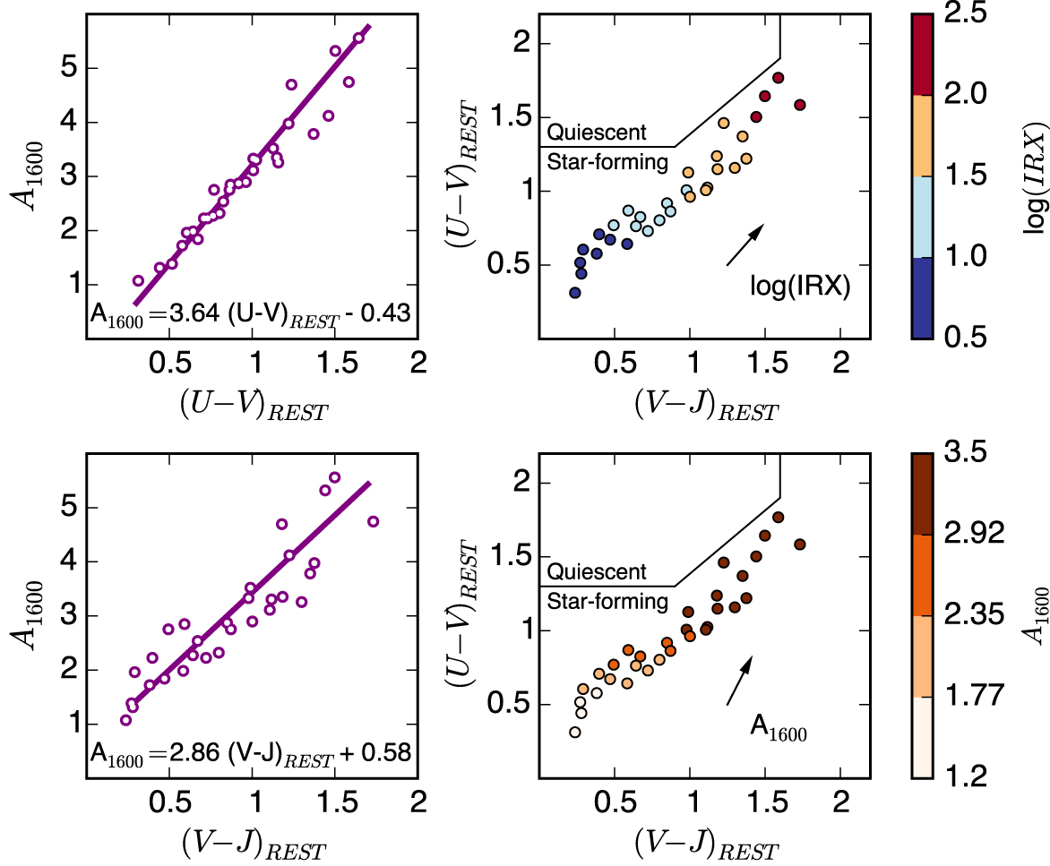
Using rest-frame colors to infer dust attenuation corrections
0<z<1
1<z<3
Arnouts+13 NUV-R, R-K colors
Forrest+13, U-V, V-J colors
Needs to be calibrated to be used at higher/different redshifts

Slide 24
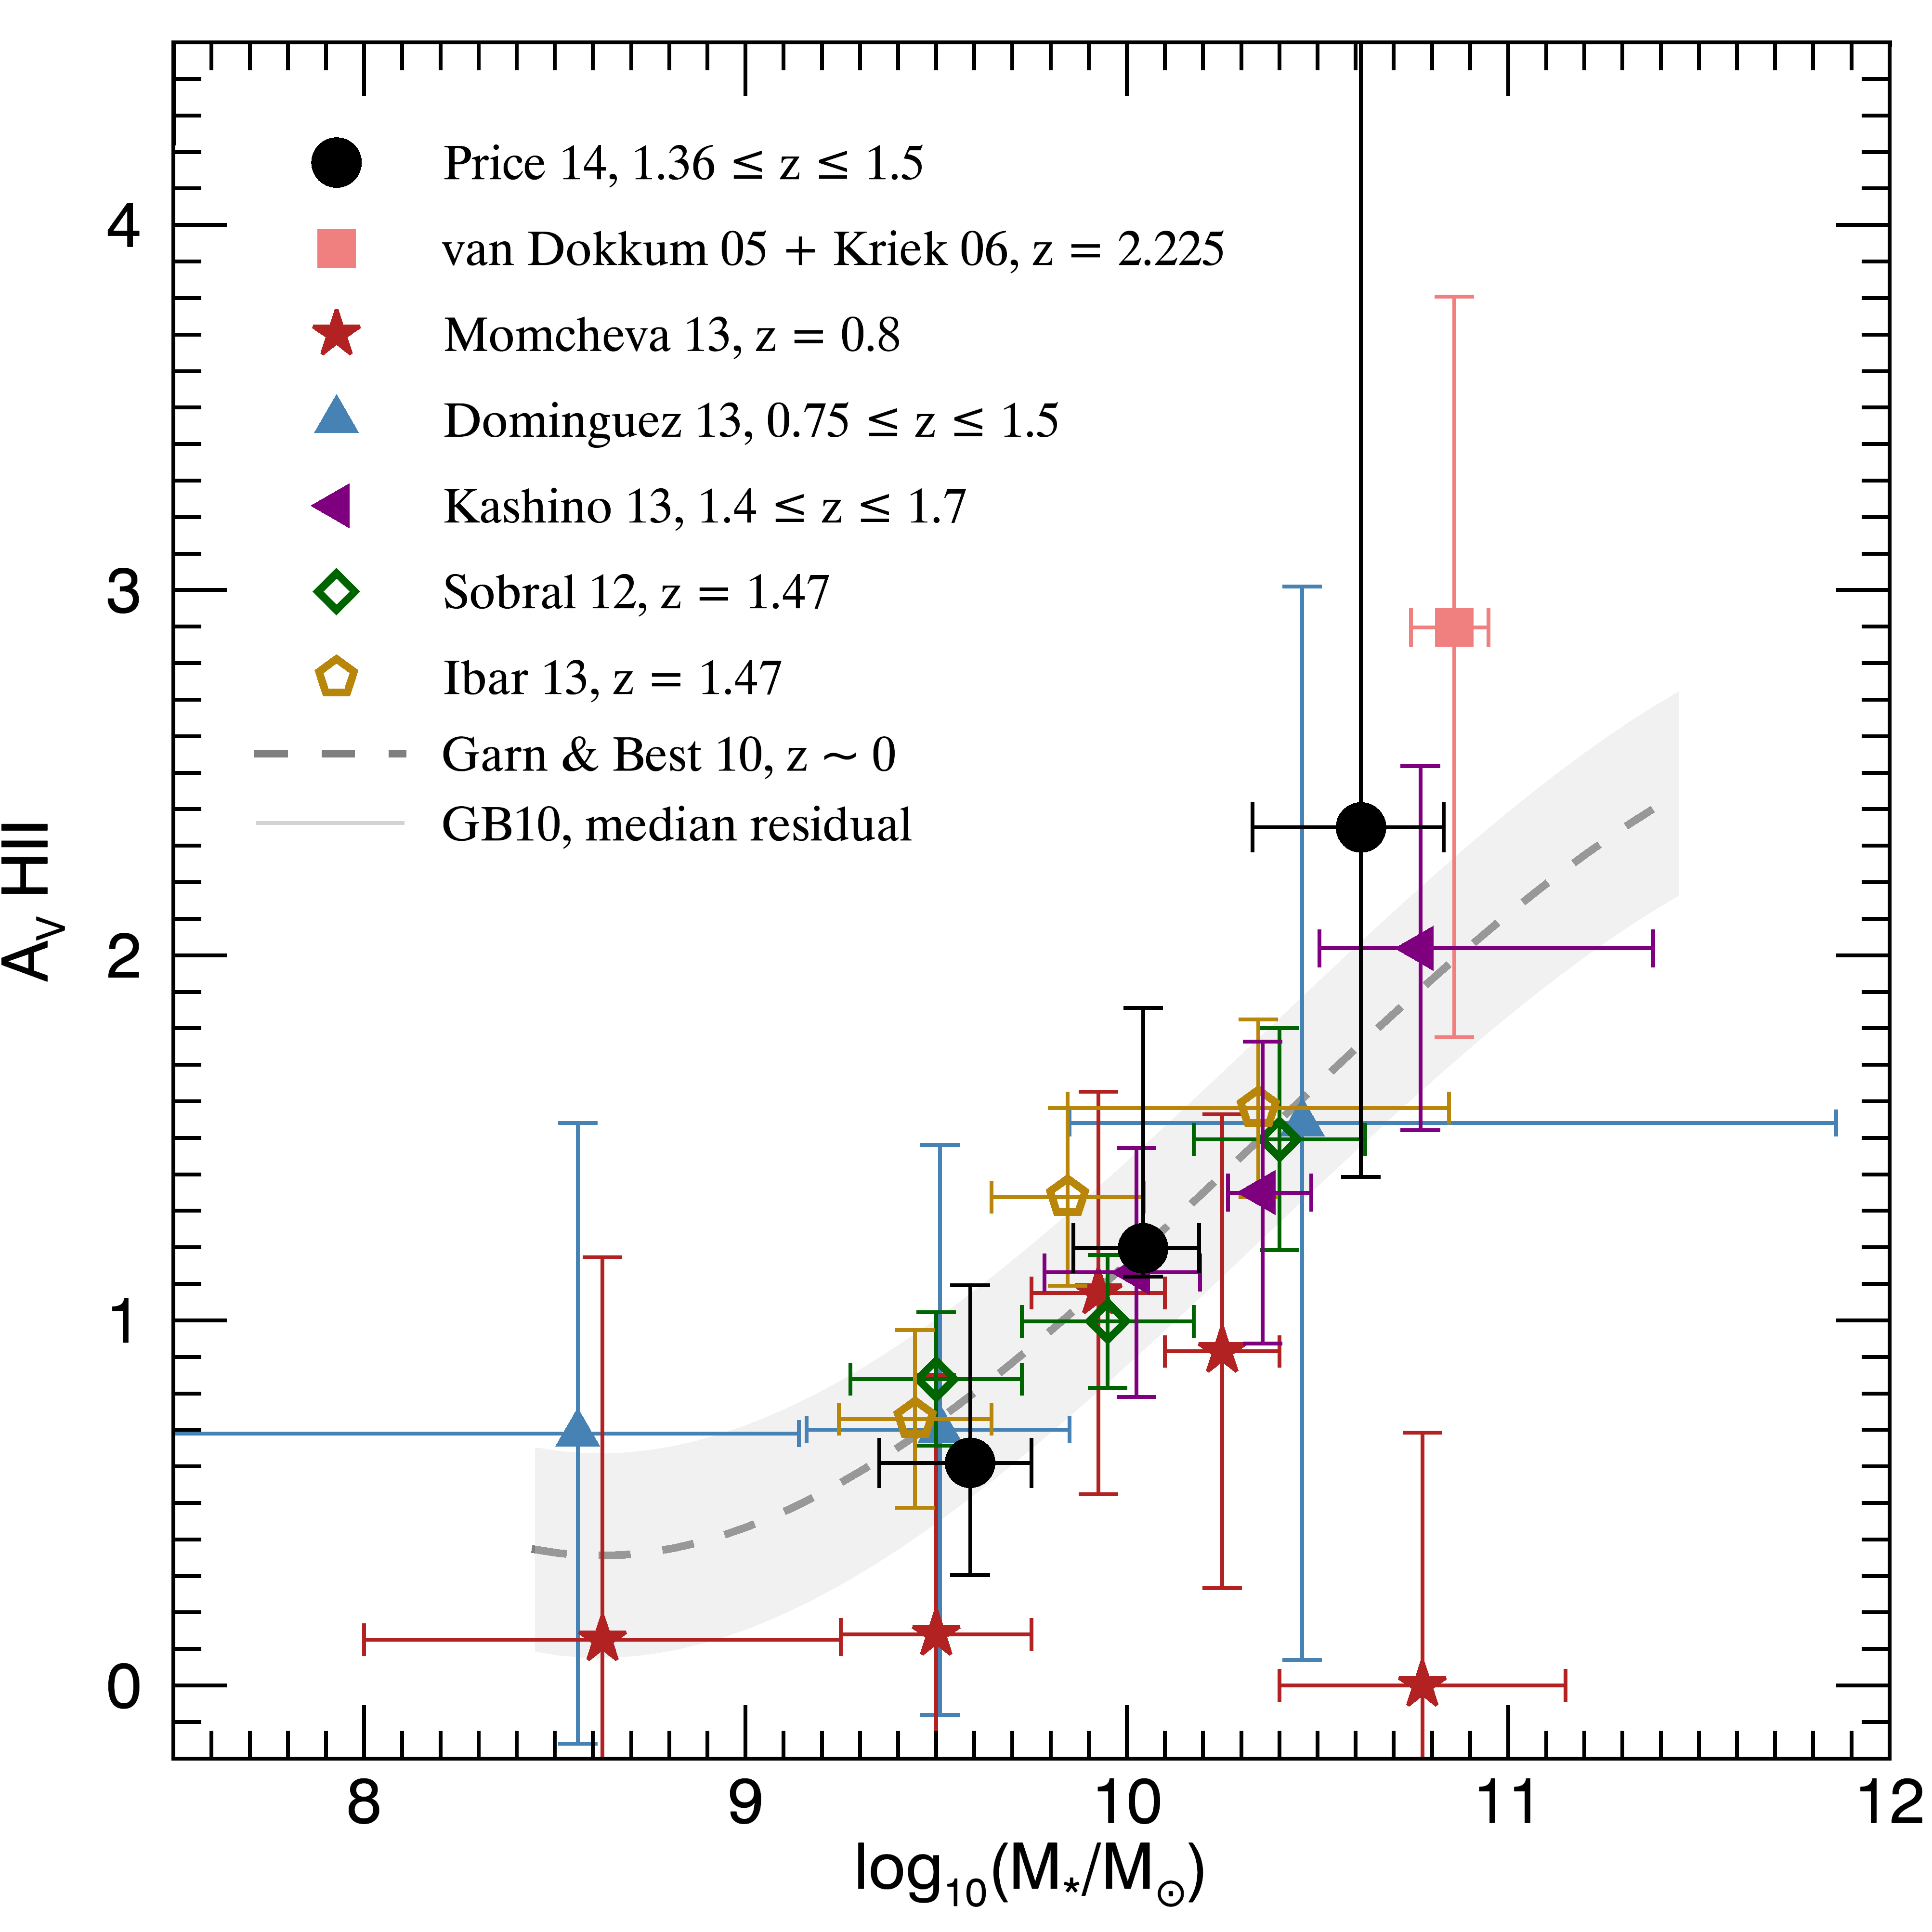
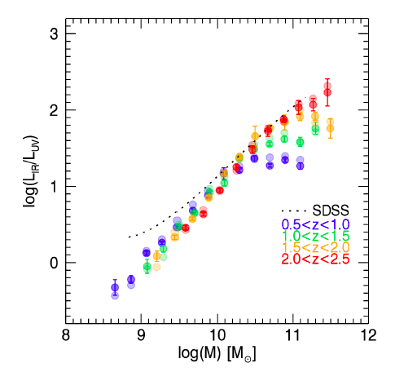
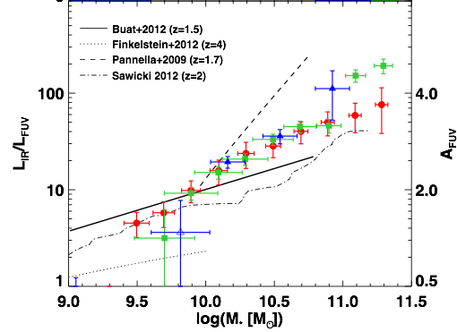
Attenuation-stellar mass relation on a large range of z
UV selected and star forming galaxies (Stacking of Spitzer/Herschel data)
Z=1.5, 3, 4
Heinis+14,
UV rest frame selection
See also Oteo+14, Panella+15, Dunlop+16….
Whitaker+14, CANDELS , UVJ selection, MIPS stacking

Slide 25
Dust attenuation in IR and UV selected samples: a difference in stellar mass
Buat+15
IRX-M* relation assumed, Bernhard+14
IR selected samples: IRAS/Spitzer/AKARI
UV rest-frame selections

Slide 26
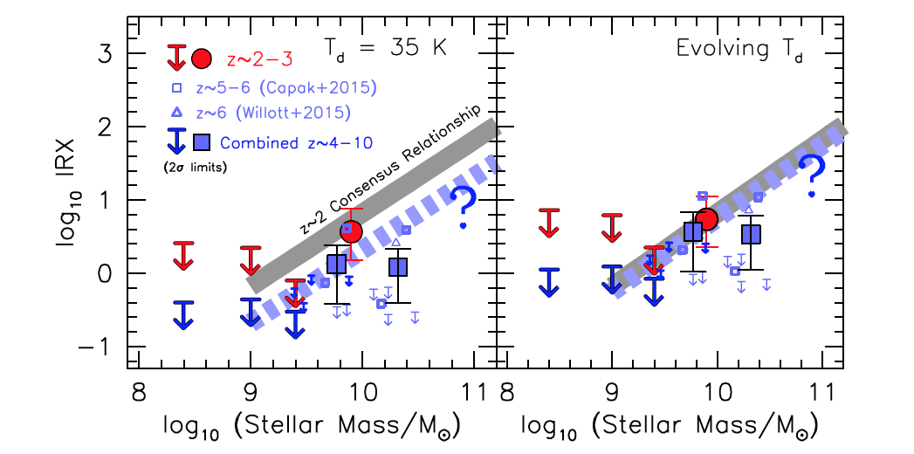
At higher redshift: ALMA observations
Either an evolution of the IRX-M* relation or an increase of T(dust) with z
HUDF-ASPECS, Bouwens+16 arXiv

Slide 27
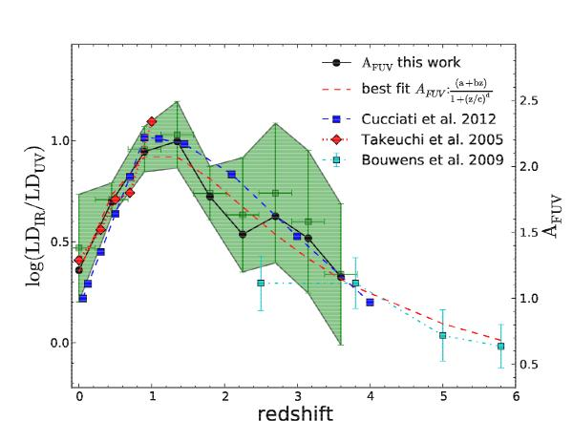
An evolution of the IRX-M* relation is needed to understand the variation of IR to UV luminosity density ratio
Burgarella et al. in prep
Burgarella+13

Slide 28
To conclude
Witt & Gordon 00
(IRX)
Confirmation of the variation of the attenuation curve among galaxies: shape in UV/NIR, UV bump: as a function of the amount of attenuation, stellar mass, sSFR…→ sample selection)
Fortunately, some recipes seem reliable to measure the total amount of attenuation: colors, stellar mass, but need to be well calibrated, at different redshifts
The IRX-ß diagnostic is very sensitive to the attenuation curve and very likely to the stellar mass of galaxies

