Slide 1
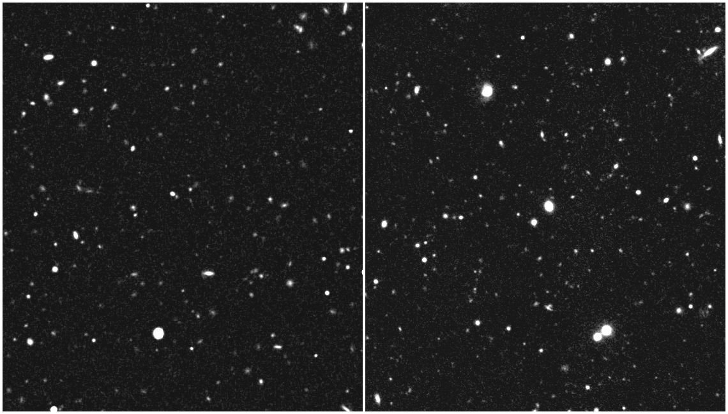
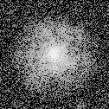
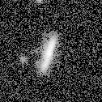
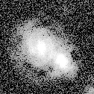
Blind challenges to improve weak lensing measurement
Simulated image
Real image
Realistic images, containing a known shear (distortion) signal.
Animations show 0-10% distortion in 1% steps (much bigger than ~2% real signal).

Slide 2
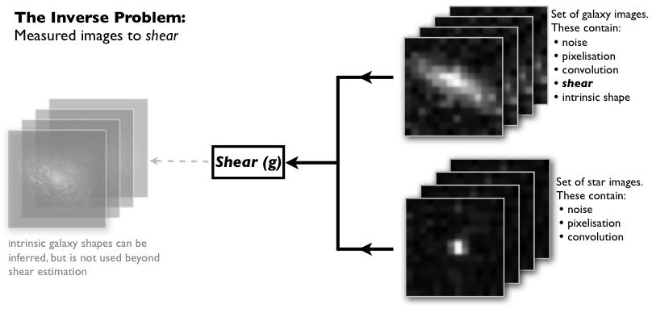
A problem ideally suited to simulation
The Forward Process
During observation, a galaxy image is
convolved with a PSF: making it bigger
and changing its ellipticity
The Inverse…
During data analysis, shear measurement
methods seek to undo these changes to
recover the true shape
…problem
An imperfect shear measurement method may not measure (any of) these quantities well. It instead obtains an inaccurate measurement, denoted by a hat.
Notes:
Easy to accurately simulate images with a known shear signal (forward process), but difficult to invert that and recover the shear.
Very simple physics in gravitational lensing.

Slide 3
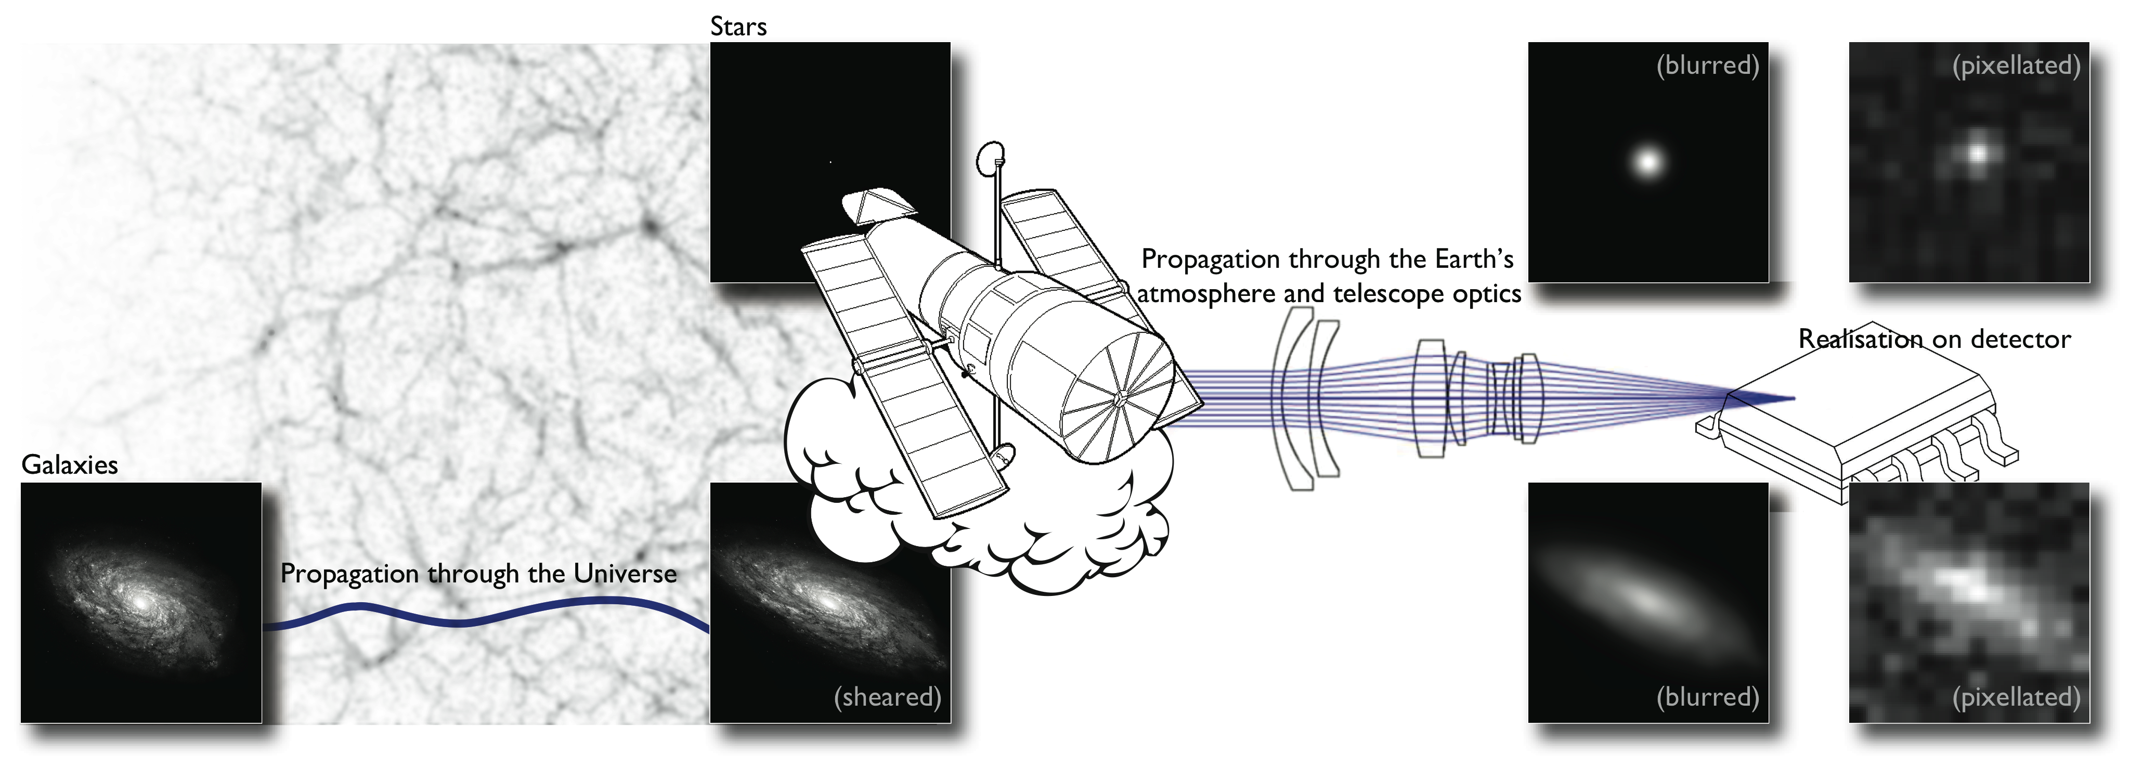
A problem ideally suited to simulation
The Forward Process
The Inverse Problem

Slide 4
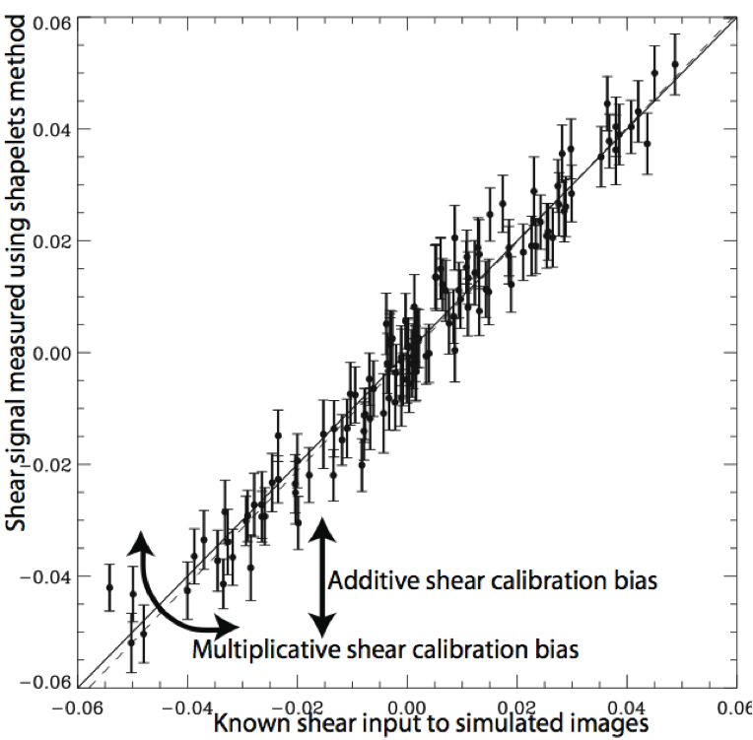
Figure of merit Iterations & lessons
2006: STEP I
Known PSF, simple galaxy morphologies, random positions, constant input shear
2007: STEP II
Known PSF, complex galaxy morphologies, random positions, constant input shear
KISS! And this isn’t an “astronomy” problem
2009: GREAT08
Known PSF, simple galaxy morphologies, grid of positions, constant input shear
Winners were computer scientists! But when outsourcing, must ask right question
2011: GREAT10 Don’t include a date
Varying PSF, simple galaxy morphologies, grid of positions, input shear f(RA,Dec)
Measured shear
Input shear
Notes:
Science community rather than a telescope/instrument consortium. Started out as “are current methods good enough for current surveys?”
Lessons learned:
KISS: when the results don’t perfectly match the inputs, how to diagnose exactly what went wrong?
When outsourcing, you have to ask the right question. Winners were compscis, but used a “feature” of the image that simplified our analysis to simplify the challenge too.

Slide 5
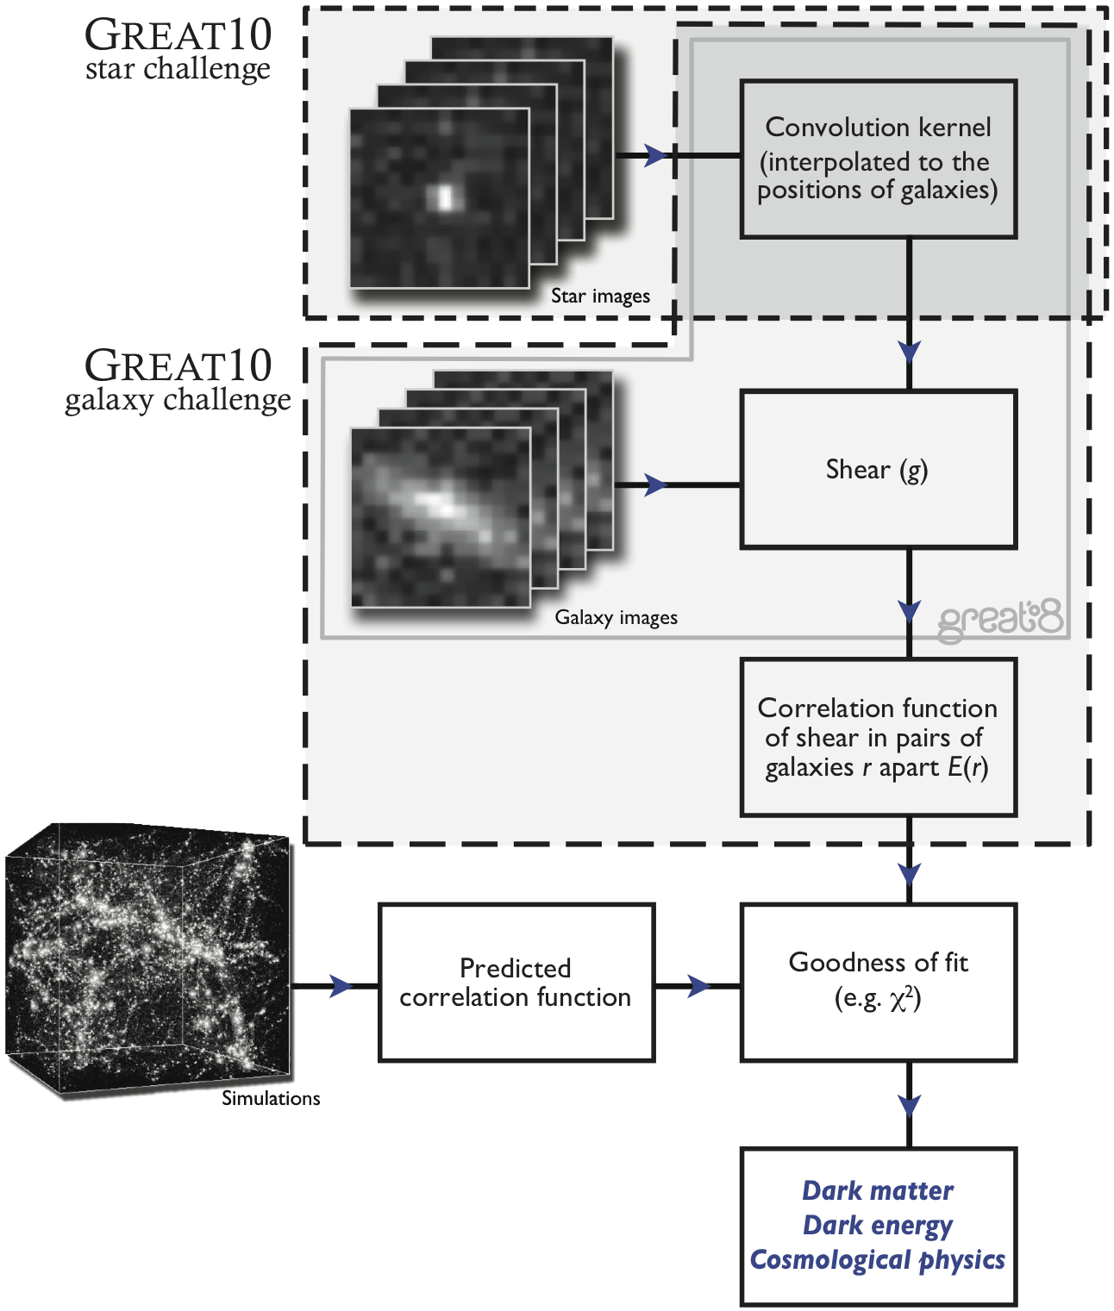
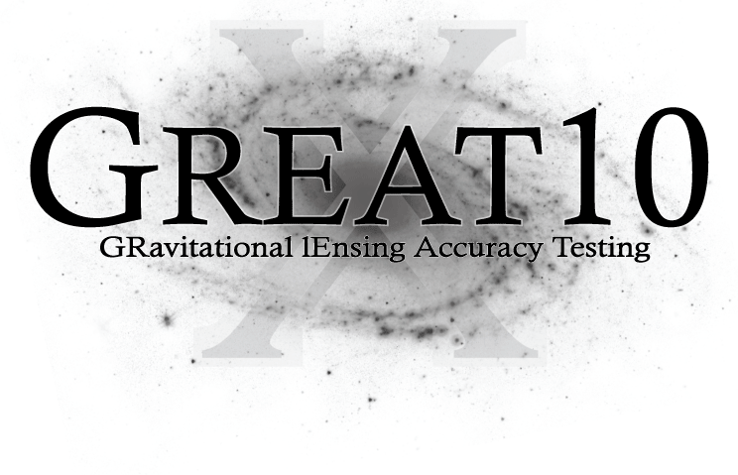
Separable challenges
Kitching et al. 2011

Slide 6
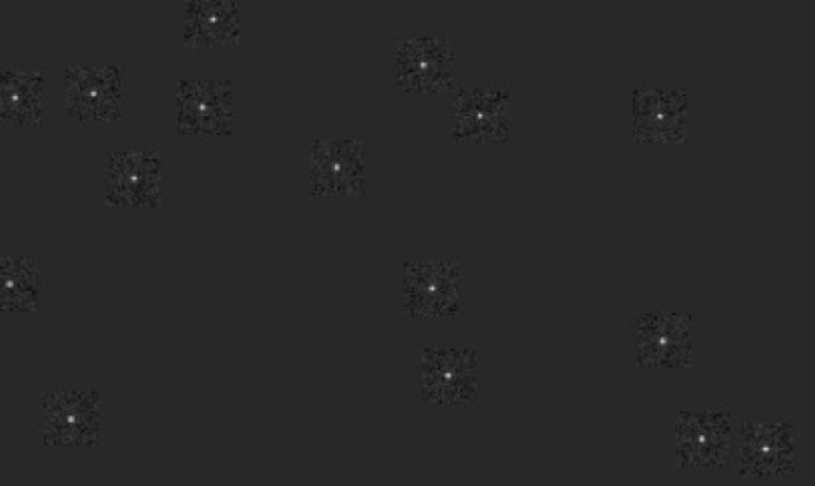
Star challenge (~50Gb)
Multiple tiers: Moffat/Airy, with/without diffraction spikes
Jitter, optical distortions, tracking
Single-screen Kolmogorov turbulence
Barney Rowe (UCL/JPL)
Notes:
Given lots of stars – compute the PSF at some other positions.
Best methods: fit pixellated model, with various 2D interpolation (nearest neighbour, Krigging)

Slide 7
Separable challenges
Kitching et al. 2011

Slide 8
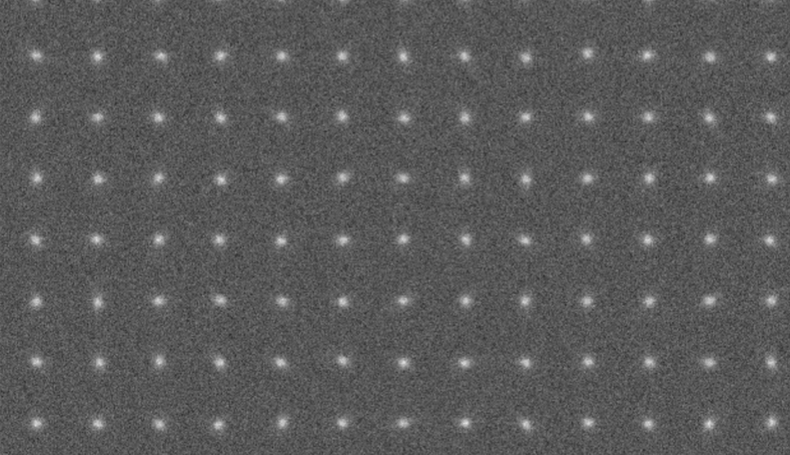
Galaxy challenge (~1Tb)
Multiple tiers: Bulge/disc models
Big/small, bright/faint galaxies
Ground/space observing conditions
All had a known PSF (the problems are separable)
Tom Kitching (ROE)
Notes:
Set to astronomers, computer scientists, all the scientific community that we could wave it in front of.

Slide 9
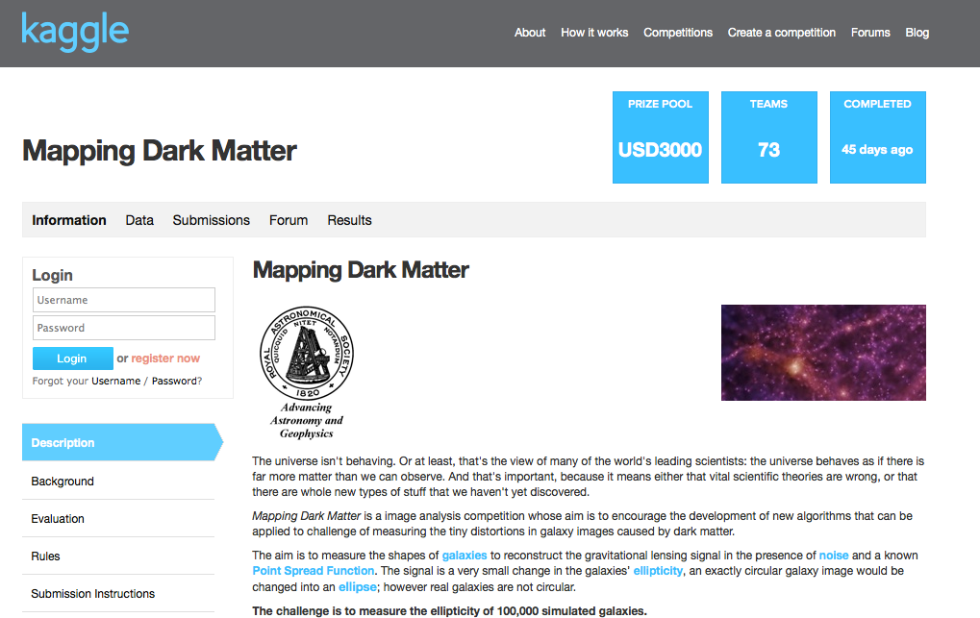
Nested challenges
Kitching et al. 2011

Slide 10

Crowdsourcing (~10Gb, .png)
Target the small of GalaxyZooers who wanted to write an algorithm
Better name, advertise in WSJ, White House blog, offer a “cool” prize
Notes:
Target the small fraction of people doing GalaxyZoo who thought they could write an algorithm to automate the process.
The final top ten included computer scientists, a glaciologist, a neuroscientist, and only one person who had even known about WL before the challenge). Their methods included new ideas including neural networks and HEP minimisers.
Crucially, this was a feeder for the main challenge: and the particle physicists who won Mapping Dark Matter ran their method on the main galaxy challenge and also won that.

Slide 11
Roger Bannister effect
Notes:
Any problem solved after 2 weeks. Any time progress was made, a buzz of interest in the forums.
Crucially, this was a feeder for the main GREAT10 galaxy challenge.
Winners (particle physicists) ran on GREAT10 main challenge. Came bottom of leaderboard… fixed things… l also came top

Slide 12
Figure of merit Past iterations
2006: STEP I
Known PSF, simple galaxy morphologies, random positions, constant input shear
2007: STEP II1 Q=57
Known PSF, complex galaxy morphologies, random positions, constant input shear
2009: GREAT08 Q=119
Known PSF, simple galaxy morphologies, grid of positions, constant input shear
2011: GREAT10 Q=309
Varying PSF, simple galaxy morphologies, grid of positions, input shear f(RA,Dec)
Requirement for Euclid/WFIRST (2019)
Bernstein has achieved this, at high S/N
Q=1000
Measured shear
Input shear
Q is a combination of multiplicative & additive biases. High values are better.
Notes:
Lessons learned: have to ask the right questions. Simulations used simple bulge+disc models of galaxy morphology.
Most methods fitted a bulge+disc model.

Slide 13
What next?
The challenge structure is proving very successful at answering questions, but has shown that we need to ask exactly the right questions.
GREAT08 used images with a constant shear signal, and the (compsci) winners exploited this by stacking the shapes of all galaxies so that their intrinsic shape was a circle. It is then easier to measure deviations from circularity. Interesting idea, but this method may not be applicable to real data.
GREAT10 made the shear vary as a function of position (and the challenge was to measure a power spectrum). The galaxy models were simple bulge+disc, and spawned many model-fitting methods – we now have as many implementations of this as we used to have of moment-based methods like KSB. We have learned that details of the fitting process, and choice/optimisation of free parameters (bulge ellipticity, disc ellipticity, position offset) is vital to success.
GREAT12 will continue to increment the simulation complexity – heading towards fully realistic images by GREAT2020. Specific questions identified for the next challenge are to include complex galaxy morphologies (spiral arms etc) and multiple, undersampled exposures of the same patch of sky.

Slide 14
Testing the unknown unknowns
Mask of
known
shapes
Offner relay
Suresh Seshadri (JPL), Roger Smith (Caltech), Jason Rhodes (JPL)

Slide 15
Lensing in a lab

Slide 16
Lensing in a lab

