Slide 1
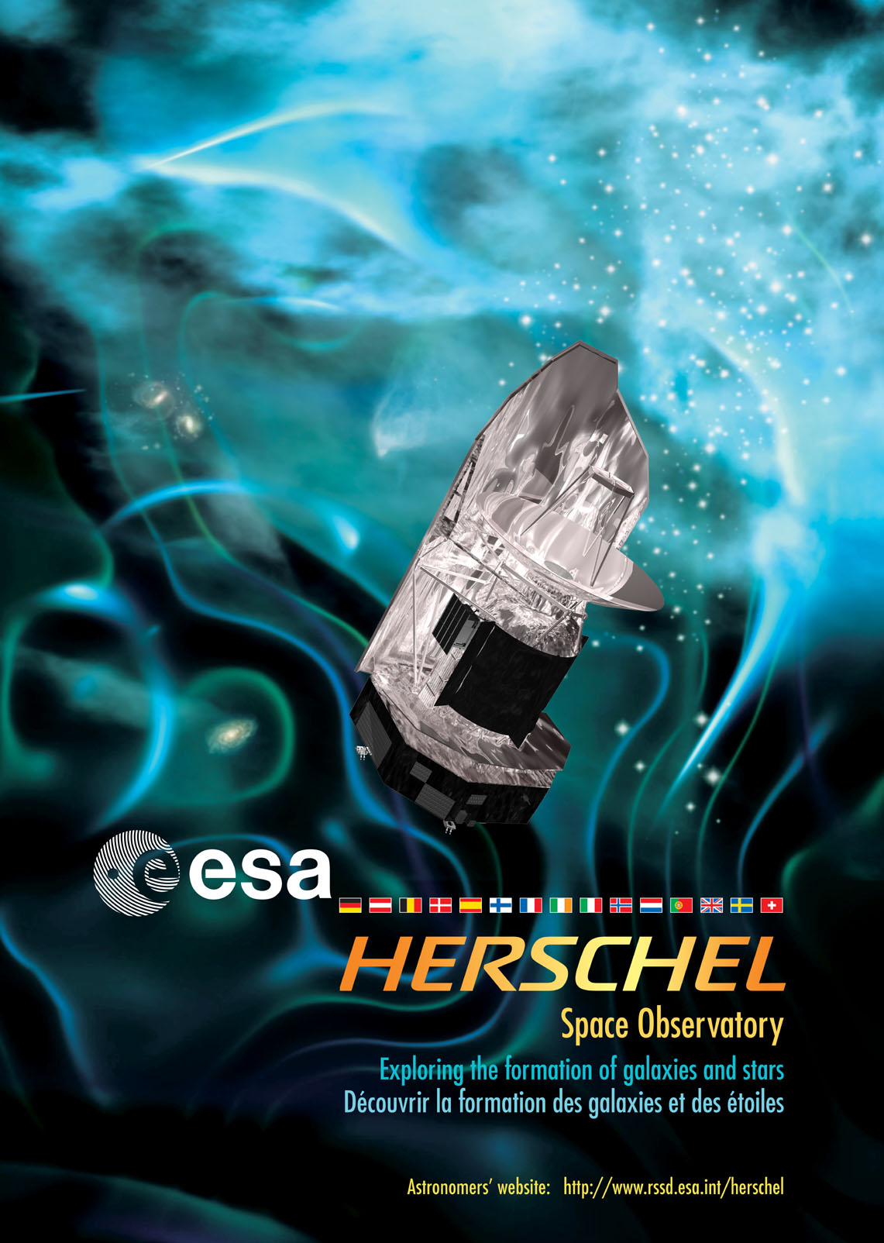
Herschel Space Observatory:
Instrument Simulations
Bruce Sibthorpe
UK Astronomy Technology Centre

Slide 2
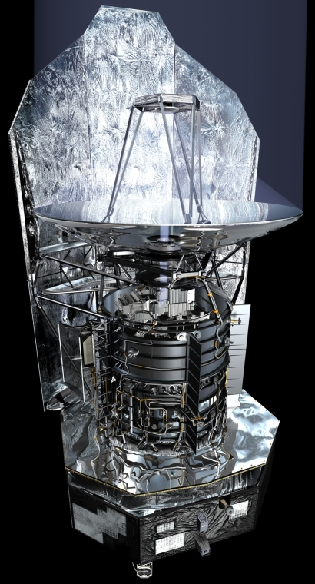
Mission Overview
Telescope diameter 3.5 m
Telescope temperature ~80 K
Effective emissivity < 2%
Operational lifetime ~3 yrs
Launch 14th May 2009
Instruments – PACS, SPIRE, HIFI
Photometry: 6 bands
70 - 500 μm
Spectroscopy: 55 - 672 μm
Orbit L2
Estimated cost €1b

Slide 3
SPIRE: Spectral and Photometric Imaging Receiver
3-band imaging photometer
  250, 350, 500 μm (simultaneous)
  4 x 8 arcminute field of view
  Beams: 18, 25, 36”
Imaging Fourier Transform Spectrometer
  194 - 672 μm
  2.6 arcminute field of view
  Low res: λ/dλ = 15 – 50
  High res: λ/dλ = 300 – 1200

Slide 4
SPIRE Photometer Simulator
Aim
  To produce a software package capable of simulating the in-flight performance of the Herschel-SPIRE instrument
Primary Goals/Uses
  Validate existing sensitivity model
  Study and optimise the available observing modes
  Investigate and characterise the instrument noise performance
  Provide an input test data set to assist in validating pipeline algorithms (e.g. map-making)
Notes:
All primary systems to be implemented to study 1st and 2nd order affects
Required to run on a standard desktop computer
Should run in less than real time

Slide 5
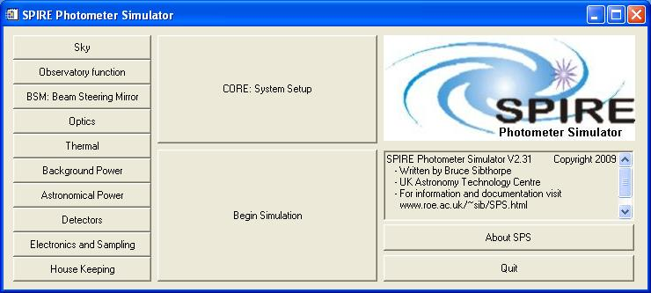
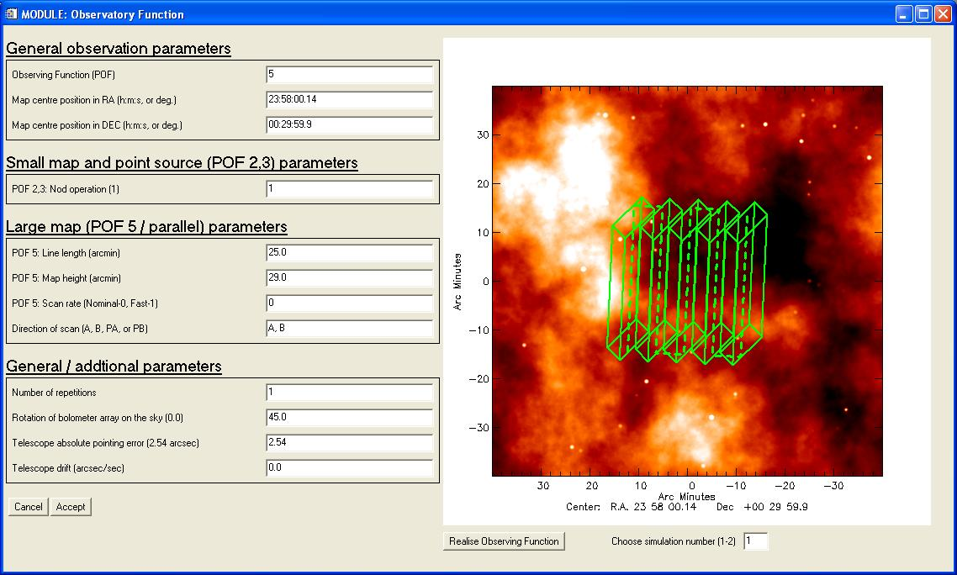

Slide 6
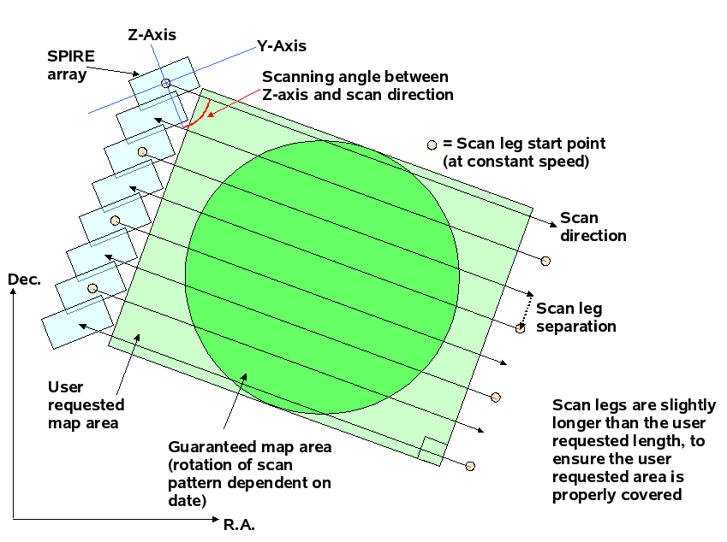
Scan-Map Observing

Slide 7
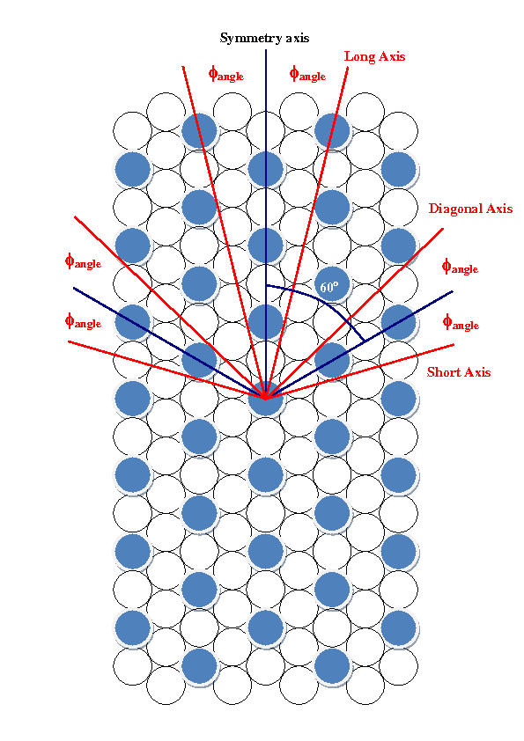
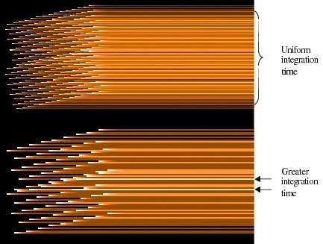
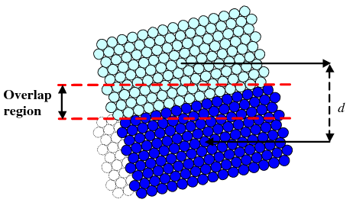
Scan-Map Observing

Slide 8
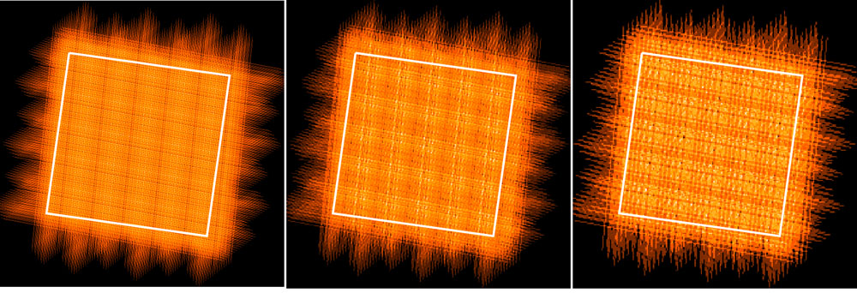
Scan-Map Observing
In-flight coverage maps – 1 sq. deg.
250 μm
350 μm
500 μm

Slide 9
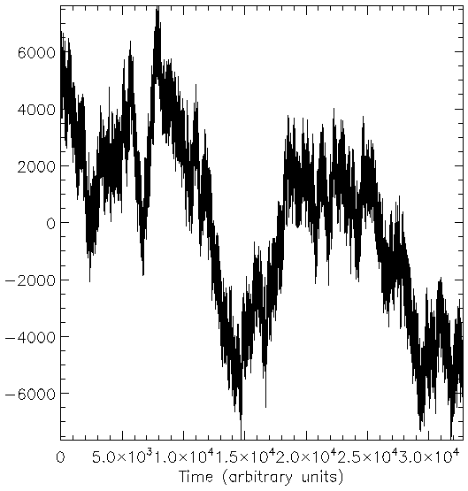
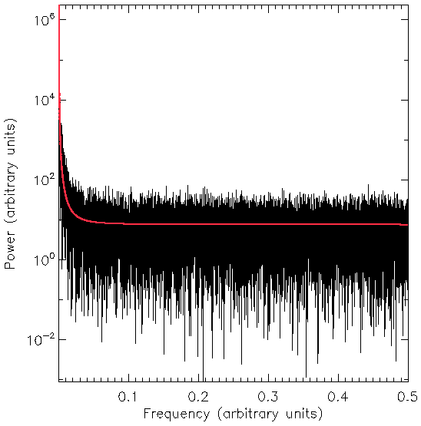
1/f noise
Data and images from Macías-Pérez and Bourrachot (2006)

Slide 10
Effect of 1/f noise on output map
Naïve mapping
Maximum likelihood mapping
Waskett, Sibthorpe, Griffin and Chanial (2007)

Slide 11
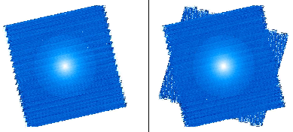
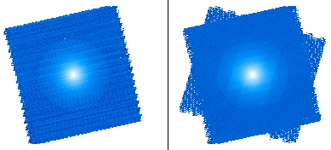
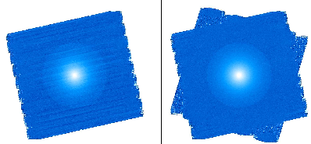
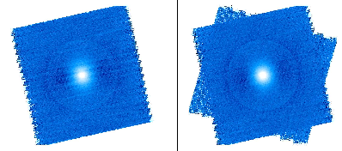
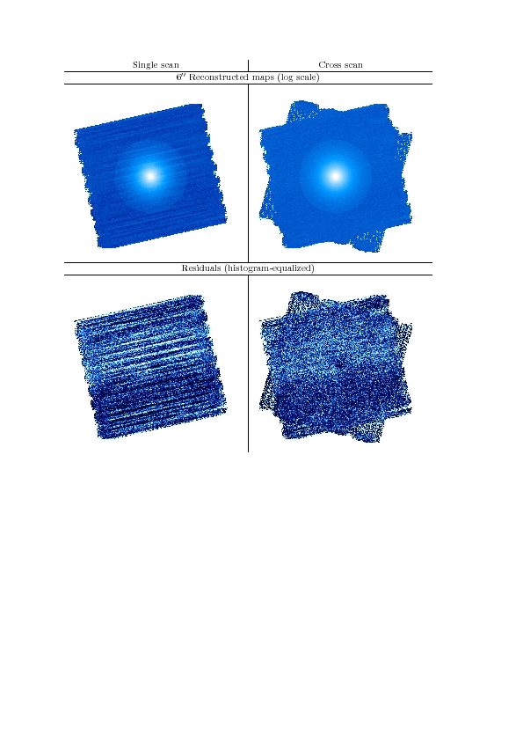
Pipeline Algorithm Development
Naive Mapper
High-Pass Filtering
CM Mapper
Bolocam Mapper
MOPEX Mapper
MADmap Mapper

Slide 12
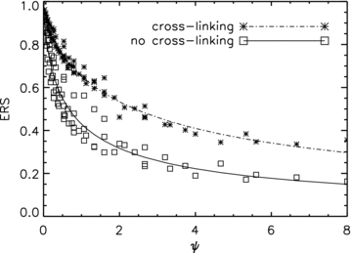
Noise Characterisation
f_{k} λ
θ
ψ =
f - 1/f knee frequency
λ - source angular
scale (arcsec)
θ - telescope scanning
rate
Effective relative sensitivity
ψ
Sibthorpe, Chanial, Waskett and Griffin (2008)

Slide 13
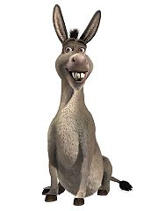
Public Use of the Simulator
Further uses of the instrument simulator
  Survey planning
  Custom software development
  Aid to understanding real data
Requirements for public distribution
  Graphical user interface
  Restricted parameter space
  Locked source code
  Distribution to astronomers

Slide 14
Case Study 1: HiGal – Characterising Saturation
16 offset values
Offset once at the beginning of an observation
Worst case dynamic range between ~50-90 Jy depending on band
Best = 10% saturation
Nominal = 30% saturation
Worst = 50% saturation

Slide 15
Characterising Saturation
Responsivity reduced by increasing detector voltage bias
Decreases dV/dS_{ν}
Positive: provides higher dynamic range
Negative: reduces sensitivity to small signal variations
Negative: Loose on array thermometry
Negative: Increase in bolometer noise level
Responsivity (V/W x10⁸)
V_{bias} (mV)

Slide 16
Characterising Saturation
Blue = 10% saturation
Green = 30% saturation
Red = 50% saturation

Slide 17
Input Sky Simulation

Slide 18
Vertical Scan Map
Horizontal Scan Map
Co-added Map
50mV Vbias
Nominal Vbias

Slide 19
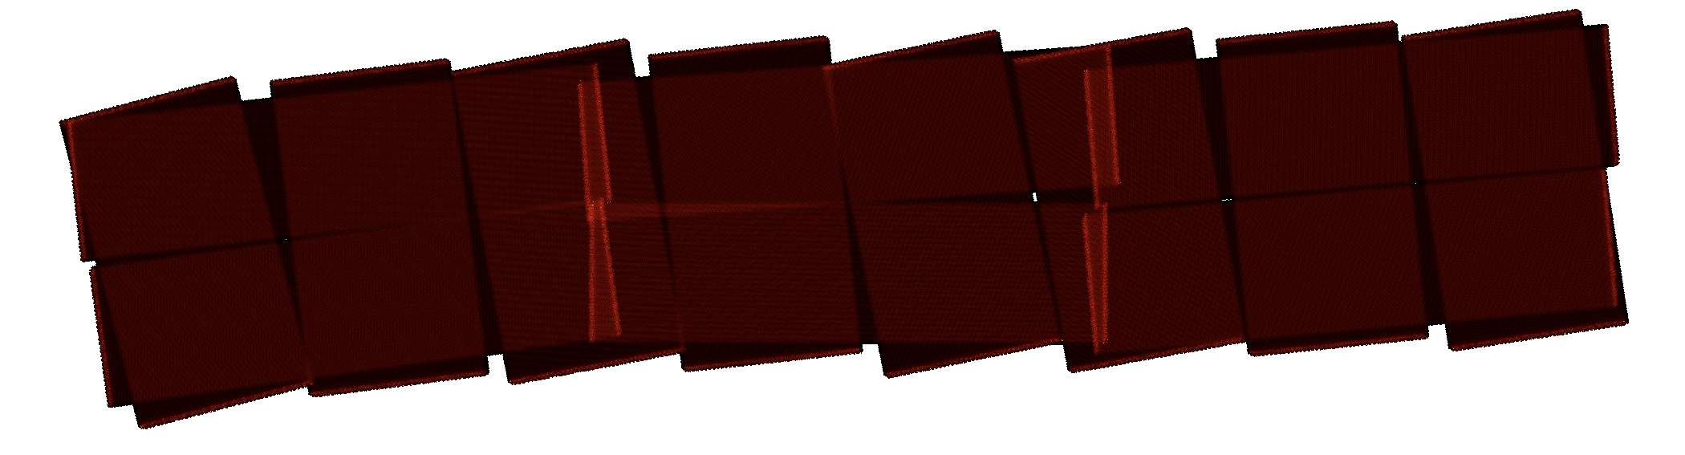
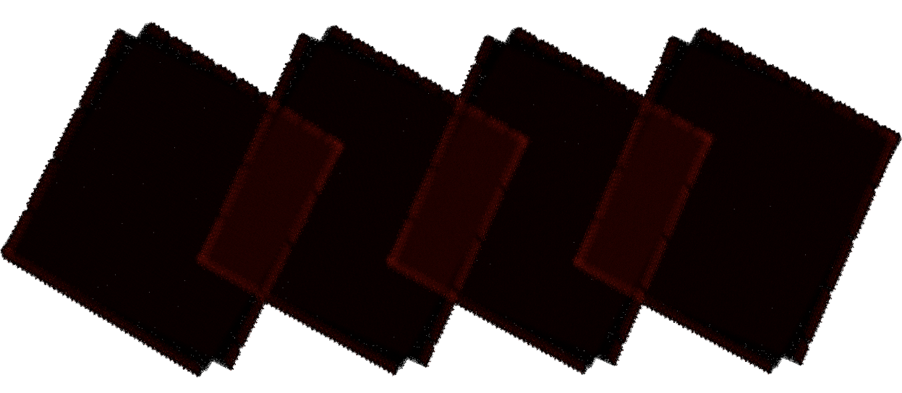
Case Study 2: H-ATLAS – Observation Planning

Slide 20
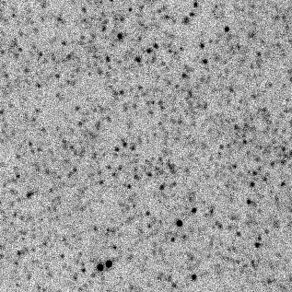
Comparison of Extra-Galactic Fields
Simulated
Observed

Slide 21
Case Study 3: GT Debris Disc Survey – Observation Planning
Input
Jiggle Map
Scan Map
250 μm
350 μm
500 μm

Slide 22
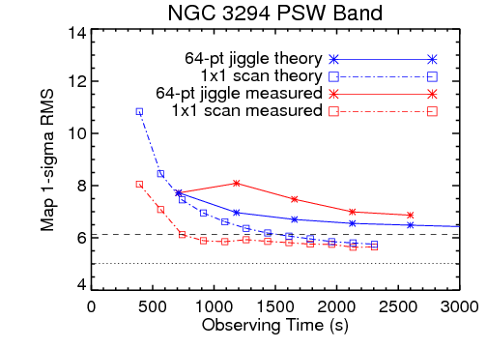
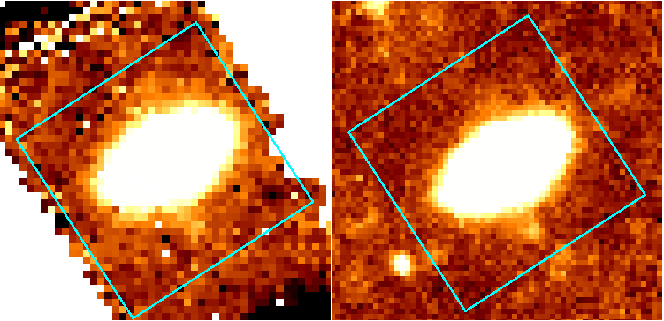
Case Study 3: GT Debris Disc Survey – Observation Planning
Theoretical - Chop/Jiggle
Theoretical - Scan-map
Measured- Chop/Jiggle
Measured - Scan-map
Chop/Jiggle-Map
Scan-Map

Slide 23
Conclusions
Software simulators:
  provide significant insight to a project at any level of sophistication
  are useful at all stages of a project, from instrument design through to data analysis
Simulation programmes should be developed alongside hardware and software, with the development of both providing two-way feedback
Simulator software requires dedicated management with close interaction with sub-system specialist to ensure maximum project return
Efforts should be made to ensure that the software is accessible as possible, e.g. programming language and interface

Slide 24
