Slide 1
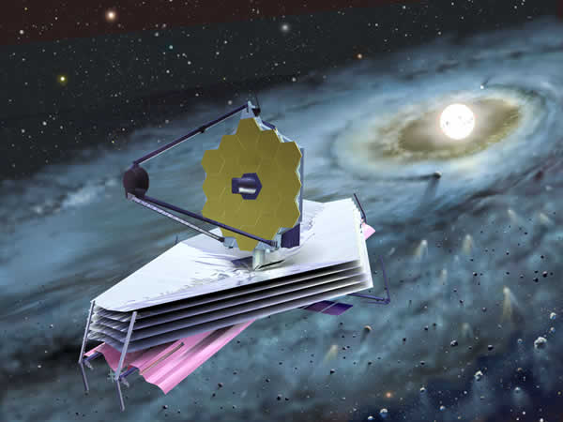

Simulating JWST-MIRI data with the Multi-Object Simulator (MOSim)
Owen Littlejohns,
Paul O’Brien & John Pye
Department of Physics & Astronomy
University of Leicester

Slide 2
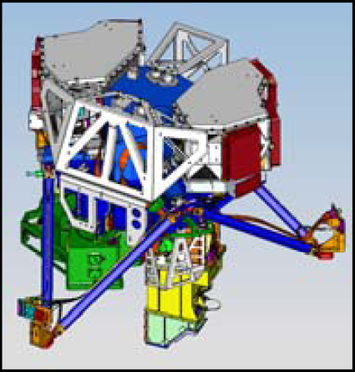
MIRI:
Mid-Infrared Instrument (5-29 μm)
Capable of imaging and spectroscopy (low and medium resolution)
0.11 arcseconds.pixel⁻¹
84” x 113” imaging field of view
Fig. 1: CAD model of MIRI produced at the University of Leicester, using Siemen’s ‘IDEAS/NX’software

Slide 3
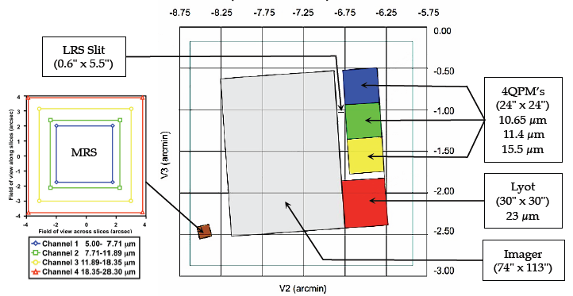
MIRI detector plane:
Fig. 2: MIRI detector plane showing location of the imager, MRS, LRS and coronographs (taken from the MIRI pocket guide)

Slide 4
MOSim rationale:
Initially designed to support the high redshift working group within the MIRI science team
Consider observing strategies
Assess source detection software
Verify detection limits
Provides full detector plane image to detector simulator (SCASim)

Slide 5
MOSim particulars:
Software written in IDL
Uses the IDL astronomy library
Simulates the imaging capabilities of MIRI
Package contains ancillary data, such as background models and PSF images
Also includes minor functions

Slide 6
MOSim:
Can cope with a variety of input flux units (e.g. Janskys or AB magnitudes)
Input consists of a ‘Sky’ FITS image
Accounts for reflections off both JWST and MIRI optics
Implements MIRI PSF and JWST effective area
Includes a background model (zodiacal light and JWST thermal emission)

Slide 7
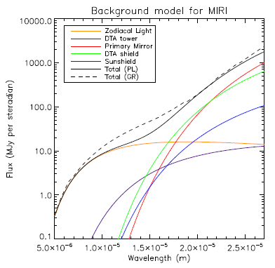
MIRI background model:
Fig. 3: Background model, including individual components (courtesy of A. Glasse)

Slide 8
Outputs:
Designed to produce SCASim compatible outputs (detector plane illumination image)
Also has a simplified version of detector characteristics, which includes Poisson noise, quantum efficiency and dark current
Dead time on detector due to cosmic rays is also simulated
All outputs are in FITS format

Slide 9
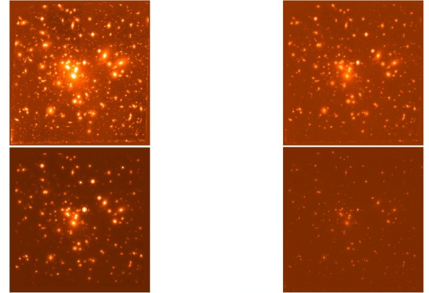
Abell 1689:
Fig. 4: Top left: 5.6 μm simulation, top right: 10 μm simulation, bottom left: 25.5 μm simulation, bottom right: original HST ACS image (courtesy of Jens Horth)

Slide 10
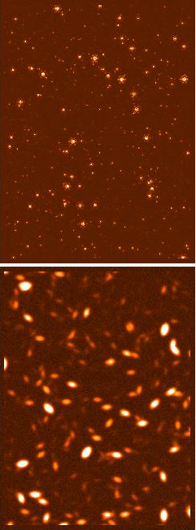
Example 1: Sources from Spitzer fluctuations:
Used logN-logS distributions from Spitzer fluctuation analysis (Savage and Oliver, 2005)
Can do point or extended sources
Fig. 5: Top: point sources from Spitzer logN-logS, bottom: extended equivalent

Slide 11
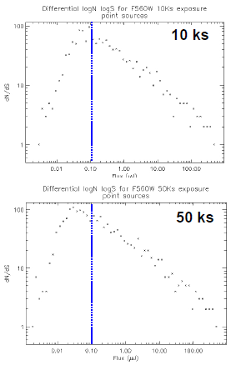
Source recovery from logN-logS:
Sources detected with SExtractor
Simulation agrees with 10σ, 10 ks sensitivity limit modelled by A. Glasse
All sources above this limit appear to be detected
Can see the improvement of detection limit with increased exposure time
Fig. 6: Sources detected from logN-logS simulations (blue line is the 10σ sensitivity limit from A. Glasse model)

Slide 12
Example 2: A deep field simulation:
Taken source catalogue from LAM (courtesy of Le Fevre and Ilbert)
Simulated entire catalogue in a 10 MIRI FoV image (6.54 x 10⁻³ sq. deg.)
30 ks exposure per pointing
Know the input sources, so can assess efficiency of source detection

Slide 13
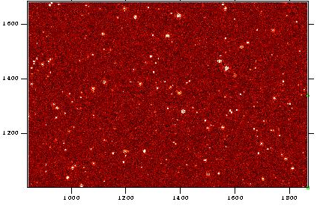
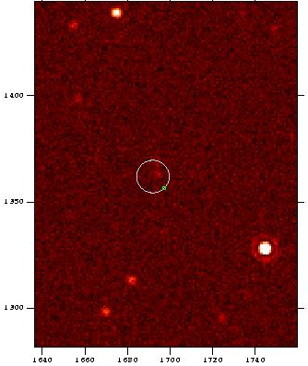
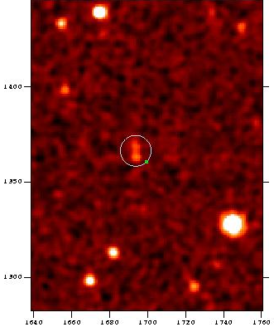
Example images:
Fig. 7: 1 MIRI FoV taken from LAM catalogue simulation. 30 ks exposure per pointing (includes simplified detector noise), point sources only
Fig. 8: Zoom in view of region containing AB ~ 27 object. Detected by SExtractor at SNR ~ 10. (Left is raw image, right is smoothed image)

Slide 14
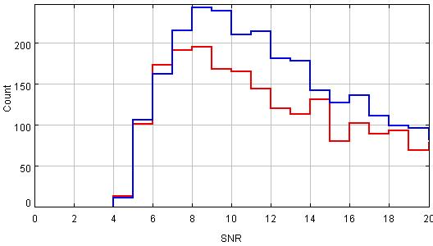
Source recovery:
Used SExtractor on output image
Can assess the issue of depth versus area
Improvement from increased exposure time shown
Fig. 9: Detected sources from LAM catalogue simulations. Red and blue lines denote 30 ks and 50 ks exposures respectively

Slide 15
Further work:
Verify recent alterations to the background model
Include the focal plane mask
Thorough documentation
Run through from input image, to MoSim, to SCASim to DHAS
Optimise source detection software

Slide 16
Conclusions:
MOSim produces full field, multi-object imager simulations
Powerful tool in assessing observing strategies for deep fields or large surveys
Modelled sensitivity limits appear accurate when tested over a large sample of sources

