Slide 1
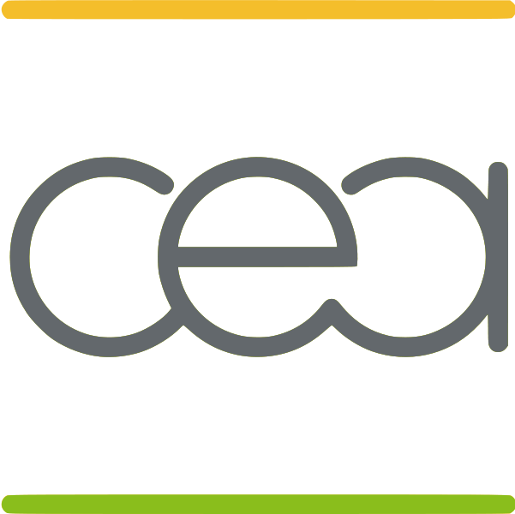
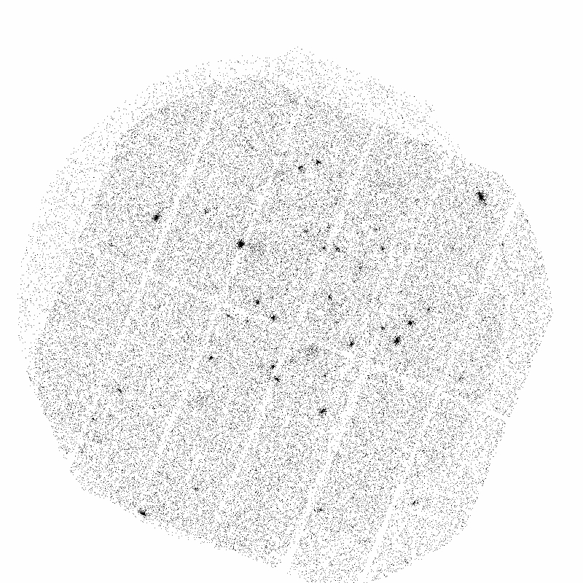
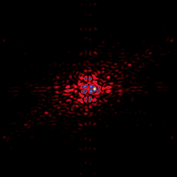
Writing Instrument Simulators
XMM 5 keV (2.5 A)
MIRIM 11.4 μ
PACS 160 μ
René Gastaud
CEA-IRFU/Sedi-Sap

Slide 2
Writing Instrument Simulators: Introduction 1
I work in cea saclay for space missions since 1991.
Lessons (hardly) learned from experience:
  What is never said…
1997-2011: fourteen years of mistakes summed up in a talk:
4 different simulators (xmm, pacs, spire, mirim) in 4 different languages (C++, Java, Jython, IDL)
  From small projects (2 men-month) to mean projects ( 30 men year)
  The most important thing for a simulator is to be used.
  The key for this is to have users !
  Fine prints
  Disclaimer:
  Opinions expressed here are mine, mistakes are mine, and numbers are approximate, namers are not quoted.

Slide 3
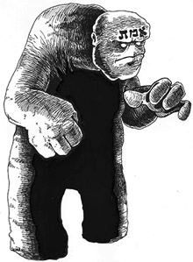
Writing Instrument Simulators: Learning from the past 2
Learn from the past
  Prague XVI century : the Golem
The problem: control
  Only one command play/stop
  ON : write אמת
  OFF erase the first letter (in the front)
  Quite difficult when moving!
  Program which runs bersek and freeze keyboard
  Turn off the computer …

Slide 4
Writing Instrument Simulators: Learning from the past 3
Learn from the past
  Geneva XIX century : the Frankeinstein Creature
The problem: users (and creator) are afraid
  Program patchwork

Slide 5
Writing Instrument Simulators: xmm/EPIC 4
Xmm – Newton: space observatory for X ray, launched december 1999 , death 2012
3 x-ray camera EPIC
Size of the project:
  First version 3 months with a programmer and a trainee, following the user/astronomer requirement, delivery august 1997 (two years before launch)
  Minor modifications: add some inputs, give more flexibility, iron some bugs (last 2010)
Goal: Test science feasibility (cluster size measurement, etc..)
Good Point: still used to day
The problem: shy astronomer
Used only by this atronomer team ➔ rewritten at ESA (scisim)
Even rewritten in my own lab (one stair down!)

Slide 6
Writing Instrument Simulators: xmm/EPIC 5
Description
small, modular code: the main file is 2000 lines. Documentation reduced to headers. Written in c/c++ language. Each module has its header.
The code is good enough to have modifications made by 3 persons without the help of the first writer.
Three simulation steps : psf, vignetting, background
Interface
‬InstSimulation options‭ [‬outputfile‭]‬
where options‭ =‬
‭ [-‬B‭]‬ SkyBackground rate due to non-defined sources‭ (‬0‭ ‬cts/s/px‭)‬
…
Usually called from an IDL program, now a python program

Slide 7
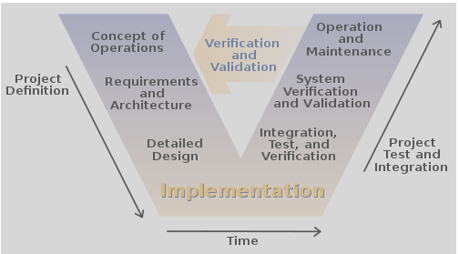
Writing Instrument Simulators: herschel/pacs 6
Herschel Space Observatory:
launched 2009, mirror 3.5m, see Bruce Sibthorpe presentation
Size of the project
  More than 6 years with more than 6 persons (2003-2009)
Manager: ESA
Esa procedures, V Model ,
Java Language

Slide 8
Writing Instrument Simulators: herschel/pacs 7
Goals:
Get acquainted with Java, Java API, UML, object oriented programmation.
Test of observation modes (strategy of observation)
Help for calibration of the instrument
Test of science goal
Prototype for the pipeline (experience, API, etc..)
Test of pipeline
Get fresh coffee

Slide 9
Writing Instrument Simulators: pacs 8
  What ESA has in mind: something complex, connected to whole environnement
  (pipeline+ simulator+help+…)

Slide 10
Writing Instrument Simulators: pacs 9
Beginning
  Language imposed by ESA (language of the future, Pascal, ADA, etc..)
  No numerical library, Fits reading but not writing…
  UML used for design, does not prevent errors:
  Low Level errors : two methods with only the type of the return value different)
  High Level errors : too many objects
  Impossible to get the format of the input/output of the pipeline (calibration)
  Our own design

Slide 11
Writing Instrument Simulators: pacs 10
First Try
  Memory explosion, factor of 10 too slow…
  Beginner error: everything was object (angle, length, ect…)
  Advantage : object with unit, no metric mishap to disintegrate Mars Climate Orbiter
  “Too early optimisation is a sin”: first have a working program, then optimize.
  False: impossible to test and correct the program if ia simple example can’t work in a reasonable time. Need to change the architecture and rewrite the program
  Second Try
  Program rewritten fortran IV style: no object, a big main loop➔ works.
  Don’t need java to write fortran style program!

Slide 12
Writing Instrument Simulators: pacs 11
  as designed by UML rewritten so that it works (no object)

Slide 13
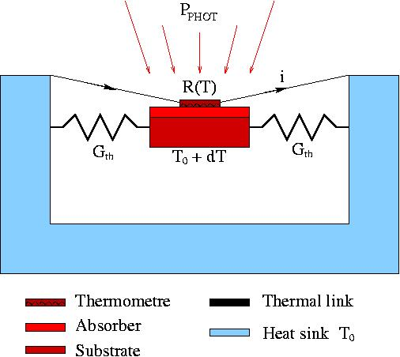
Writing Instrument Simulators: pacs 12
Going to deep in the physics, e.g. :
  Bolometers are thermal detectors :
  R(T) ∝ exp(1/√ T)
  C_{th} dT/dt = P_{PHOT} + P_{JOULES} – G_{th} (T-T₀)
    T = Q/C_{th} , C_{th}∝ m x T³
At the end, in the pipeline, only a response curve ➔
we should have started with a response curve,
then add a full model when the other problems are solved (easy with object programming)

Slide 14
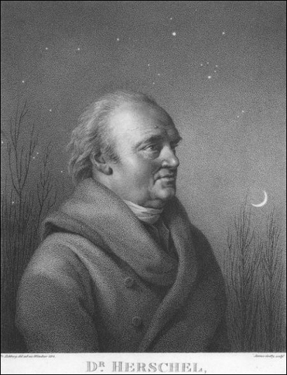
Writing Instrument Simulators: pacs 13
  In 2009 some users don’t want java : simulator simplified, rewritten in IDL.
  YAPS uses pipeline calibration files, works only for the scan mode, and uses a background extracted from real data. Pointing was more realist. About 5 persons 2 months, used for COSMO survey.
Yet Another Pacs Simulator
astronomer

Slide 15
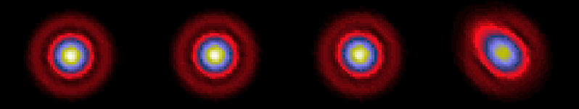
Writing Instrument Simulators: pacs 14
  We should have started with this, but pipeline did not exist, and scan mode was not unique.
  Conclusion: a failure.
  No more than 3 users!
  http://herschel.esac.esa.int/twiki/bin/view/Pacs/PacsSimulator
  Used to check the psf spread during a scan with time:
Vscan =
0 ’’/s
10 ’’/s
20 ’’/s
60 ’’/s
Only two modules re-used by the pipeline:
computing the coordinates of each corner of each bolometer
making a crude map

Slide 16
Writing Instrument Simulators: pacs 15
Too complicate:
Going in all details: electronic delays, chopper mirror kinematics, bolometer physics, etc..
No link with the Pipeline
Too early first the pipeline did not exits, then it was not documented and closed.
Simulator is about 4 megabytes (sources, classes and input files), needs 600 megabytes of RAM
Pipeline is about 10 gigabytes and needs 4 gigabytes of RAM.
Warning from the simulator team ignored by pipeline manager.
Solution : shift man power from simulator to pipeline (but politics)
Not enough users interaction
An example : the first simulator output was not welcomed by the user,
because it was noise dominated.
But this always the case with raw data in IR (background = 1000*signal)
You can not reduce the data with a non existing pipeline
Add control, artificial magnification of the source and/or bacgrkound can be put to zero
(also usefull for debuggging)

Slide 17
Writing Instrument Simulators: Spire 16
Spire is another instrument of the Herschel observatory, see Bruce Sibthorpe presentation.
Goal : Pipeline Test
Very crude simulator for testing the pipeline for chopping/nodding modes.
Done by two persons during 3 weeks in java/jython, possible by re-using part of pacs simulator and by our knwoledge of spire instrument.
Cloning: Start from a real observation, replace the bad chopper motion by the correct one, compute the position and the flux of the sources: we avoid to compute all the ancillary flags.
Success: Used until we have real data.

Slide 18
Writing Instrument Simulators: Mirim 17
MIRIM is the imager of the Mid Infrared Instrument (MIRI),
one of the three scientific instruments on the James Webb Space Telescope (JWST).
MIRIM will provide imaging between 5.6 μm and 25.5 μm,
low resolution spectroscopy (LRS) between 5 and 10 μm,
and coronagraphy at 10.65 μm, 11.4 μm, 15.5 μm and 23 μm.
See Steven Beark, Owen Littlejohns
Goal : write a simulator for MIRIM.
Starting point : a simulator for the coronograph written by an astronomer in IDL
for its own usage.
Problem : the program contains hard coded parameters:
need to rewrite the code to change the position/ number of planets!,
no documentation, and no experts avalaible (deadline ahead!),
Solution: all parameters in two files:One for the user, one for the developper.
In the one for the developper, the telescope diameter (usefull for RAL calibration campaign)
The code for imager and spectrometer can not use the routines of the corono,
too dedicated ➔ separated modules

Slide 19
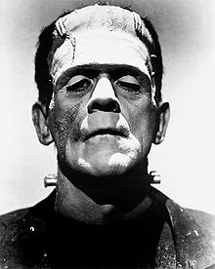
Writing Instrument Simulators: Mirim 18
Frankestein code : patchwork with no use of commonality.
Solution:
Analysis of the problem (UML), Write the code in python.
So this simulator can be included with Steven Beard modules, and the future pipeline.
Should have started there, the quick and dirty solution costs time !
Prototype with TAMASIS (see Pierre Chanial Talk): done in half a day, 2 persons. It is at least 10 times quicker and 10 times lighter.
It uses standard components of Tamasis which are highly optimised.
It has an python interface.
First rejected by the project manager (keep the existing code)

Slide 20
Writing Instrument Simulators: interface 19
Exemple of a configuration/properties file
# GENERAL PROPERTIES FOR SIMULATOR #######################################
# $Id: simulator.props,v 1.27 2008/09/23 13:51:08 rgspire Exp $
#
# modified by hand May 26th 2009 by Rene gastaud
# for bolosim.jar version 1.38
#
# Copyright (c) 2008 Commissariat a l'Energie Atomique
#
# Pointing errors
# angle in arcseconds time in seconds
# 4 hertz
Simulator.pointing.frequency=4.
# // 4 arcsecond/second/second
Simulator.pointing.gamma=4.
# Time constant for each pixel
Simulator.PhotometerBlueTConstant=PhotBlueTimeConstant.fits
!

Slide 21
Writing Instrument Simulators: interface 20
Example of an output fits file
HISTORY debug=false/ not given by the user, use default value
HISTORY photometerQuick=false/ not given by the user, use default value
HISTORY backgroundFlag=true/ given by the user
HISTORY distoFlag=true/ given by the user
HISTORY NormalFactor=1000.0/ given by the user
HISTORY oofNoiseFactor=1.0/ given by the user
HISTORY Beta 1.39 / parameter of the bolometer
HISTORY
BoloSimulatorScan $Revision: 1.5 $
User=Gastaud
Date=Mar 11 oct 2011 00:46:09 CEST / better in english
!

Slide 22
Writing Instrument Simulators: Conclusion 21
Users/astronomers
  Requirements
  check the ergonomics (naming convention)
  interface
Instrument Specialist
  Gives the behaviour othe instrument
  check that nothing has been forgotten
Software Developper
  Use as much as possible standard libraries (CFITSIO)
  Keep It Simple
  and then Grow…

Slide 23
Writing Instrument Simulators: Conclusion 22
Language, Tools
  Language selected by the user and not the project manager.
  Control Configuration
  Documentation
Spiral Development
  Keep It Simple
  and then Grow…
  Start with 2 sheets of paper with the physics
  module, unit test

Slide 24
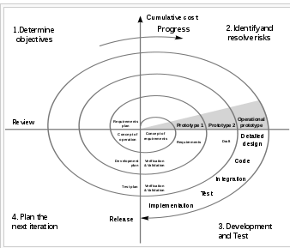
Writing Instrument Simulators: Conclusion 23
Beware, this is for good interaction with the users, should be stopped at a reasonable
Stage (e.g. changing upper case in lower case, should have been done before!)
See Agile, etc…

Slide 25
Writing Instrument Simulators: Conclusion 24
Input Output
  Simple ascii input parameters file with control for each step (switch on/off and more)
  GUI : only if needed
  No hard coded variables (put them in a “hidden” file) : this is
  Beware a simulator is as good as the parameters (instrument knowledge)
  output in one fits file with history
  compatibility with pipeline: calibration files, simulator output must be the pipeline input
  possibility to blend with real data

Slide 26
Writing Instrument Simulators: Conclusion 25
Do Anything to Attract Users/astronomers
  Advertisment pays! GitHub (or whateve works)
  (and don’t believe that your code will be stolen, modified)
Post Scriptum:
Theses problems can be found outside the academic word,
I have seen triplication in the industry, strong egoes and bad decisions..

Slide 27
END

Slide 28
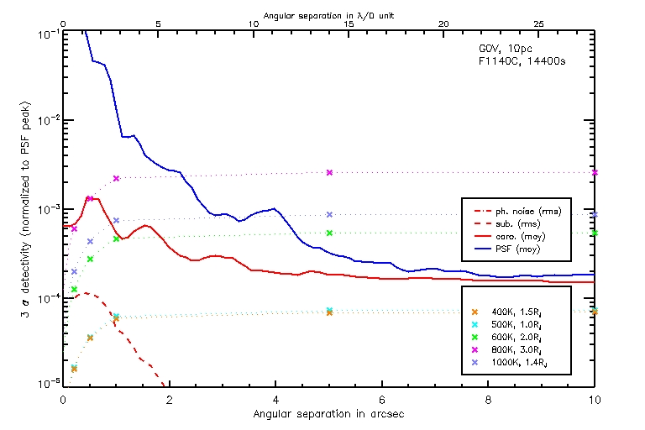
Writing Instrument Simulators: Mirim 18
coronograph output: visibility of a planet.

