Slide 1
Anisotropic Clustering of Galaxies in High-z Universe as a Probe of Dark Energy
Taka Matsubara (Nagoya Univ.)
“Decrypting the Universe: Large Surveys for Cosmology”
(Edinburgh, Scotland) 10/24/2007

Slide 2
How to constrain dark energy by galaxy surveys
Anisotropy in the galaxy clustering constrains dark energy
comoving space redshift space (z-space)
observer
Alcock & Paczynski 1979; Ballinger et al. 1996; TM & Suto 1996

Slide 3
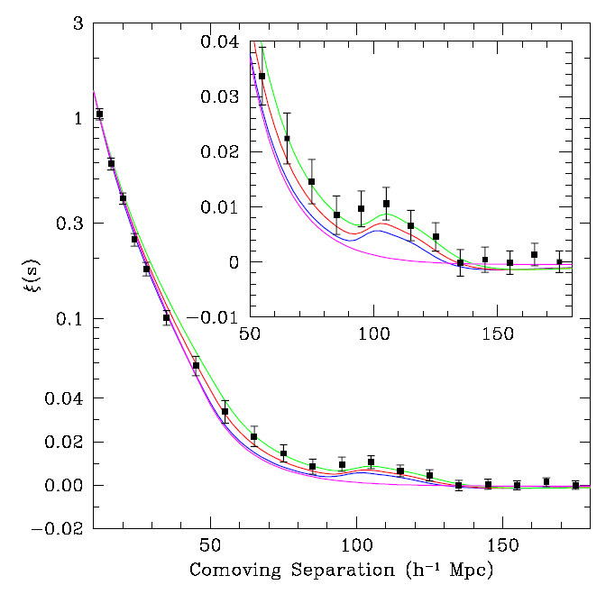
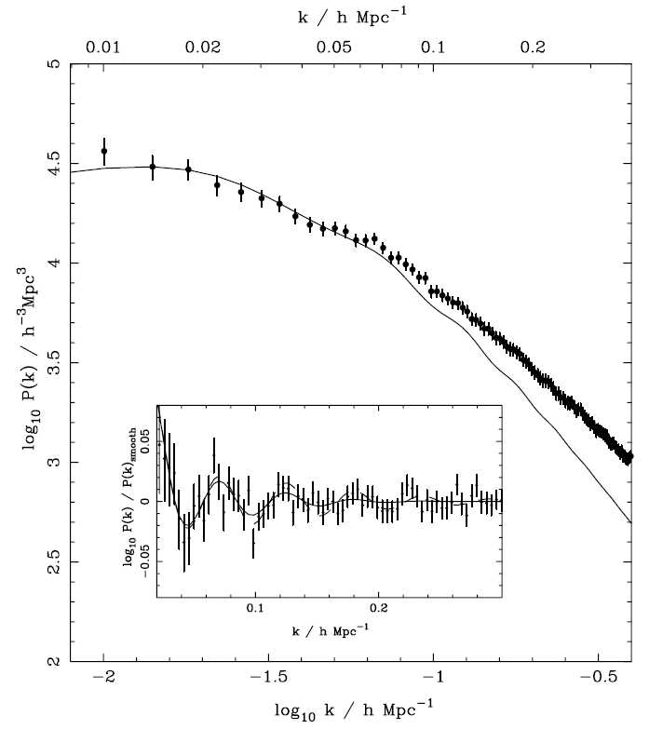
BAO: a standard ruler in the large-scale structure
Baryon Acoustic Oscillations: BAO
  Acoustic scales determined by physics in the early universe
    ⇒ A standard ruler : ideally spherical object in the universe
In correlation function ξ(r)
In power spectrum P(k)
Eisenstein et al. (SDSS) 2005
Percival et al. (SDSS) 2007

Slide 4
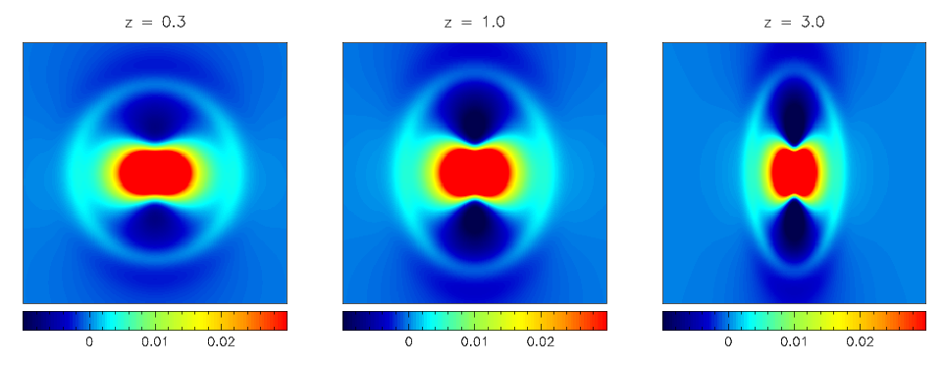
Anisotropic Correlation Function
Anisotropic clustering in observed z-space
  2D correlation function
Lines of sight
TM 2004
z = 0.3
z = 1
z = 3
BAO ring
(Kaiser’s squashing effect)

Slide 5
Anisotropic Correlation Function
Measurement of 2D correlation function
Dark energy, w
40<s<200Mpc/h
60<s<150Mpc/h
Okumura et al. (SDSS) 2007, submitted

Slide 6
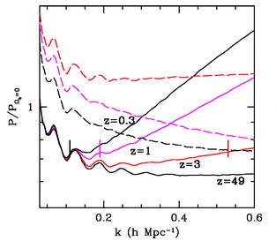
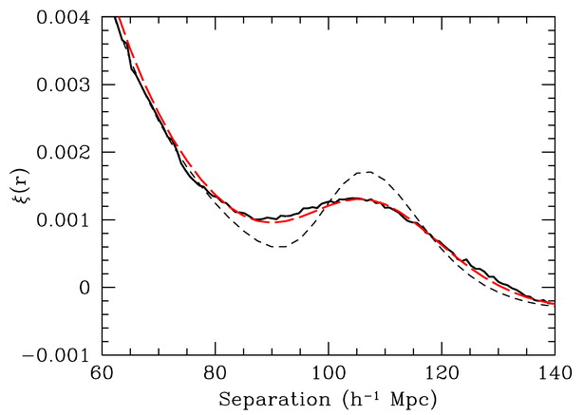
Nonlinear effects and redshift-space distortions
Nonlinear effects and redshift-space distortions
  Even though the BAO scale (~ 100 h⁻¹Mpc) is large, nonlinearity affects the BAO signals in P(k) and ξ(r)
  Nonlinear redshift-space distortion effects on BAO
z = 0.3
Eisenstein & Seo 2005; Eisenstein, Seo & White 2007

Slide 7
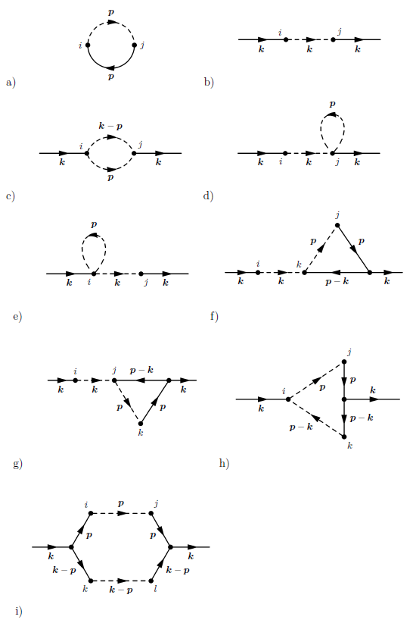


Resummation in perturbation theory (PT)
Standard 2nd order PT does not work well on BAO scales (z ~ 0 - 3)
Attempts to improve the standard PT
  Partial inclusions of higher-order terms
    Renormalized PT (Crocce & Scoccimarro)
    Large N expansions (Valageas)
    Renormalization group method (Matarrese & Pietroni)
    Closure theory (Taruya & Hiramatsu),…
A new resummation technique (TM 2007, submitted)
  Starting from Lagrangian picture
  Better than standard PT
  Capable of calculating nonlinear P(k) and ξ(r) in redshift space
Disconnected bubble diagrams are resummed
(via Lagrangian picture)

Slide 8
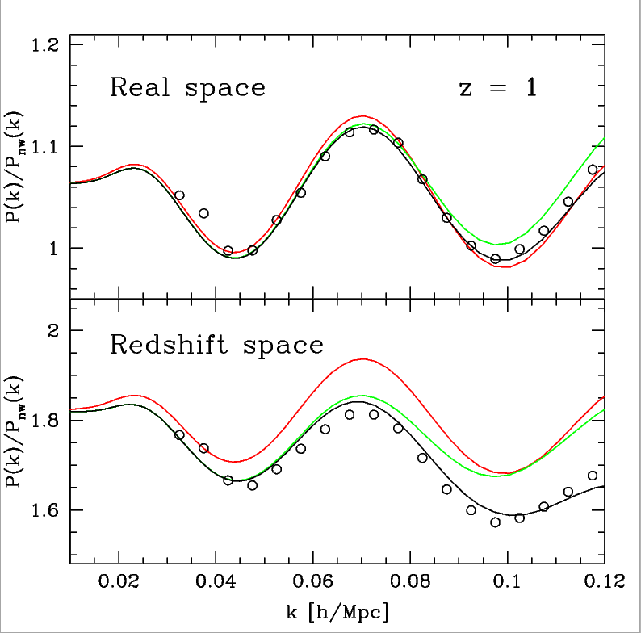
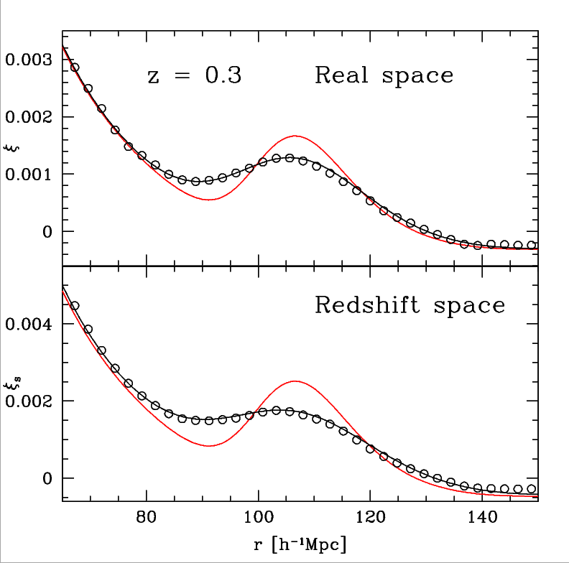
Resummation via Lagrangian picture
A new resummation technique via Lagrangian picture
  Good agreements with N-body simulations
  P(k) and ξ(r) in real space and in redshift space
Linear theory
2nd order PT
N-body
This work
N-body
This work
Linear theory
TM 2007, submitted (points from N-body simulation of ES 2005)

Slide 9
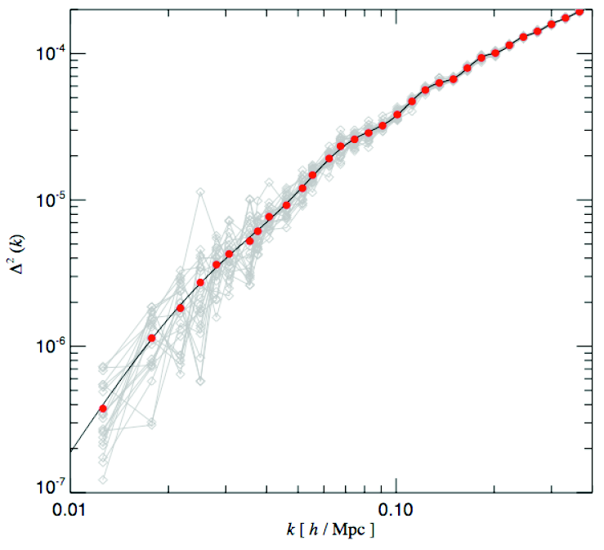
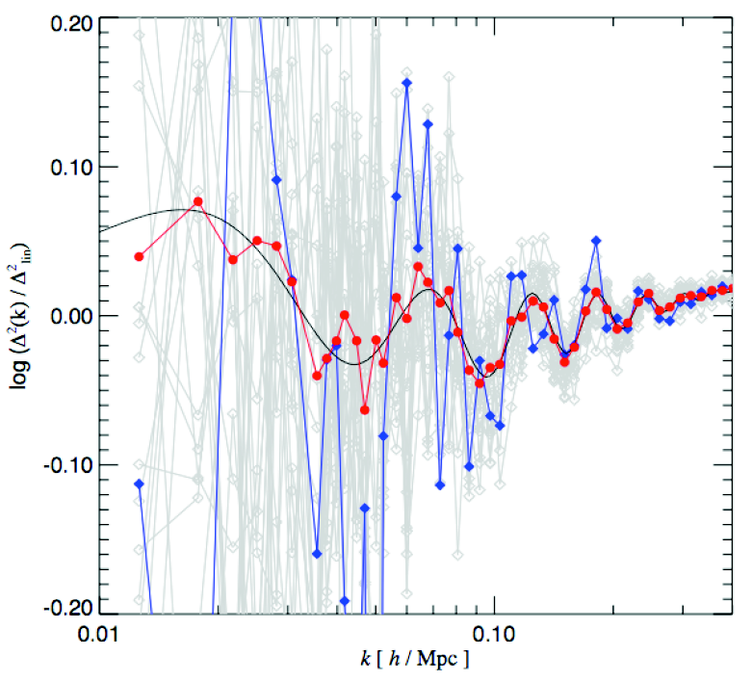
Technical Issues
Statistical analysis of BAO is delicate
  Estimating the power spectrum is not a trivial task
    e.g., each Fourier mode is randomly distributed around a theoretical power spectrum
  Proper analysis of the data correlations is required
Millennium Simulation (courtesy N. Yoshida)

Slide 10
From Takahashi-san’s POSTER
Growth rate of each mode
500 Mpc/h 256^3

Slide 11
Summary
Galaxy clustering in high-z universe constrains the dark energy
  Geometrical effects
  BAO as a standard ruler
  Analysis of 2D correlation function
Nonlinear effects and Redshift-space distortions
  A new theory with a resummation technique via Lagrangian picture
Beyond P(k), ξ(r) ?

