Slide 1
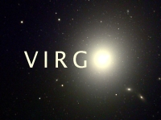
Quenching of Galaxies in Hydro-Simulations: The Eagle Simulation Suite
Michelle Furlong
Durham: Richard Bower, Yetli Rosas-Guevara, Matthieu Schaller, Tom Theuns
Carlos Frenk, John Helly, Adrian Jenkins
Leiden: Rob Crain, Joop Schaye (PI)
Claudio Dalla Vecchia, Ian McCarthy, Craig Booth…

Slide 2
Outline
An overview of the Eagle project
Verification of the Model
Local Universe
Quenching through environment or feedback?
Verification of the Model
Evolution
Summary
NAM - July 2013 – The EAGLE Simulations

Slide 3
The Eagle Project
Gadget-3 + Anarchy
Planck Cosmology
Resolution 10⁶ solar masses
25, 50 and 100 Mpc boxes, with up to 10⁴ MW galaxies
Advanced subgrid physics modules
Star formation
Cooling
Chemical evolution
Stellar feedback -> thermal
AGN feedback -> ang. mom.
Evolution to redshift 0
Gas above density threshold converted to stars stochastically– reproduce KS law
Element by element cooling for each particle
11 elements traced, enrichment from stars
Available energy from 10⁶ solar mass SSP
Energy fraction deposited as thermal energy from local gas metallicity
EAGLE ≠ SAM
BH seeded in halos of 10¹⁰ solar masses
Grow through accretion of low ang. mom. gas in centre of halo
Also through mergers
NAM - July 2013 – The EAGLE Simulations

Slide 4
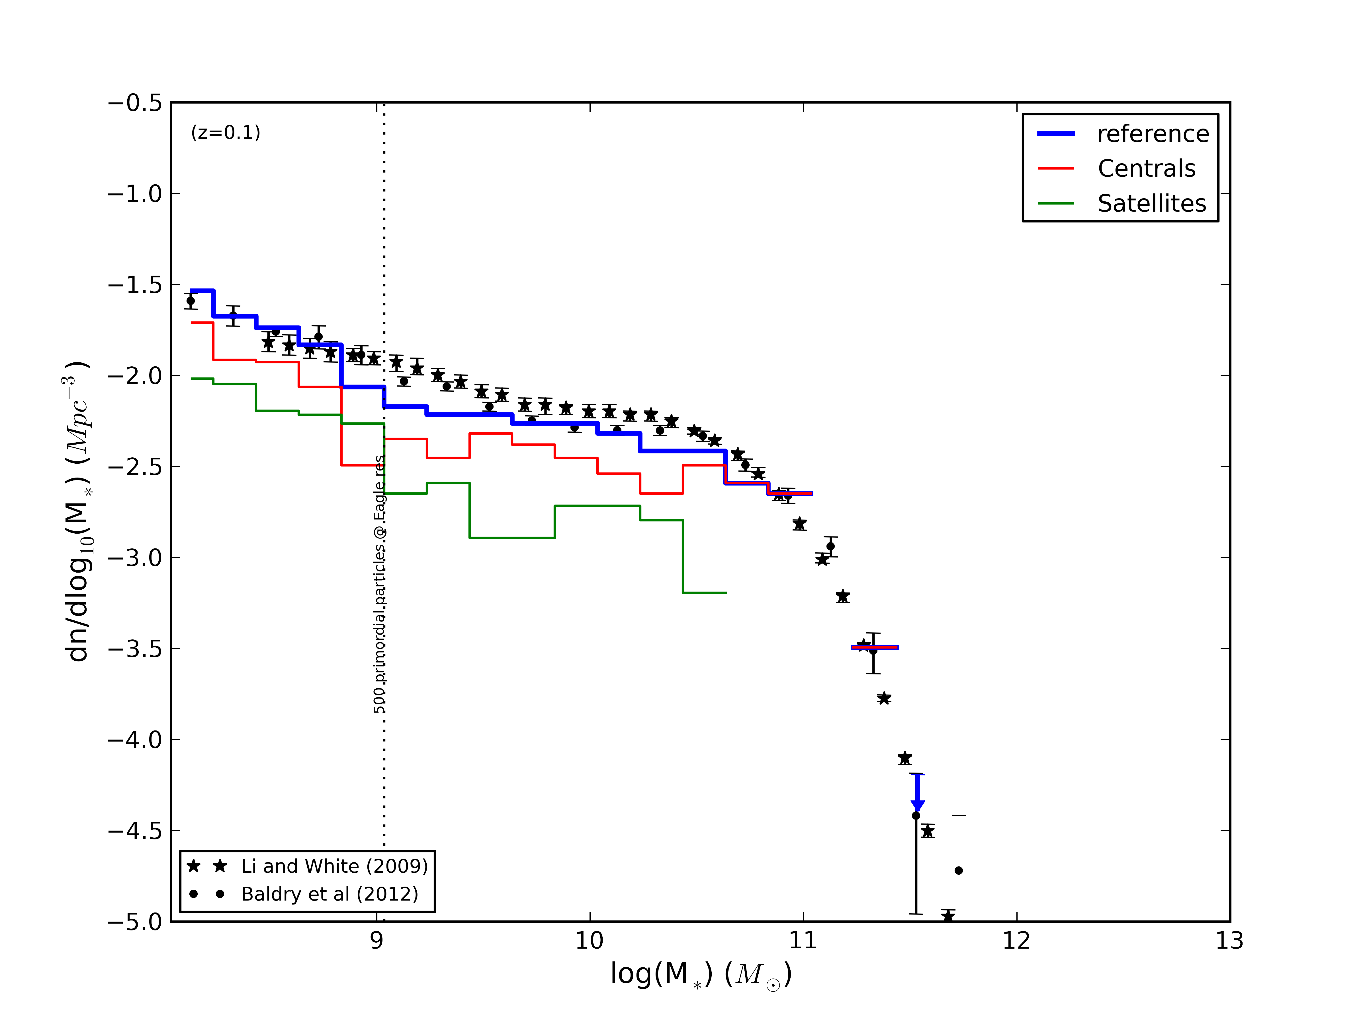
Local Universe Comparison of GSMF to Observations
25Mpc box, reference model with SN feedback scaled with local gas metallicity
Good match to GSMF observational data across large range of stellar masses.
dn/dlog(M*) [Mpc⁻³]
log(M*) [M_{O}]
NAM - July 2013 – The EAGLE Simulations
Notes:
Axes, dotted line, redshift
Different colour lines
Model used (Zdep 0.2, width 1.0, max 2.0, min 0.5)
Comparison with data – as Rob already did…, one object per bin

Slide 5
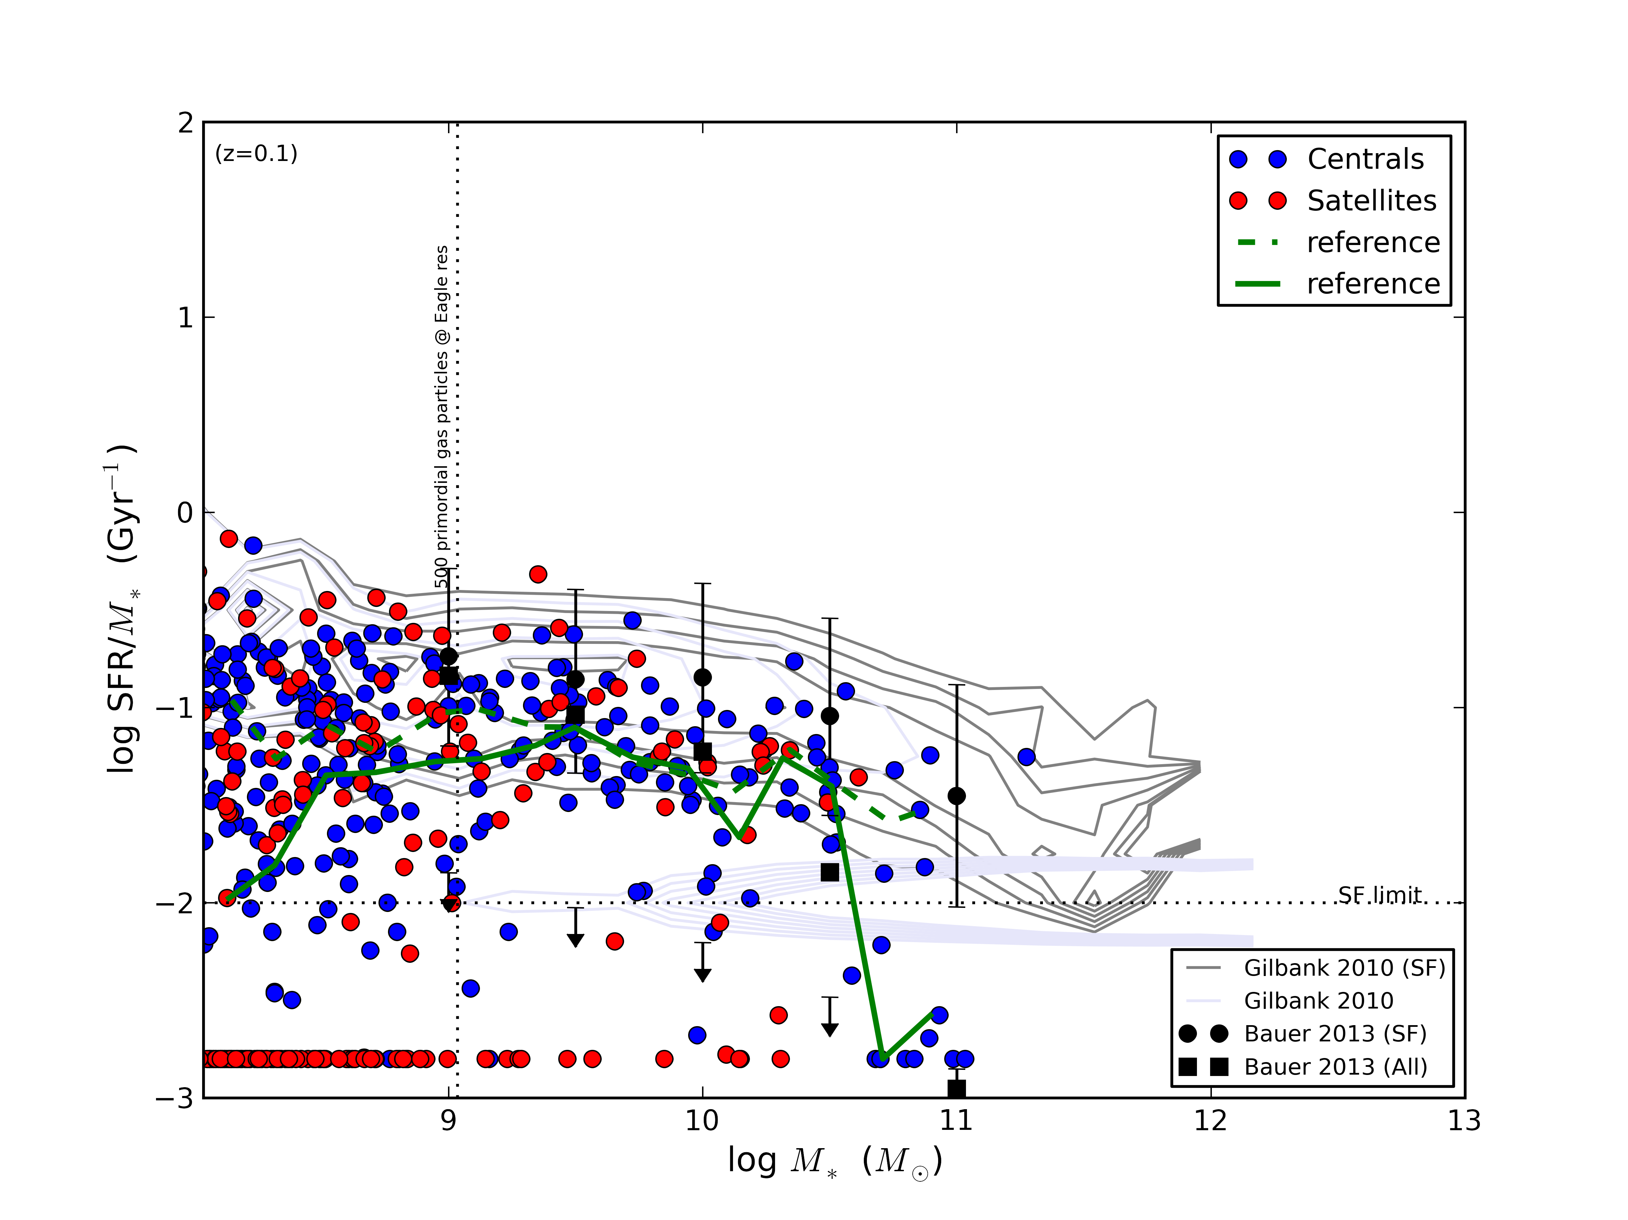
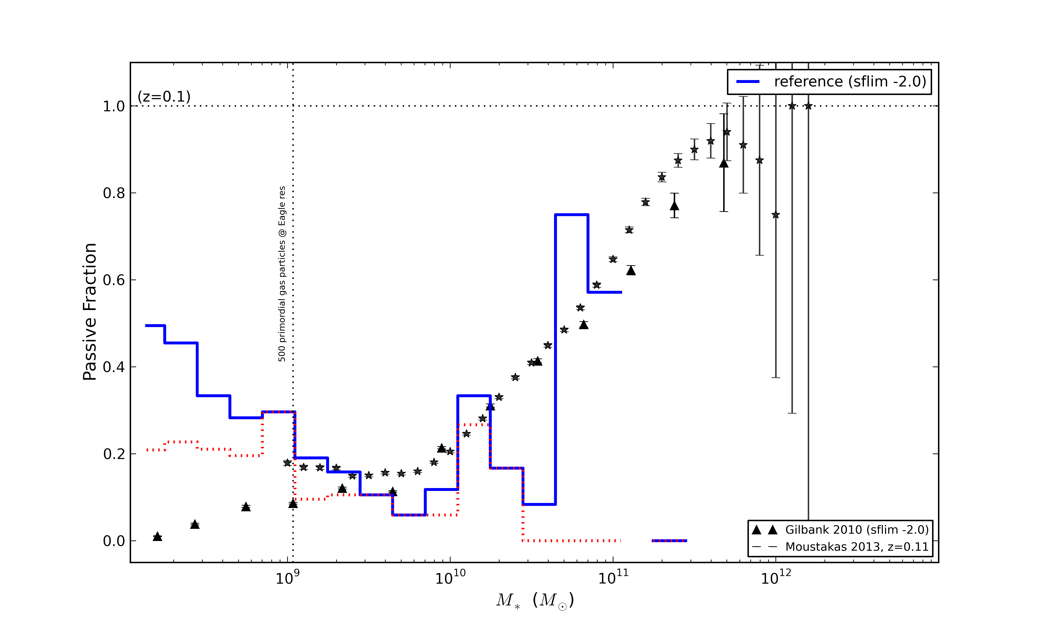
Star Formation Rates
log(SFR/M*) [Gyr⁻¹]
Passive Fraction
log(M*) [M_{O}]
M* [M_{O}]
SSFR data split by centrals and satellites at z=0.1 is consistent with Gilbank et al 2010.
Passive fraction as a function of mass increases, above resolution limit.
NAM - July 2013 – The EAGLE Simulations
Notes:
Axes, redshift
Points, colours, mean
Obs data + comparison
Passive fraction splitting SSFR along SF limit
Above res limit…..

Slide 6
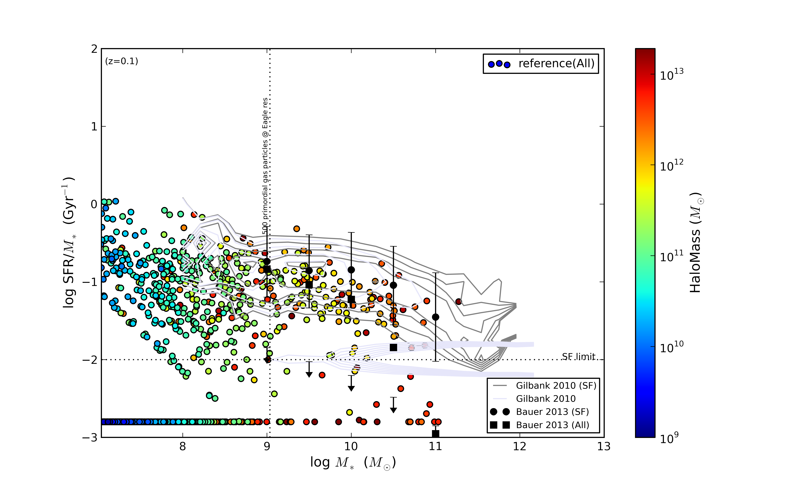
Environmental Quenching?
log(SFR/M*) [Gyr⁻¹]
Halo Mass [M_{o}]
Passive galaxies in higher halo mass
log(M*) [M_{o}]
NAM - July 2013 – The EAGLE Simulations

Slide 7
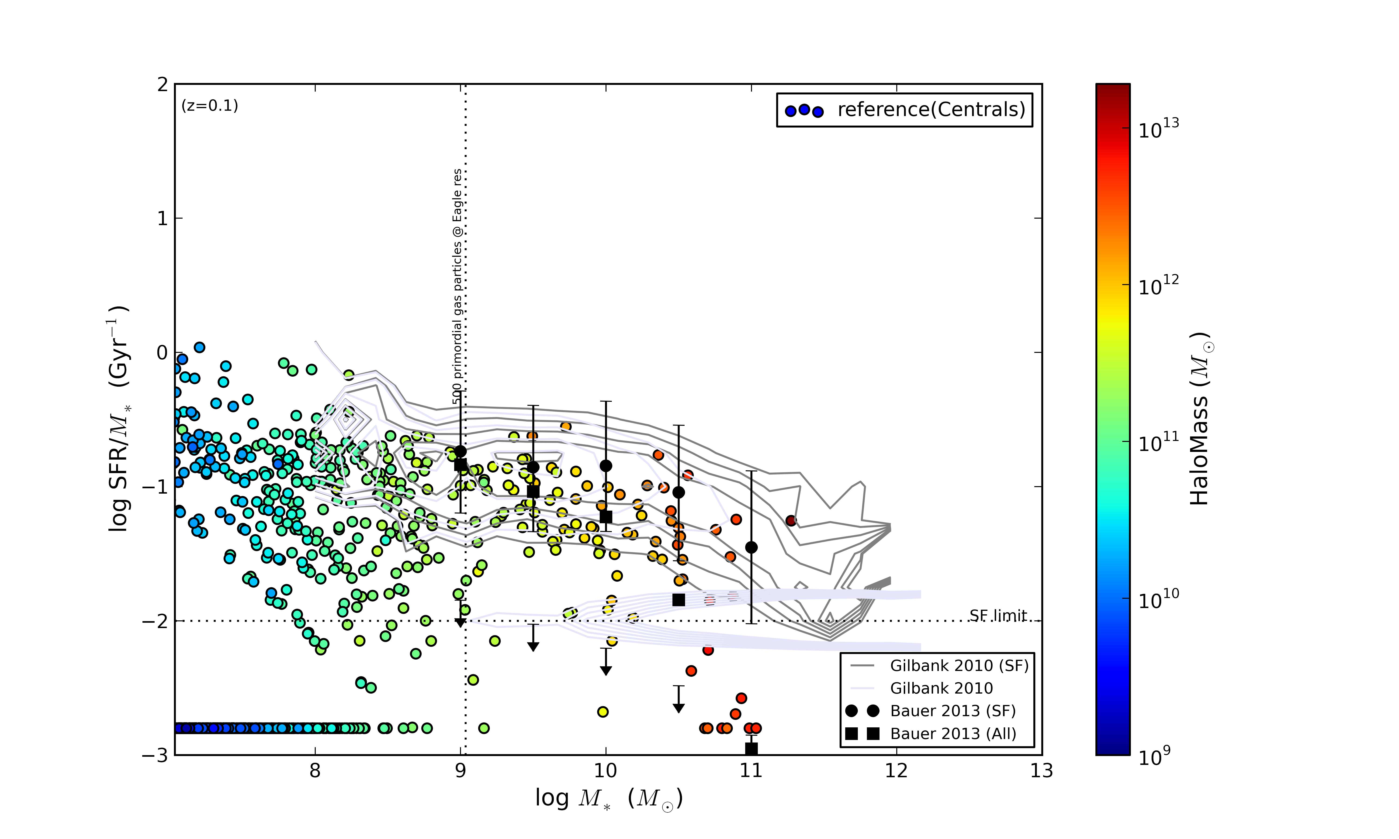
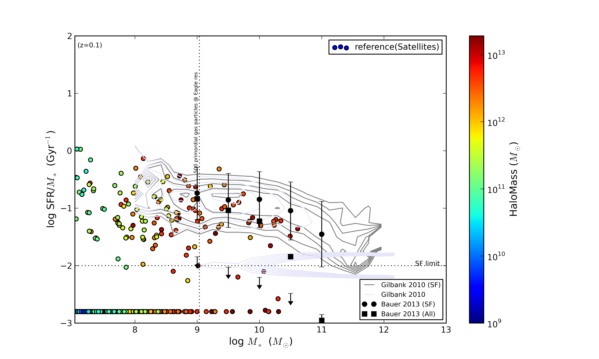
Satellite Quenching
Centrals
Satellites
ç
ç
log(SFR/M*) [Gyr⁻¹]
Halo Mass [M_{o}]
log(M*) [M_{o}]
log(M*) [M_{o}]
Split population
SF match centrals!
Centrals mostly star forming
Environment?
NAM - July 2013 – The EAGLE Simulations

Slide 8
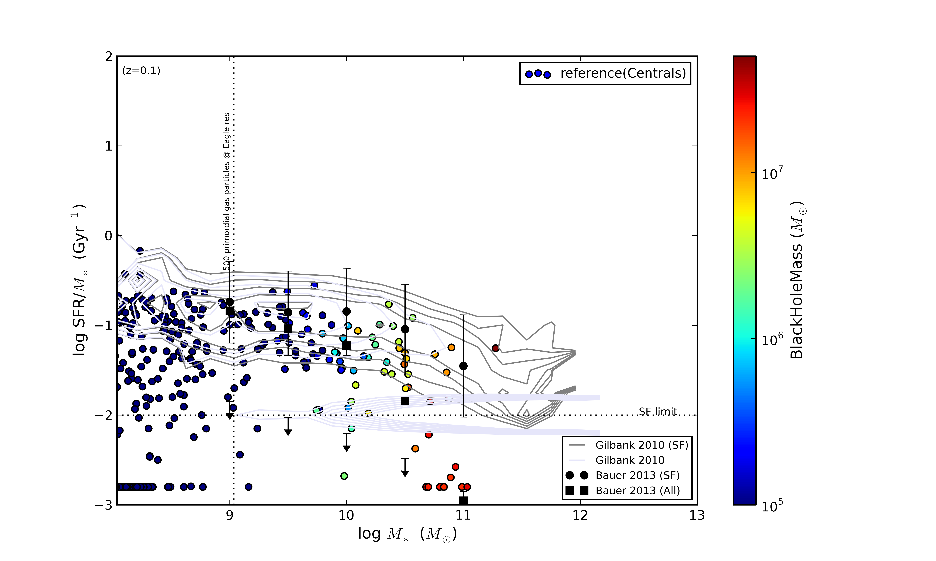
Central Quenching
Centrals
SF galaxies have smaller BHs
-> Less AGN feedback
log(SFR/M*) [Gyr⁻¹]
Black Hole Mass [M_{o}]
log(M*) [M_{o}]
NAM - July 2013 – The EAGLE Simulations

Slide 9
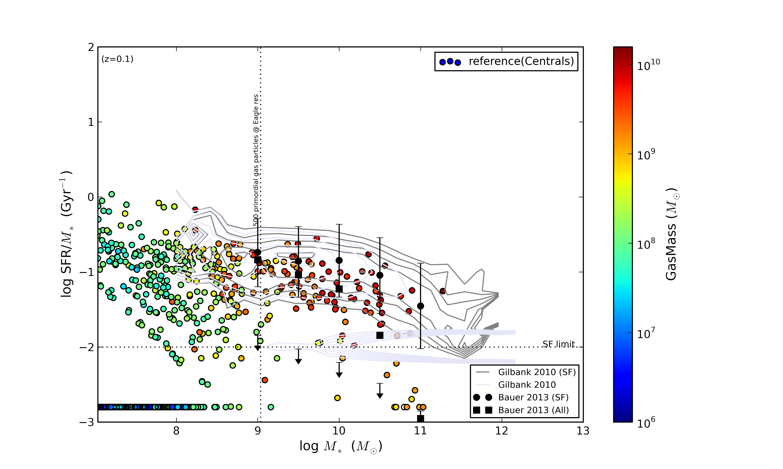
Gas Content?
Centrals
Satellites
log(SFR/M*) [Gyr⁻¹]
Gas Mass [M_{o}]
No gas left!
log(M*) [M_{o}]
log(M*) [M_{o}]
Still some gas content
NAM - July 2013 – The EAGLE Simulations

Slide 10
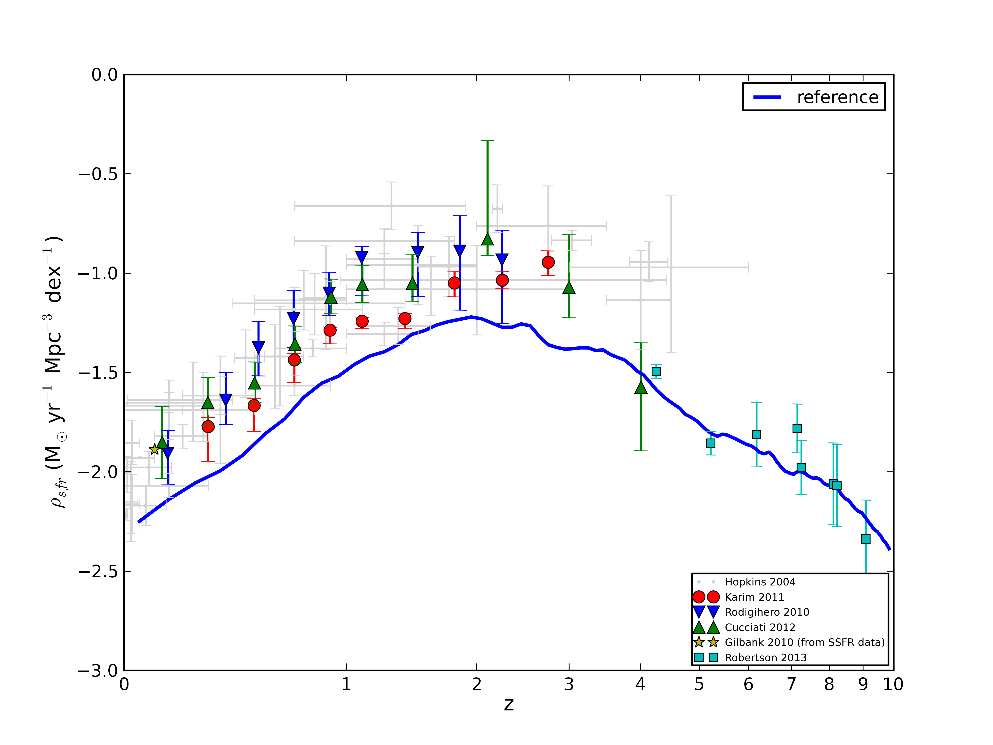
Star Formation Rates
Matches high-z data.
Correct shape for star formation rate history.
Peak around redshift 2.
ρ_{sfr} [M_{o}yr⁻¹Mpc⁻³dex⁻¹]
z
NAM - July 2013 – The EAGLE Simulations
Notes:
Axes
Obs data
Comparison to simulation
50Mpc box?

Slide 11
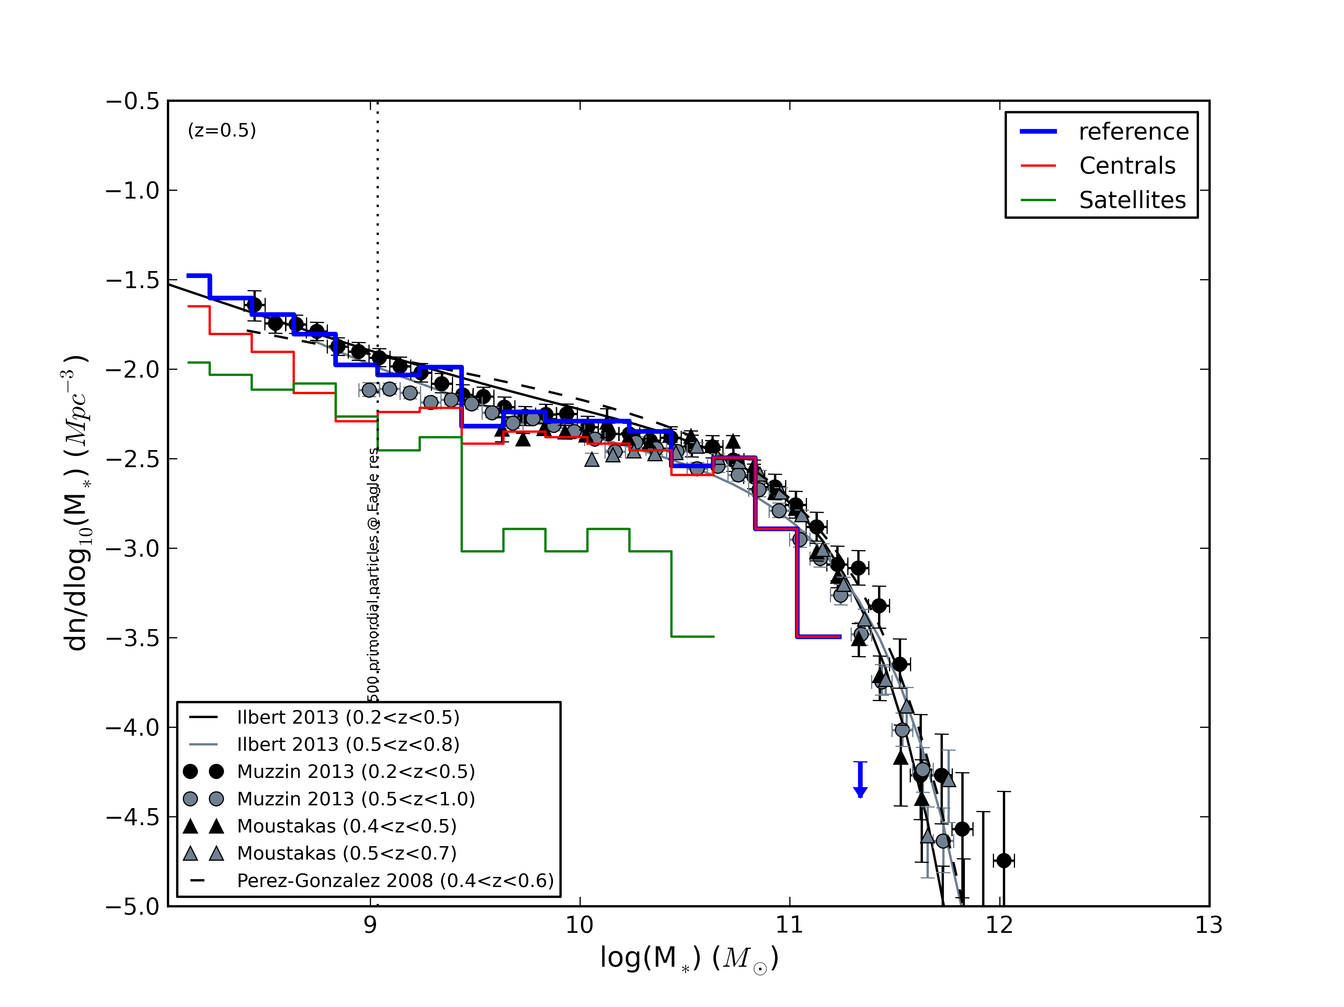
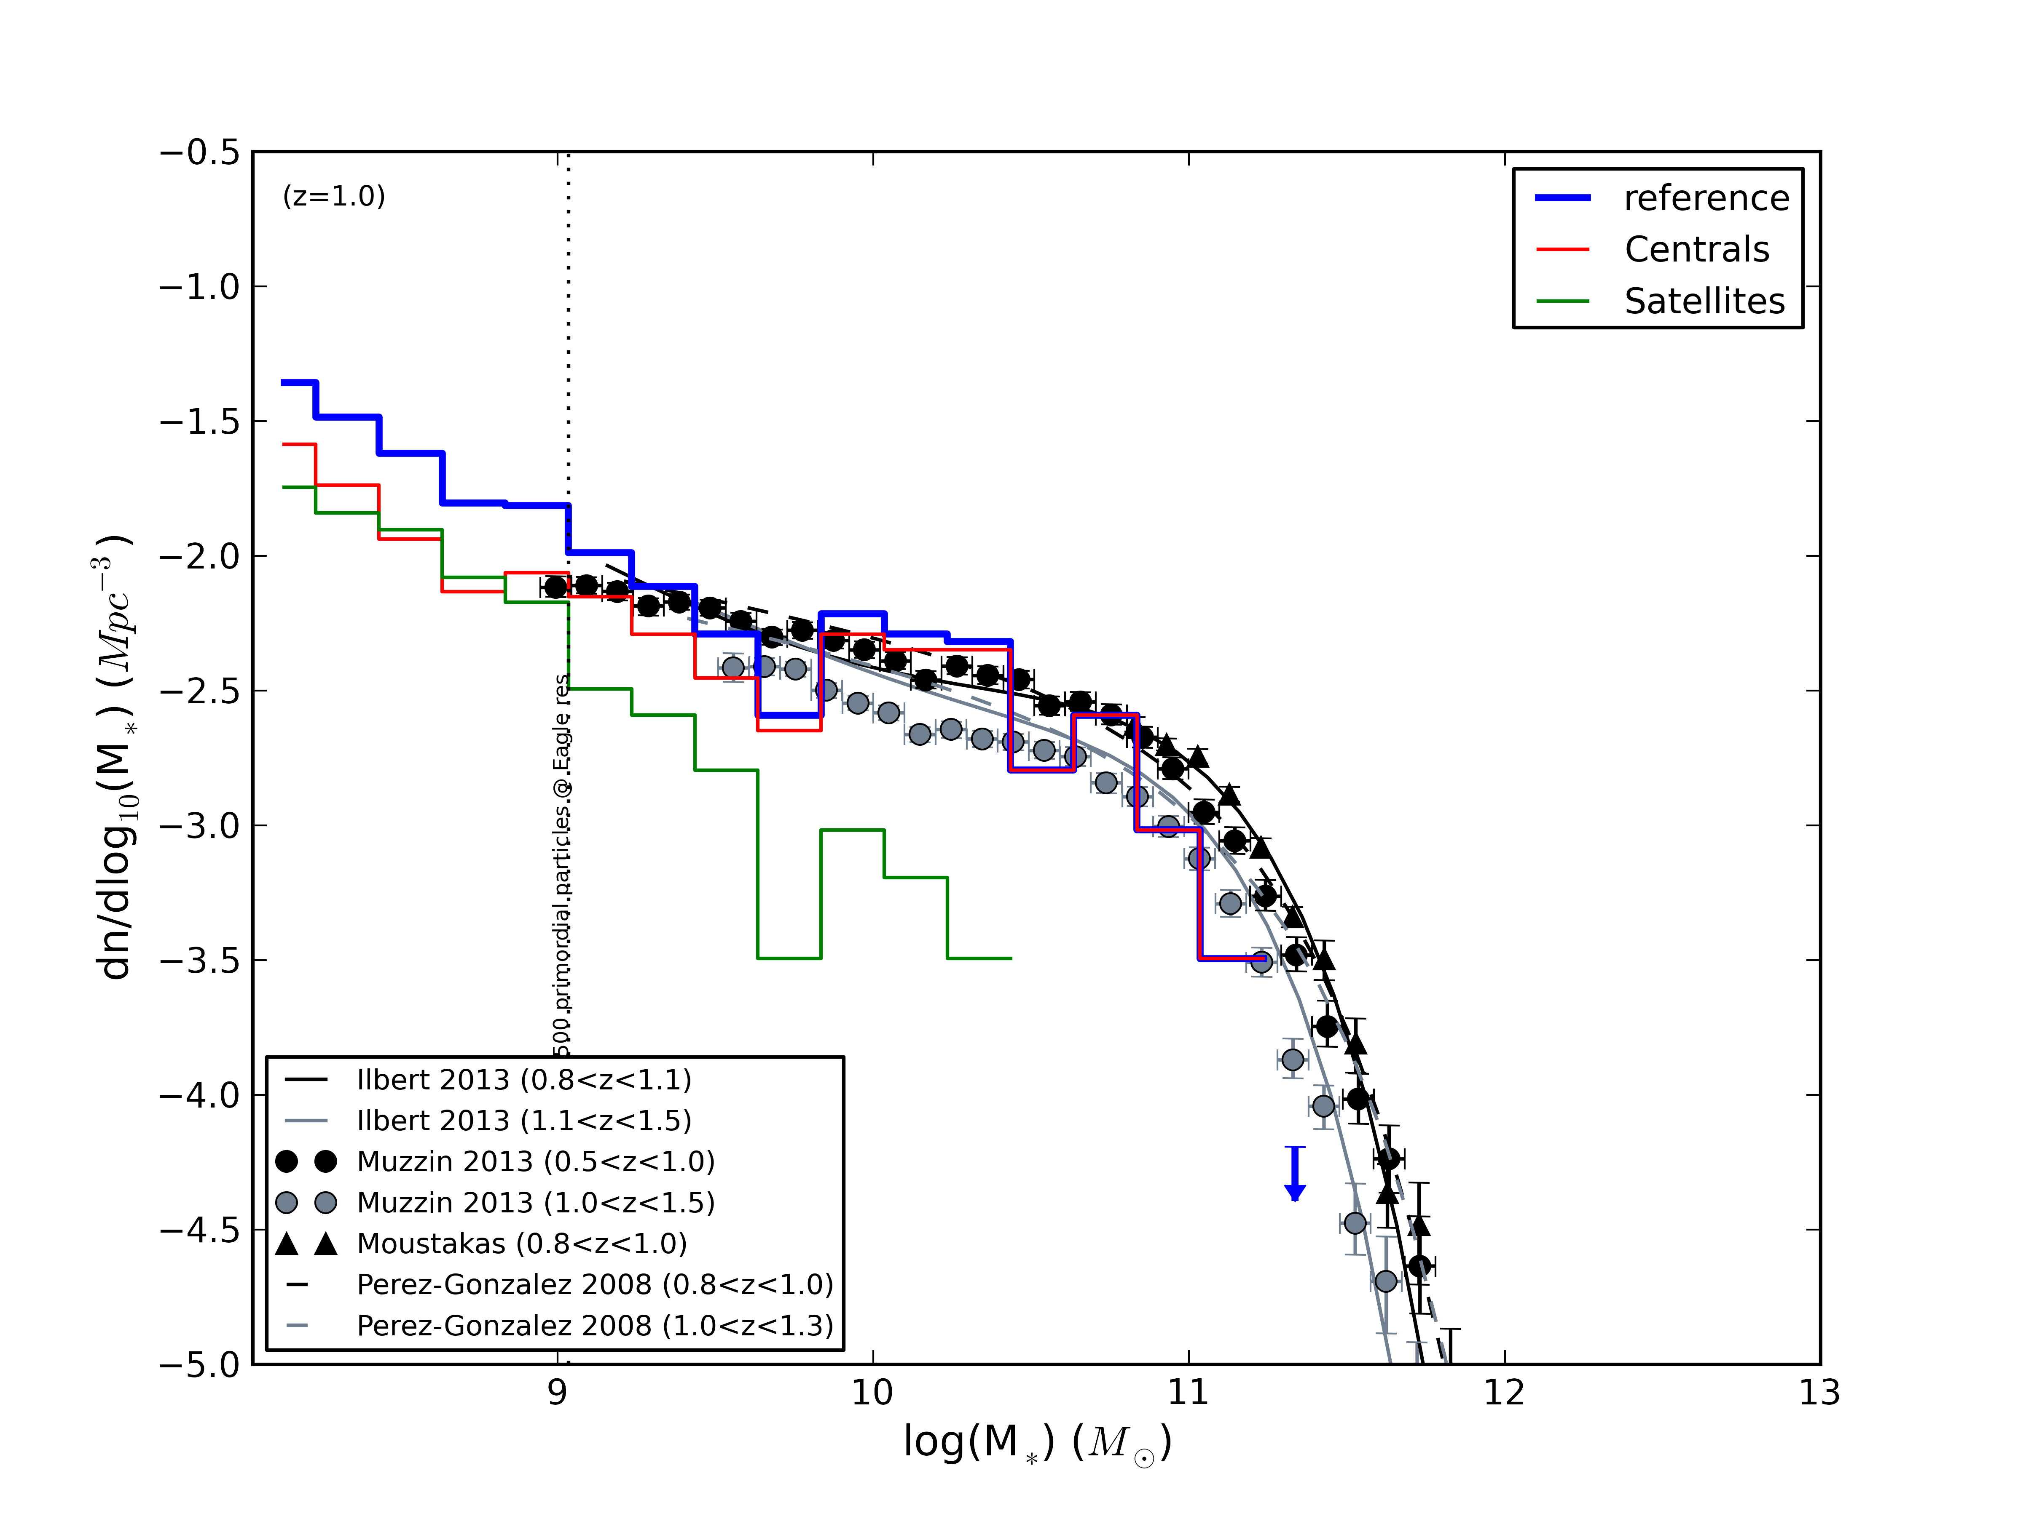
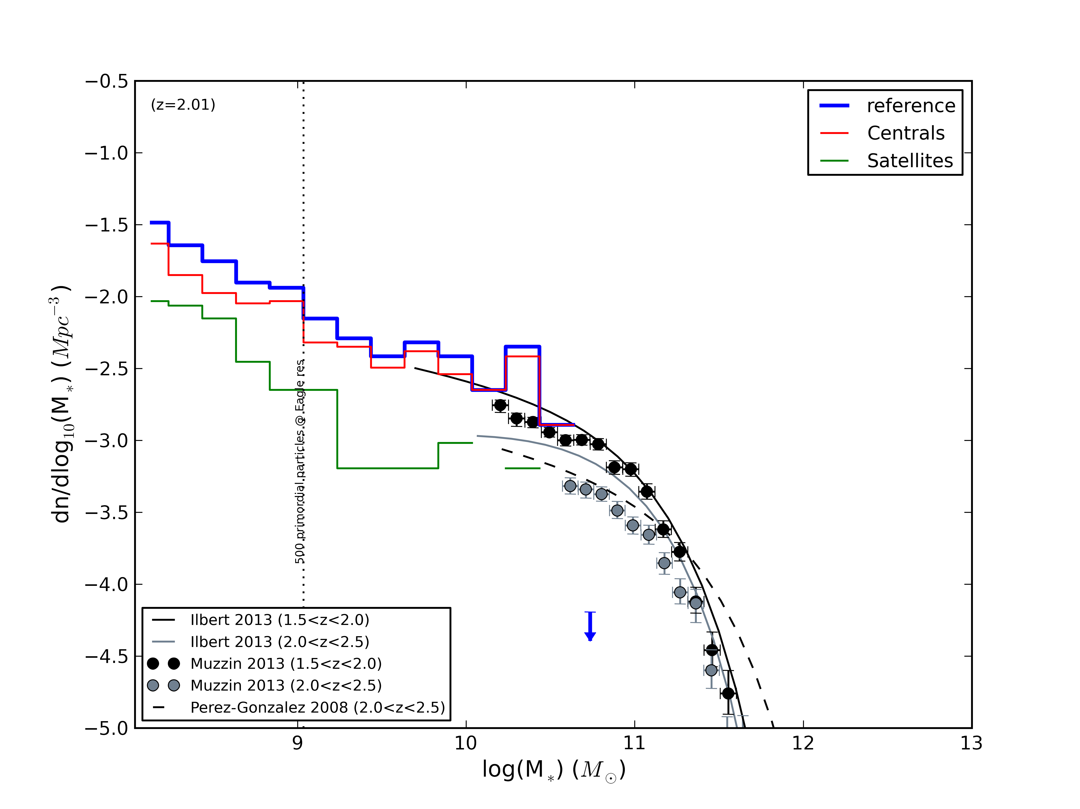
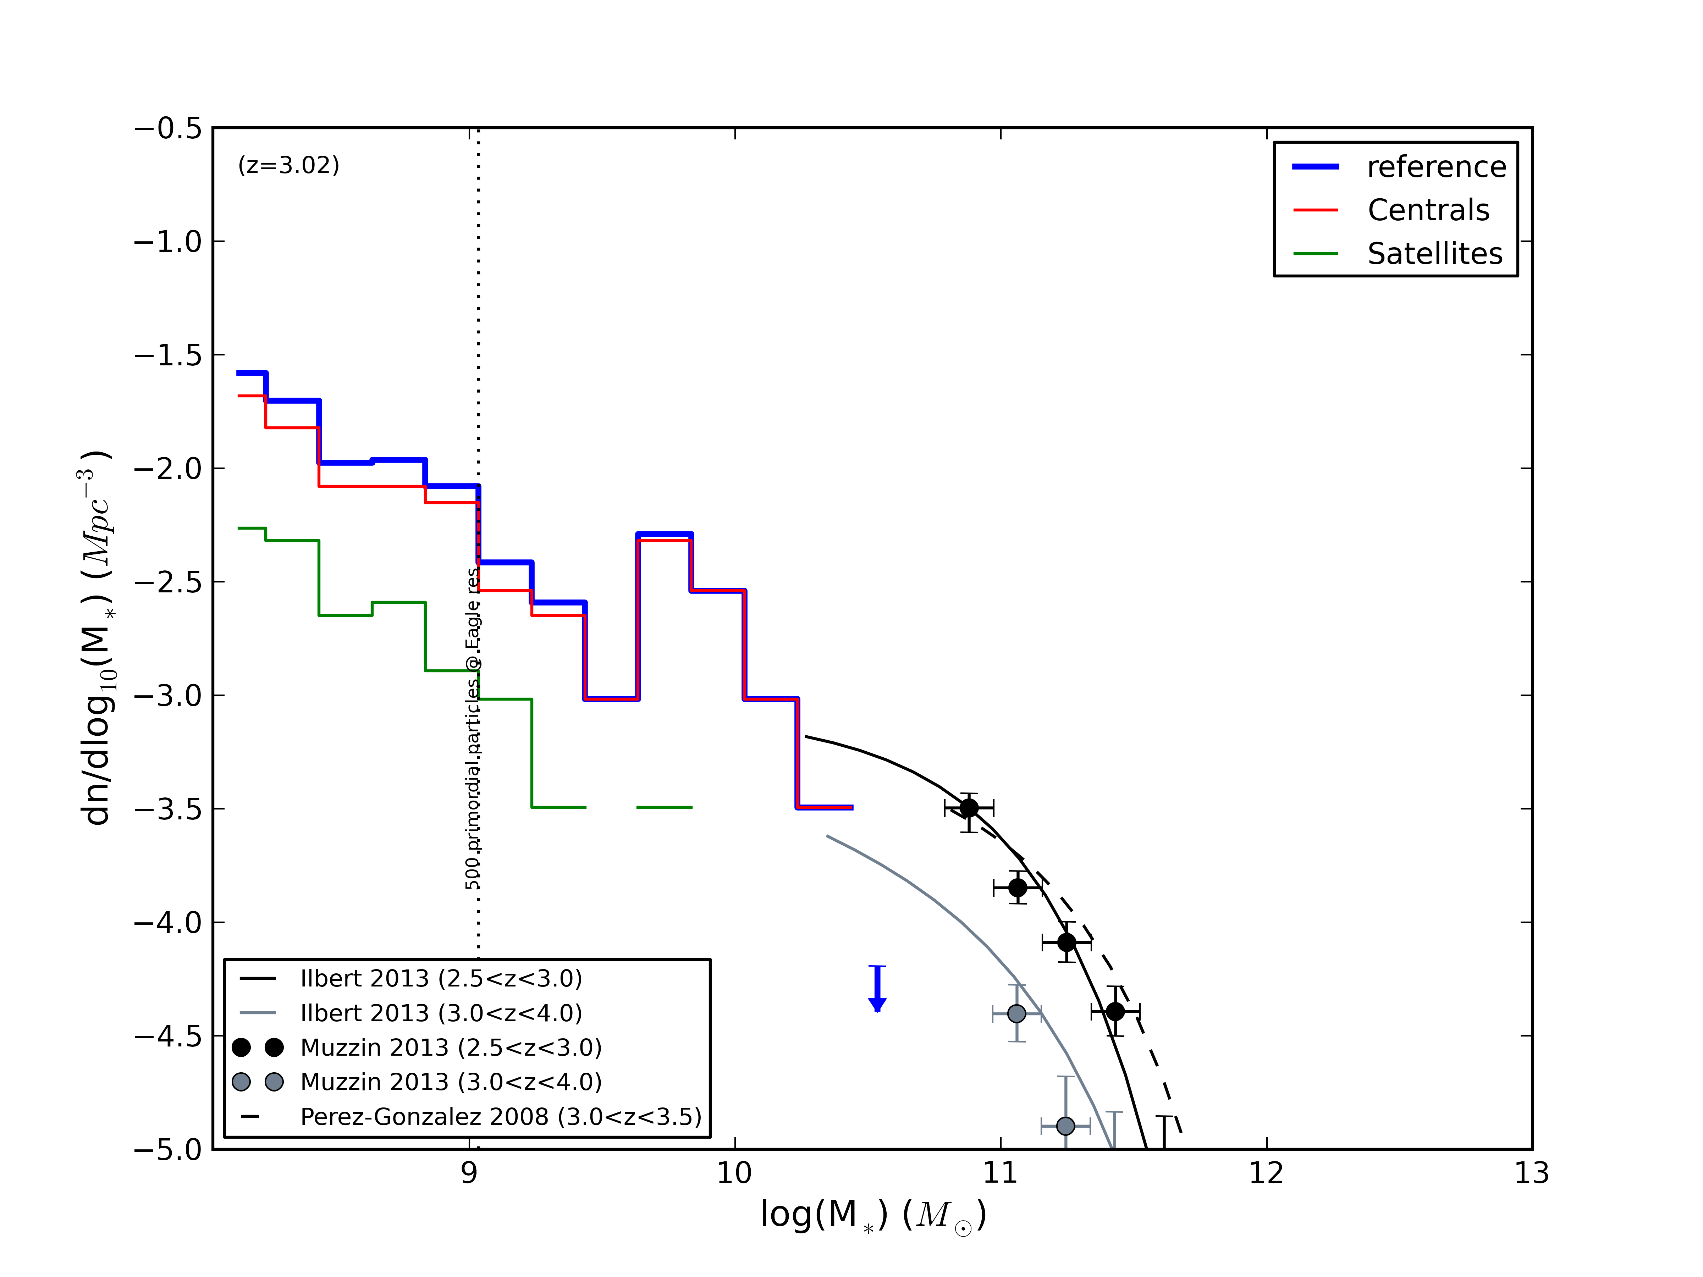
High-z Comparison of GSMF to Observations
z=0.1
z=0.5
z=1.0
z=2.0
z=3.0
NAM - July 2013 – The EAGLE Simulations
Notes:
UPDATE PLOTS!
GSMF, different redshifts
Simulation data and different colours
Datasets shown and colours

Slide 12
Summary / Future Work
Simulations reproduce many real Universe properties
Large numbers of galaxies to study statistics
Tracking of individual objects, understand galaxy histories
Environmental quenching important for satellite galaxies
AGN feedback crucial for quenching central galaxies
Not all galaxies conform…
NAM - July 2013 – The EAGLE Simulations

