Slide 1
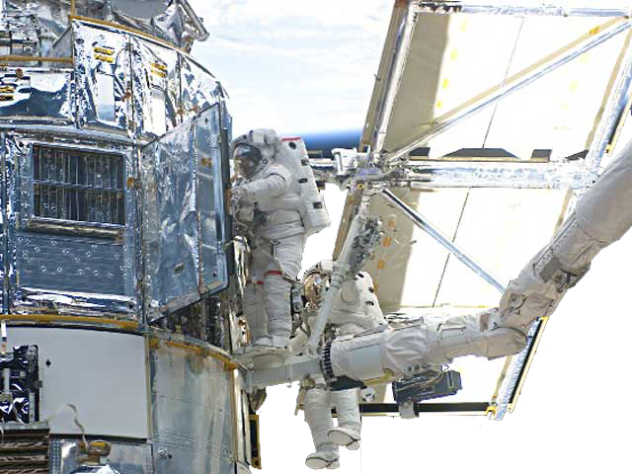
Mitigating radiation damage for WL
Richard Massey
with Alexie Leauthaud, Jason Rhodes, Suresh Seshadri, Roger Smith & Chris Stoughton
© NASA
Massey et al. 2010, MNRAS 401, 371
Rhodes et al. 2010 PASP 122, 439
Massey 2010, MNRAS submitted

Slide 2
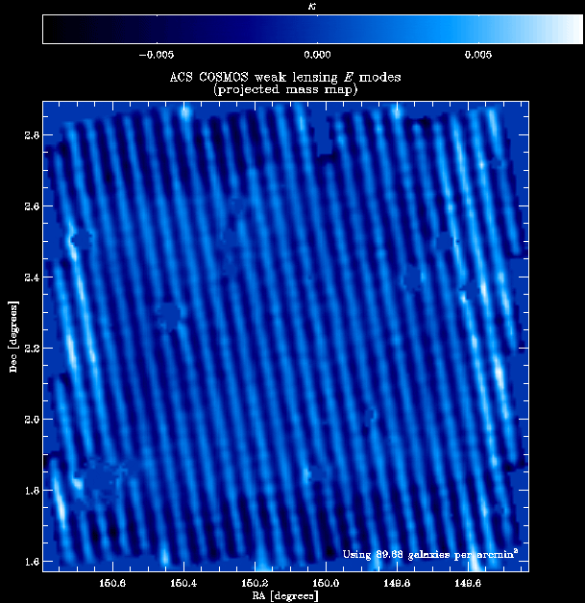
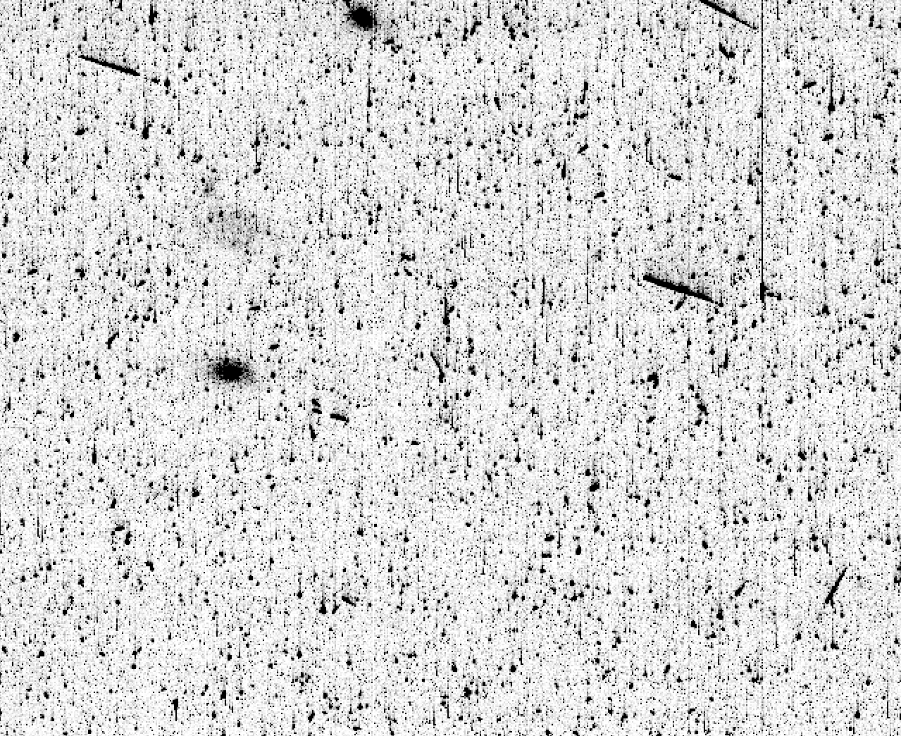
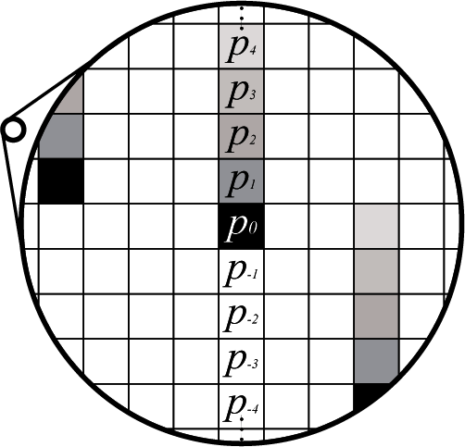
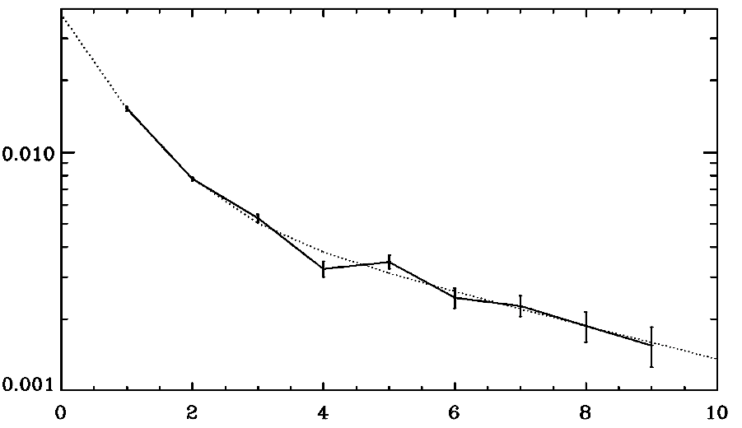
Recent HST/ACS image
Massey et al. 2010, MNRAS 401, 371
Rhodes,.. Massey et al. PASP 122, 439
Massey 2010, MNRAS submitted
p_{i} - p_{-i}
ρ₁e^{-y/τ1} + ρ₂e^{-y/τ2}
i
Charge transfer inefficiency during CCD readout creates a spurious, coherent trailing that affects the photometry, astrometry and morphology of faint galaxies.
Notes:
Why do we care about this?

Slide 3
Weak shear measurements with HST/ACS
Notes:
Spurious ellipticity. Worst in middle of detector, faint (or small) objects.
Pure E-mode
JDEM entire error budget after 5 years

Slide 4
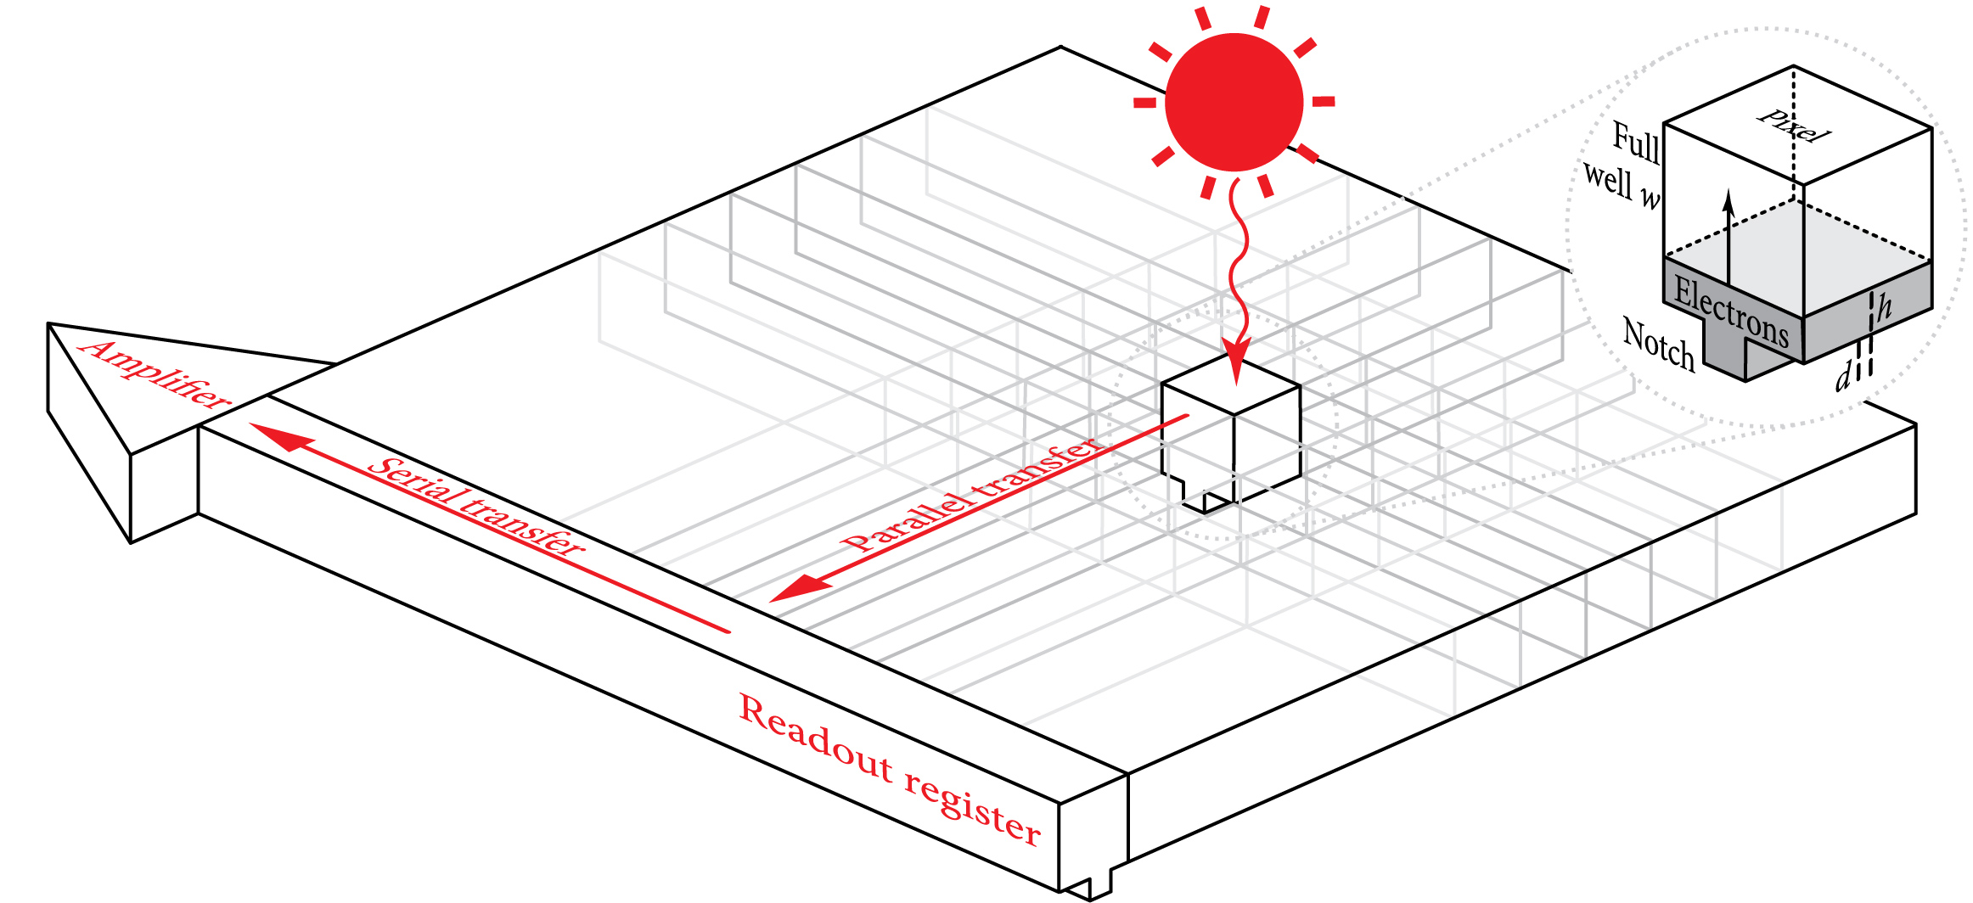
Charge Transfer Inefficiency
T
T
T
T
T
T
T
T
T
T
T
T
T
T
T
T
T
T
T
T
T
T
T
T
T
T
T
T
T
T
T
T
T
T
T
T
T
T
T
T
T
T
T
T
T
T
T
T
T
T
T
T
T
T
T
T
T
T
T
T
T
T
T
T
T
T
T
T
T
T
T
T
T
T
T
p_{i} - p_{-i}
Notes:
Trap density uniform
Nobel prize

Slide 5
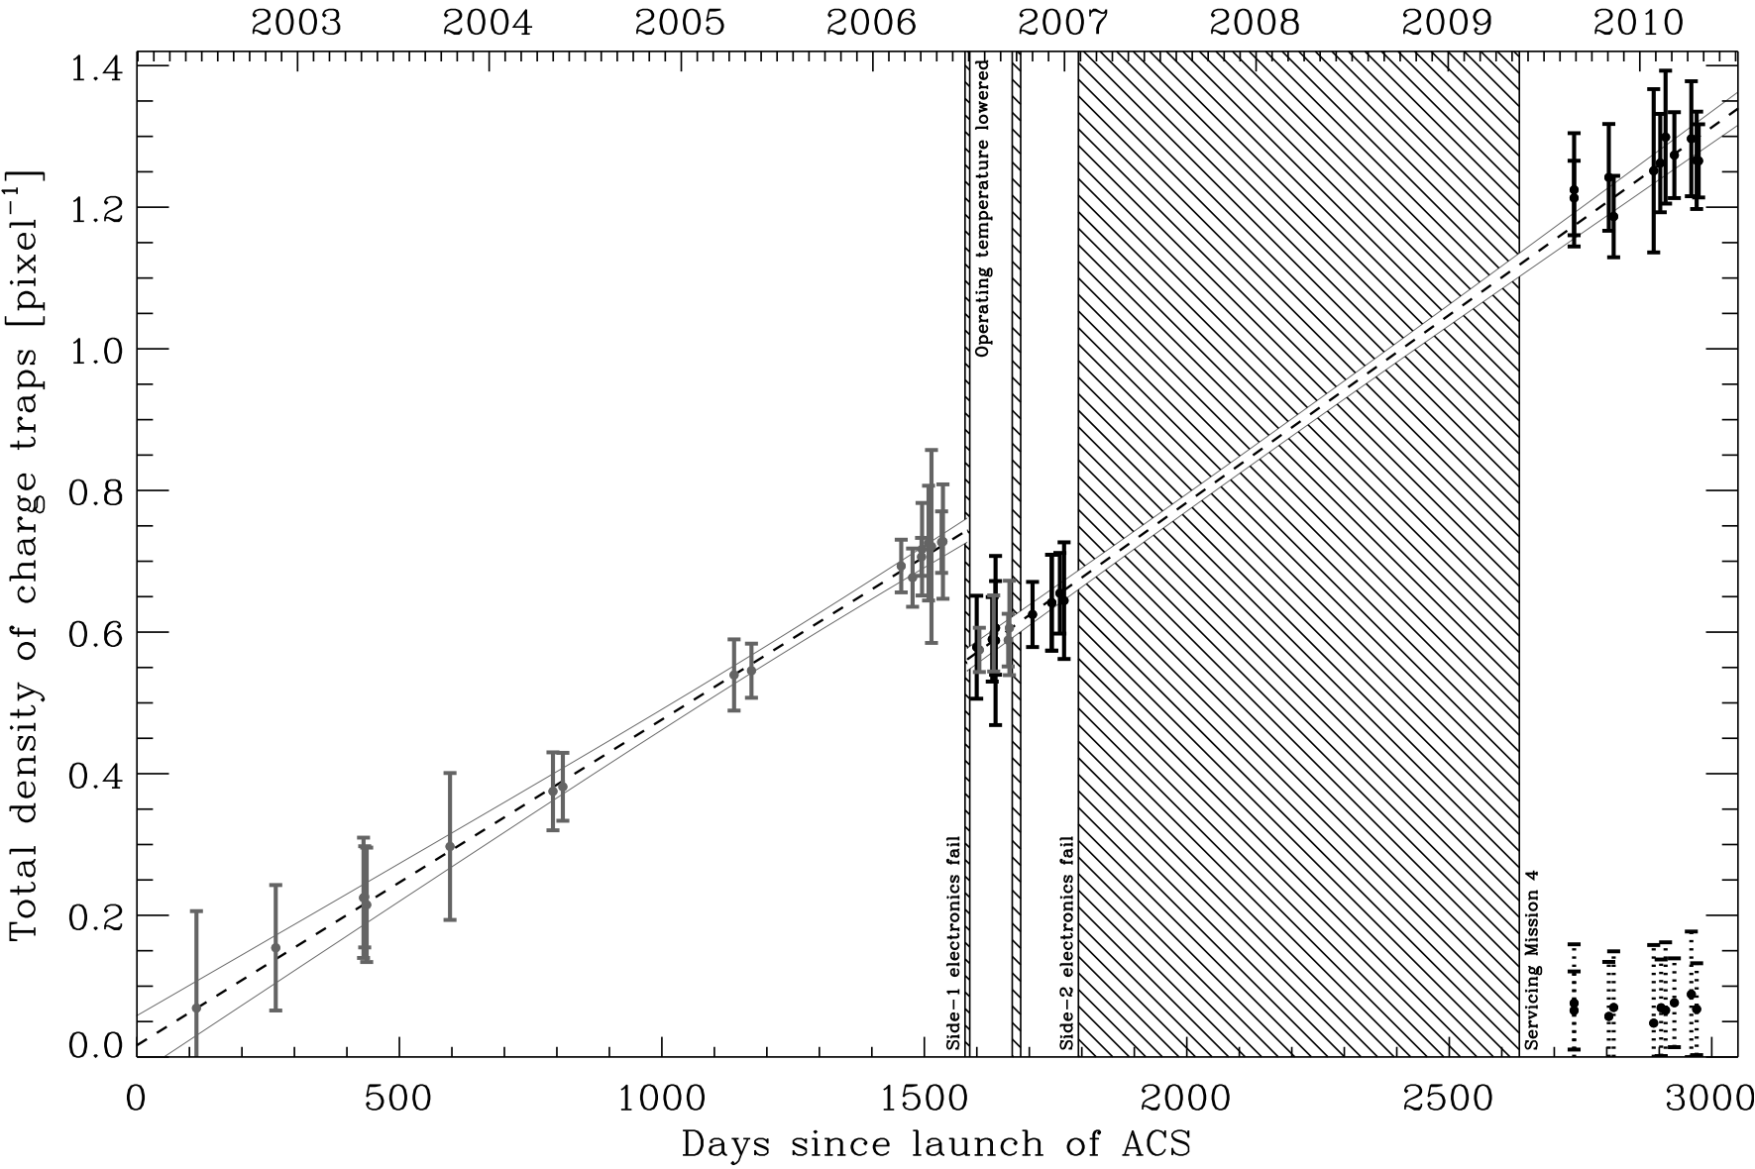
Effective charge trap density

Slide 6
Growth of charge traps over time
Notes:
7-8% spurious shear for smallest, faintest galaxies in the middle of the detector
Half as bad on average throughout the field of view, or for galaxies a magnitude brighter

Slide 7
Charge Transfer Inefficiency
T
T
T
T
T
T
T
T
T
T
T
T
T
T
T
T
T
T
T
T
T
T
T
T
T
T
T
T
T
T
T
T
T
T
T
T
T
T
T
T
T
T
T
T
T
T
T
T
T
T
T
T
T
T
T
T
T
T
T
T
T
T
T
T
T
T
T
T
T
T
T
T
T
T
T
p_{i} - p_{-i}
Notes:
At this stage, it is just a convolution, so the trailing can be modelled as a component of the PSF…
2 effects: extended sources, leading edge fills traps and masks them from rest
Potential well fills up non-linearly

Slide 8
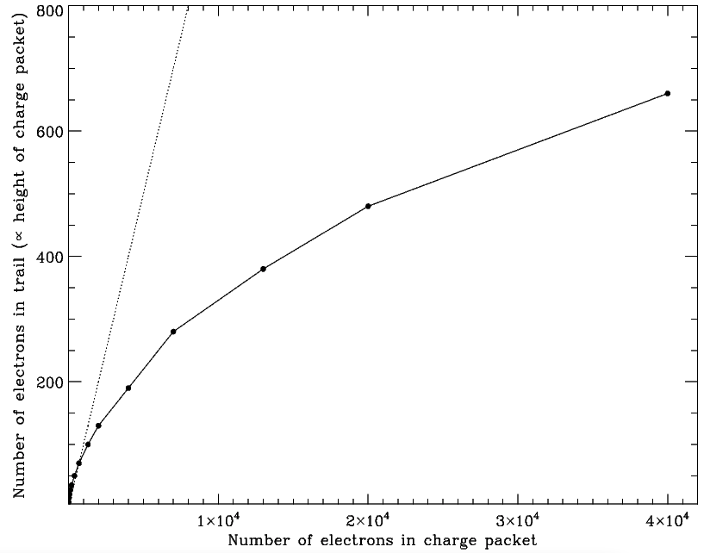
Well filling rate
Anderson & Bedin 2010, ApJ submitted

Slide 9
Blank
Notes:
We have a physically-motivated model of hardware CCD readout process, which we can mimic in software.
Model has free parameters of characteristic trap release times, trap density and well filling behaviour, but we can measure those using warm pixels.
Now, this is a bit like GREAT08 – we can easily implement the forward process, but want to somehow invert it, and undo the effect.

Slide 10
Iterative CTI correction using a forward algorithm
(characteristic trap release times, trap density and well filling behaviour)
I What we want
I + t What we start with (A)
I + 2t + t² After one extra readout (B)
I – t² (A)+(A)-(B) (C)
I + t - t² - t³ After another readout (D)
I + t³ (A)+(C)-(D)
I – t⁴ (A)+(E)-(F) … etc.

Slide 11
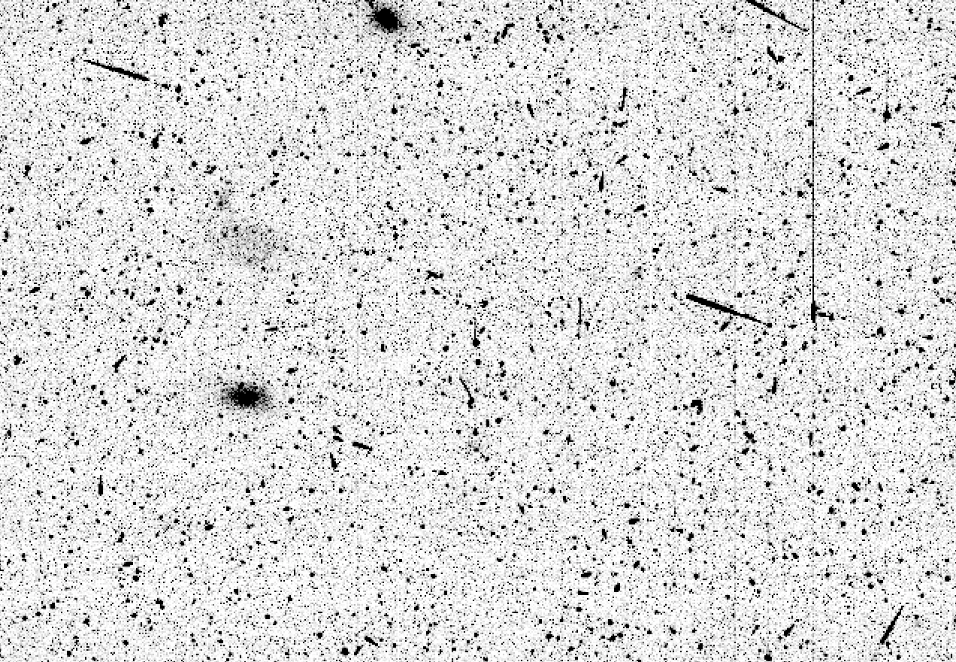
Effect of CTI correction algorithm
Massey et al. 2010, MNRAS 401, 371
Massey 2010, MNRAS submitted
Charge transfer inefficiency during CCD readout creates a spurious, coherent trailing that affects the photometry, astrometry and morphology of faint galaxies.
Notes:
Pixel-level correction automatically makes images ready for any scientific analysis

Slide 12
Effective charge trap density
Notes:
HST/ACS is unusable for lensing without correction
…but software postprocessing ➔ image quality ~6 months after launch
STScI are currently incorporating this correction into the standard CALACS data reduction pipeline.

Slide 13
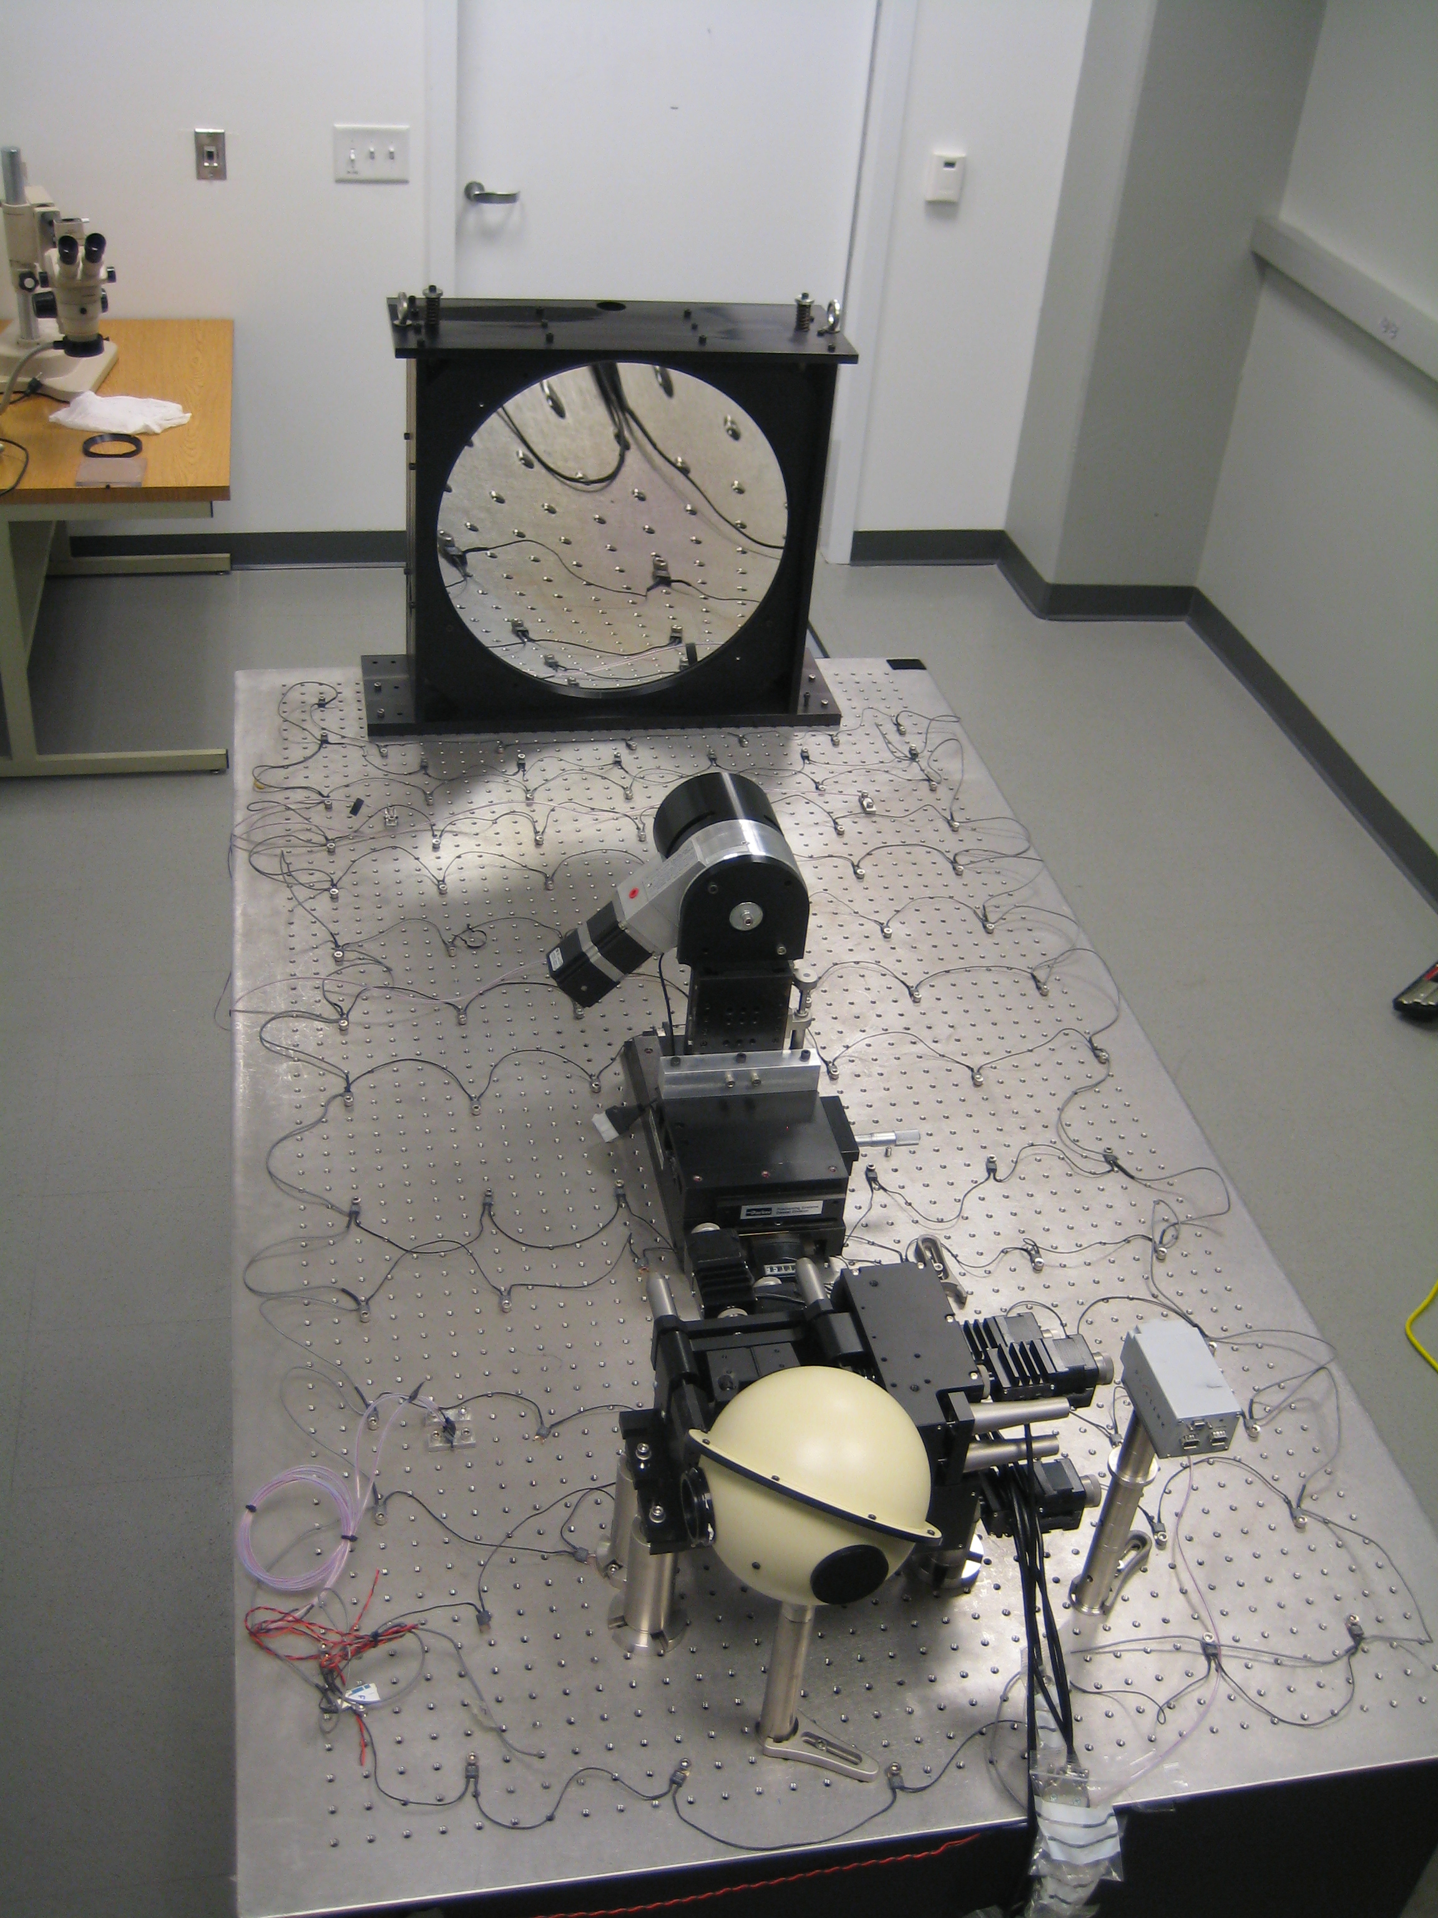
Projector system to test near-IR detectors
Non-linearity in detector response Reciprocity failure in detector response Interpixel capacitance Image persistence
18” primary
RoC=1500mm
4.25” Secondary
RoC=750mm
(inside)
Pupil stop rotation motor
XYZ stages for secondary
6 axis flexure stage carrying input mask
Fold mirror,
Main camera
& enclosure removed, to show optics
Integrating sphere currently fed by 650nm LED
Alignment camera
Heaters
Notes:
Even with radiation-hardened detectors, raw CTI will consume all the shape measurement error budget of JDEM within 5 years. After correction, this is manageable – but the best hardware & software will be needed!

Slide 14
Conclusions
HST/ACS is unusable for lensing without correction
…but software postprocessing ➔ image quality ~6 months after launch
STScI are currently incorporating this correction into the standard CALACS data reduction pipeline.
Even with radiation-hardened detectors, raw CTI will consume all the shape measurement error budget of JDEM within 5 years. After correction, this is manageable – but the best hardware & software will be needed!

Slide 15
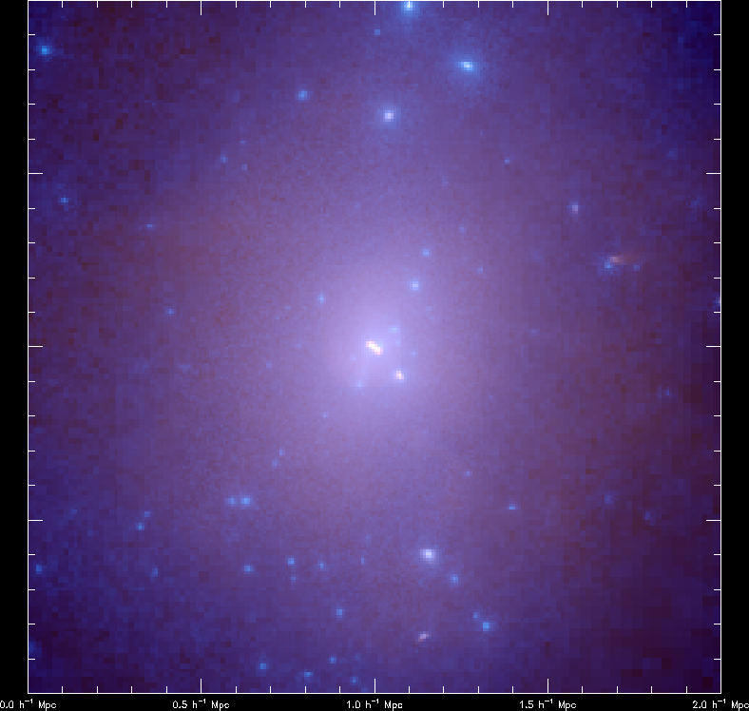
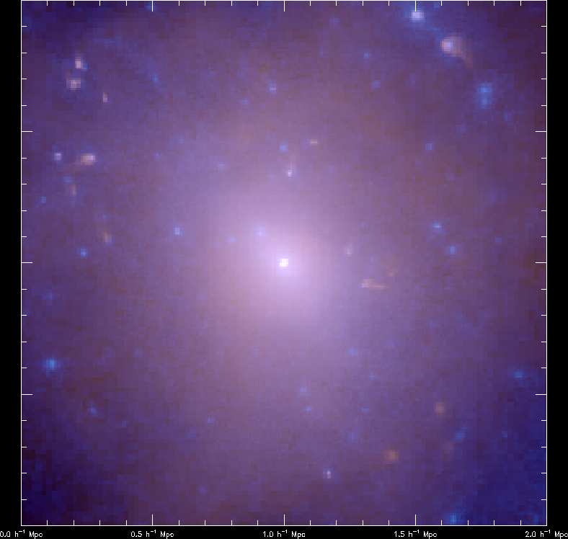
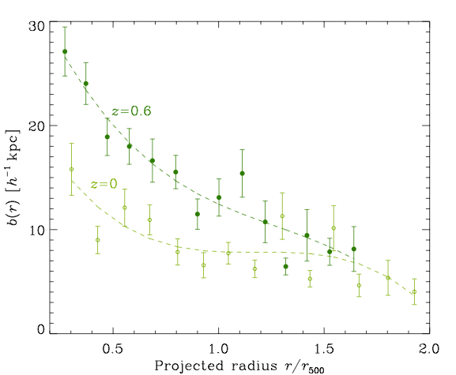
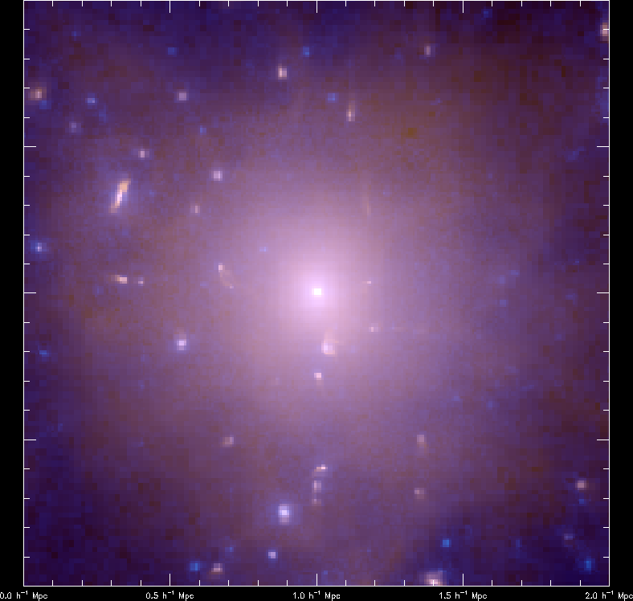
Bulleticity
Massey, Kitching & Nagai
2010, arXiv:1007.1924
0.5 h⁻¹ Mpc
Notes:
Ram pressure stripping – star formation & galaxy evolution
Average over phase space of orbits/orientations wrt L.O.S.

Slide 16
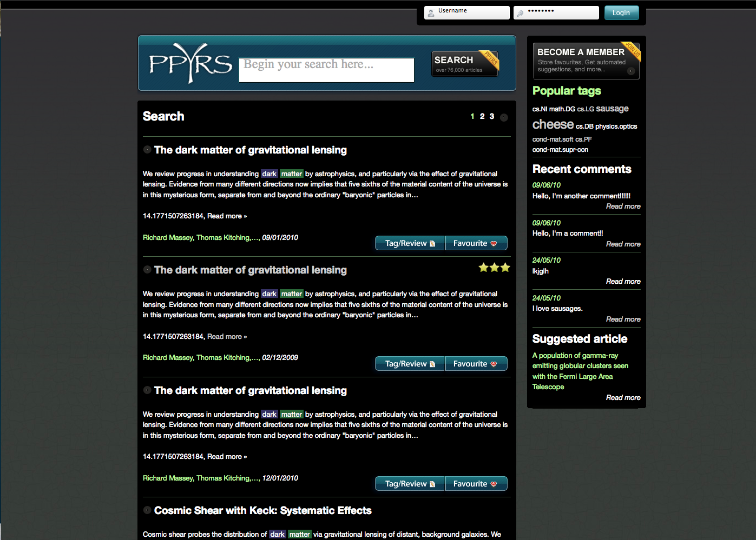
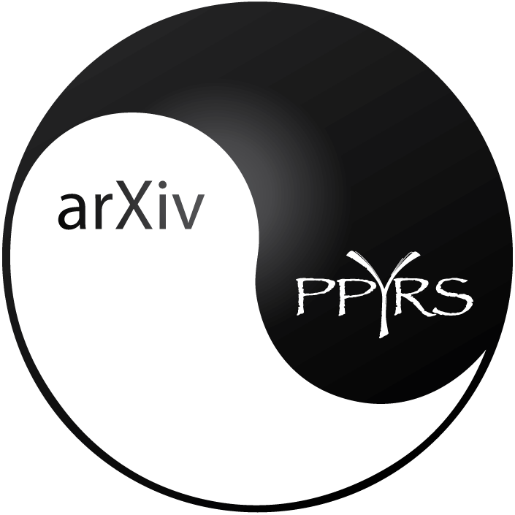
Papyrus
Notes:
All sorts of money around for this sort of thing. The challenge is in getting the right people together.

Slide 17
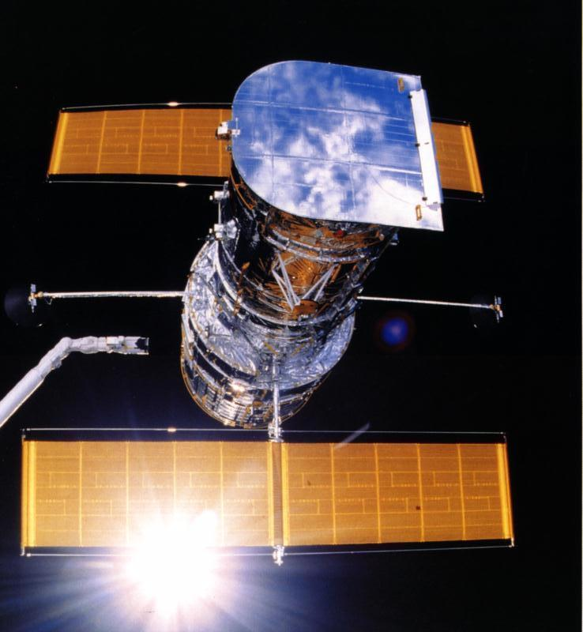
Back to Hubble

Slide 18
Fin

Slide 19
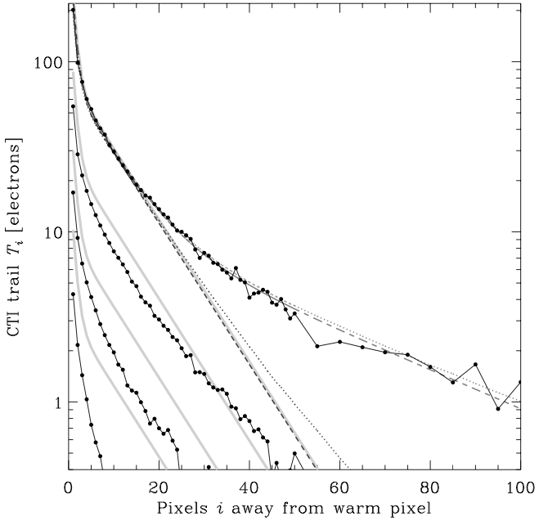
Remaining conundrum

Slide 20
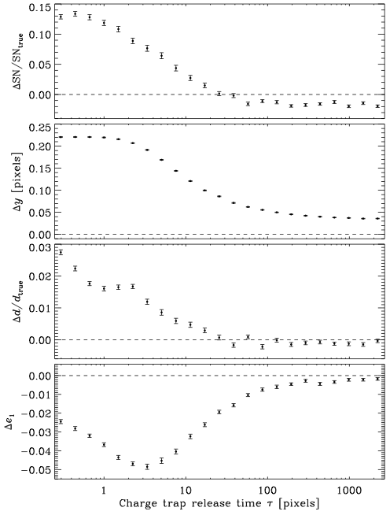
Effect of trap release time

Slide 21
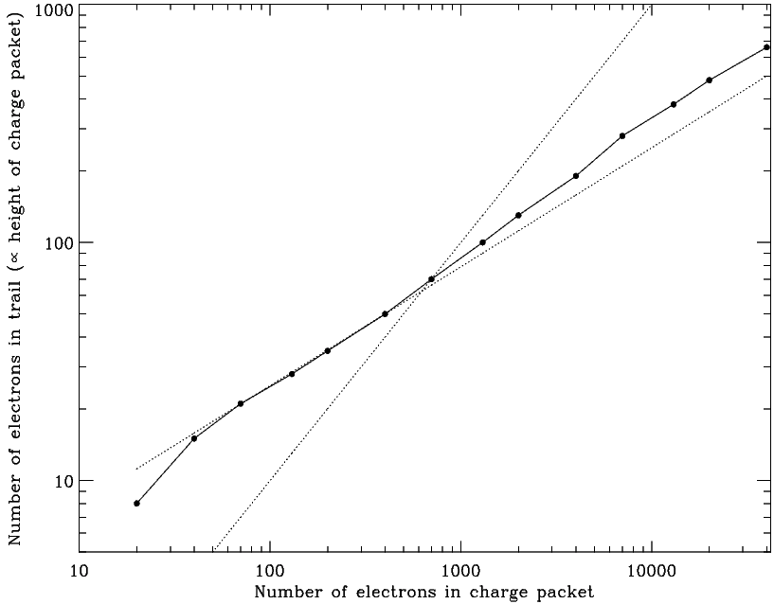
Fin
Anderson & Bedin 2010, ApJ submitted

Slide 22
Charge Transfer Inefficiency
p_{i} - p_{-i}
Notes:
At this stage, it is just a convolution, so the trailing can be modelled as a component of the PSF…
2 effects: extended sources, leading edge fills traps and masks them from rest
Potential well fills up non-linearly

