Slide 1
Tidal Alignments
&
Large Scale Structure
Christopher Hirata
Edinburgh, 22 Jul 2010
C.H., MNRAS 399:1074 (2009) – Redshift space distortions
Elisabeth Krause & C.H., 1004.3611 – Bispectrum

Slide 2
Outline
Growth of Structure
Tidal Alignments & Effects on LSS
Formalism & Models
Redshift Space Distortions
Bispectrum

Slide 3
The Growth of Structure
The discovery of cosmic acceleration motivates an independent check of general relativity on cosmological scales.
  More than just w.
The principal test we have available is the growth of linear perturbations:
  Growth function G(t): [δρ/ρ ∝ G] In GR, smooth DE:
  Growth rate f(t):

Slide 4
Tests of Growth?
Weak lensing (∇∇Ψ)
ISW (∂Ψ/∂t)
Clusters (virialized massive halos)
Redshift space distortions (∇v)
Galaxy bispectrum (nonlinear evolution)

Slide 5
Tidal Alignments
Galaxy orientation determined by:
  Triaxiality (ellipticals)
  Disk angular momentum (spirals)
Both affected by large-scale tidal fields – somehow:
  Affects principal axes of collapse of halo
  Tidal torquing of infalling baryons
Clearly an issue for weak lensing. Much effort by community on this.
BUT when combined with orientation-dependent selection biases: Also an issue for large scale structure!

Slide 6
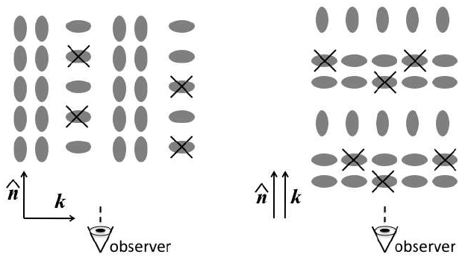
Example: Redshift Space Distortions
Hirata 2009

Slide 7
Formalism
A galaxy’s orientation is described by a matrix Q ∈ SO(3), or equivalently the 3 Euler angles (θ,ϕ,ψ).
The observer looks at the galaxy along the line-of-sight unit vector n ∈ S².
The probability of observing the galaxy is modulated by a function Υ of the line of sight in the galaxy frame:

Slide 8
Effect on Observed Galaxy Density
The number density of galaxies observed depends on the statistics of their orientation:
Effect nonzero if BOTH:
  Intrinsic alignments: P(Q|x) not uniform.
  Anisotropic selection: Υ(Qn) ≠ 0.

Slide 9
Model I: Luminous Red Galaxies
LRGs are known to be aligned with the stretching axis of the tidal field (Binggeli 1982).
If aperture magnitudes are used to select LRGs, there is a bias in favor of looking down the long axis.
Of course, if an accurate model is used to fit the galaxy and it is optically thin, then the model magnitude leads to no such effect.
Observer B
Observer A

Slide 10
Model I, continued
LRGs alignments are expected to be linear in the tidal field. The only possibility is then:
The coefficient A₁ is the product of:
  Anisotropic selection (take from theory)
  Intrinsic alignment amplitude, i.e. ellipticity-LSS correlation (take from observations – SDSS)
  Theory predicts an ellipticity-density correlation function with the same power-law slope, , as the matter or galaxy correlation functions. This is indeed seen!

Slide 11
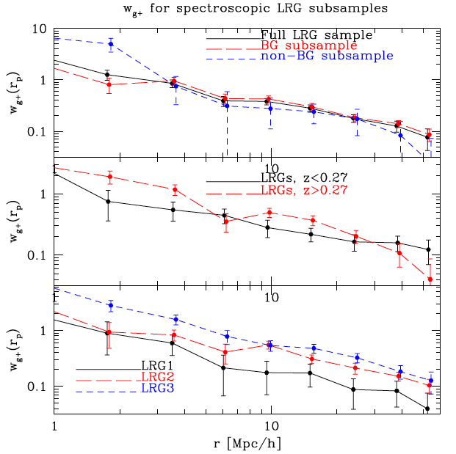
Hirata et al 2007

Slide 12
Model II: Disk Galaxies
Spin-up by tidal torques:
  T = tidal tensor
  I = anisotropic moment of inertia tensor of collapsing galaxy
Expected to be quadratic in tidal field since the moment of inertia tensor is itself induced by the tidal field.
Selection bias against edge-on galaxies.
Predict:
At tree level, first term is A₂. [Note: on large scales, the A₁ term should exist, see Hui & Zhang 2002, but has never been detected.]

Slide 13
Redshift Space Distortions
In the linear regime limit, the observed number density fluctuation of galaxies becomes:
In Fourier space: [where μ = k•n]
The new term exactly mimics RSD even on linear scales! Origin of both: sensitivity to tidal field.

Slide 14
Examples
LRGs:
  Cut at M_{r}^{0.0} = −22.5, assume isophotal magnitude cut at 3r_{eff.} Use Hirata et al 2007 amplitude for intrinsic alignments (@ z=0.3).
  A₁ ~ −0.024 (4% contamination).
Disk galaxies:
  Use anisotropic selection model with flux ~ cos^{0.4} i, cumulative LF ~ 1/F². Intrinsic alignments: use upper limit on linear alignment coefficient from Hirata et al. 2007.
  |A₁| ≤ 0.039 (6% contamination).
  But unconstrained at high z (BigBoss, JDEM/Euclid, etc.) although see Mandelbaum et al 2009.

Slide 15
A Note on Lyman-α Emitters
Zheng et al 2010 find a strongly anisotropic clustering pattern for z=5.7 LAEs opposite to linear RSD.
  Same macrophysical effect: an anisotropic selection effect determined by the tidal forces on a galaxy.
  This is exactly degenerate with β in the linear regime since the tidal field is the lowest-order feature of large scale structure to which a galaxy can be sensitive. (All others have additional powers of k.)
  Very different microphysics: Escape of Lyman-α radiation along directions of high velocity gradient. Zheng et al 2010 aligns the surrounding IGM whereas Hirata 2009 aligns the galaxy itself.

Slide 16
Bispectrum
On quasilinear scales, galaxy density is traditionally expanded:
This results in a bispectrum. The real space bispectrum (observed for transverse Fourier modes) is:
Can break degeneracy between b₁, σ₈ since the F₂ term scales as σ₈⁴b₁³. (e.g. Fry 1994, Verde et al 2001, …)
Must ultimately calibrate against N-body mocks.

Slide 17

Bispectrum II
We have found that the quadratic alignment term (A₂) is a contaminant for the bispectrum by introducing additional terms:
~5% effect plausible but not guaranteed.
But different functional form from 2nd order perturbation theory bispectrum, so can be marginalized out – even in photo-z survey. [See Krause & Hirata 2010]

Slide 18
Conclusions
Tidal galaxy alignments, when combined with anisotropic selection effects, can affect LSS observables.
In particular, has implications for measuring the growth of structure:
  Redshift space distortions: exactly degenerate in linear regime.
  Bispectrum: not exactly degenerate in quasilinear regime, can simultaneously fit out albeit with some increase in error bars.
Cures: Judicious galaxy selection to reduce orientation dependent biases? Modeling?

