Slide 1
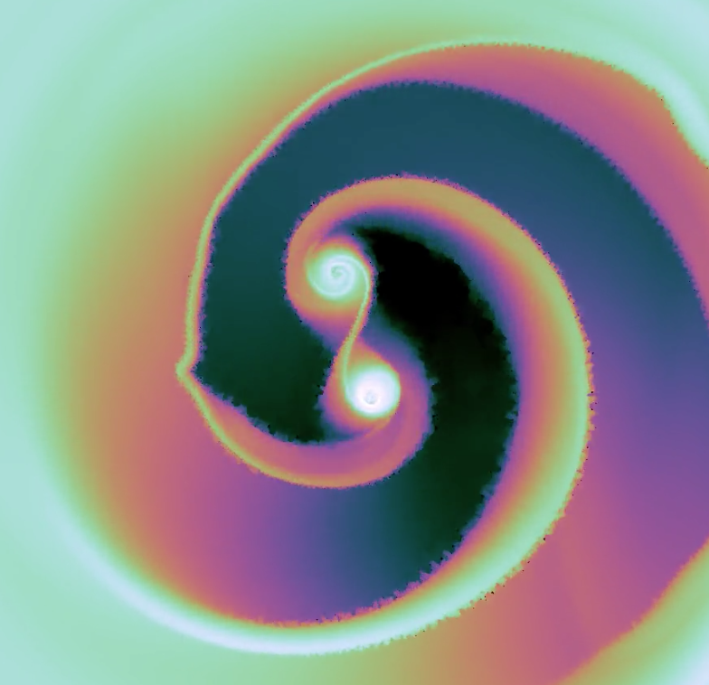
ACCRETION DYNAMICS IN
PRE-MAIN SEQUENCE BINARIES:
Robert Mathieu
University of Wisconsin - Madison
Dissertation of
Ben Tofflemire
University of Wisconsin – Madison
Ph.D August 2018
Collaborators:
David Ardila (IPAC)
Rachel Akeson (IPAC)
David R. Ciardi (IPAC)
Greg Herczeg (Kavli Institute)
Christopher Johns-Krull (Rice Univ.)
Alberto Quijano-Vodniza
(University of Nario, Colombia)

Slide 2
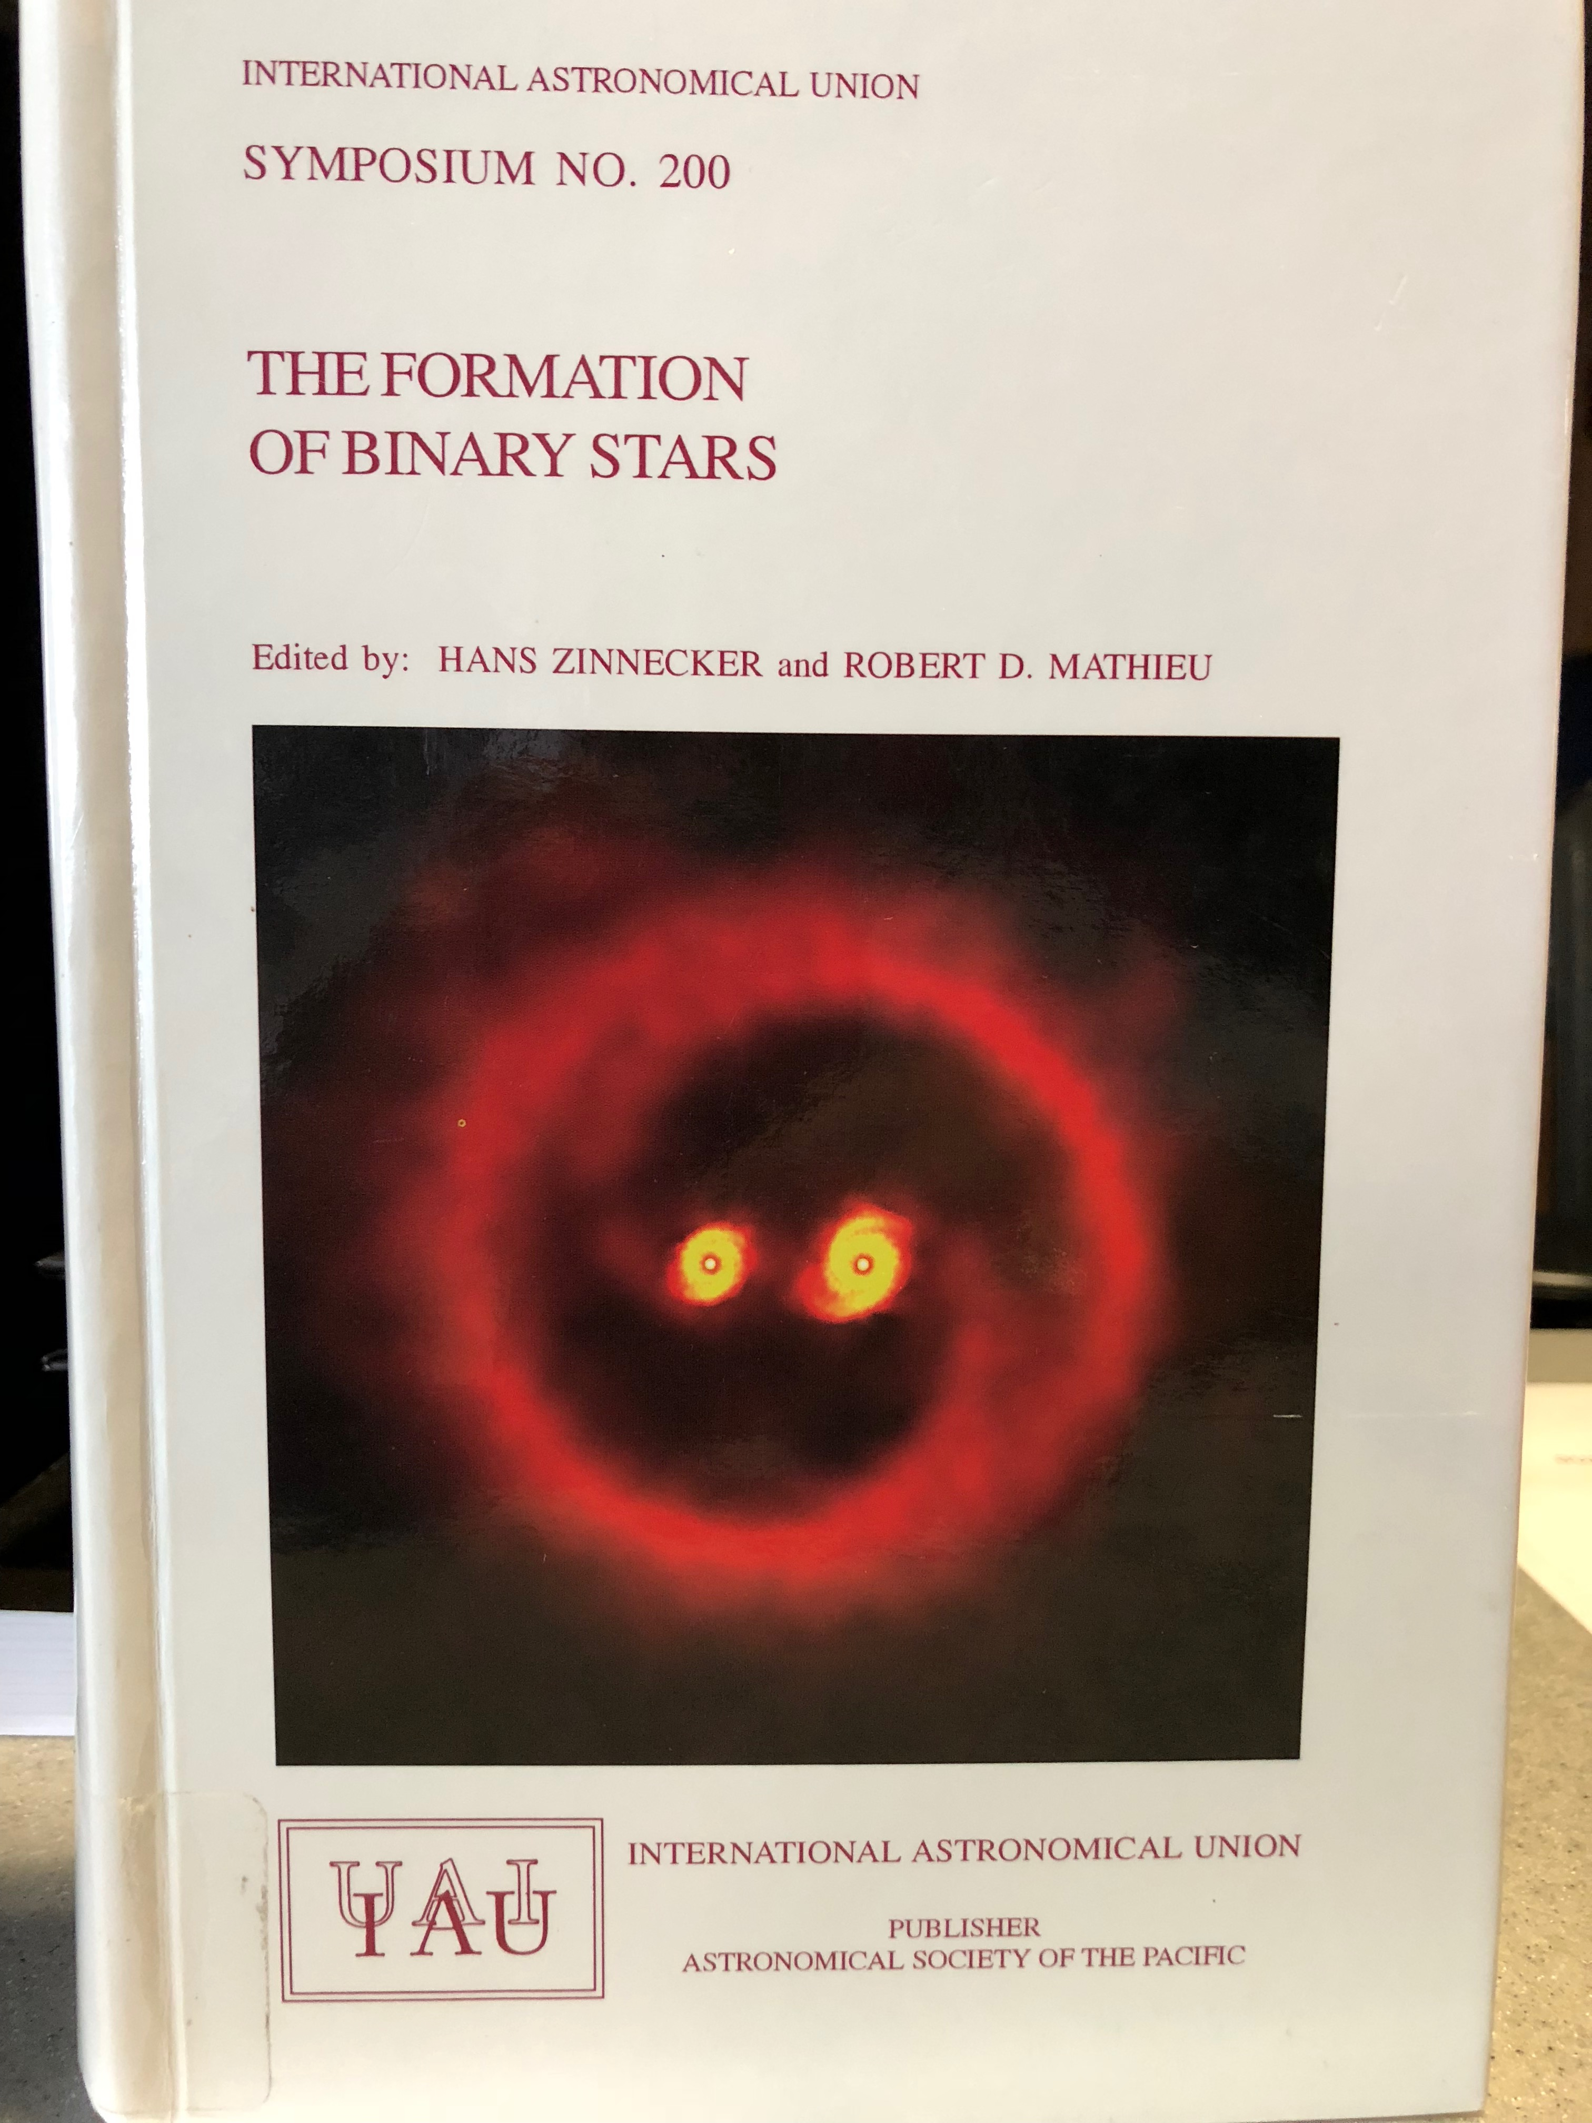
April 2000
Potsdam

Slide 3
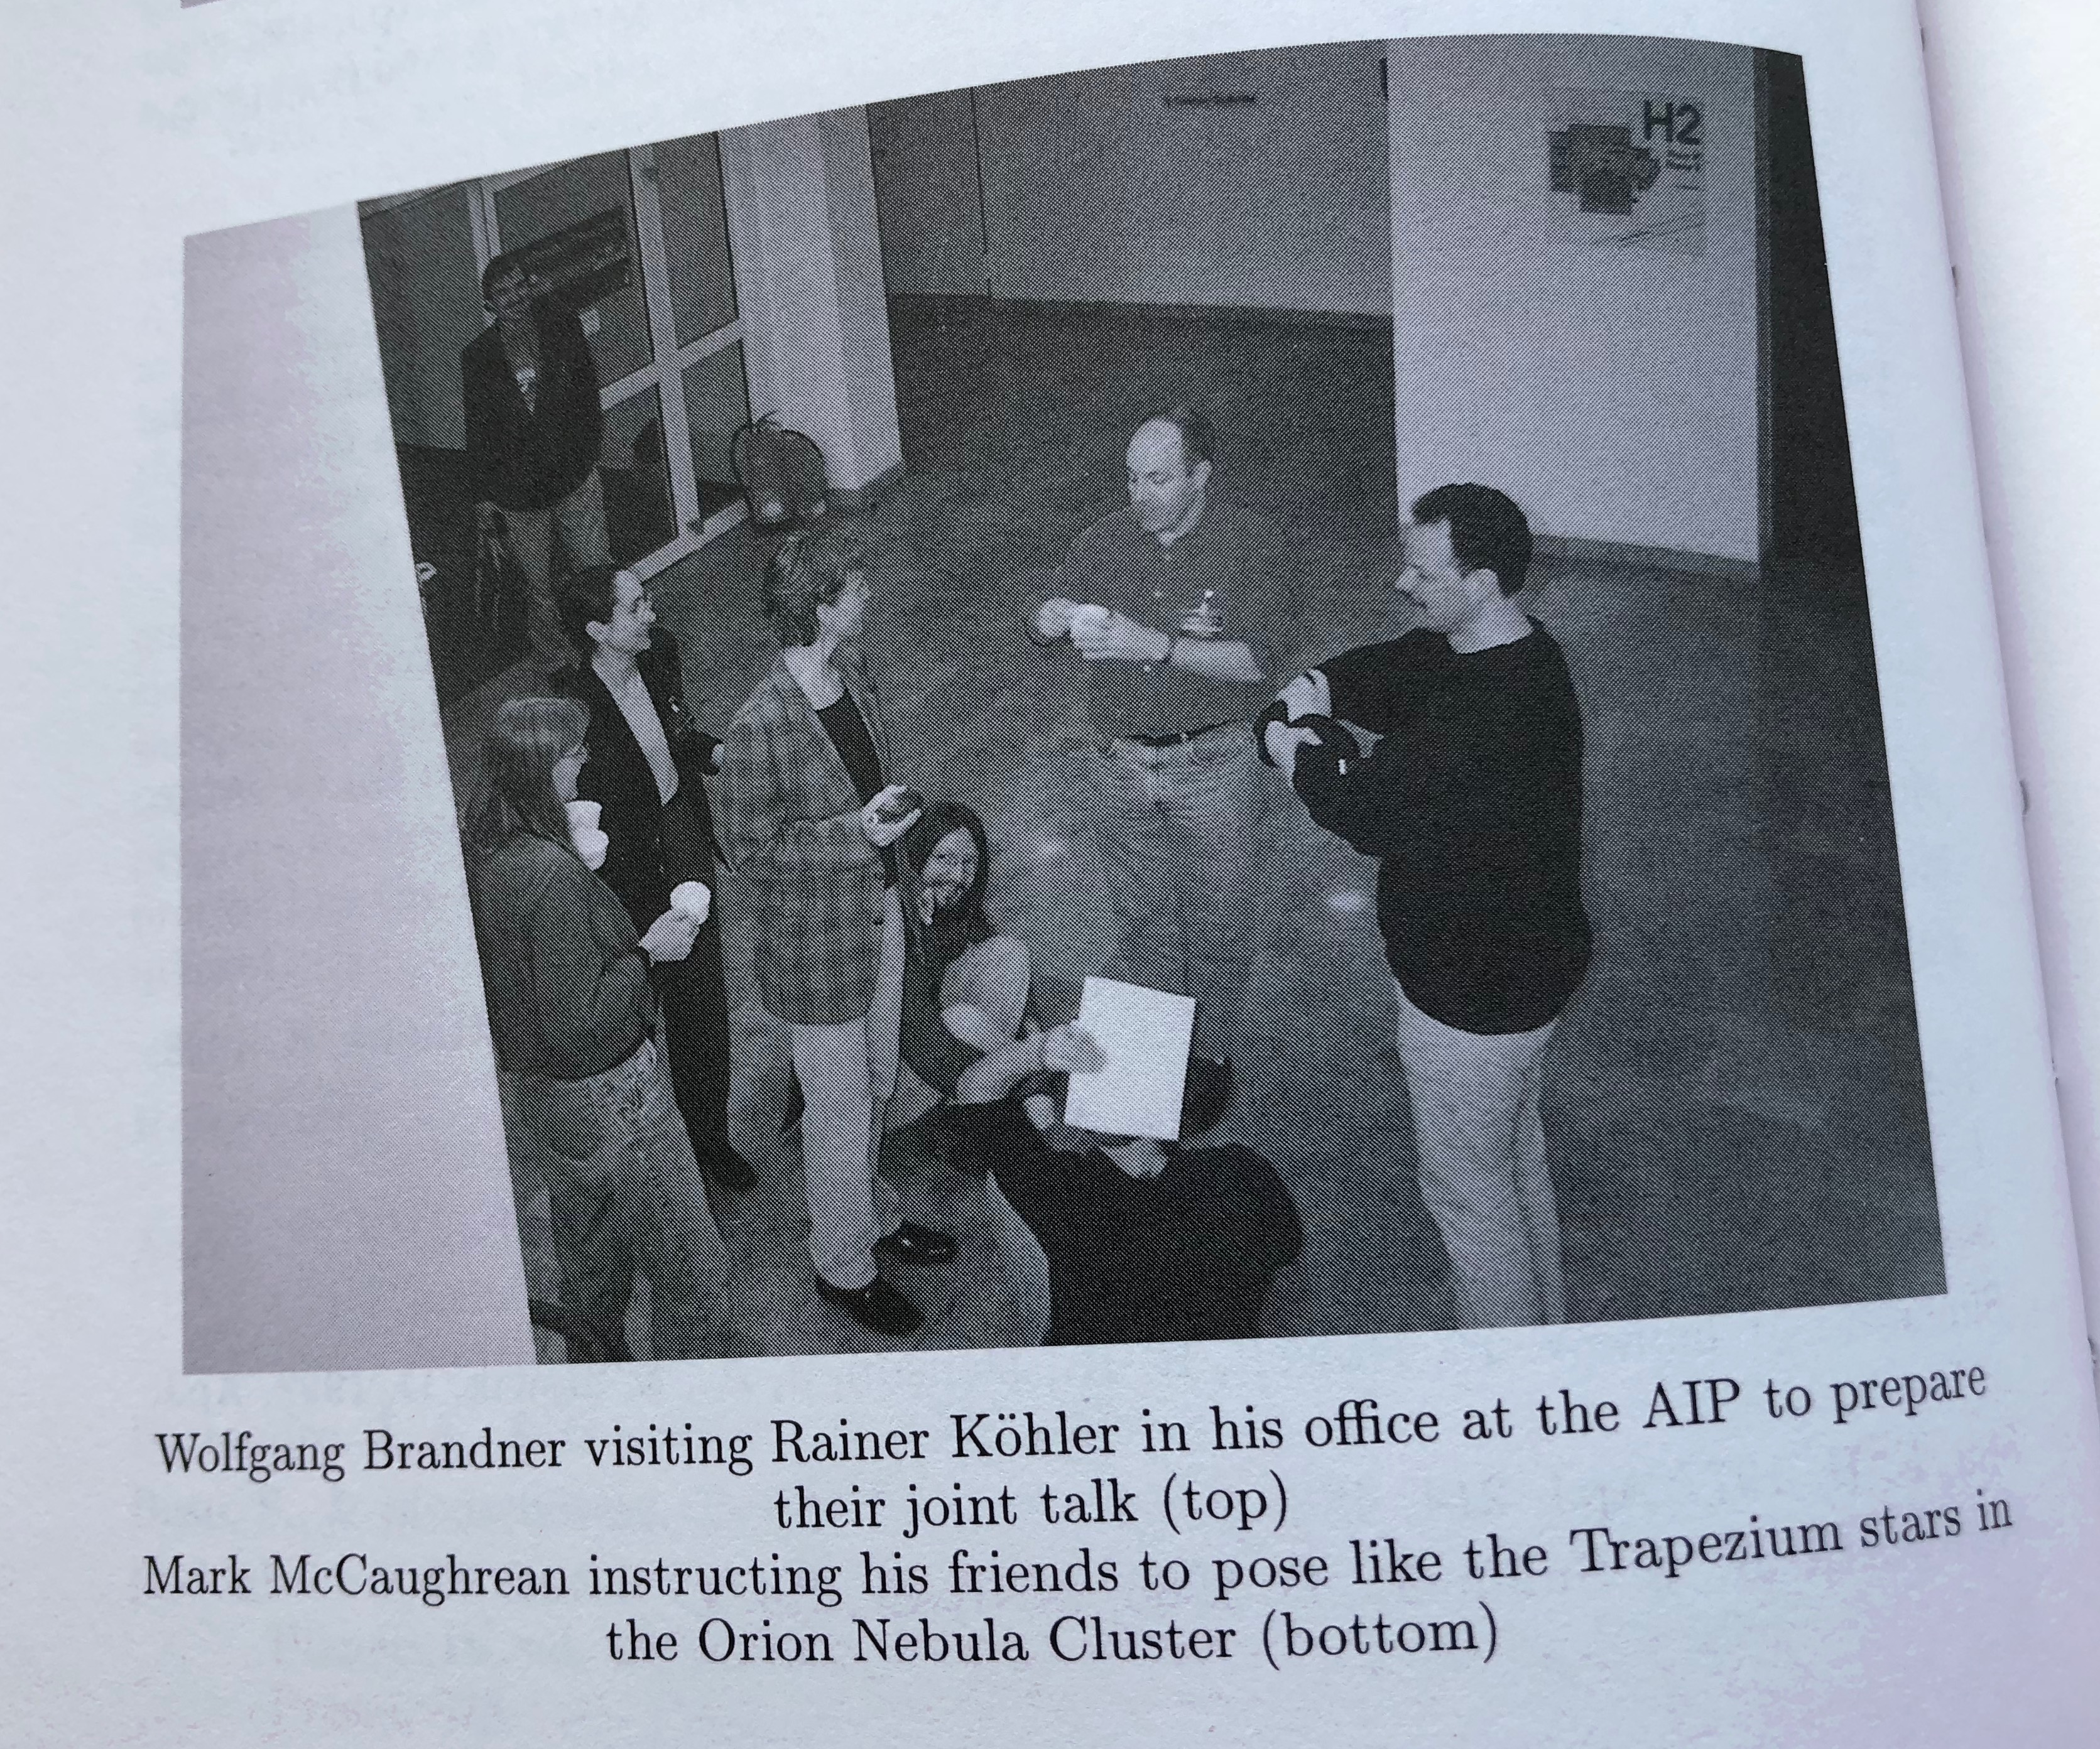

Slide 4
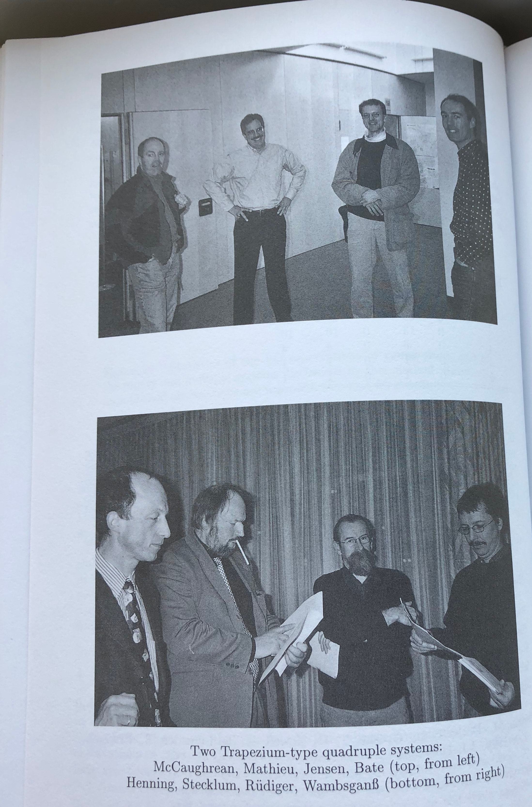

Slide 5
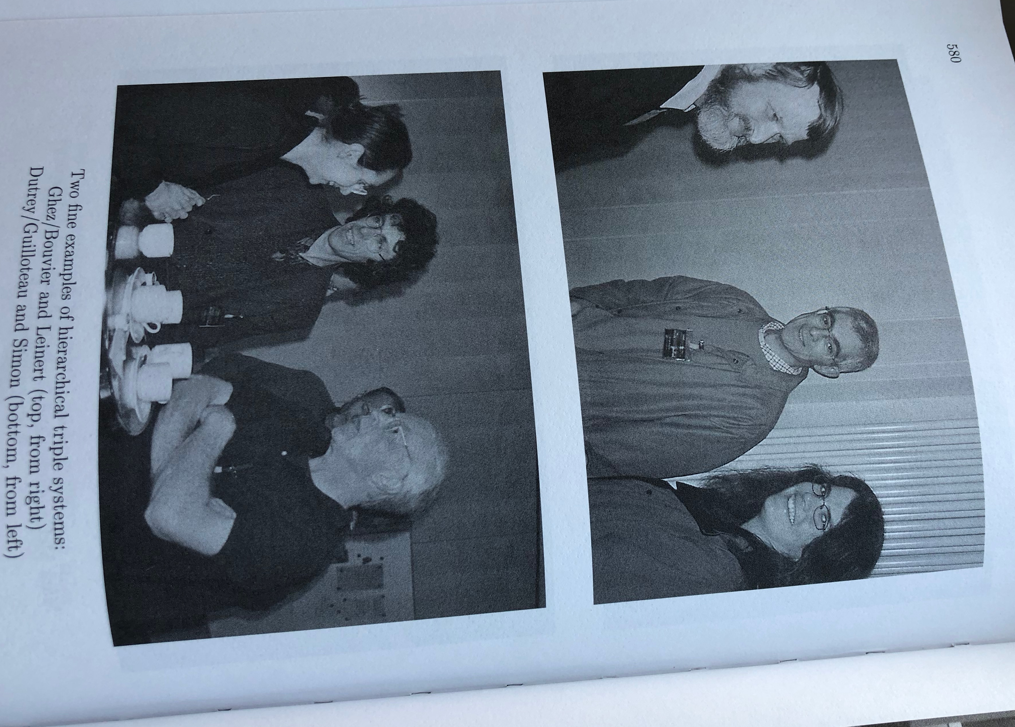

Slide 6
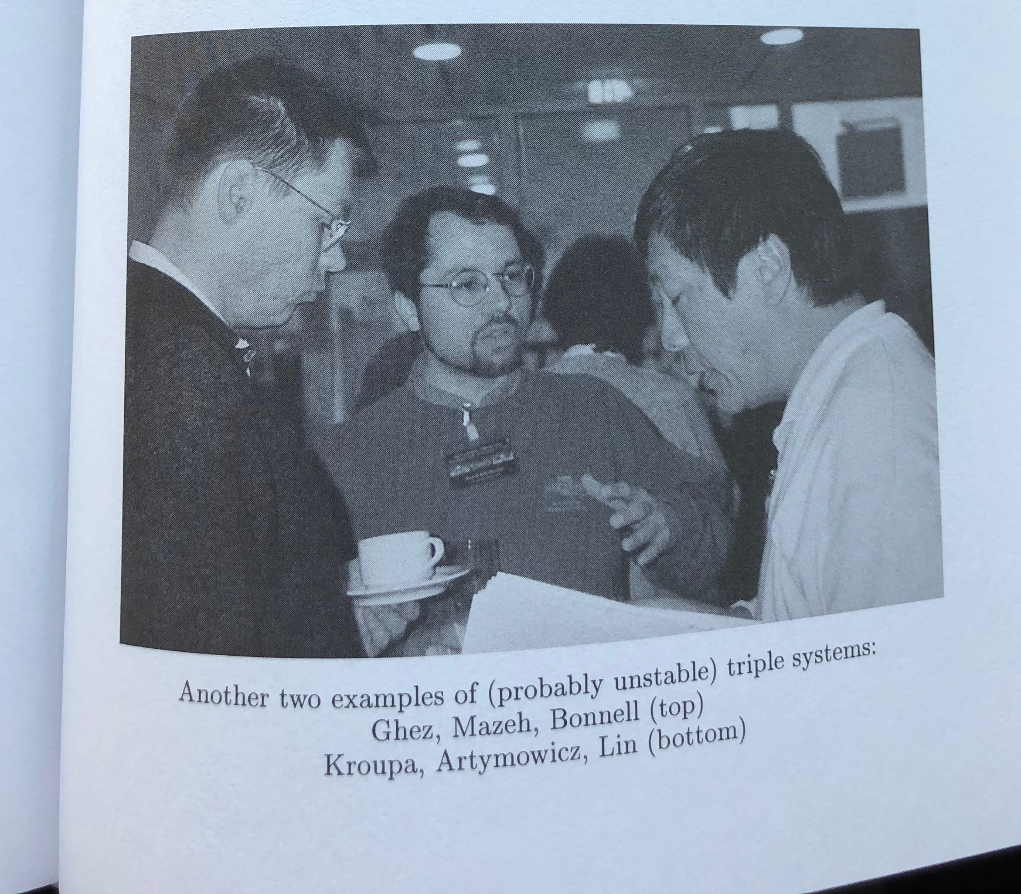

Slide 7
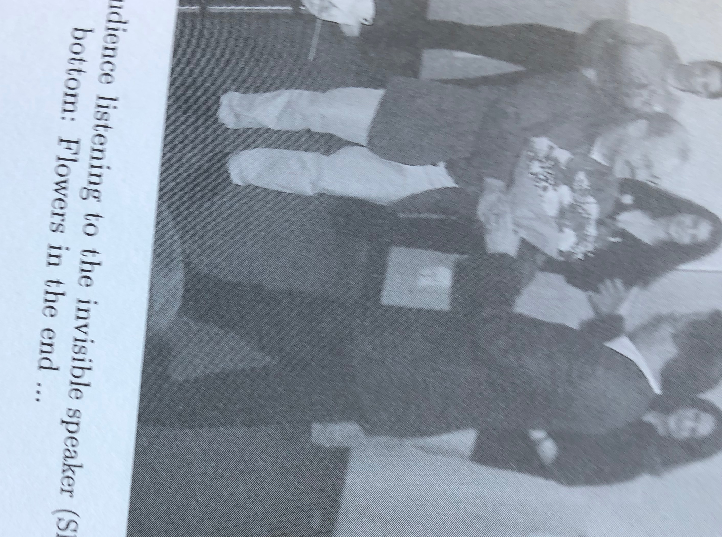

Slide 8
The Binary-Disk Interaction
The Challenge
The Exemplar - UZ Tau E
  UZ Tau was one of the first 11 stars originally identified as members of the class of T Tauri variable stars
  “UZ Tau E is the canonical eruptive T Tauri star“ – George Herbig
    Observed properties
      Strong Hα and other emission lines
      Strong spectral veiling
        Accretion rate 3x10⁻⁷ M_{o} yr ⁻¹
      Large IR excesses
      Large sub-mm emission
    Every observational diagnostic of active accretion
    from a protostellar disk onto a single star

Slide 9
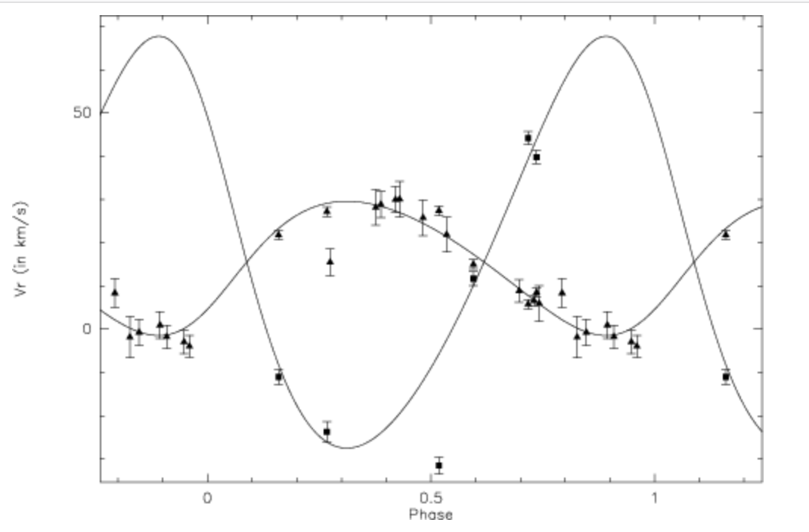
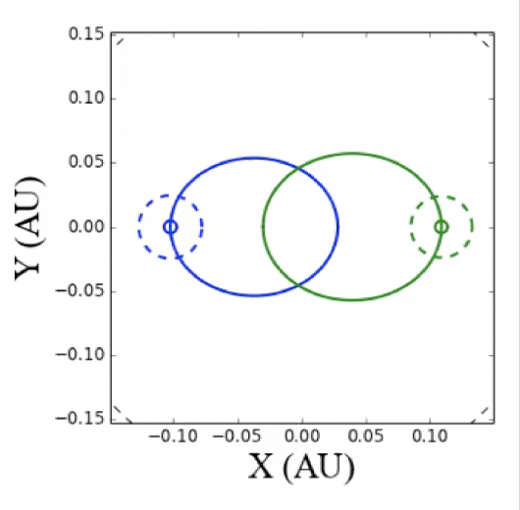
UZ Tau E
P = 19.0 days
e = 0.14
asin i = 0.13 AU
q = 0.26
How Do Stars In
Binaries Accrete
Mass from Disks?

Slide 10
The Binary-Disk Interaction
Theoretical Predictions:
Orbital resonances clear a central gap
  Three disks: two circumstellar and a circumbinary
Periodic accretion streams from circumbinary disk
  Feed circumstellar disks or accrete directly onto stars?
Higher accretion rates on primary stars

Slide 11
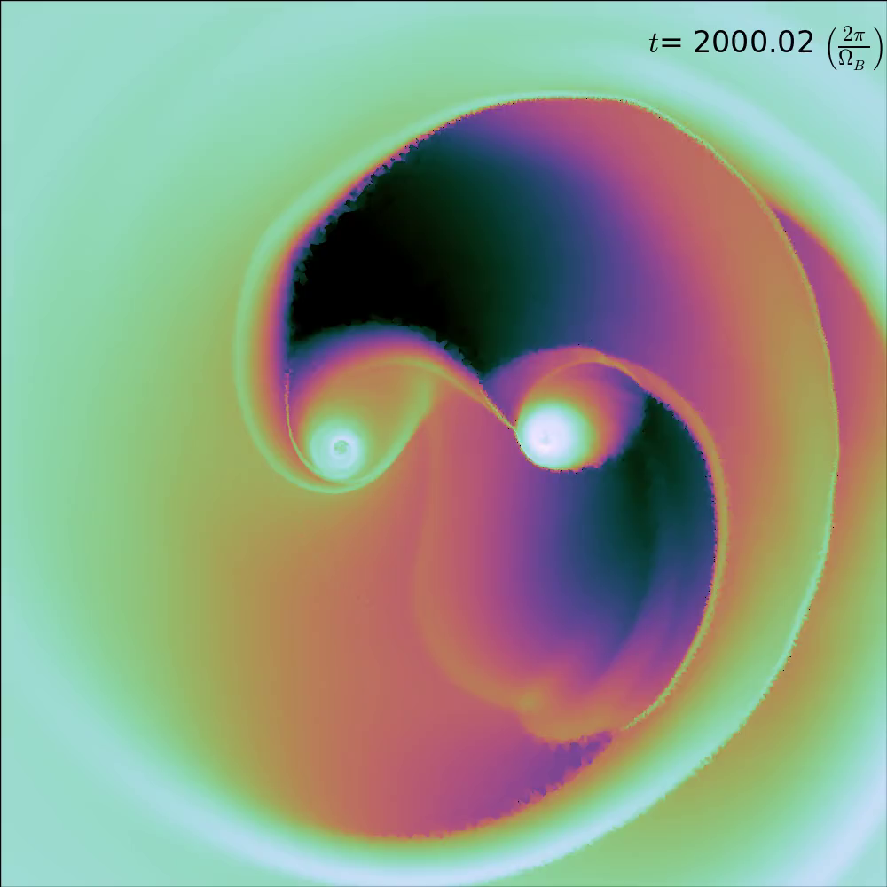
Accretion
Streams
Simulation:
AREPO
(Voronoi AMR)
>2000 orbital
periods simulated
Scale free
e = 0.5; q=1.0
Includes gravity and
gas physics only
Results:
Accretion streams at every orbital period
Periastron accretion
bursts
Muñoz & Lai 2016
Notes:
In the eccentric case…
Bursts of accretion don’t come stream material accreting directly onto the stars but rather from gravitational torques each star induces on its companion’s disk.

Slide 12
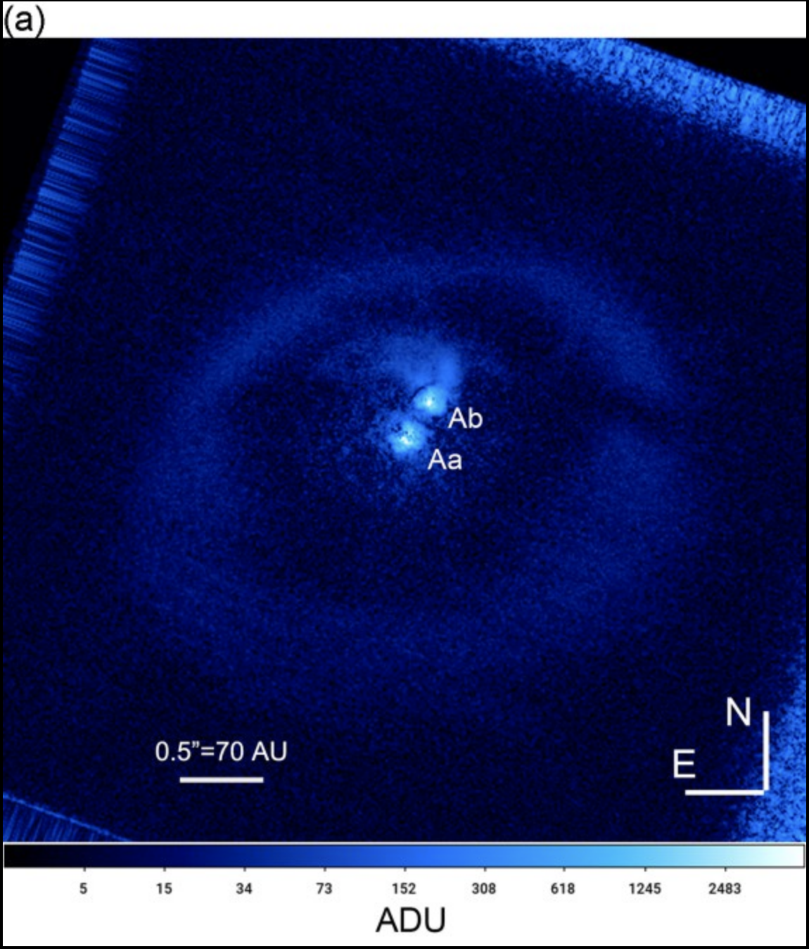
Accretion
Streams
GG Tau
(see poster by
Nelson & Mazari)
Muñoz & Lai 2016
Notes:
In the eccentric case…
Bursts of accretion don’t come stream material accreting directly onto the stars but rather from gravitational torques each star induces on its companion’s disk.

Slide 13
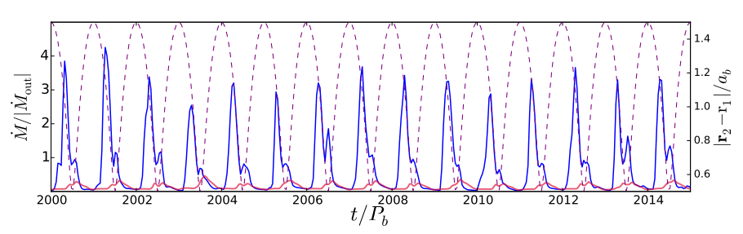
Pulsed Binary Accretion
Theory
Muñoz & Lai 2016

Slide 14
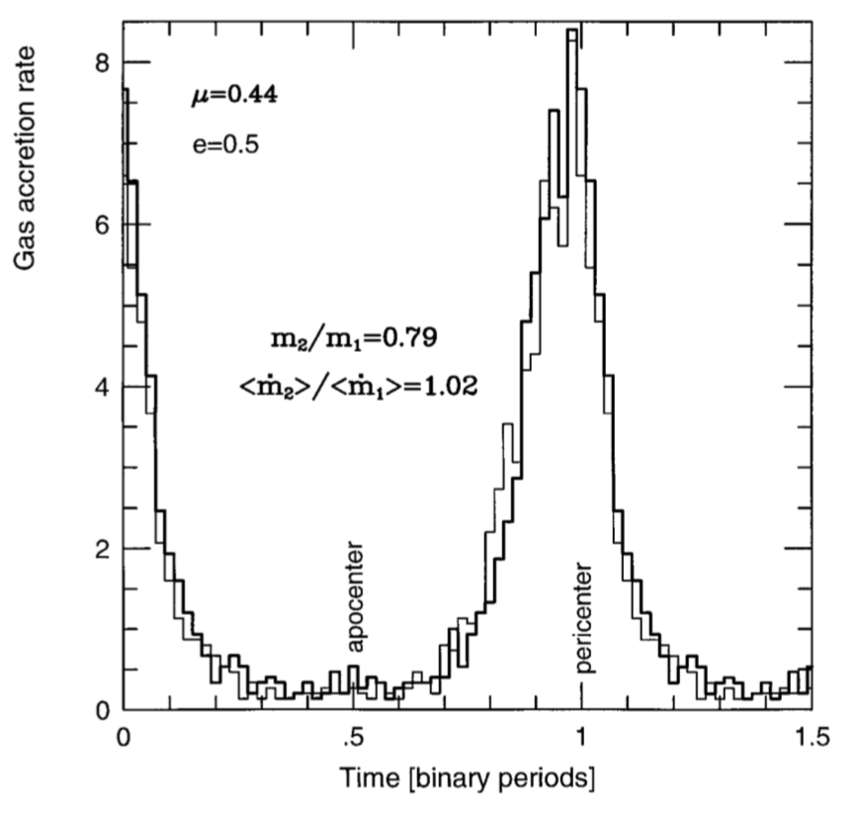
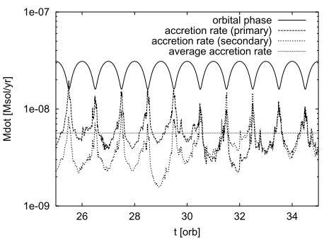
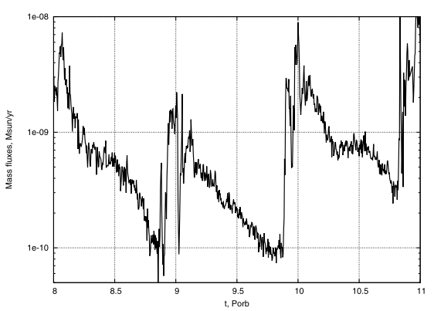
Eccentric Binary Accretion
Theory
Artymowicz & Lubow 1996
Günther & Kley 2002
Gomez de Castro+ 2013
Muñoz & Lai 2016

Slide 15
The Binary-Disk Interaction
Theoretical Predictions:
Orbital resonances clear a central gap
  Three disks: two circumstellar and a circumbinary
Periodic accretion streams from circumbinary disk
  Feed circumstellar disks or accrete directly onto stars
  Highly dependent on orbital parameters and viscosity
Higher accretion rates on secondary stars
Empirical Testbed:
Short-period (P < 100^{d}) binaries
Eccentric orbits

Slide 16
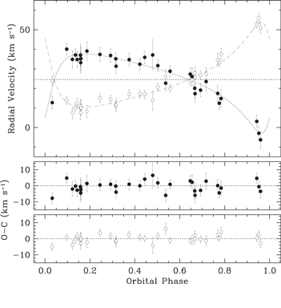
DQ Tau
P = 15.8 days
e = 0.57
a = 0.13 AU
q = 0.94
(M₁~M₂~0.6M⨀)
Czekala+ 2016

Slide 17
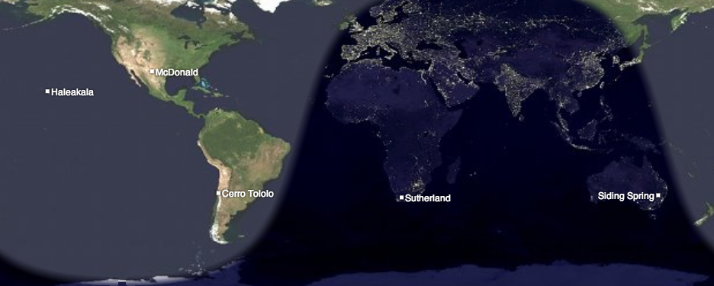



DQ Tau
Photometry:
LCOGT moderate-cadence (~20 hrs); 10 orbital periods
ARCSAT & WIYN 0.9m
high-cadence (~3 minutes)
33 nights

Slide 18
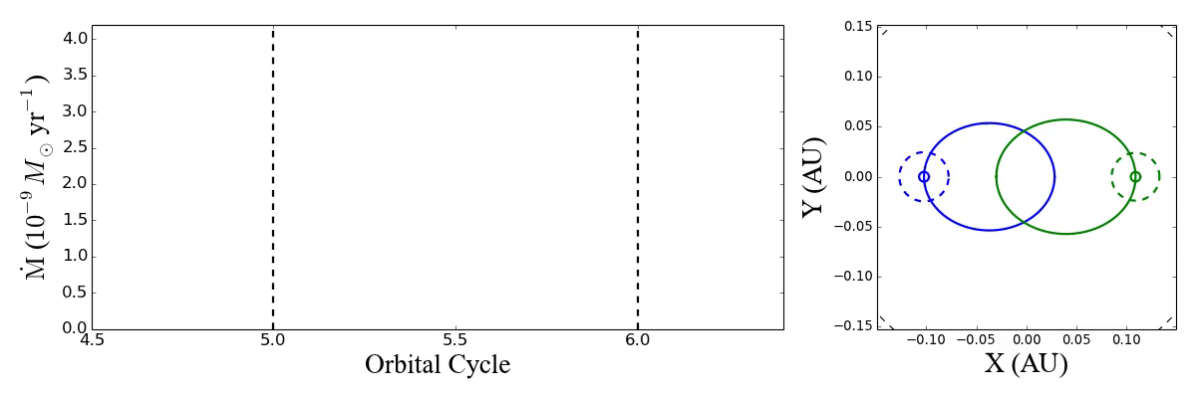
DQ Tau – Observed Accretion Rate
The Movie

Slide 19
DQ Tau – Observed Accretion Rate
Tofflemire et al. (2017a)

Slide 20
DQ Tau – Average Accretion Rate

Slide 21
DQ Tau – Average Accretion Rate
Differences:
Orbit-to-Orbit Variability
Event Morphology
Muñoz & Lai 2016
Notes:
Very good agreement to first order.

Slide 22
TW 3A
P = 34.9 days
e = 0.63
q = 0.84
asin i = 27 R⨀
Kellogg et al. 2017

Slide 23
TWA 3A – Full Light Curves
Tofflemire et al. (2017b)
Notes:
Scenario may be ripe for magnetic mirroring
So this is where if you assume a gyrating particle’s magnetic moment is a conserved quantity,
Repulsive force that can confine particles to bounce back and fourth between magnetic foot point radiating away their energy.
This would give us the radio flare that are observed without the whitelight component

Slide 24
TW 3A – Average Accretion Rate
Tofflemire et al. (2017b)
Notes:
Encouraging none-the-less
Near-Identical even though their accretion rates differ by more than an order of magnitude.
Transitioning to our spectroscopic observations.

Slide 25
The Binary-Disk Interaction
Theoretical Predictions:
Orbital resonances clear a central gap
  Three disks: two circumstellar and a circumbinary
Periodic accretion streams from circumbinary disk
  Feed circumstellar disks or accrete directly onto stars
  Highly dependent on orbital parameters and viscosity
Higher accretion rates on secondary stars

Slide 26
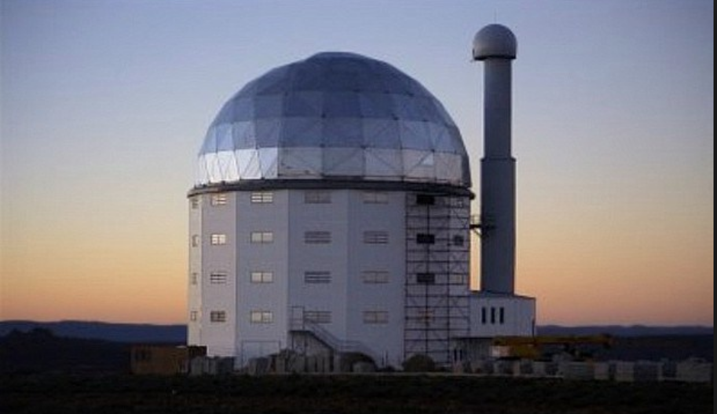
TWA 3A – SALT Spectroscopic Campaign
Tofflemire et al. (2018, in prep)
Notes:
Here is a summary of our campaign

Slide 27
TWA 3A – Hα Variability
Tofflemire et al. (2018)
Notes:
Indicative of a complete absence of accretion outside of these discrete bursts
May be Indicating a lack of circumstellar disks.
So now knowing when accretion takes place…

Slide 28
TWA 3A – He I 5876 Variability
Before
Periastron
Primary
He I emission favors the primary’s velocity, suggesting it is the primary accretor
Secondary
Primary
Apastron
After
Periastron
Notes:
This line is great because it is a narrow compared to H-alpha and near periastron, when the primary and secondary have the greatest velocity separation, we can use it to diagnose not only when, but on which star accretion is happening.
Here I am plotting a subset of our spectra
Observations
FWHM ~1A and an EW between 0.3 and 0.5A
Literature Stuff on Chromospheric emission
For solar type dwarf this line shows variability but it is always in absorption (http://adsabs.harvard.edu/abs/1988PASP..100.1452C)
AD Leo/GX And – FWHM of 0.6A and a EW of 0.3A. (http://adsabs.harvard.edu/abs/1981ApJ...251..571P)
DZ Cha – EW < 0.14A for a M0 WTTS star (https://arxiv.org/abs/1710.09393)
HRS uses a 2.2” fiber in High-Resolution mode
TWA 3A and 3B are 1.5” apart.

Slide 29
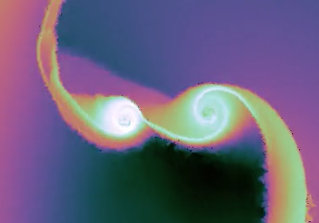
What are the Pathways to the Surface ?
Direct Impact of Streams or Transient CS Disks?
Notes:
-The variability we’re observing is also highlighting the importance of magnetic fields.
-Periastron where for DQ Tau’s orbital parameters, the black circles mark the magnetospheric truncation radii assumed for single stars.
-Sense of scale
-Not same scenario balance point is likely variable an interior to the single star value
-Don’t have a clear picture but in at some point the disk is going to be disrupted by the magnetic field, potentially to the point that no stable circumstellar material exists, and this will greatly decrease their ability to buffer these incoming stream.
-And his is the only reason we think that we’re able to see variability in the streams because the stars don’t have circumstellar disk capable of buffering them.
-This is not the single star case: not a balance of viscous ram pressure with magnetic pressure, material is torqued, infalling from large radii,
may apply a larger pressure on the B-field compressing it but close to the star but the magnetic field of the stars will disrupt the circumstellar disk at some point.

Slide 30
TW 3A – Average Accretion Rate
Transient
Accretion
Disks
Observed
Tofflemire et al. (2017b)
Notes:
Encouraging none-the-less
Near-Identical even though their accretion rates differ by more than an order of magnitude.
Transitioning to our spectroscopic observations.

Slide 31
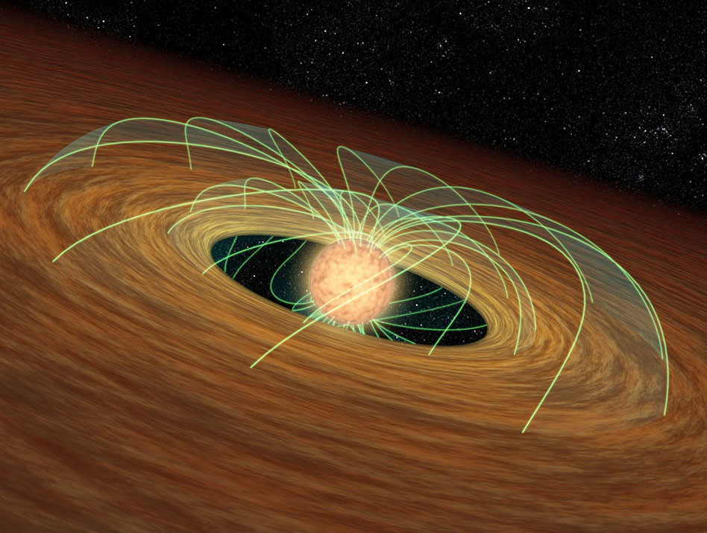
What are the Pathways to the Surface ?
Single Star
Magnetic Truncation Radii (R_{in} ~ 5 R★)
a(1-e) ~ 12.5 R★
Stellar Magnetic Fields?
Notes:
-The variability we’re observing is also highlighting the importance of magnetic fields.
-Periastron where for DQ Tau’s orbital parameters, the black circles mark the magnetospheric truncation radii assumed for single stars.
-Sense of scale
-Not same scenario balance point is likely variable an interior to the single star value
-Don’t have a clear picture but in at some point the disk is going to be disrupted by the magnetic field, potentially to the point that no stable circumstellar material exists, and this will greatly decrease their ability to buffer these incoming stream.
-And his is the only reason we think that we’re able to see variability in the streams because the stars don’t have circumstellar disk capable of buffering them.
-This is not the single star case: not a balance of viscous ram pressure with magnetic pressure, material is torqued, infalling from large radii,
may apply a larger pressure on the B-field compressing it but close to the star but the magnetic field of the stars will disrupt the circumstellar disk at some point.

Slide 32
DQ Tau – Variability Within a Stream ?
Notes:
-Looking within a single orbital periods we also see variability with an accretion event with discrete bursts of accretion.
-The number of the discrete events points to non-steady flows that provide episodic bursts within an periastron event.
-Also occur at a wide range of orbital phases, unlikely that the companion is applying a significant torque at this orbital phase, see their separation…

Slide 33
Summary
Pulsed accretion events consistently occur near periastron passage in DQ Tau and TW 3A, much as models predict
Possible to have preferred accretion on to primary star
Complex variability in the amplitude, morphology, and phase of accretion events points to:
  Variable feeding rate from orbit-to-orbit?
Current & Future Work:
  Determine impact of orbital parameters from full sample
    6 more PMS binaries with light curves coming
  Characterize streams with time-series spectroscopy
    Is higher accretion onto primary typical?
  Constrain flow onto stars, e.g. impact of magnetic fields and three dimensions
    High-resolution NIR spectroscopy? Other thoughts?

Slide 34
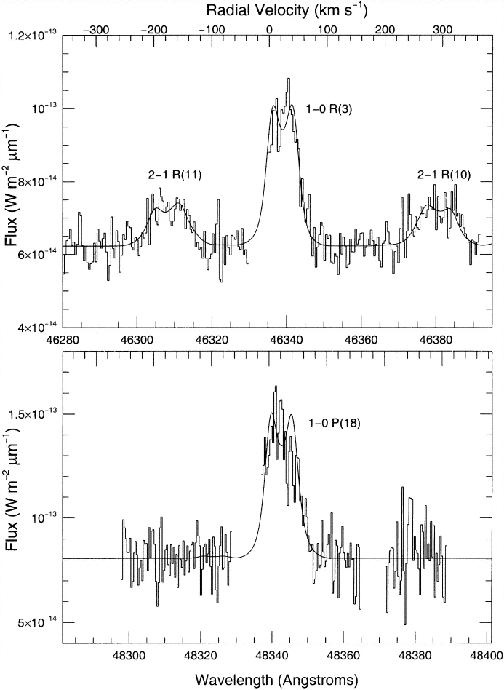
NIR High-Resolution Spectroscopy
GW Ori
Material with kinematics of being in the
“cleared” gap
Carr et al. 2001
Notes:
-Looking within a single orbital periods we also see variability with an accretion event with discrete bursts of accretion.
-The number of the discrete events points to non-steady flows that provide episodic bursts within an periastron event.
-Also occur at a wide range of orbital phases, unlikely that the companion is applying a significant torque at this orbital phase, see their separation…

Slide 35
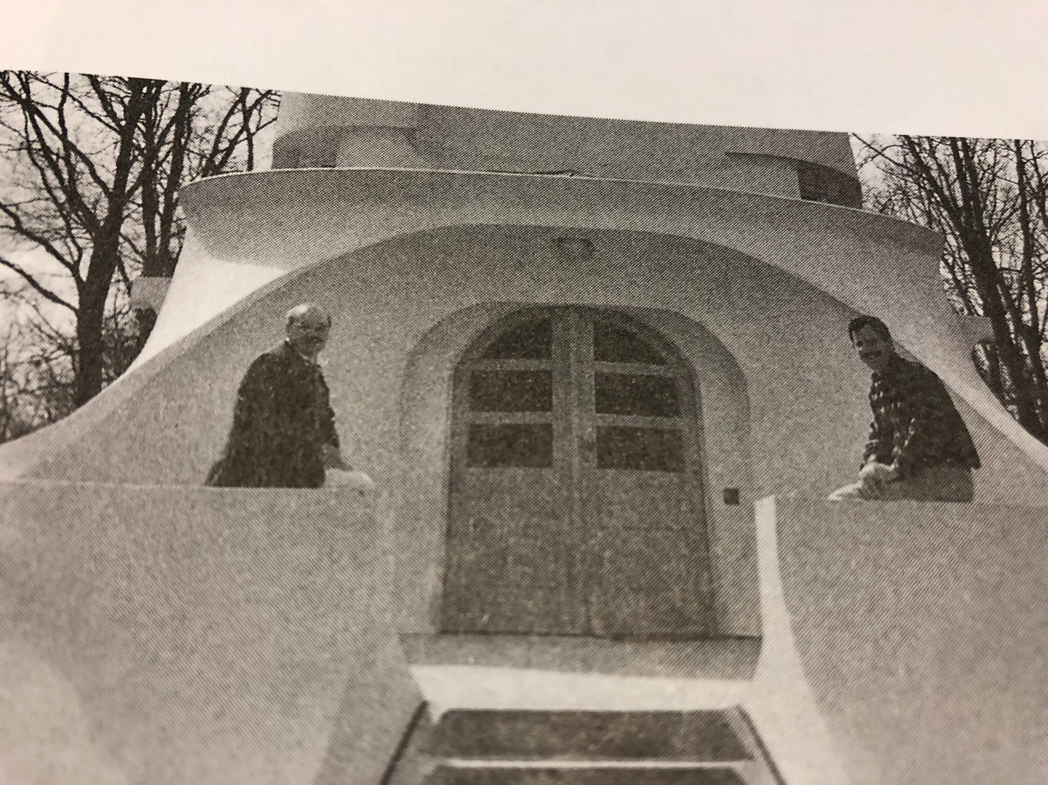
You Haven’t Changed at All, Hans!

