Slide 1



ALMA finds top-heavy stellar initial mass function (IMF) in dusty starburst galaxies
across cosmic time
Zhi-Yu Zhang 张智昱
U. Edinburgh/ESO
Collaborators:
Donatella Romano (INAF-OAS)
Rob Ivison (ESO, U. Edinburgh)
Padelis Papadopoulos (Aristotle U. of Thessaloniki)
Francesca Matteucci (U. Trieste, INAF-OATS)
COSMICISM

Slide 2
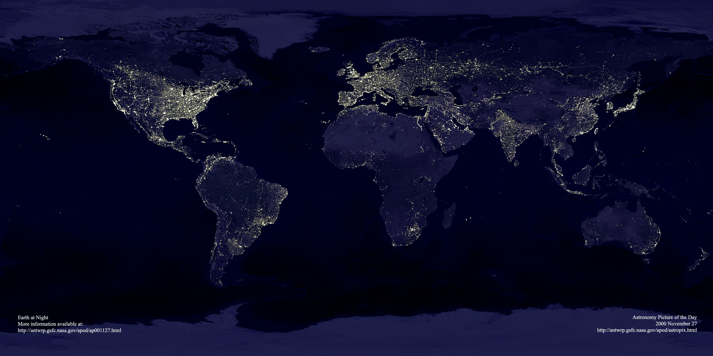
Does light always trace mass (population)?
今夜，我不关心人类，我只想星辰。
Tonight, I only care about stars, not the earthlings.
Earth at night, from APOD

Slide 3
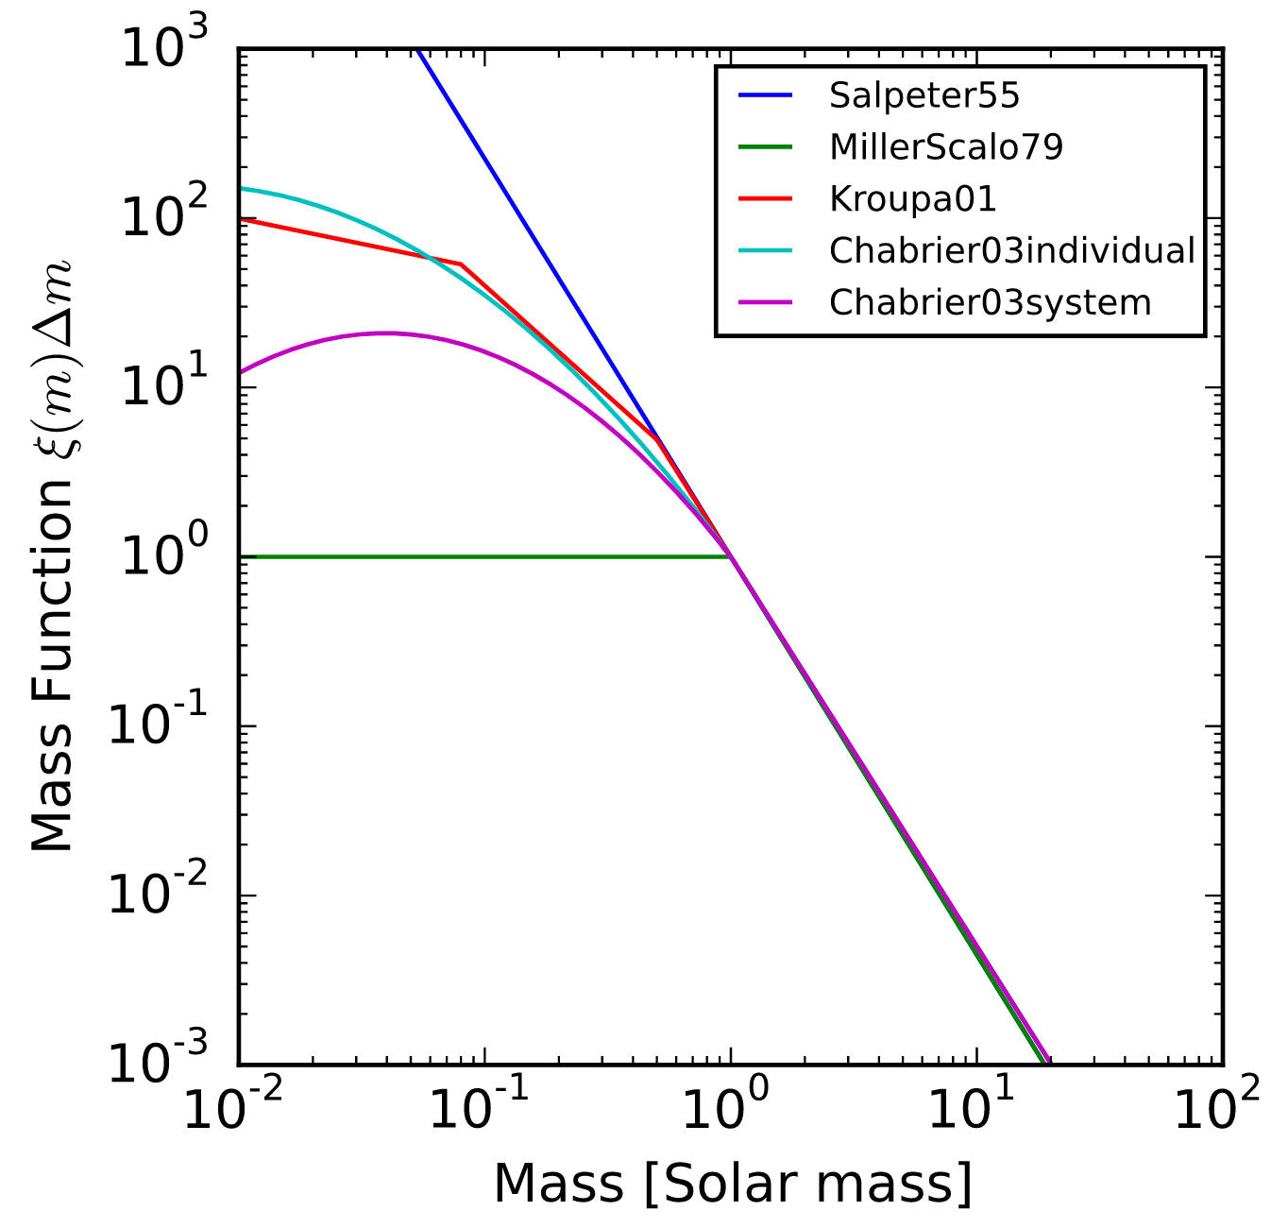

The stellar initial mass function (IMF)
A probability distribution function of stars with different masses formed in a single star-formation episode.
The fundamental function for understanding star formation, galaxy evolution and the Baryon cycle across cosmic time
Bottom-heavy
bottom-light
Total stellar mass
Star-formation rate
Top-heavy
IMF
Top-light
Mass
Light
UV, Hα, radio
continuum, optical, etc.
from Wikipedia

Slide 4
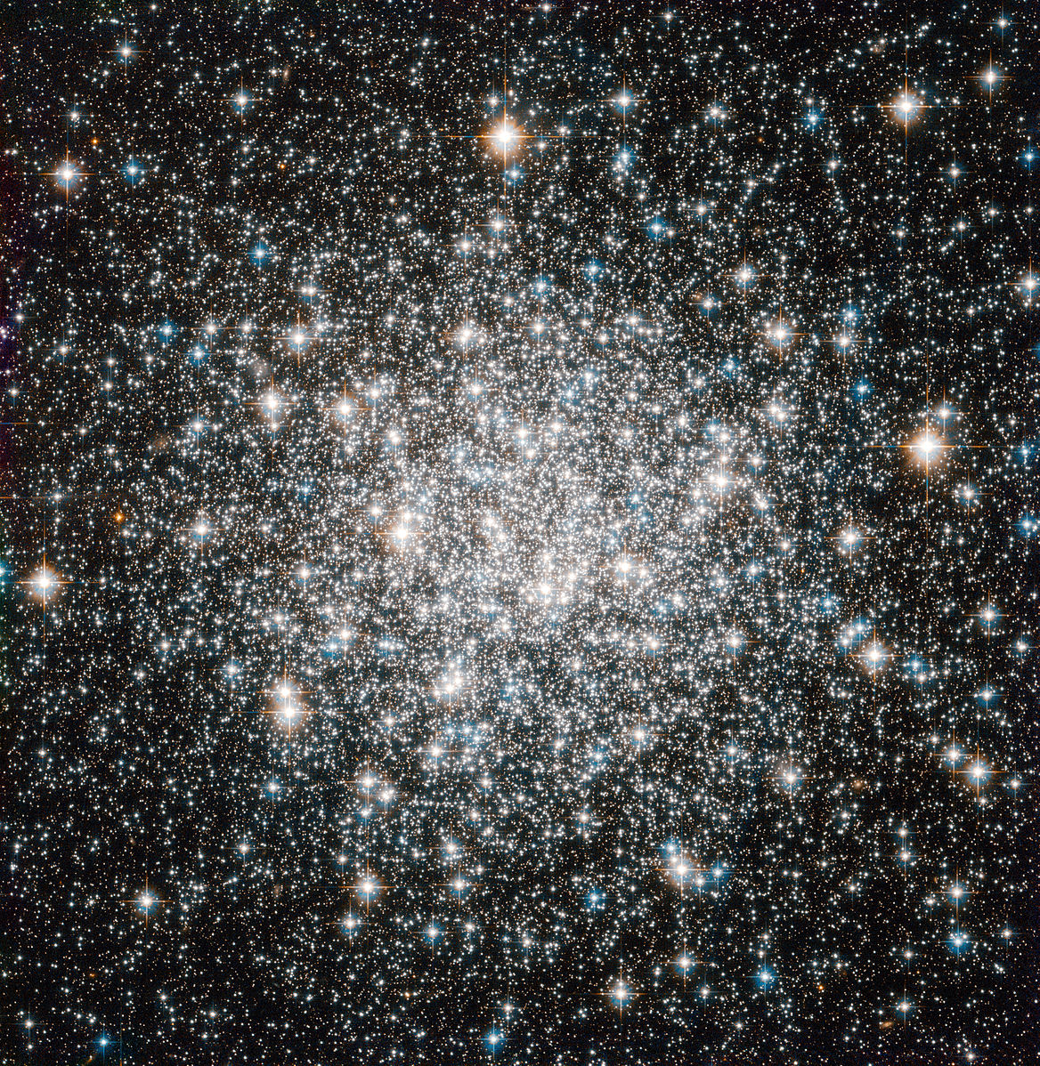
Measuring the stellar IMF:
There is no direct way to measure the full IMF.
We can only count the present-day mass function.
Classical methods:
Star counting
Spectroscopic identification
Hα + UV
Hα + colour
Mdyn/L and M*/L ratio
TiO, CaH, NaD, FeH…
Dynamics
M68
from Wikipedia
Credit: NASA/STScI/WikiSky
All limited to use at optical, UV, NIR wavelengths

Slide 5
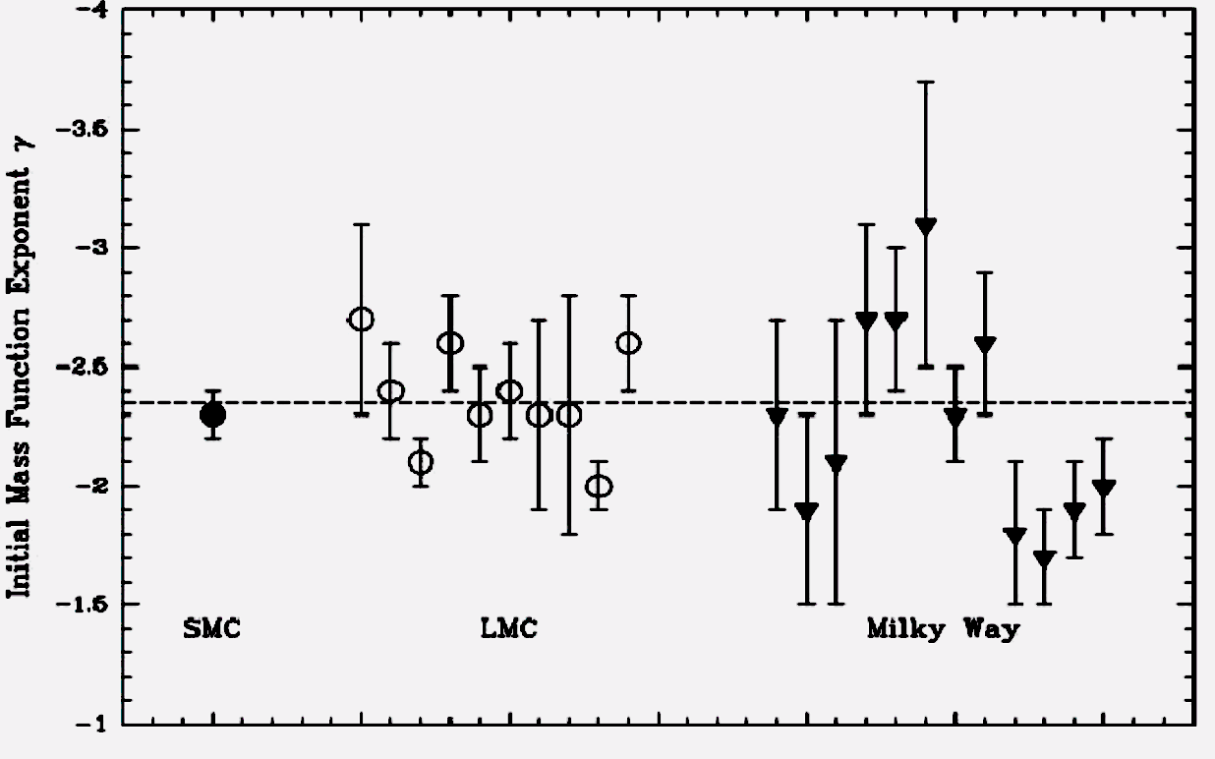
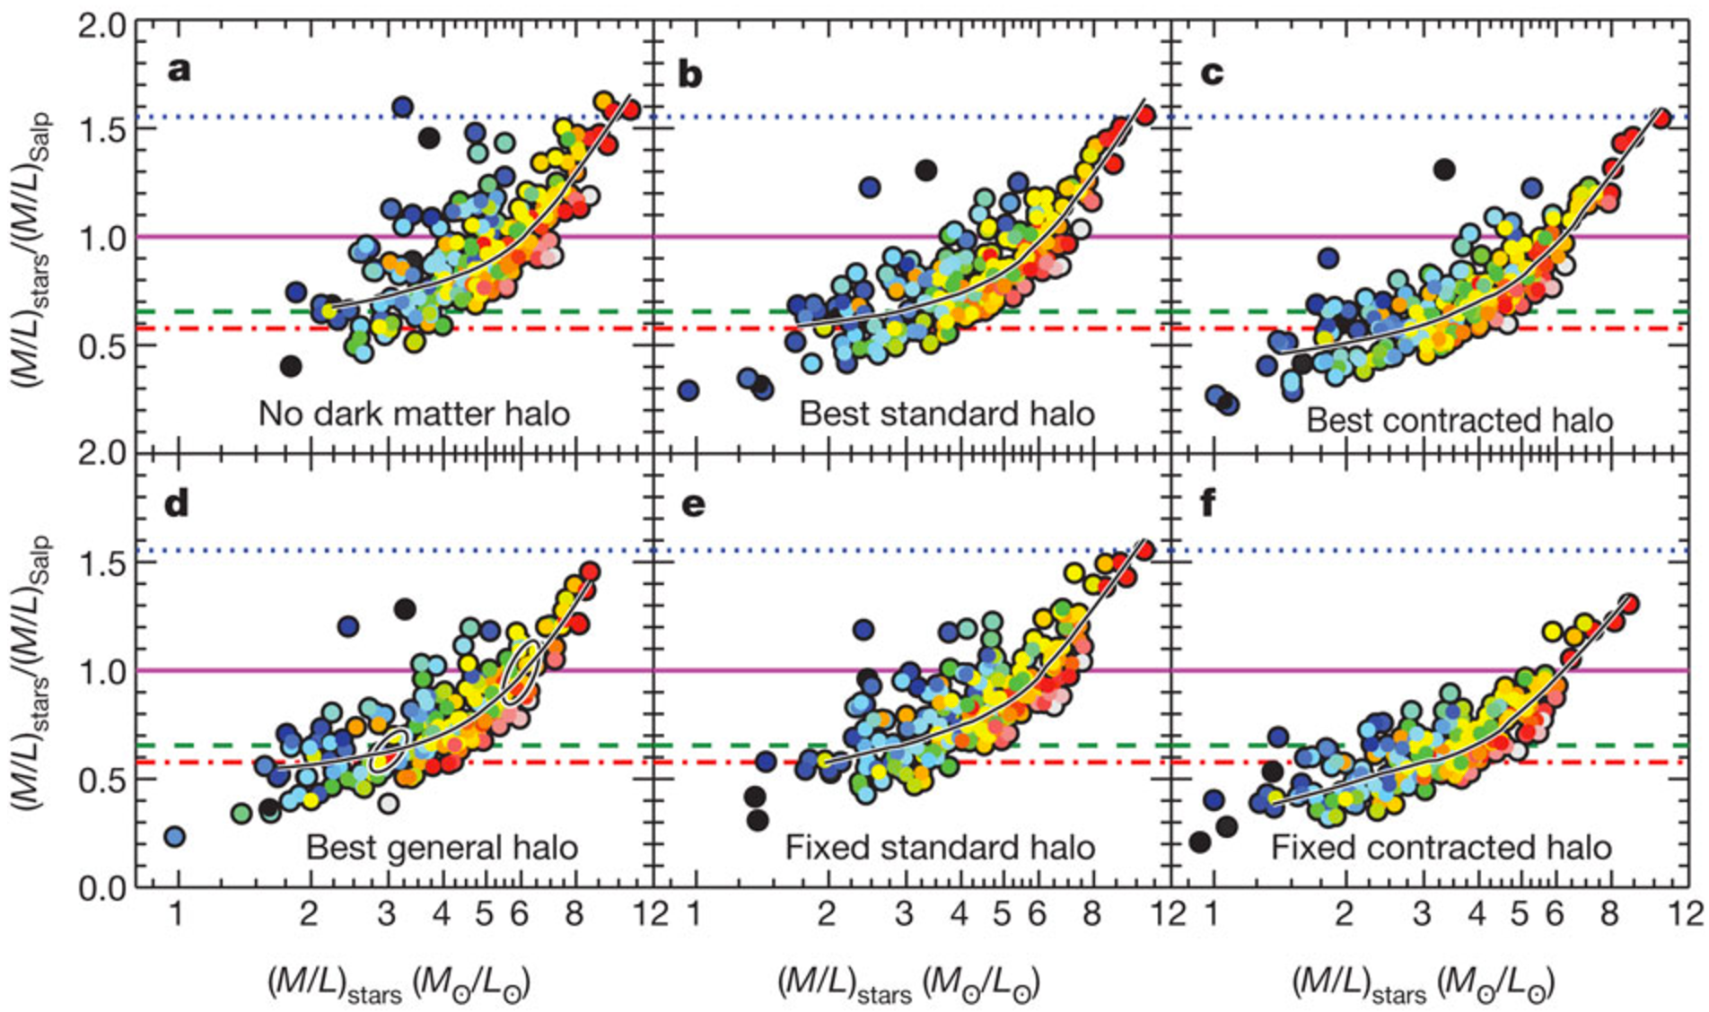
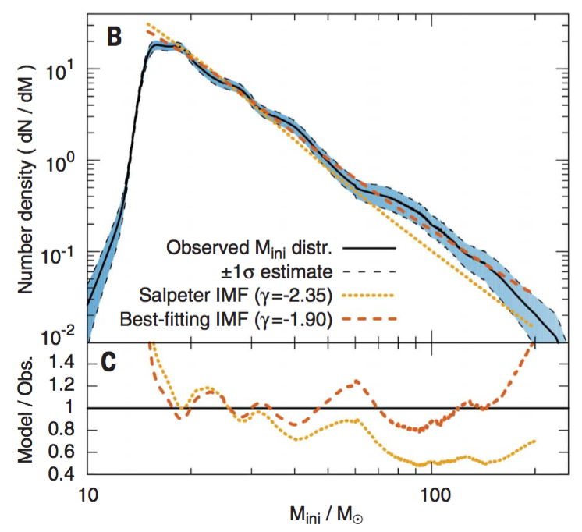
Universal, variable, or mixed IMF?
IMF seems universal in Galaxy and in nearby galaxies
(star counting).
see reviews by Massey 2003, Bastian+2010
Large variation in early-type galaxies (ETGs)
(using M*/L, Mdyn/L, etc.)
Cappellari+2012, Conroy & van Dokkum 2012, van Dokkum+2016
Top-heavy IMF found in 30 Dor, a starburst
region in the LMC, via detailed star-counting.
Schneider+2018

Slide 6
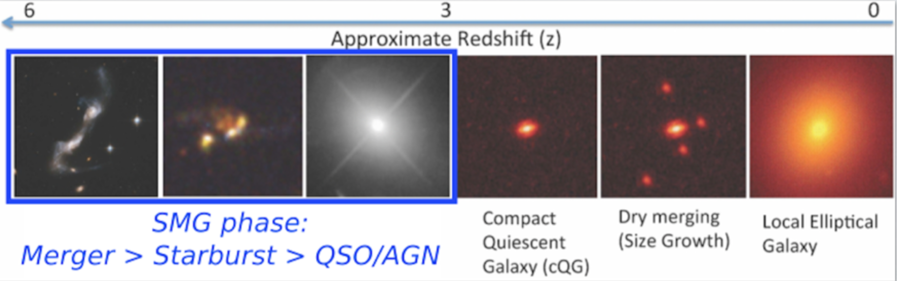
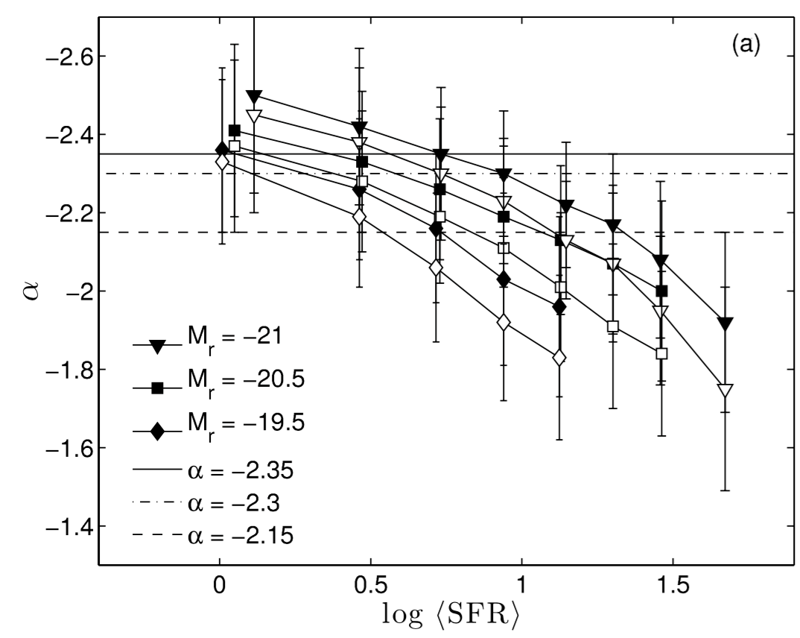
Dusty starburst galaxies: top-heavy or bottom-heavy IMF?
Very dusty, so A_{V} > 100 (e.g. Simpson+2017): not possible to use UV/optical/IR
Very high apparent SFR ~ 100–1000 M⊙/yr
Expected to evolve into today’s ETGs, with most of their stars formed in starburst(s)
Toft+2014
Top-heavy ?
vs.
Bottom-heavy ?
found
Expectation
Hα +color
Gunawardhana+2011
Cappellari+2012

Slide 7
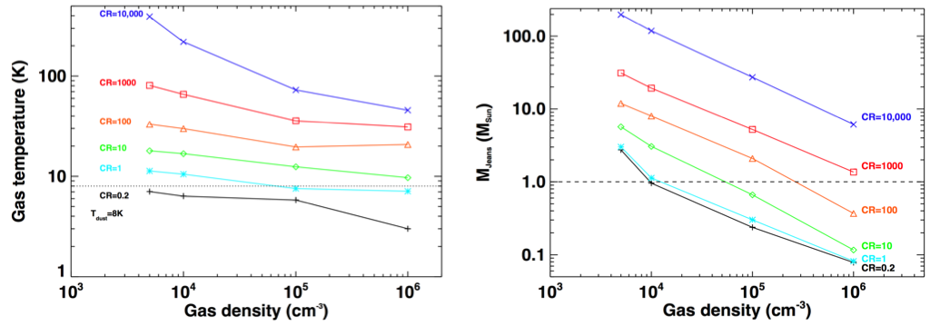
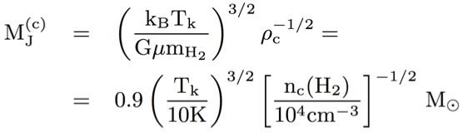
Cosmic Ray (CR) + CMB heating —>Top-heavy IMF?
Tgas, Mjeans, at different CR heating rates in dense gas cores:
Papadopoulos+2010, 2011; Bisbas + 2015; 2017
TCMB(z=10) equivalent to Tgas(100 x CRGalactic)
Zhang+2016, RSOS
Jeans Mass:
Larson 2005, Elmegreen+2008

Slide 8
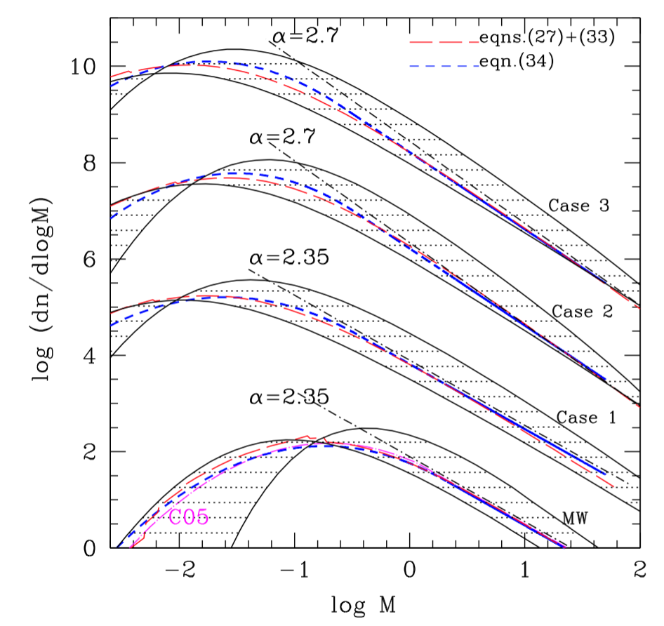
Gravo-Turbulence: —> Top- or Bottom-heavy?
Fragmentation
Starburst
higher Mch, n(H2), Tkin
Gravo-turbulence, thermo-dynamical models predict top-heavy IMFs for starburst conditions.
e.g. Hocuk & Spaans 2011
reviewed in Papadopoulos+2011
However, a bottom-heavy IMF
can be produced by turbulence too, and it reconciles with the bottom-heavy IMF results of
local ETGs.
Hennebelle & Chabrier 2011; Chabrier+2014
lower Mch, n(H2), Tkin
Milky Way

Slide 9
Our work:
Using C and O isotopes measured in the ISM
to probe the stellar IMF
in distant dusty starburst galaxies
with ALMA

Slide 10
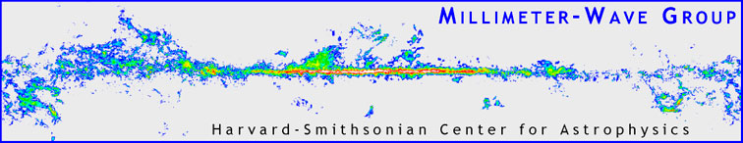
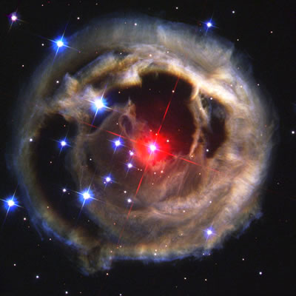
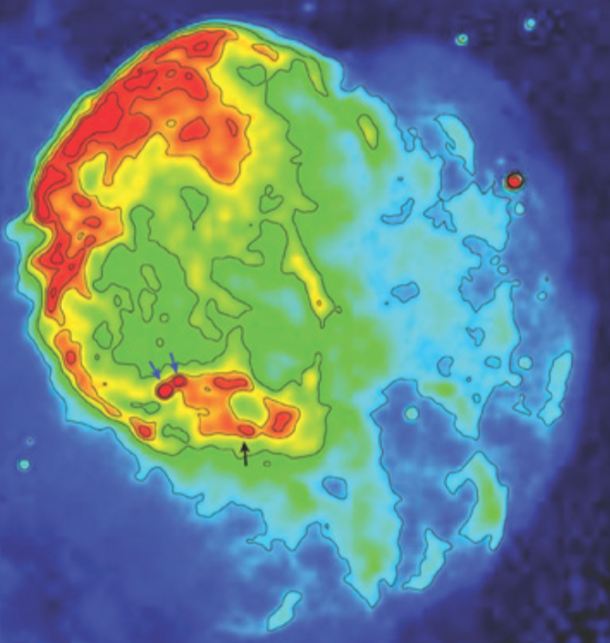
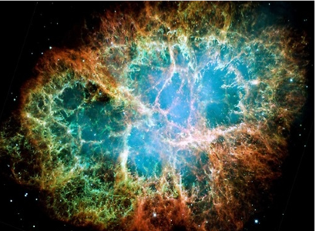
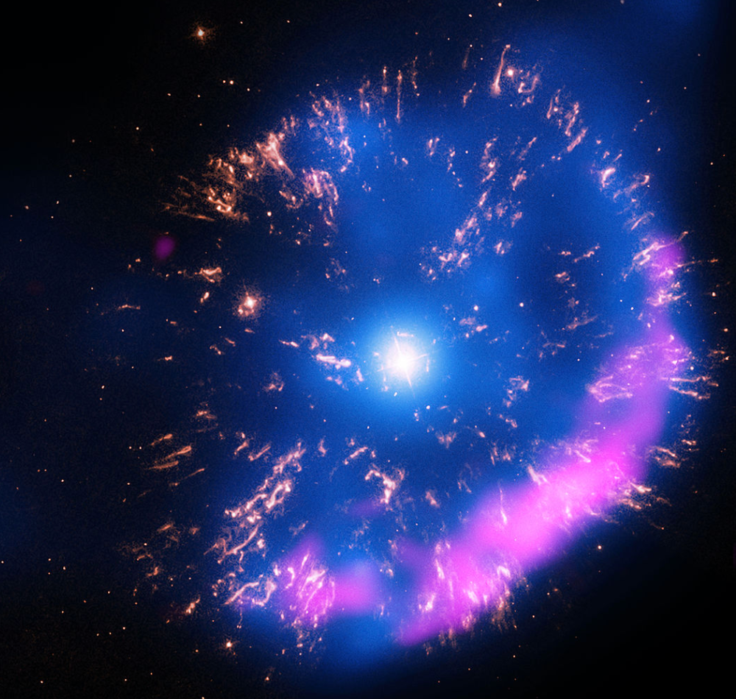
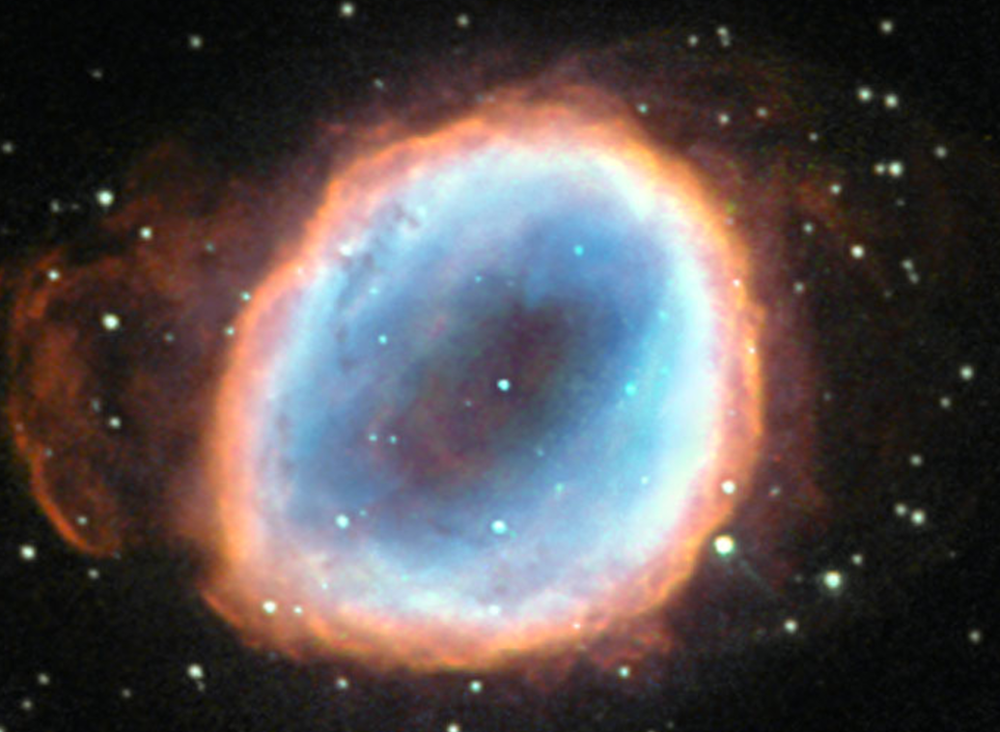
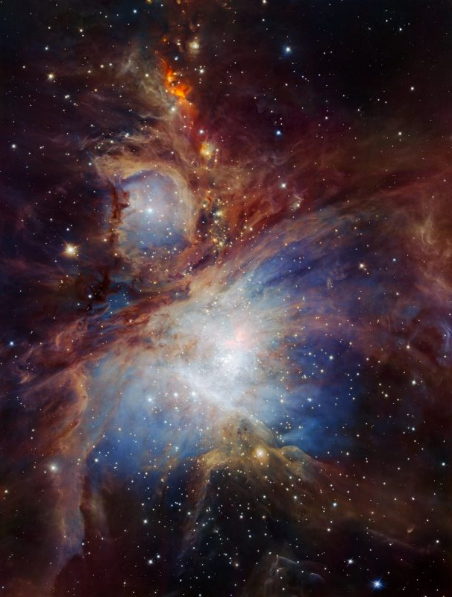
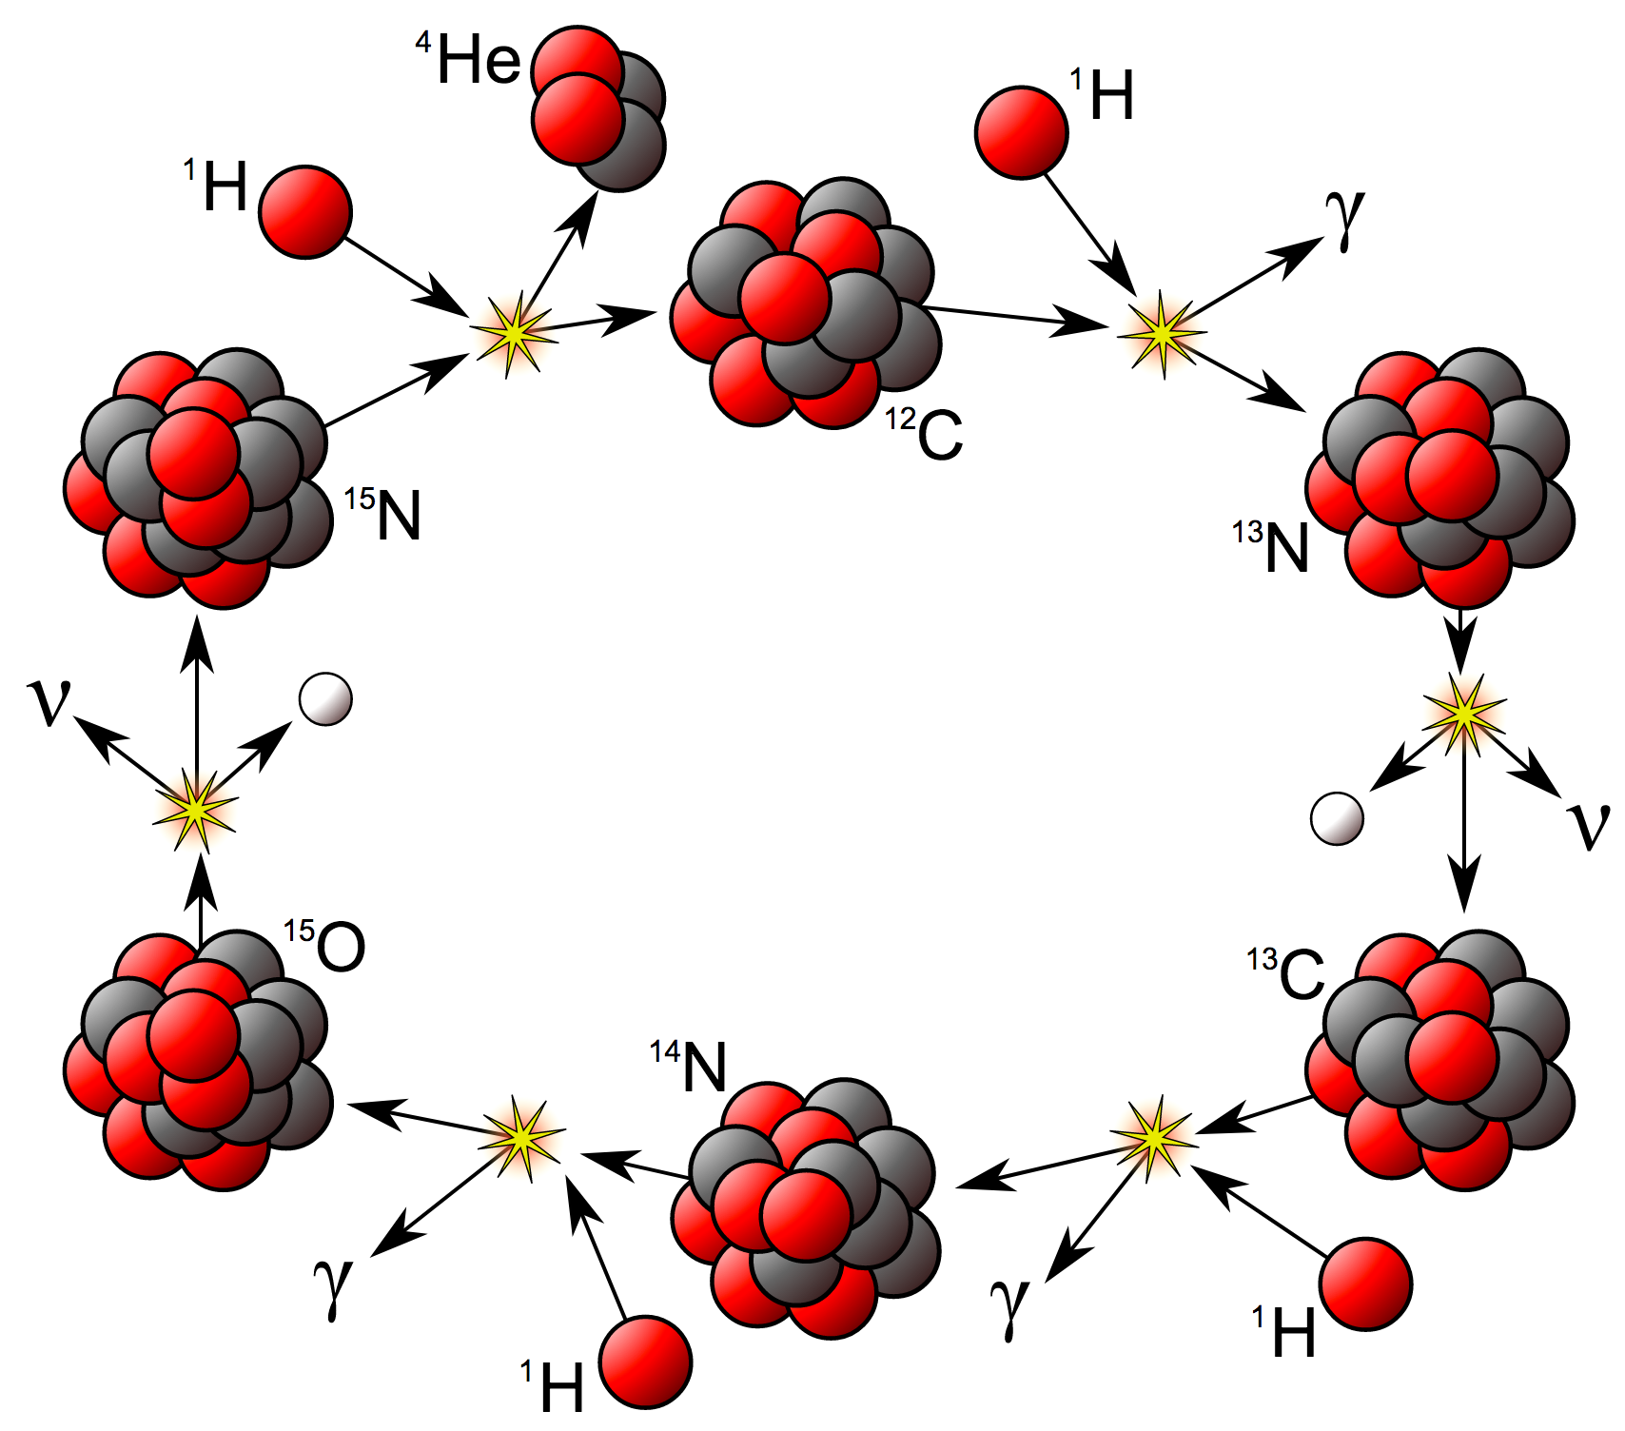
Star-ISM-Star ecosystem: galactic chemical evolution
H⁺/HI/H2, gas + dust
Core mass function
Turbulence
Gravity
AGB
SNe-II
SNe-I
Nova
PN
IMF, SFH, metallicity
Star formation
nucleosynthesis

Slide 11
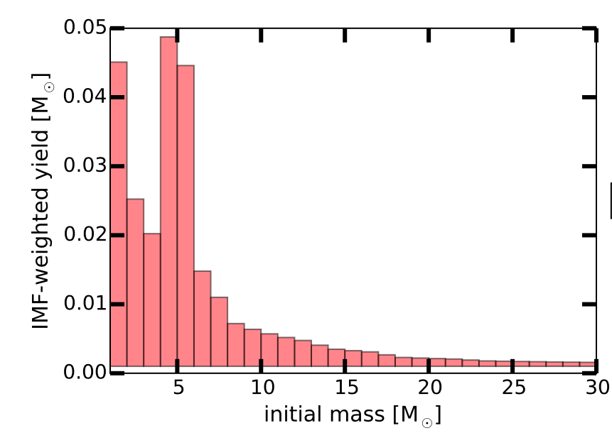
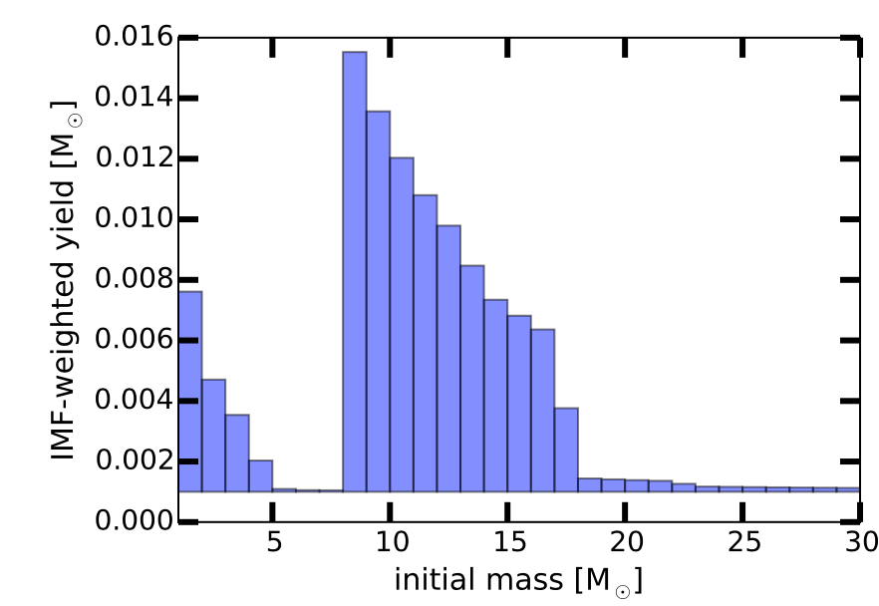
IMF-weighted stellar yields
¹³C, Z~Z⊙
I(¹³CO)/I(C¹⁸O)
~
¹³CO/C¹⁸O
~
¹³C/¹⁸O
Optically thin lines (see next page)
Immune to dust extinction
Simple chemistry
Can observe together
Reachable with ALMA
¹⁸O, Z~Z⊙

Slide 12
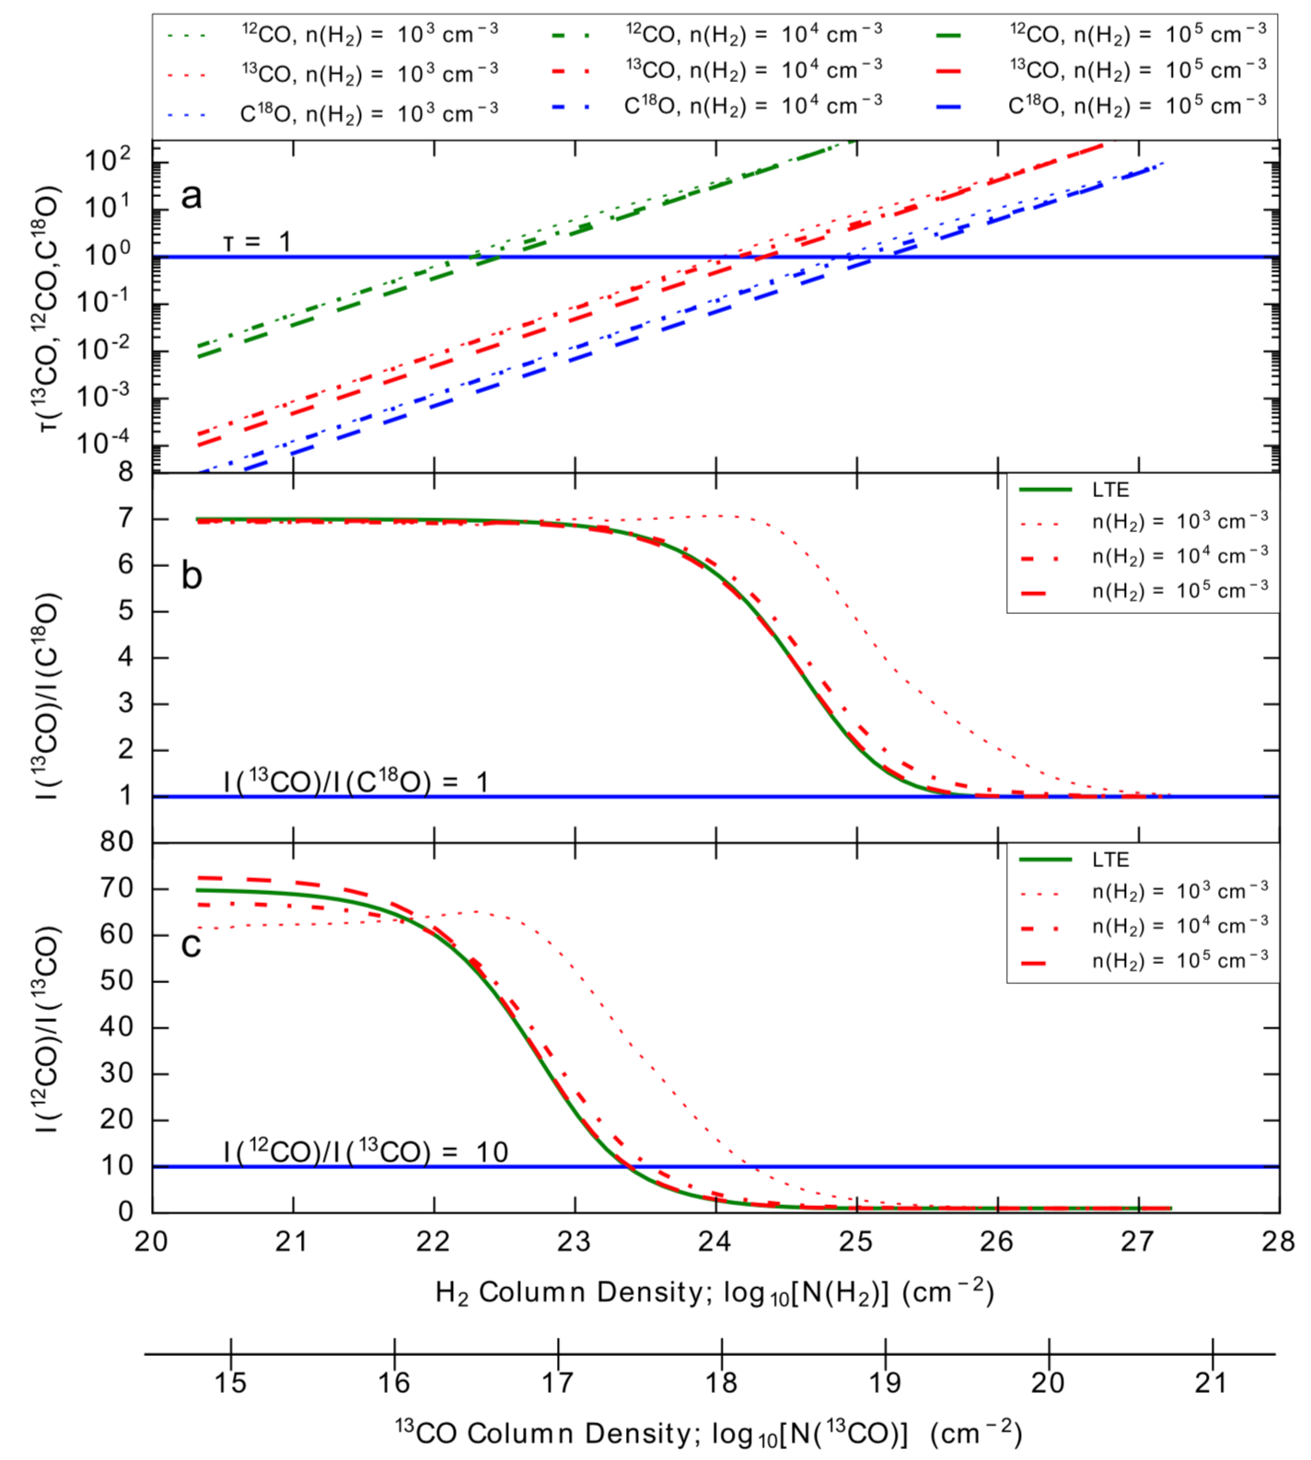
Optical depth and astrochemistry do not heavily bias
abundance ratios
I(¹³CO)/I(C¹⁸O) ~¹³CO/C¹⁸O ~ ¹³C/¹⁸O
LTE & non-LTE conditions:
For typical Galactic abundances,
to reach ¹³CO/C¹⁸O = unity,
N(H2) > 10²⁶ cm⁻² is needed,
which is not physical (typical
N(H2) in an SMG is ~10²⁴ cm⁻²)
Astrochemistry:
Selective photodissociation destroys
the less abundant isotopologues, i.e.
¹³CO/C¹⁸O ratio would be higher for
typical Galactic abundances
Fractionation could not dominate,
given the high Tkin in starburst
conditions
Romano+2017
For J=3-2

Slide 13
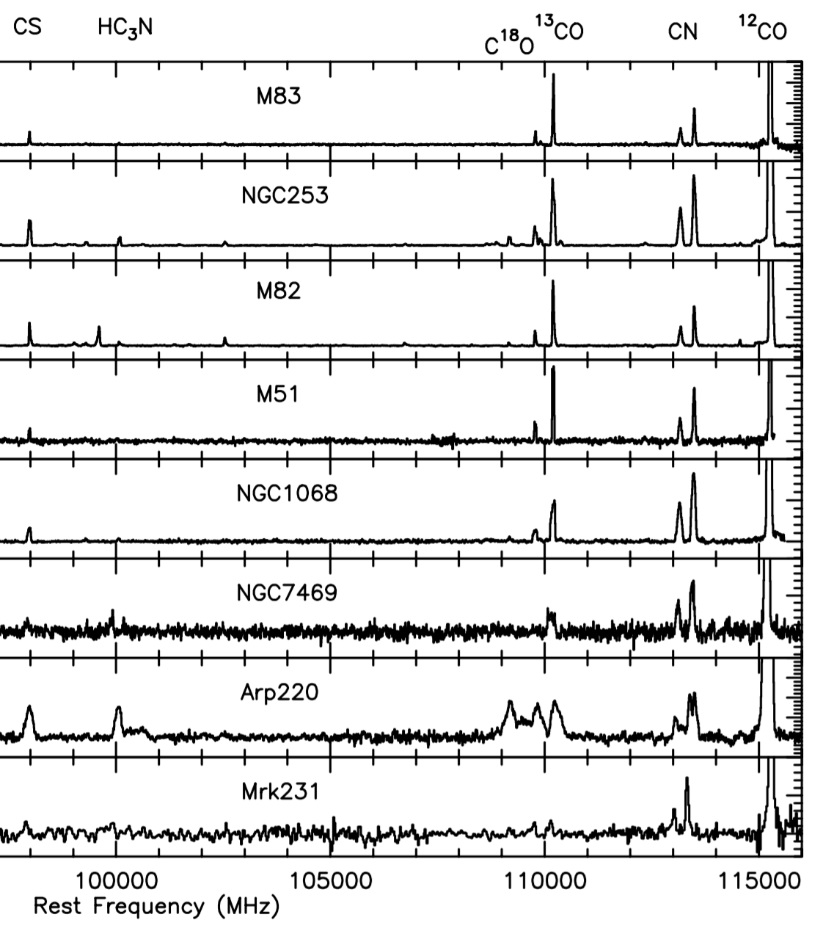
Local star-forming galaxies
Normal spirals
¹³CO/C¹⁸O ~7-15
LIRGs
¹³CO/C¹⁸O ~ 4-6
ULIRGs
¹³CO/C¹⁸O ~ 1
Aladro+2015

Slide 14
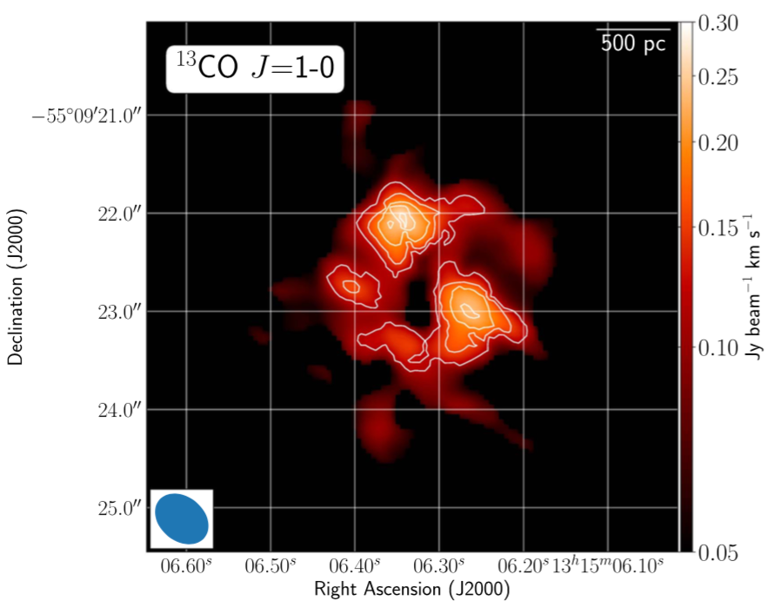
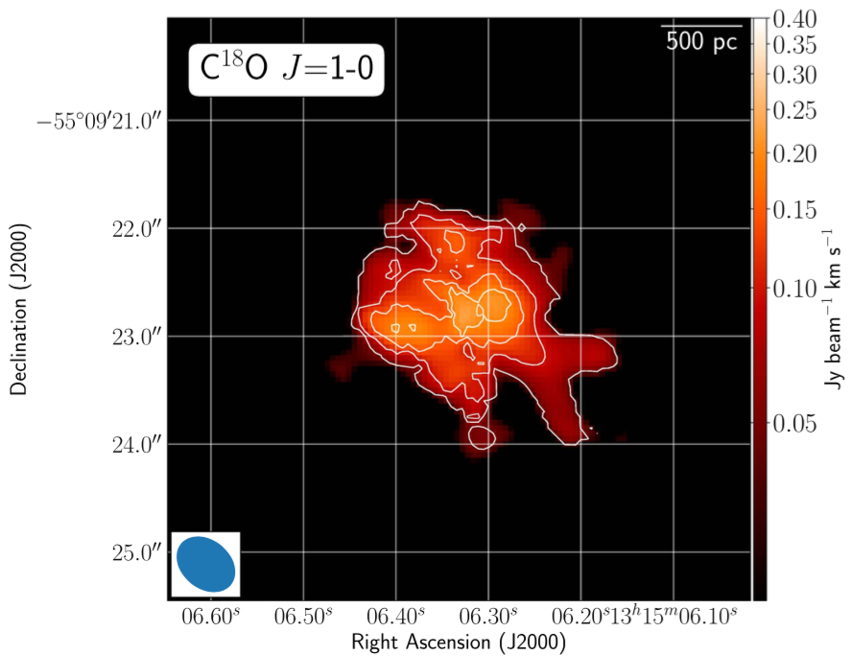
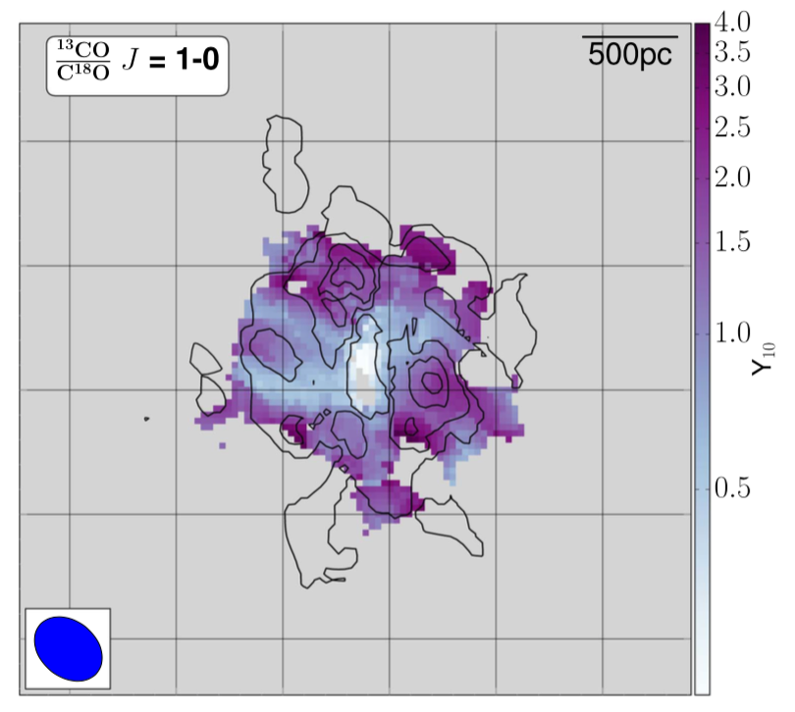
A resolved extreme case in a local ULIRG
IRAS 13120-5453
Sliwa+2017
A recent starburst enriched the C¹⁸O/¹³CO ratio in the central
500-pc region, showing ¹³CO/C¹⁸O < 0.5, the lowest value reported
in the literature
This also rules out a high optical depth, since a
¹³CO/C¹⁸O ratio of unity would then be expected

Slide 15
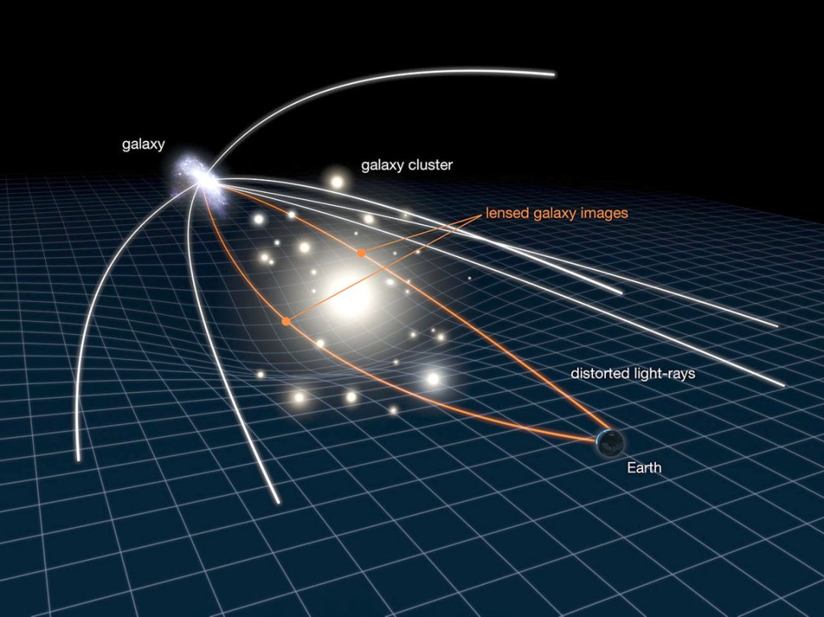
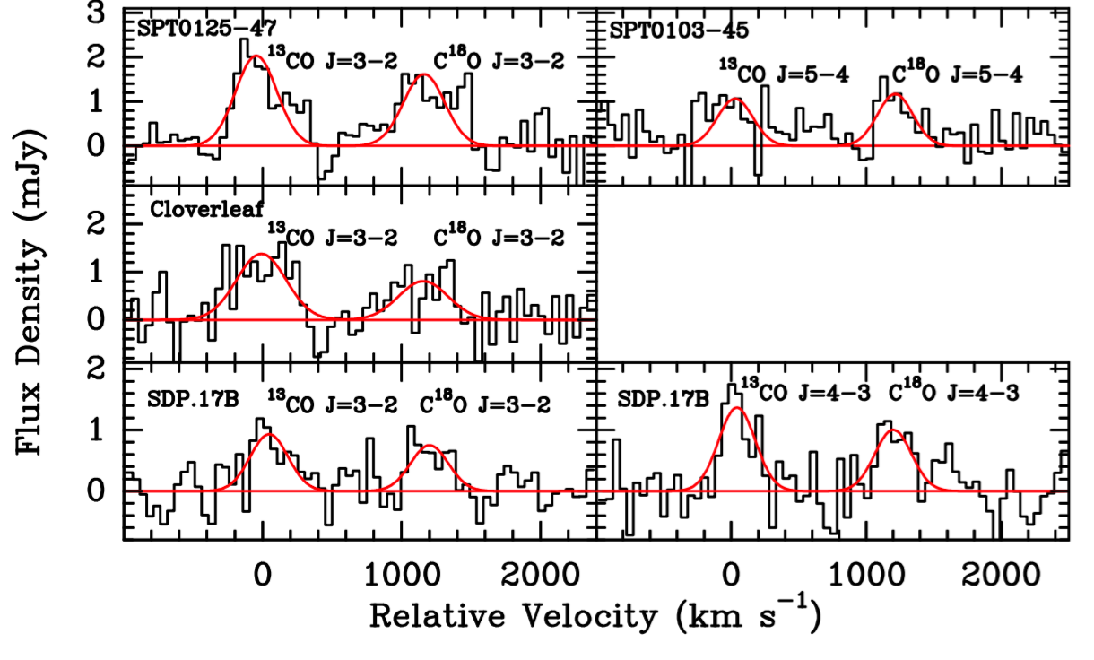
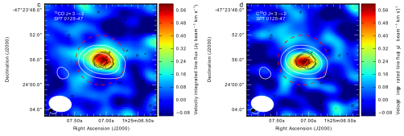
Our ALMA observations: strongly lensed high-z starbursts
Strongest CO emitters in the literature
z ~ 2-4 (1.5-3 Gyr after the big bang)
SFR ~ 800 - 2000 M☉/yr
High-z galaxies may have cleaner signals that minimise contamination from prior star-formation histories.
Zhang et al., Nature, 4th June 2018

Slide 16
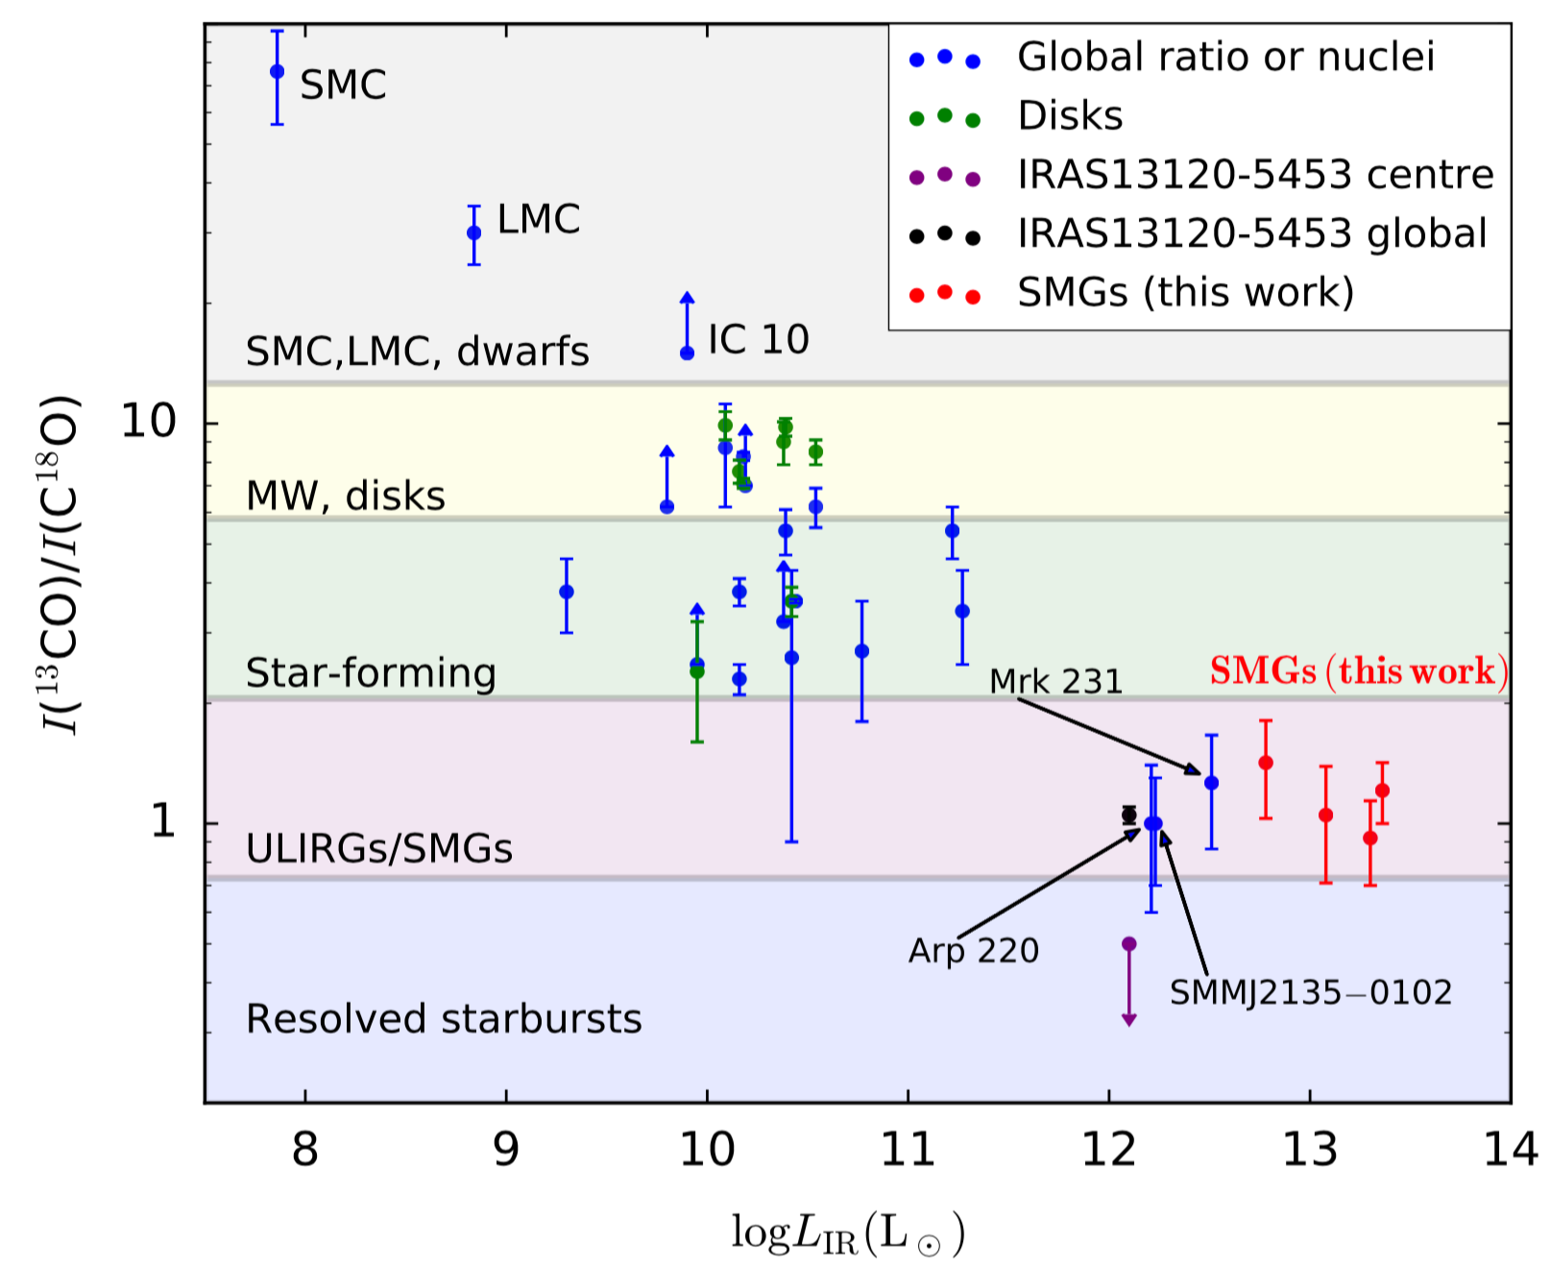
A systematic trend of the ¹³CO/C¹⁸O line ratio
in different types of galaxies/environments
Zhang et al., Nature, 4th June 2018

Slide 17
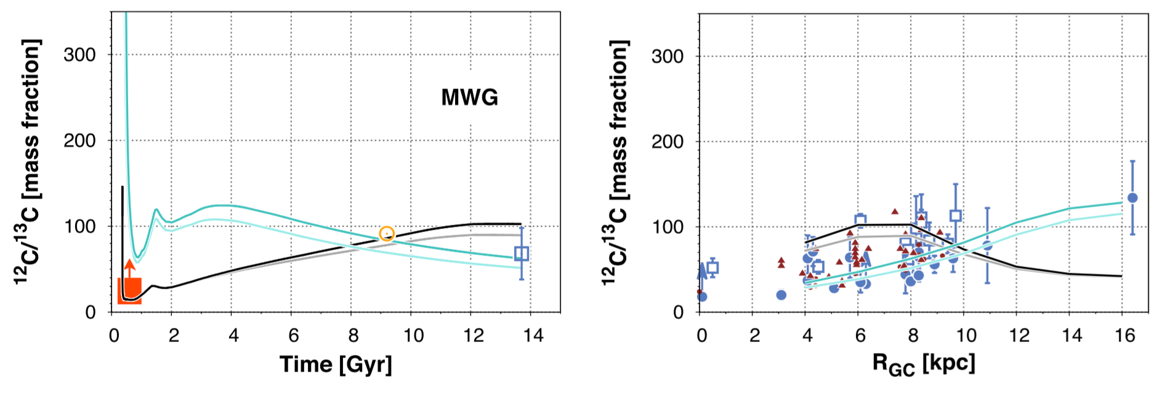
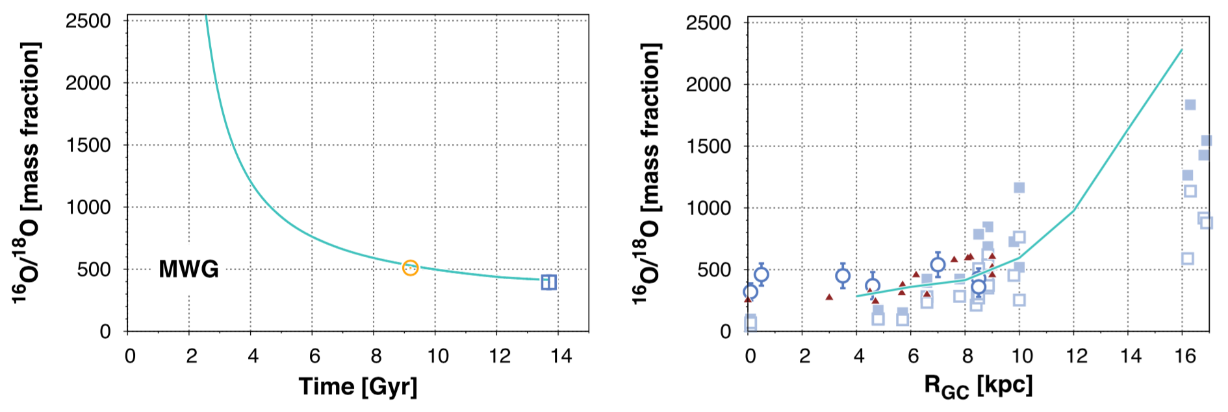
Detailed Galactic chemical evolution modelling:
Benchmarked with rich
data in the MW, including
a large range of cosmic ages, metallicities (radial gradients),
against both ISM and stars
Anchored in stellar physics
Romano+2017
Key parameter inputs:
Stellar yields
Stellar lifetimes
Initial metallicities
Outflow
Gas inflow
Previous galactic evolution
Dark matter halo
Mixing history

Slide 18
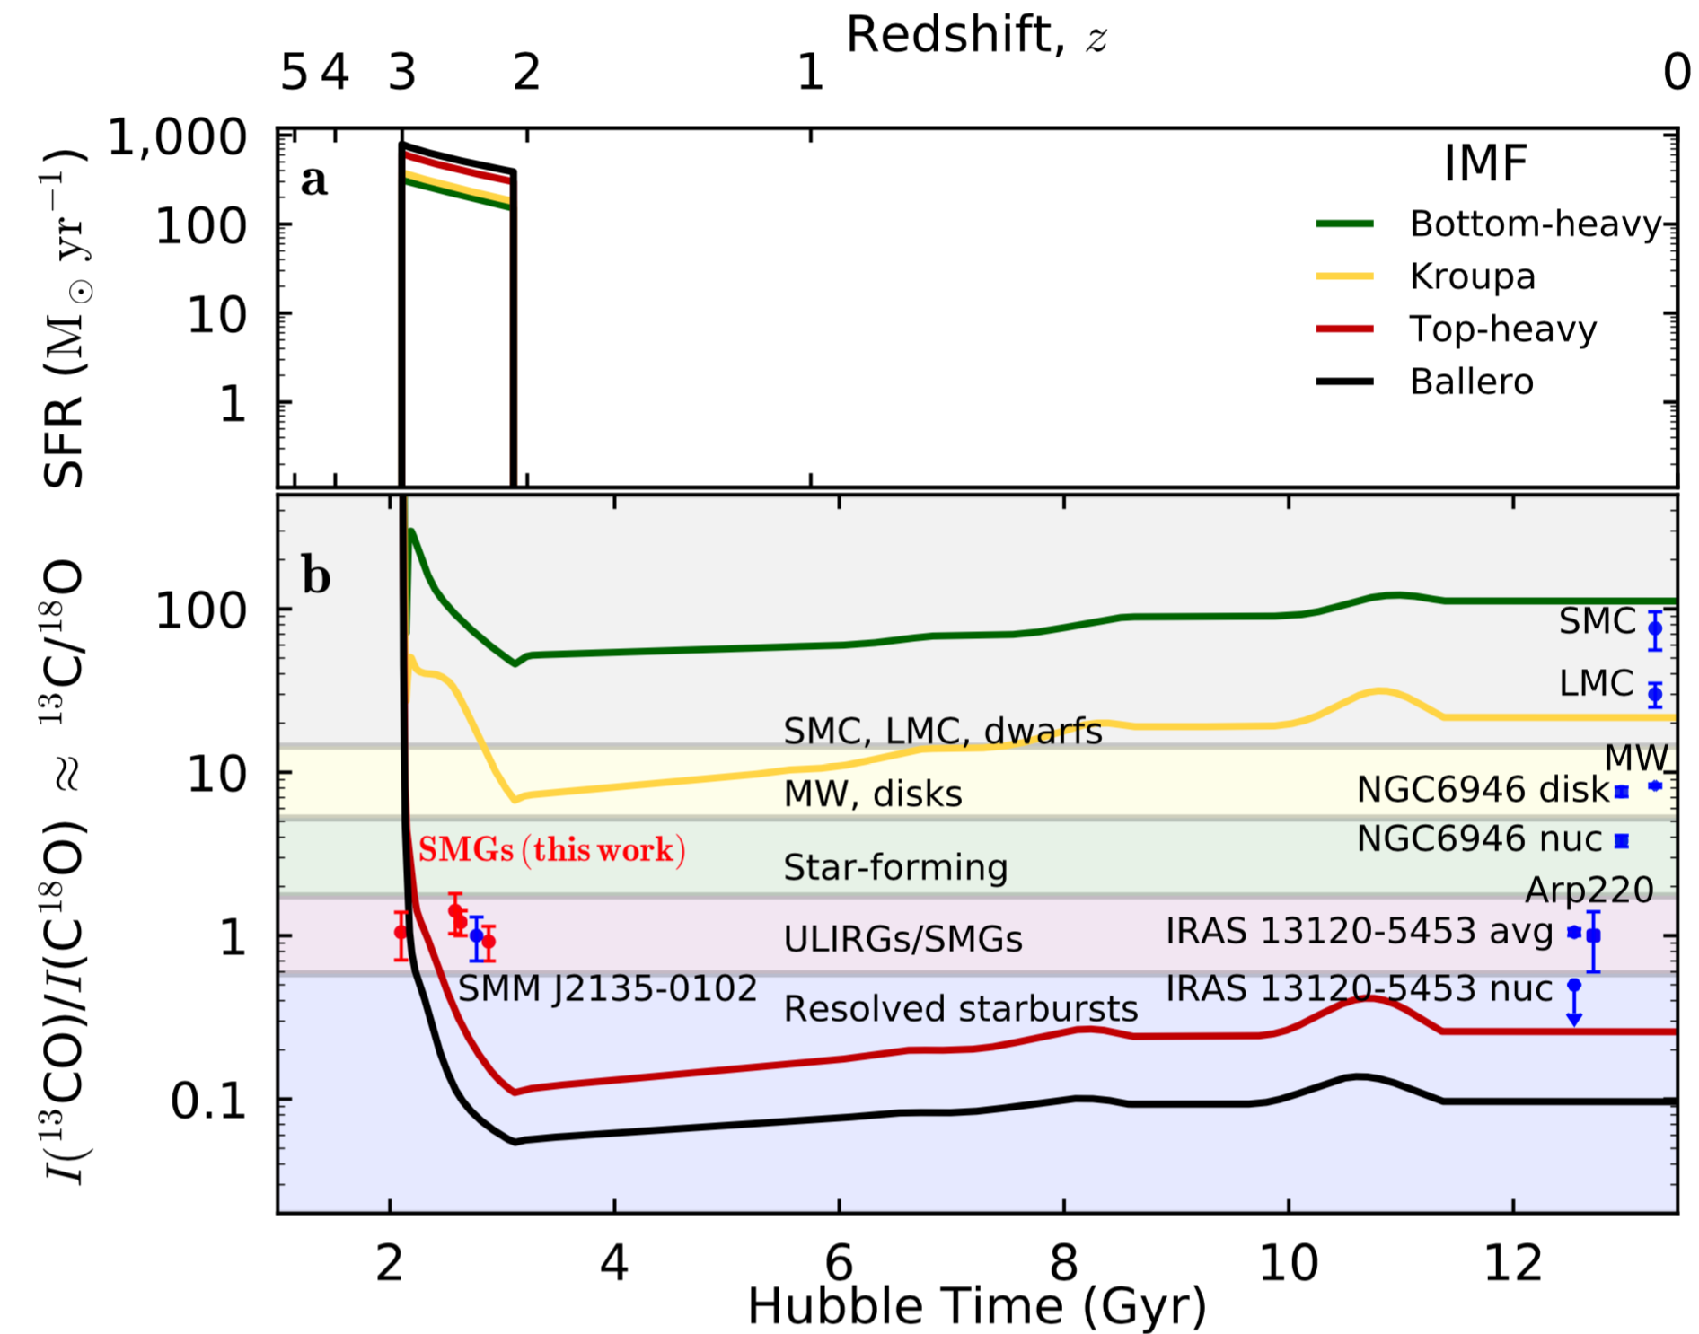
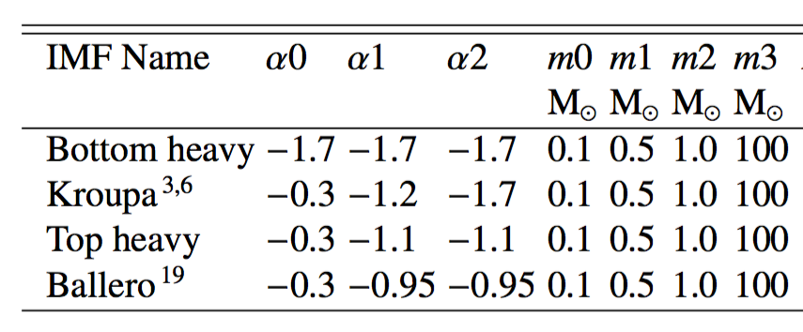
Testing against various IMFs with extreme starbursts
Star-formation
history
Evolutionary
tracks of ¹³C/¹⁸O
Zhang et al., Nature, 4th June 2018

Slide 19
Messages from the modelling figure:
Only a top-heavy IMF or mixed IMFs can produce the SMG/ULIRG results, irrespective of SF history.
A Kroupa IMF can still reproduce Galactic abundance ratios, but it never reaches a ratio of unity.
Our top-heavy IMFs overshoot the abundance ratios but can reproduce the extreme ratio found in the centre of IRAS13120-5453.
A bottom-heavy IMF is incompatible with starbursts, but can be reconciled with dwarf galaxies.
A mixed IMF is very likely everywhere: e.g. top-heavy IMF in starburst knots locally and a normal IMF globally.
MDM = 10¹² M⊙, after burst
M* = 10¹¹ M⊙, after burst
∆tburst = 1 Gyr
Zhang et al., Nature, 4th June 2018

Slide 20
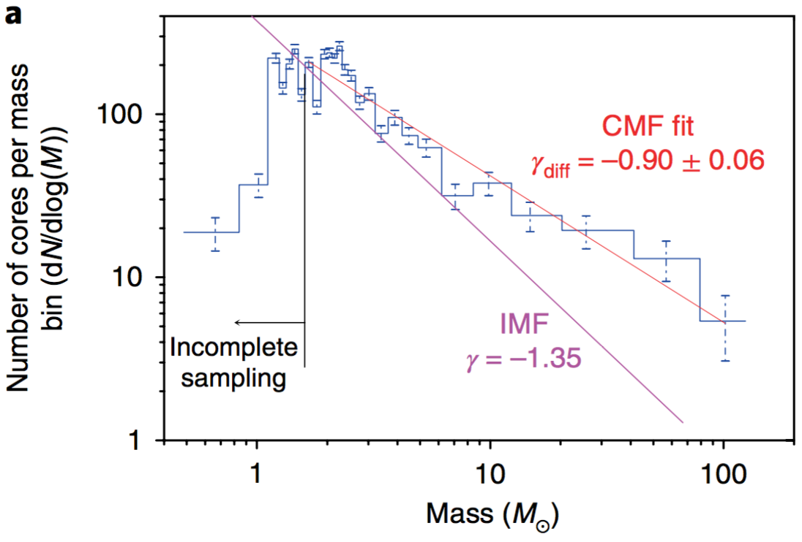
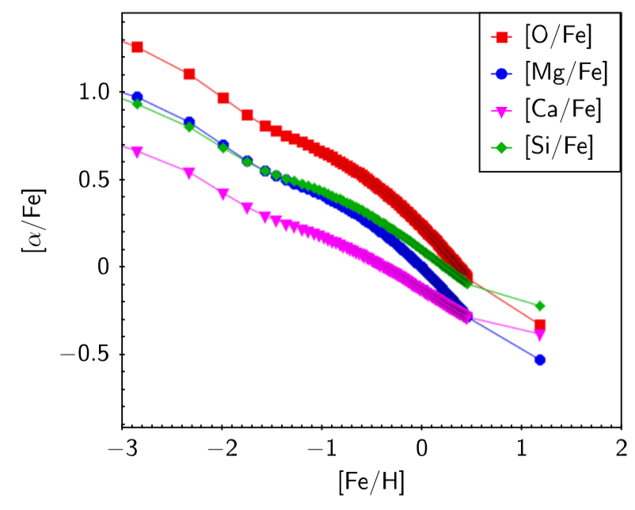
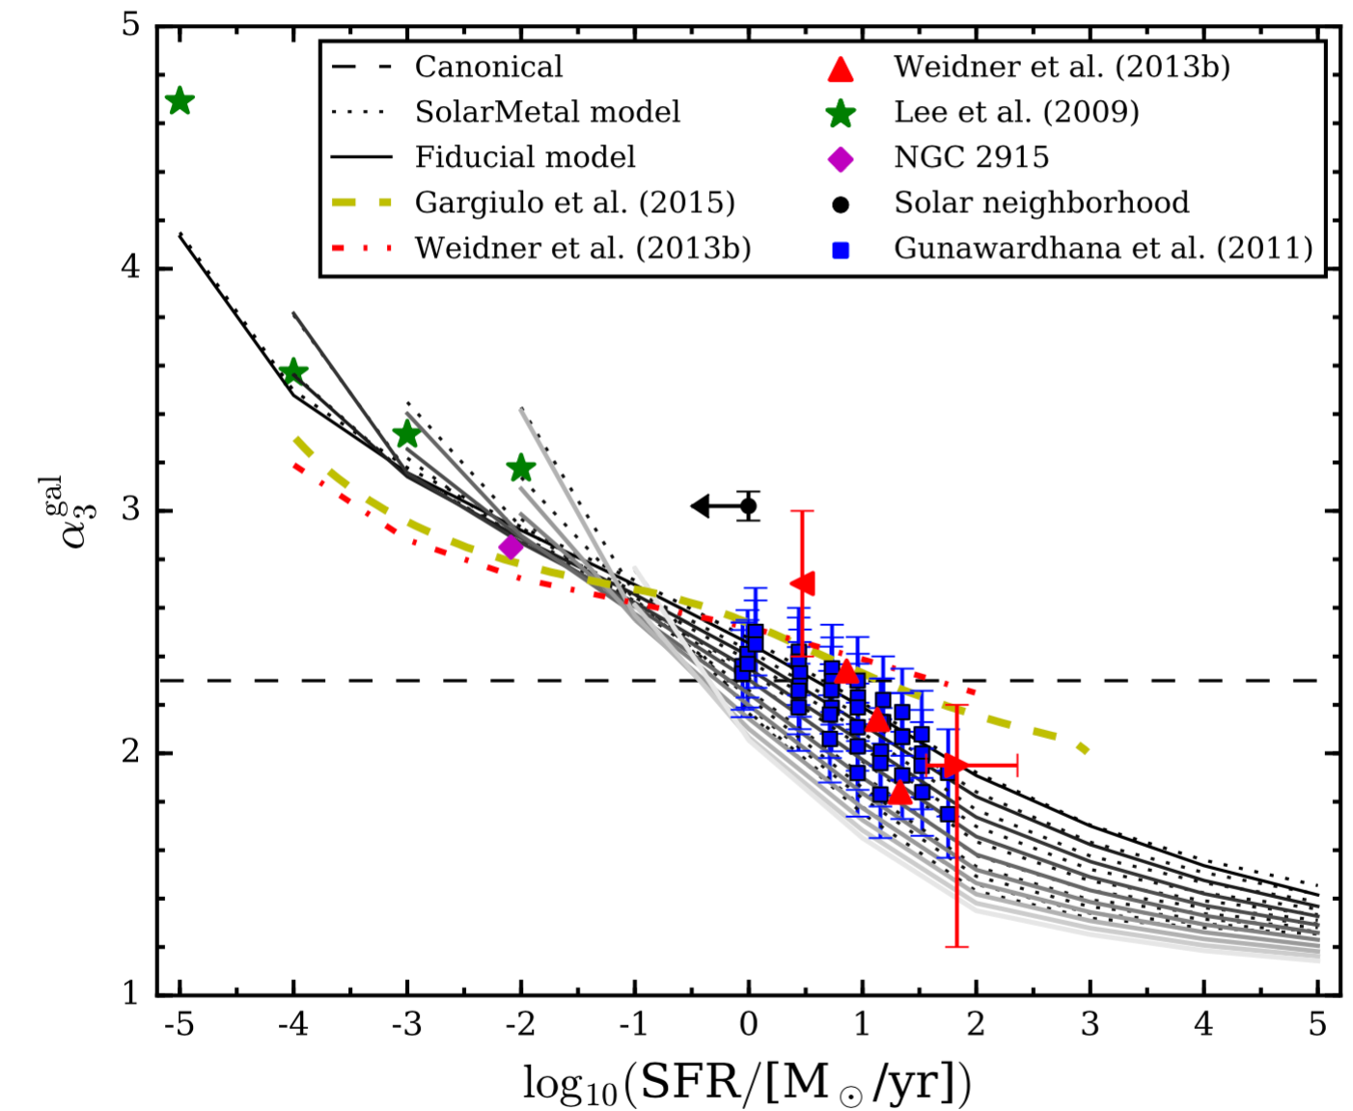
Top-heavy CMF
in W43
Other evidence of top-heavy IMFs in starburst conditions
Top-heavy IMF
in 30 Dor
30 Dor
W43
Schneider+2018
Motte+2018
The IGIMF theory.
[alpha/Fe] & [Fe/H]
De Masi+2018, Matteucci+1998
Yan et al. 2017

Slide 21
IMF systematically varying from bottom-heavy to top-heavy,
the higher the formation rates (densities) of massive stars
Reconciles with the IGIMF theory
Zhang+2018
Yan+2017

Slide 22
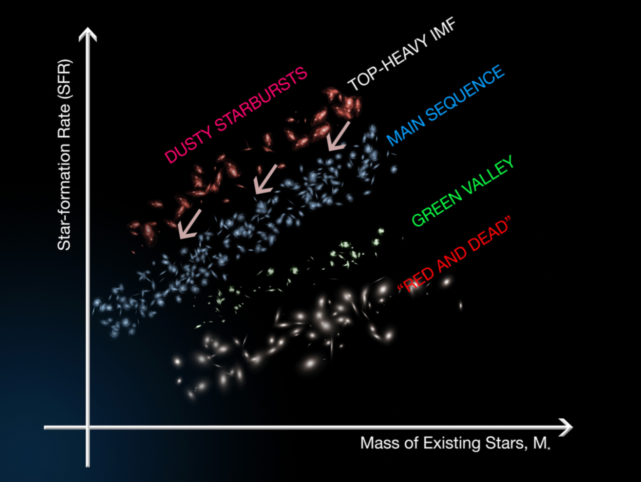
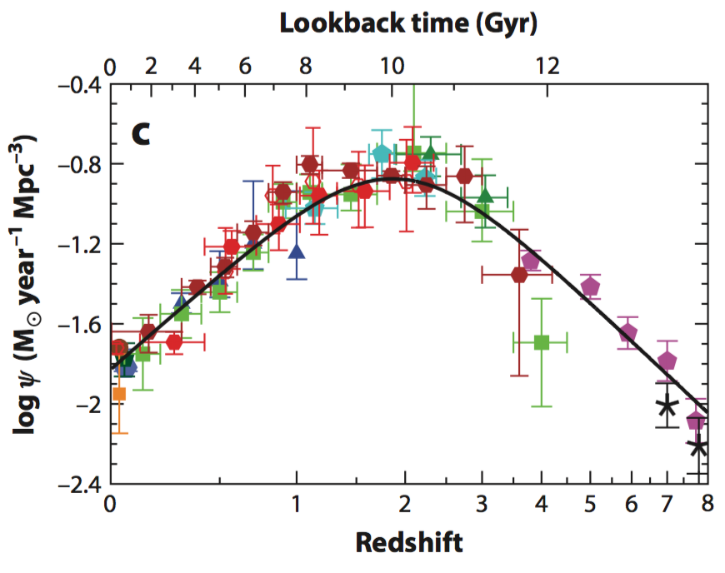
Potential impacts
Classification of Star-forming galaxies
Madau & Dickinson 2014
What happens to the “main sequence” of star-forming galaxies, if the bursty nature of the high-z “main-sequence” galaxies and dusty starbursts implies radically different SFRs and possibly M* ?
Does this change our understanding of the cosmic history of star formation ?

Slide 23
Take home messages:
A new and independent method to measure IMF in dusty galaxies
Top-heavy IMF found for dusty starburst galaxies, near and far
Questions:
What other implications for the star-forming mode of galaxies, when both SFR and M* are likely varying, and significantly so?
What is the underlying physics controlling the IMF?

Slide 24
Thank you!
Questions and comments are welcome: Zhi-Yu Zhang (zzhang@roe.ac.uk)

Slide 25
Backup slides

Slide 26
Major sources of stellar yields:
Isotope | Nucleus | Origin | Release | Reaction
¹²C | primary | massive | winds/pre-SN
 |  | AGB | winds
¹³C | secondary | AGB | winds | rotation?
 | primary | 4-8 M☉ | dredge-up/HBB
¹⁶O | primary | massive | winds/pre-SN
 |  | AGB | Winds
¹⁸O | secondary | massive | Winds/pre-SN
⁴He + ⁴He + ⁴He => ¹²C
¹²C + ¹H =>¹³C
with ¹²C seeds
¹²C + ⁴He => ¹⁶O
¹⁴N+ ⁴He => ¹⁸O
with ¹⁶O seeds
Timmes et al. 1995; Woolley et al. 2002; Hughes et al. 2008; Meyer et al. 2008

Slide 27
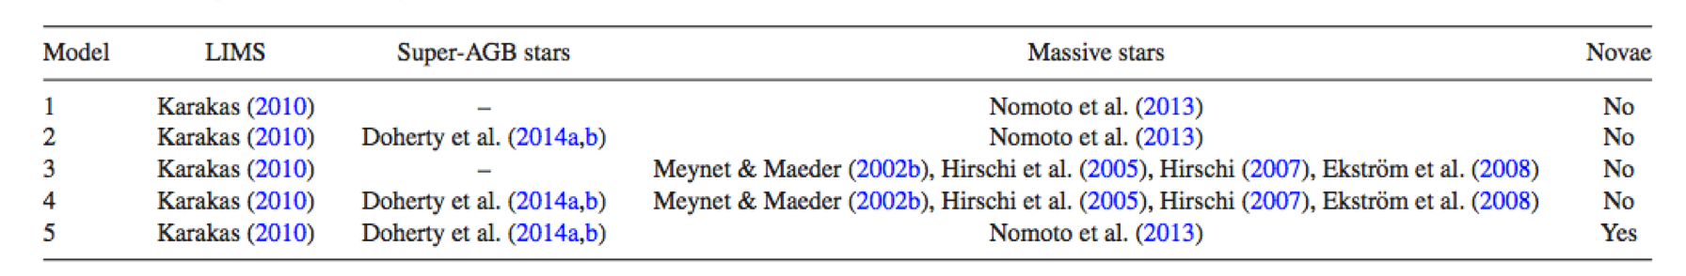
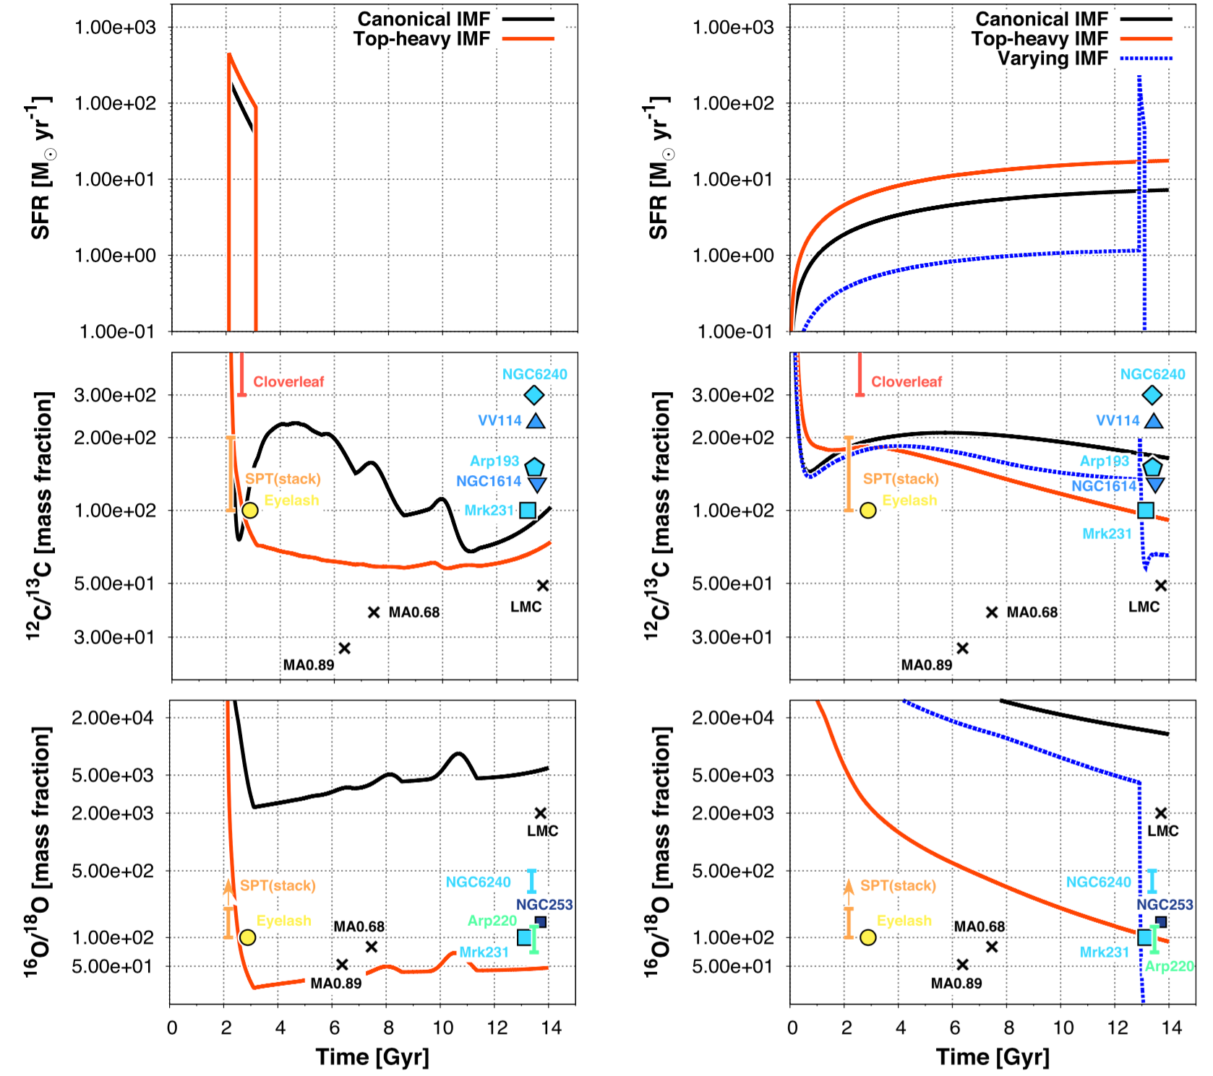
Stellar yields tables:
Romano+2017

Slide 28
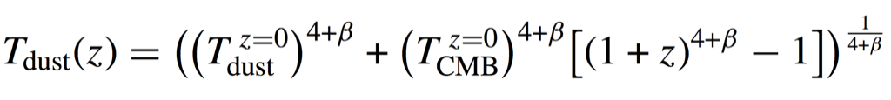
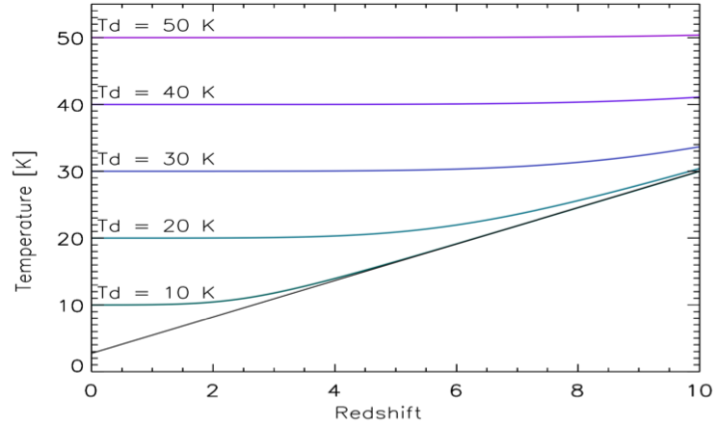
CMB Heating
Zhang et al. 2016
Thermodynamic equilibrium equivalent Tdust values in high-z systems

Slide 29
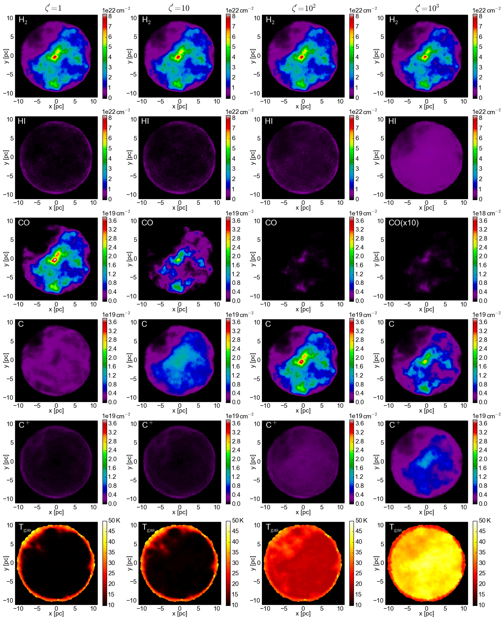
Cosmic Ray
Heating -2
ζ'=1
ζ'=10
ζ'=100
ζ'=1000
H₂
HI
Detailed 3-D
Astrochemical
Modelling.
CO
CI
CII
T_{gas}
Bisbas et al. 2017

Slide 30
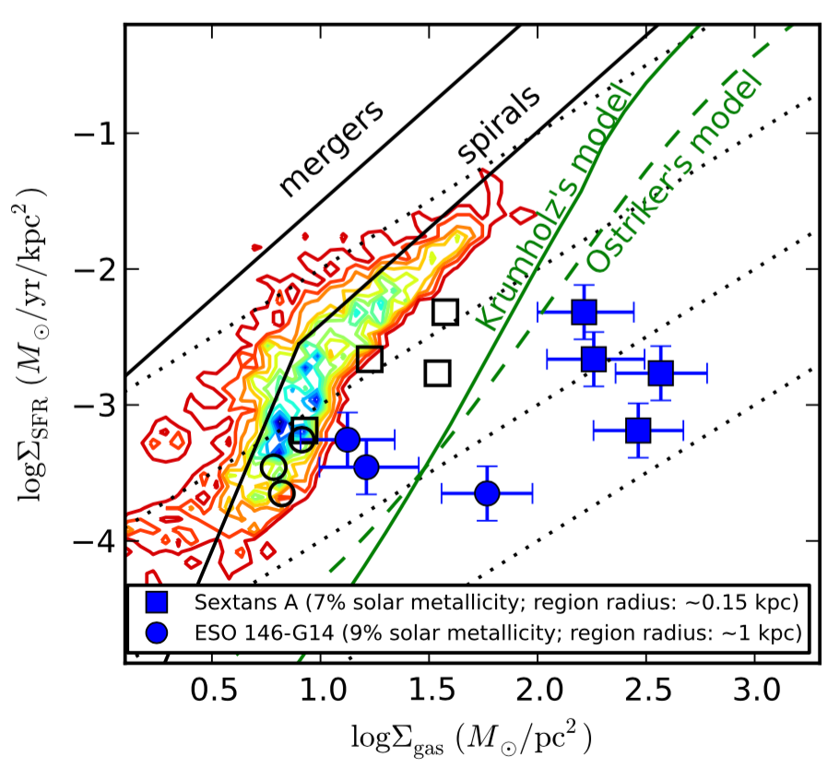
Inefficient star formation in low-metallicity dwarf galaxies?
Top-light IMF,
or low SFE?
Shi et al. 2014, nature

