Slide 1
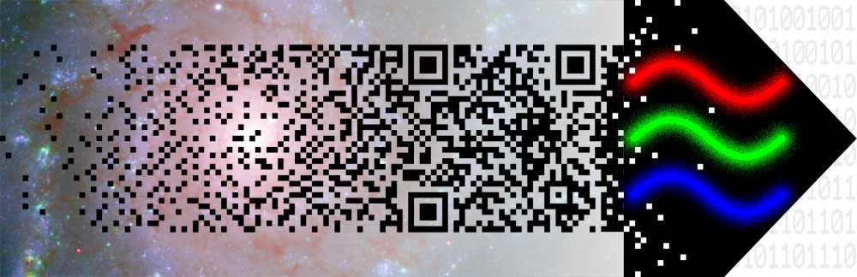
Conference summary
Richard Massey
Following the Photons Workshop
Edinburgh
12th October 2011

Slide 2
How do we convince funding agencies/panels that simulations are essential?
Requires a process of continuous education
…or just load panels with sympathetic members.
Risk reduction – speed hardware commissioning, reduce downtime
Cost reduction – speed hardware commissioning, reduce downtime
Simulations can provide the flow down from the requirements – which are complex, relying on multidimensional distributions that are not easy to model as a “mean and variance”. Simulations also provide accurate error matrices.

Slide 3
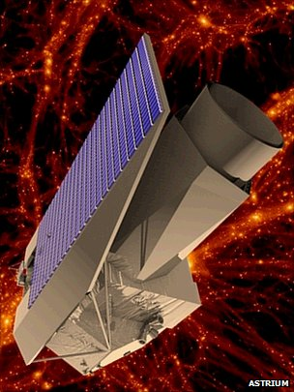
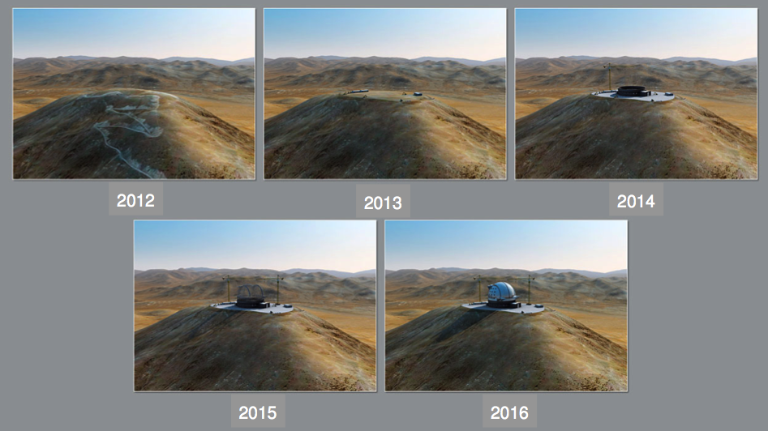
Stunning array of dedicated simulations for every new telescope: perhaps they are already convinced?
Bianca Garilli
Remy Indebetouw
Joe Liske

Slide 4
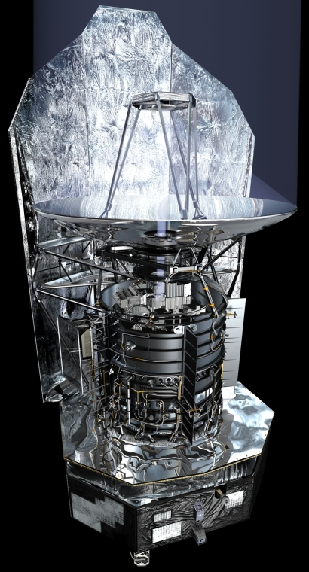
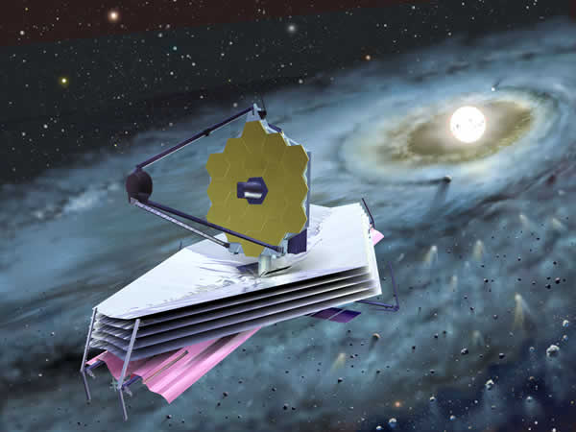
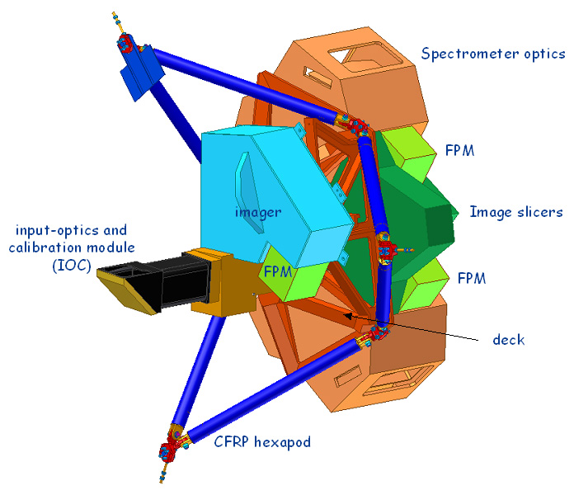
Stunning array of dedicated simulations for every new telescope: is funding now widely available?
Owen Littlejohns
Remy Indebetouw
Adam Bolton
Bruce Sibthorpe

Slide 5
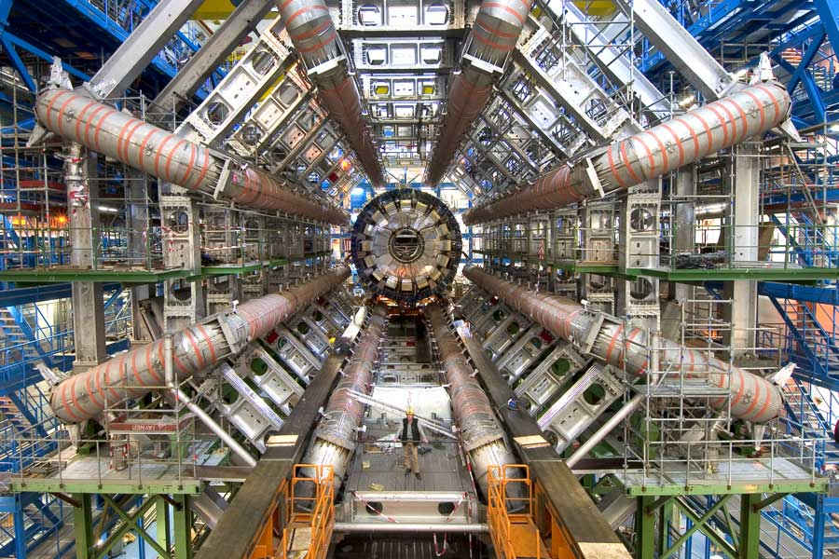
End-to-end blind challenges like particle physics:
Do we need them? Can we hope to have them?
Remy Indebetouw
Joe Liske
Probably depends on the type of observations
Definitely depends on the cost of the telescope

Slide 6
What do you get out of simulations?
Risk reduction – speed hardware commissioning, reduce downtime
Cost reduction – speed hardware commissioning, reduce downtime
Simulations can provide the flow down from the requirements – which are complex, relying on multidimensional distributions that are not easy to model as a “mean and variance”. Simulations also provide accurate error matrices.
Not just answering questions, but asking them.
Keep community happy while you build the next $nB mission.

Slide 7
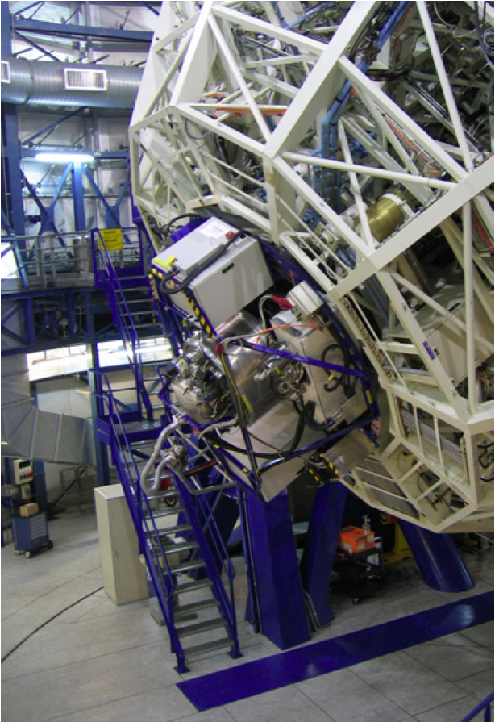
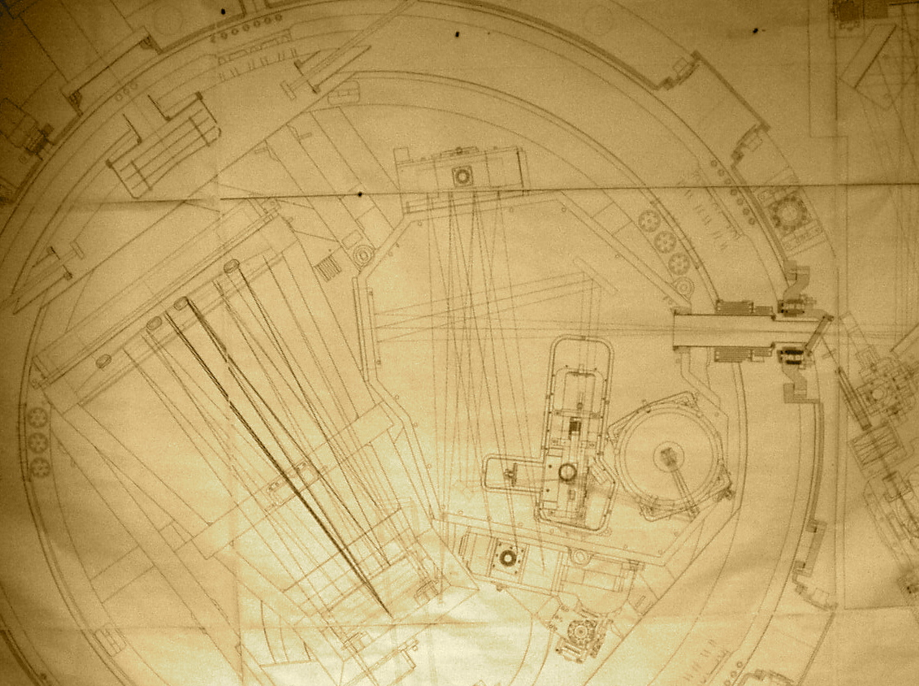
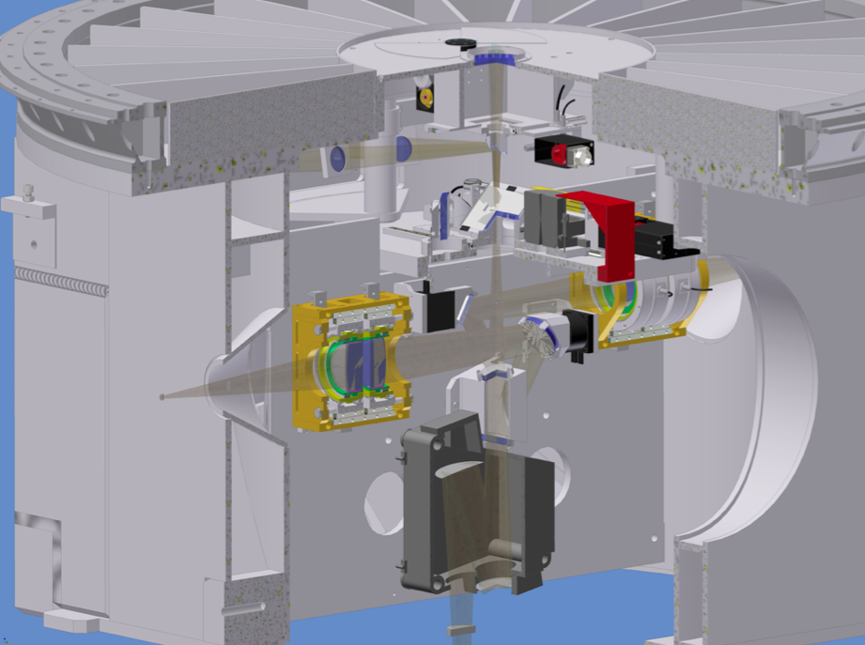
X-shooter Flexure
Paul Bristow
Physical understanding
to diagnose problems
Backbone flexure
  Causes movement of target on spectrograph slits
  Corrected with Automatic Flexure Compensation exposures
Spectrograph flexure
  Flexing of spectrograph optical bench
  Can also be measured in AFC exposures
  First order translation automatically removed by pipeline
UVB
VIS
NIR

Slide 8
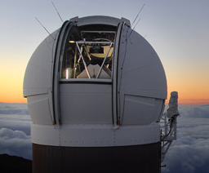
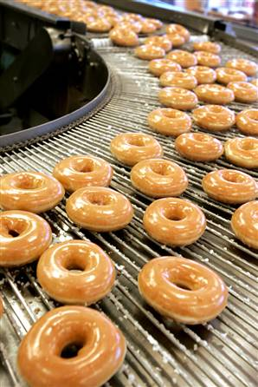

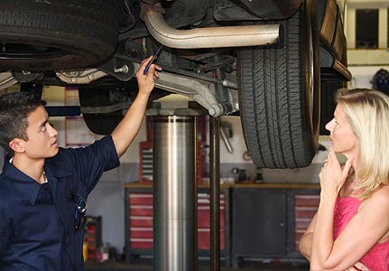
Physical understanding to diagnose problems…
…at a price
Nick Kaiser
  Oooh, it’ll
  cost you…

Slide 9

Speed development of data analysis software
Andrew Connolly:
Develop simulations in concert with the analysis framework (build the complexity to match the analysis).
Phil Marshall:
Would you believe something not blind tested? Avoiding observer bias drives us to [independent] simulations.
Nick Kaiser:
Should we have people simulating a project just
to shoot it down?

Slide 10
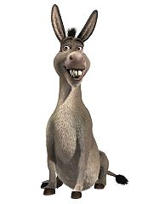
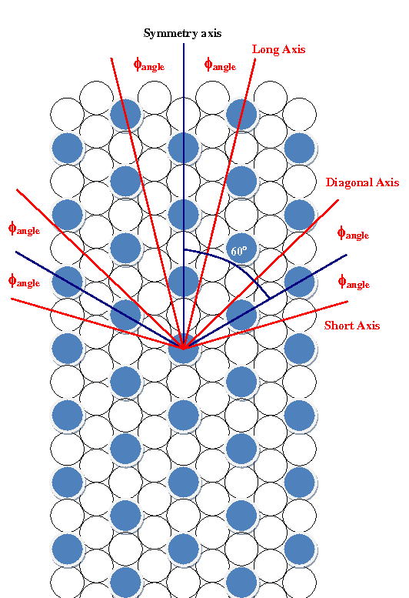
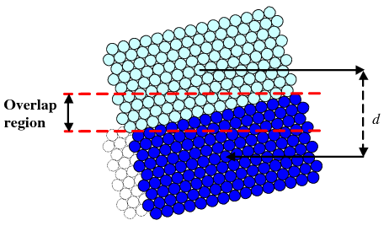
Optimising observation/survey strategy
Bruce Sibthorpe
Herschel costs €1M/day:
Spend it wisely!

Slide 11
Hello

Slide 12
And lots more…
Phil Marshall

Slide 13

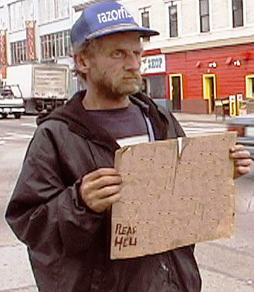
Who will simulate?
How can senior people help juniors?
I
SIMS
Have deep understanding
of data. Will
simulate
for food

Slide 14
How to simulate:
What is important?
  Potential to keep adding bells and whistles:
  When do we stop? Do we need to pre-define requirements?
Robert Lupton:
Good enough for problems to be invisible to the pipelines – it’s an arms race.

Slide 15
Validate, validate, validate!
Michael Goodwin
Closing the loop with E2E simulations is vital for validating
Simulations themselves (b) Science analysis code
Model can be fitted (mean error ~0.34 pixels) to real data (dashed line) with a simple transformation:
y-offset = 5.5 pixels;
scale factor = 0.994;
Rotation = -0.17 degrees
(i.e. clockwise)
model ~ observed
mechanical alignment
optical tolerances
Verification of model (solid line) with AAOmega observational data (image with dashed line).

Slide 16

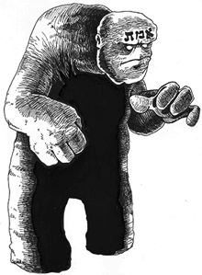
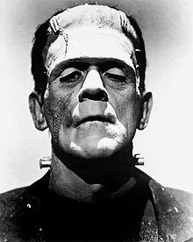
Speed hardware commissioning
Learn from the monsters of the past
Do anything you can to attract users
Also need separate software developers and instrument specialists
Start simple then grow
(although lots of debate about this!)
Rene Gastaud

Slide 17
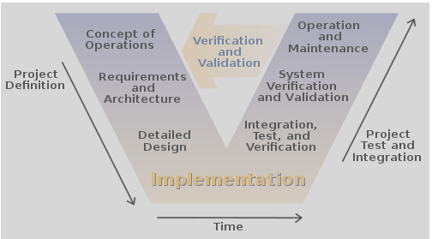
Don’t do it the ESA way!

Slide 18
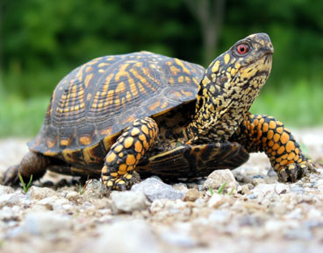
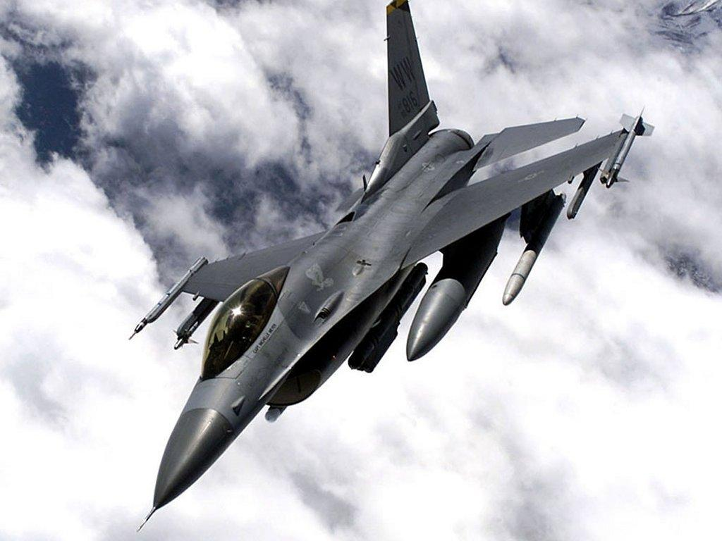
Go back to bed and wait for Moore’s law
Alistair Basden
Unnecessary computing
speeds up global warming
makes the atmosphere worse

Slide 19
Is the atmosphere the hard part?
Remy Indebetouw
…is the hard part?
Is ALMA
sited in the 7th
circle of hell?

Slide 20
Turbulence profiling
Richard Wilson
Andrew Connolly

Slide 21
Hello
Remy Indebetouw

Slide 22
Hello
Andrew Connolly
Complexity avoids
Garbage in – garbage out?

Slide 23
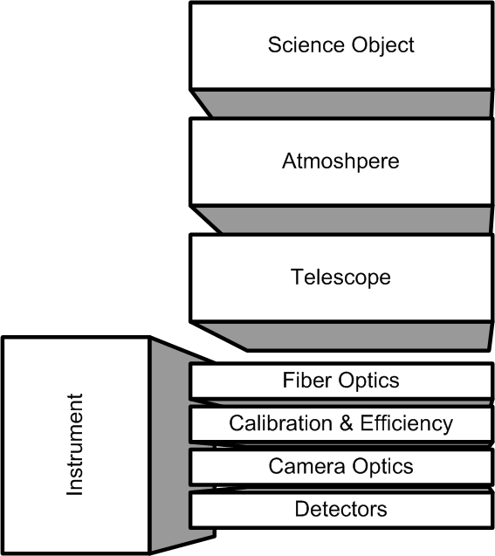

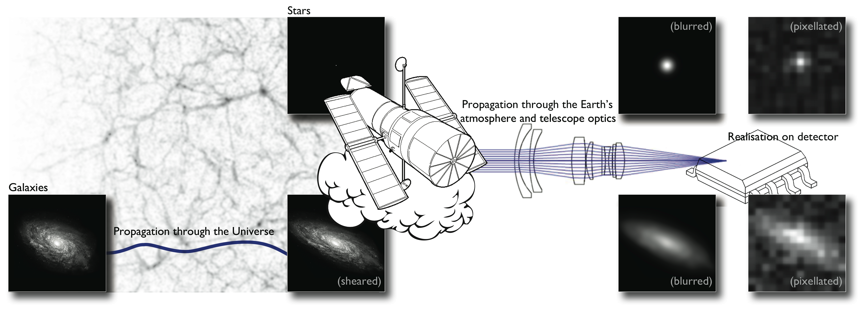
Duplication of effort
Does every project need its own simulator?
Atmosphere

Slide 24




A success story in solving problems only once:
The MIRI Simulator Suite
Steven Beard
Having a suite of simulators ensures that every problem is solved only once.
  But we did miss the opportunity to share “simulate targets” and “simulate background”.
SCASim provides a common detector simulation service for the other simulators.
It converts detector illumination information from any MIRI simulator and generates simulated MIRI data in a choice of formats accepted by MIRI pipeline and analysis software.
Notes:
MoSim is an extra simulator for MIRI.

Slide 25
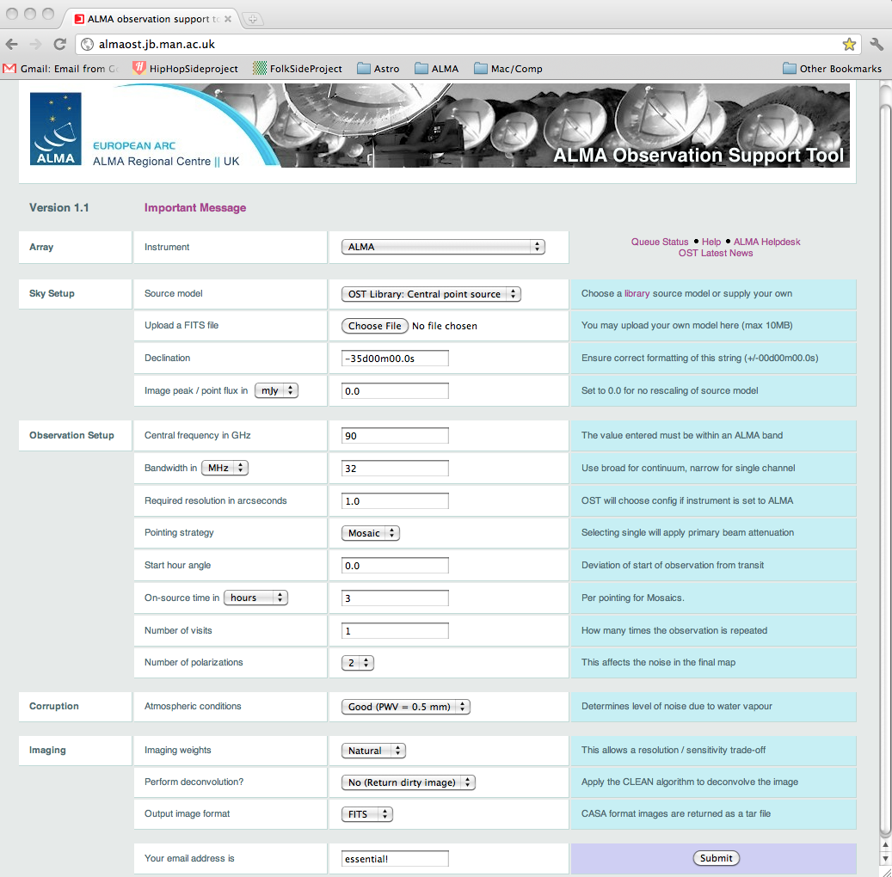
A success story in making simulation code available to others:
ALMA Observation Support Tool
Adam Avison
(see also GIBIS, Xavier Luri)
The OST is a web based ALMA simulator. Accessible from any standard web browser.
Designed for those who are not interferometry experts .
Written by Ian Heywood (Oxford).
http://almaost.jb.man.ac.uk

Slide 26
What next?
Talks on the workshop web page
Email exploder
Aspen-style 3 week workshop

