Slide 1
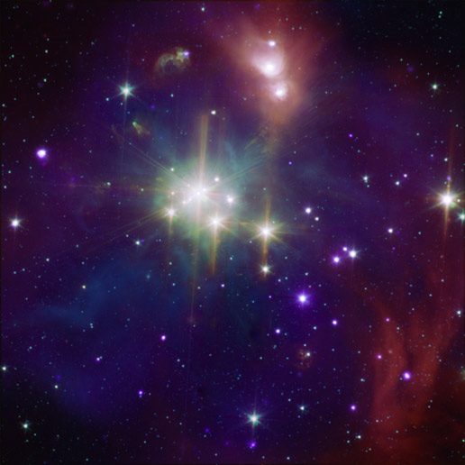
The Dominant Role of Bulge Mass in Quenching Local SDSS Galaxies
Implications for the Formation of the Red Sequence
Asa F. L. Bluck
University of Victoria
(Canada)

Slide 2
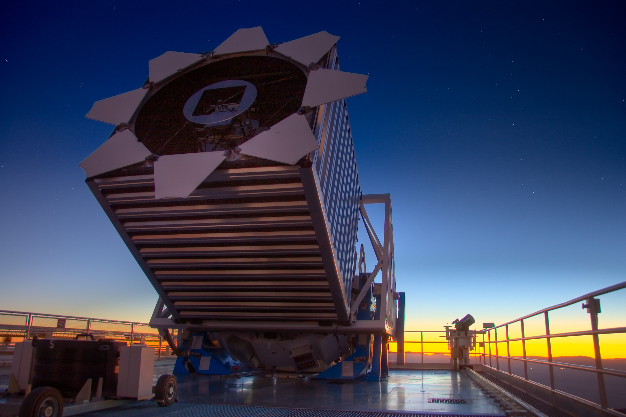
Talk Outline:
Why do some galaxies stop forming new stars?
Collaborators
Conceptual Overview
Sample Introduction
Results
    Environment
    Total Stellar Mass
    Morphology
    Bulge + Disk Mass
Conclusions
J. Trevor Mendel
(MPE)
Sara L. Ellison
(U. Victoria)
Luc Simard
(HIA)
Jorge Moreno
(U. Victoria)
David R. Patton
(U. Trent)

Slide 3
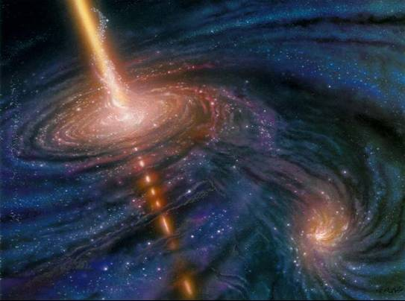
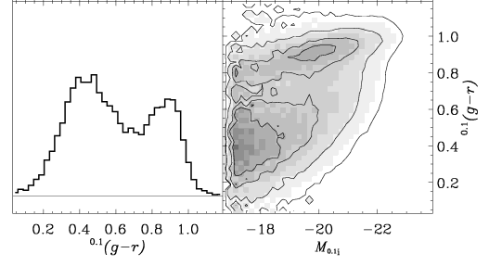
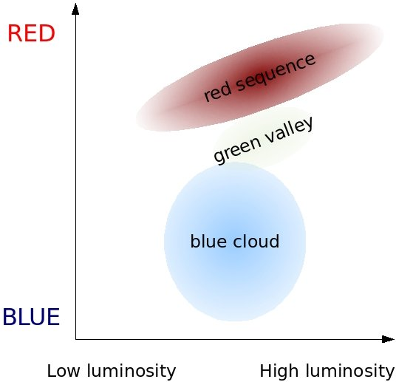
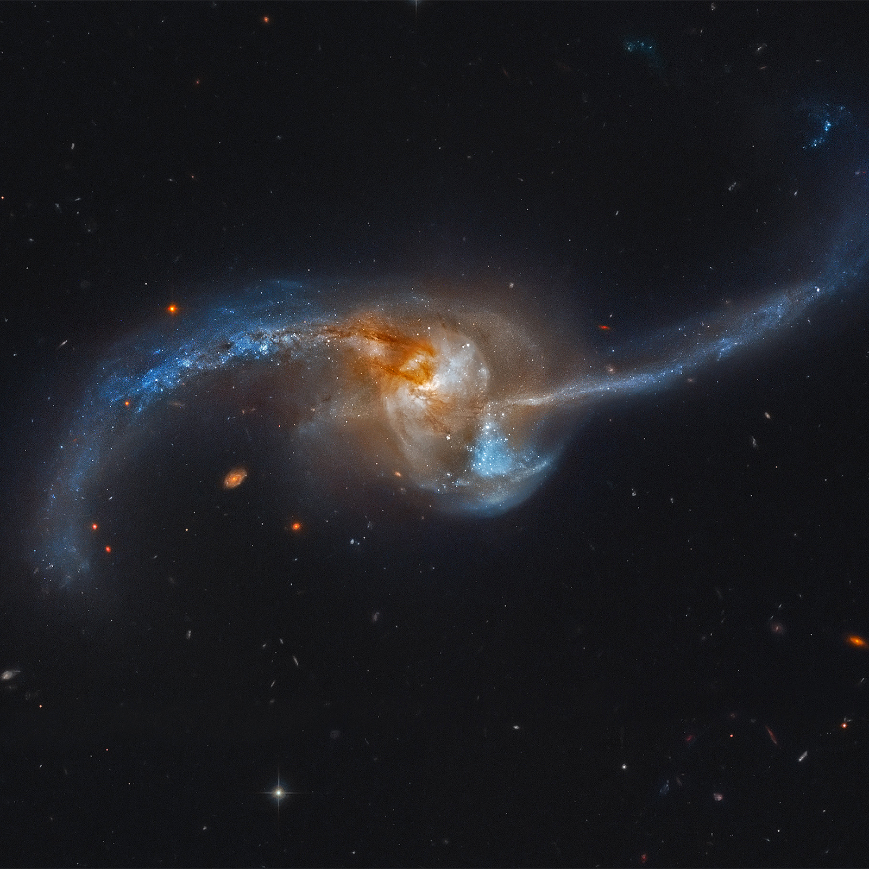
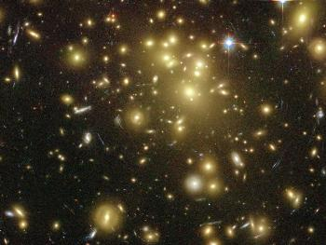
The Big Picture

Slide 4
Basic Sample Details
SDSS Data Release 7 Spectroscopic Sample.
SFRs from Brinchmann et al. (2004).
These come from Hα fluxes, and D4000 A break – sSFR relation for some passive systems.
AGN are excluded with Kauffman‘03 BPT line cut at s/n > 1, ensuring that SFRs are very accurate for star forming galaxies.
Bulge + Disk photometric decomposition and masses from Simard et al. (2011) & Mendel et al. (2013).
Aim is to be as inclusive as possible in terms of SFRs, masses, and morphologies.
This leaves a sample of ~400,000 galaxies with reliable bulge + disk decompositions and SFRs

Slide 5
The Star Formation Main Sequence
Definition: Passive = Log Δ SFR < -1

Slide 6
SFR vs. Delta SFR i) Mass
Confusing due to competing processes – i.e. SFR – M* relation + f_passive – M* relations
Simply divides the bimodal peaks, because mass is taken into account iteratively.

Slide 7
SFR vs. Delta SFR ii) Morphology
Confusing due to competing processes: B/T – mass – SFR interdependencies.
Simply divides the bimodal peaks again, because mass is taken into account iteratively.

Slide 8
A Few Definitions:
Passive Fraction:
Density Parameter:
Morphology Parameter:

Slide 9
Interrelations: Mass, Morphology, Density

Slide 10
Stellar Mass & Environment
Log M*
11 – 12
10 – 11
9 – 10
8 – 9

Slide 11
Stellar Mass vs. Bulge & Disk Mass
@ Fixed Environment

Slide 12
Morphology vs. Bulge & Disk Mass
@ Fixed Environment
Log M*
11 – 12
10 – 11
9 – 10
8 – 9

Slide 13
Final Comparison

Slide 14
Conclusions
Bulge mass couples more strongly to the global star forming properties in SDSS galaxies than either total stellar mass or morphology alone
There is still an environmental effect on quenching independent of mass and morphology
There are several morphology – star formation sequences dependent on mass
Complementarily, there are several mass – star formation sequences dependent on morphology
AGN driven quenching models can lead to a natural explanation of these relationships
Coming Soon – Bluck et al. (2013 in prep.)

Slide 15
A Possible Explanation?
The AGN Driven Quenching Argument

